Slide 1
Railway Storage Security System
DU Hacks 2.0 (Open Innovation Project)

Slide 2
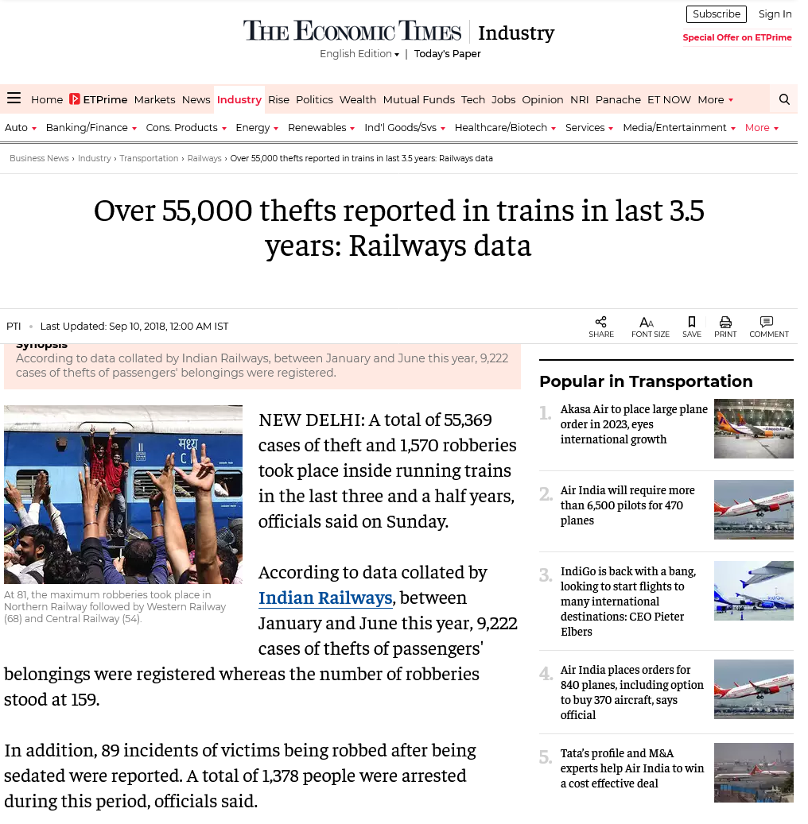
Ever travelled in train but were sleepless due to carrying valuable belongings?
Everyday thousands of cases of theft happen in Indian Railways
There is literally no way to have a safe guarded place to put valuable belongings

Slide 3
But We came up with a solution…
Introducing an idea of a FSM based 4 digit pin lock…
You can book a secured storage space just next to your seat inside the train coach.
Get a PIN lock, unique for your own seat.

Slide 4
Here’s how it works
Get your ticket booked on the website
You get a 4 digit pin on your phone
There’s also an alarm system in case of breaching
User Friendly approach
The lock can only be accessed by the pin

Slide 5
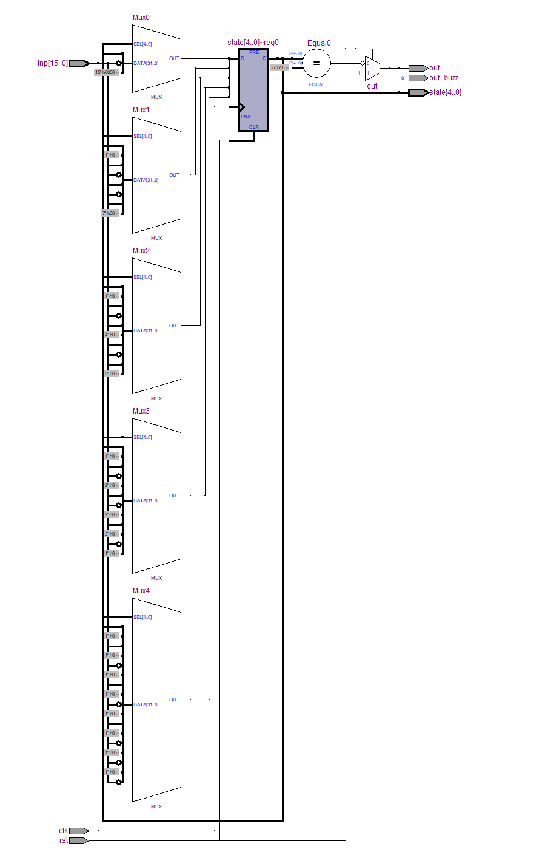
RTL View of the Circuit

Slide 6
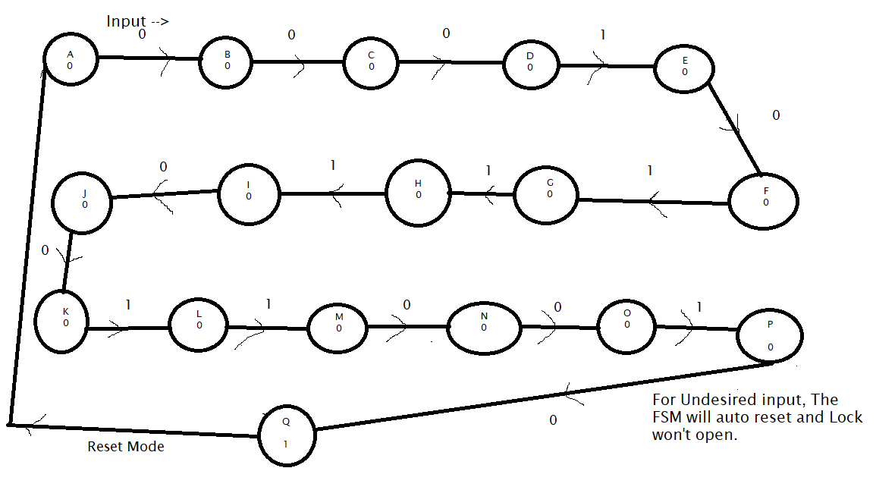
State Diagram of the FSM

Slide 7
Team :– NERV
Thank
You
Team Members :
ANSHUL PANDYA
DIVYAJYOTI PATRA
KASIF DHADA
BHASKAR GUSAIN

