Slide 1
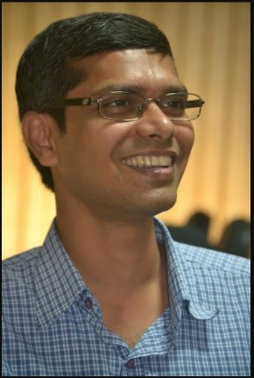
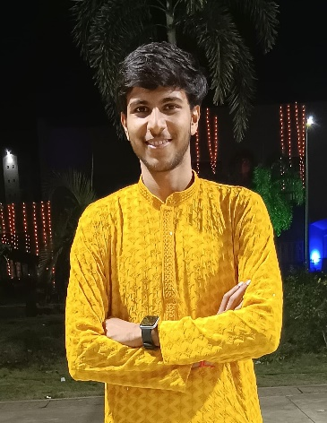
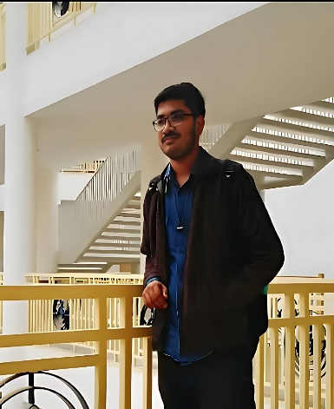
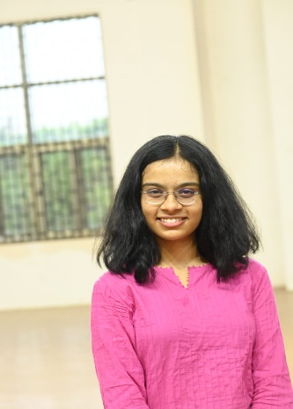
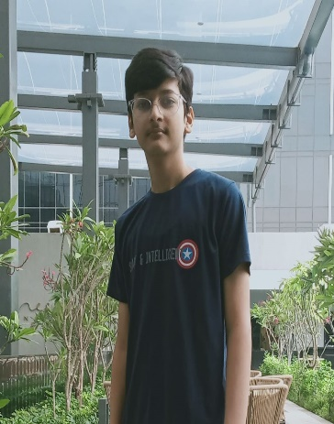
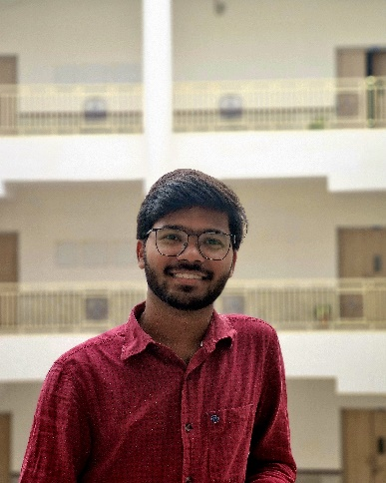
Two Wheeled Self Balancing Robot
Indian Institute of Technology Bhubaneswar
Dr. Satyanarayan Panigrahi
Divya Kumar
Ayush Gupta
Jiya Chakraborty
Rachit Jain
Vivek Singh

