Slide 1


SECURE DATA HIDING IN IMAGES USING STEGANOGRAPHY
CAPSTONE PROJECT
Presented By: Divyam Singh Katoch
Student Name : Divyam Singh Katoch
College Name : Arni University Kangra
Department : COMPUTER SCIENCE & ENGINEERING

Slide 2
OUTLINE
Introduction to Steganography
Problem Statement
Technology used
Wow factor
End users
Result
Conclusion
Git-hub Link
Future scope

Slide 3
Problem Statement
The increasing need for secure communication and data protection necessitates robust methods for concealing sensitive information. Traditional encryption techniques can be conspicuous and may attract unwanted attention. Steganography offers a solution by embedding data within seemingly innocuous carriers, such as images, making it imperceptible to the casual observer.

Slide 4
Wow factors
High capacity for data hiding without significant image degradation.
Implementation of robust encryption techniques to further secure the hidden data.
User-friendly interface for easy data embedding and extraction.

Slide 5
End users
Individuals, organizations, or government agencies requiring secure and discreet communication.
This could include journalists, whistleblowers, or anyone needing to protect sensitive information.

Slide 6
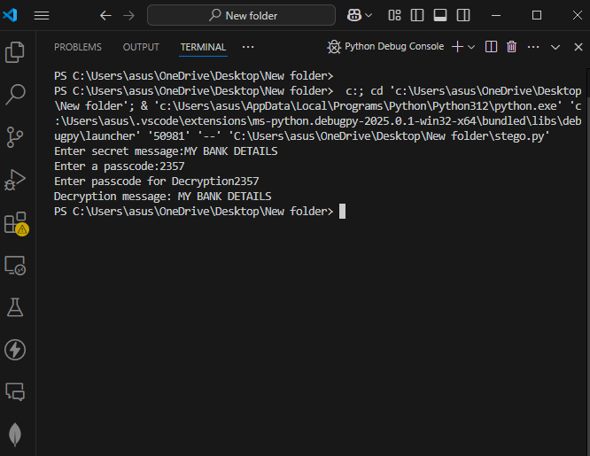


Results

Slide 7
Conclusion
This project demonstrates the successful implementation of steganography techniques for secure data hiding in images. The results show that it is possible to embed a significant amount of data within images without introducing noticeable artifacts, providing a reliable method for covert communication.

Slide 8
GitHub Link
https://github.com/Divyam2357/STEGANOGRAPHY.git

Slide 9
Future scope (optional)
Explore more advanced steganography techniques to increase capacity and robustness.
Develop methods to counter steganalysis attacks.
Implement support for hiding different data types (e.g., text, audio, video).
Create a cross-platform application for wider accessibility.

Slide 10
THANK YOU

