Slide 1
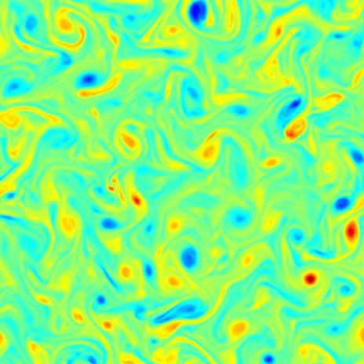

Integrating Text-Based
Problem Descriptions with
Data-driven PDE Solvers
02.06.2026
Divyam Jain | Roll Number: 638041
Notes:
Open with the motivation: PDEs are not abstract equations only; they are how we describe systems that evolve in space and time.

Slide 2

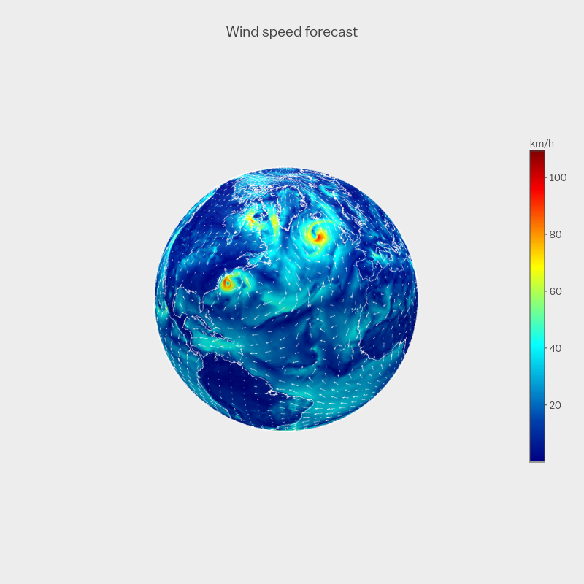

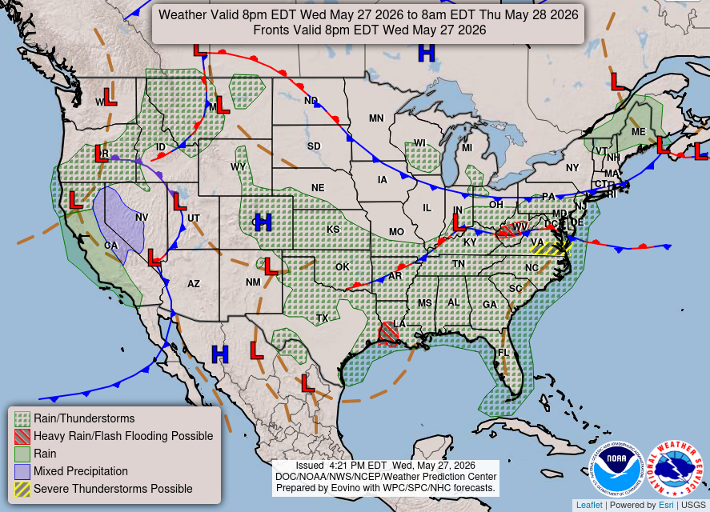
Why work with PDEs?
PDEs are the language of evolving physical systems.
weather & climate
fluids & turbulence
• They connect equations, data, and forecasts.
• The challenge: fast prediction outside the training distribution.
Divyam Jain | 638041
1
Notes:
Tell the audience why PDEs matter before showing model details: weather, fluids, heat, waves.

Slide 3
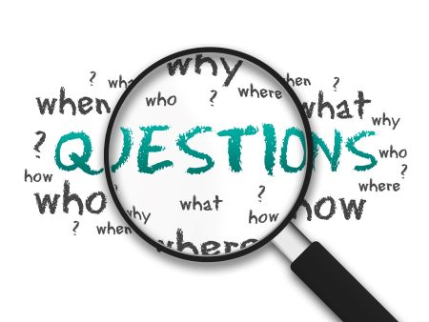
Research question as a story
Can language help a solver understand a new PDE world?
Numerical fields → model → OOD rollout
Text description → context → better generalization?
• Hypothesis: PDE descriptions add context the raw tensors may miss.
• Test: compare baseline, conditioned UNet, and AViT rollouts.
Divyam Jain | 638041
2
Notes:
Frame the study as a test of whether text provides useful context, not just as adding embeddings.

Slide 4
The data: two training worlds, one unseen world
training: turbulent radiative layer
training: active matter (GIF)
OOD test: Helmholtz staircase
• Training combines different PDE families.
• Testing asks the model to cross a distribution shift.
Divyam Jain | 638041
3
Notes:
Use this slide to make the OOD setting visible: the model learns from two worlds and is tested on a third.

Slide 5

What makes this data hard?
Grid: 128 × 384
Time: 4 inputs → 1 prediction
Fields: multi-channel tensors
Shift: new equation + new structure
• Small local errors can accumulate during rollout.
• The model must preserve spatial structure and dynamics.
Divyam Jain | 638041
4
Notes:
Talk about data properties: spatial grid, temporal rollout, channels, and OOD shift.

Slide 6
PDE descriptions become structured context
Four layers in the text description
Turbulent radiative layer in two spatial dimensions governed by the compressible Navier–Stokes equations coupled with thermal energy transport. The lower boundary injects heat, the upper boundary removes heat through radiative cooling, and the horizontal boundaries are periodic. The system includes nonlinear advection, viscous diffusion, and buoyancy forcing driven by vertical temperature gradients. The flow is convection driven and turbulence dominated, developing multi-scale vortices, thermal plumes, chaotic velocity structures, intermittent turbulent mixing, and filamentary temperature fields.
Basic description
Boundary conditions
Operator coefficients
Qualitative behavior
Divyam Jain | 638041
5
Notes:
Explain text as structured information, not prose for its own sake.

Slide 7
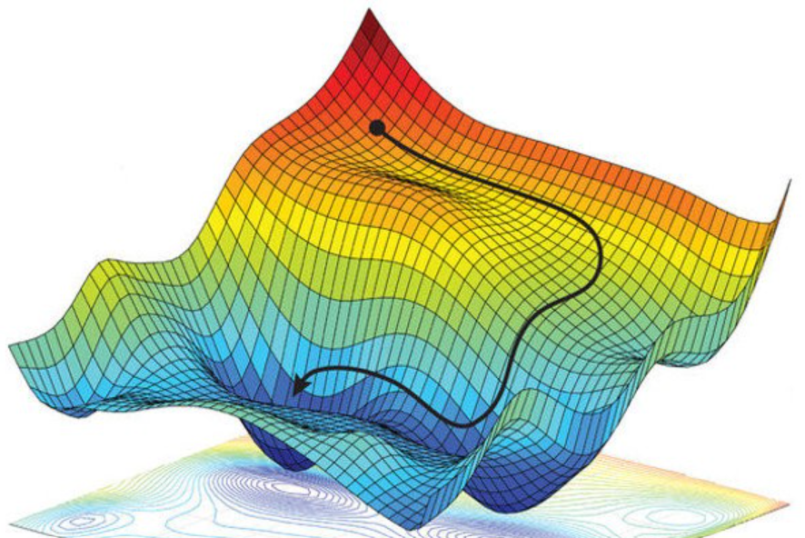
Experimental setup: one pipeline, three model choices
Input fields + optional text context
→ neural PDE solver
→ multi-step rollout
• UNetClassic: numerical fields only.
• UNetClassicConditioned: fields + text embedding.
• AViT: transformer-style baseline with axial attention.
Optimizer: AdamW • Schedule: warmup + cosine • Evaluation: rollout loss
Divyam Jain | 638041
6
Notes:
Keep the experimental setup as a simple process instead of a dense table.

Slide 8
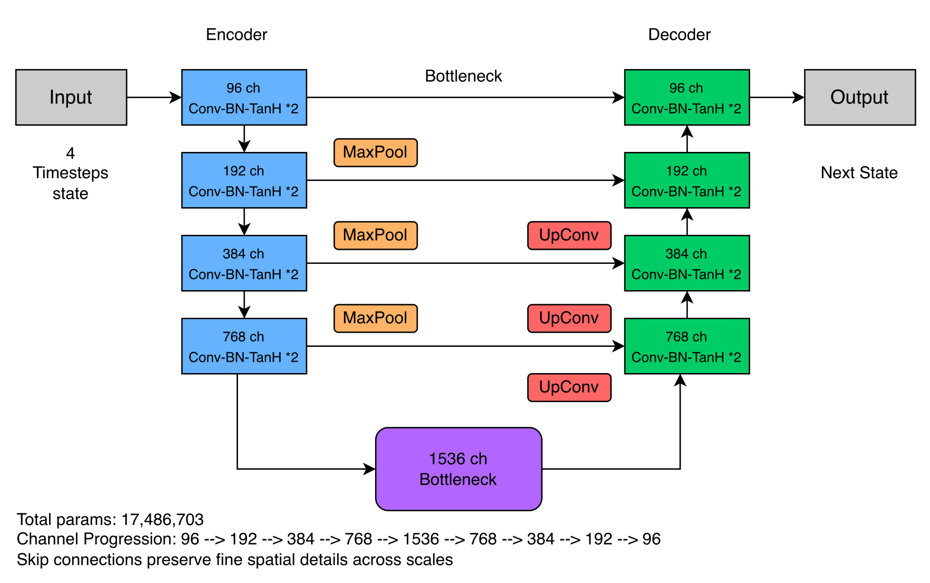
Methodology: UNet learns local-to-global structure
Baseline idea
• Convolutions capture local PDE patterns.
• Downsampling expands context.
• Upsampling reconstructs the next field.
Why it fits PDE data: spatial neighborhoods matter.
Divyam Jain | 638041
7
Notes:
Describe UNet as a natural baseline for grids: local patterns first, broader context later.

Slide 9
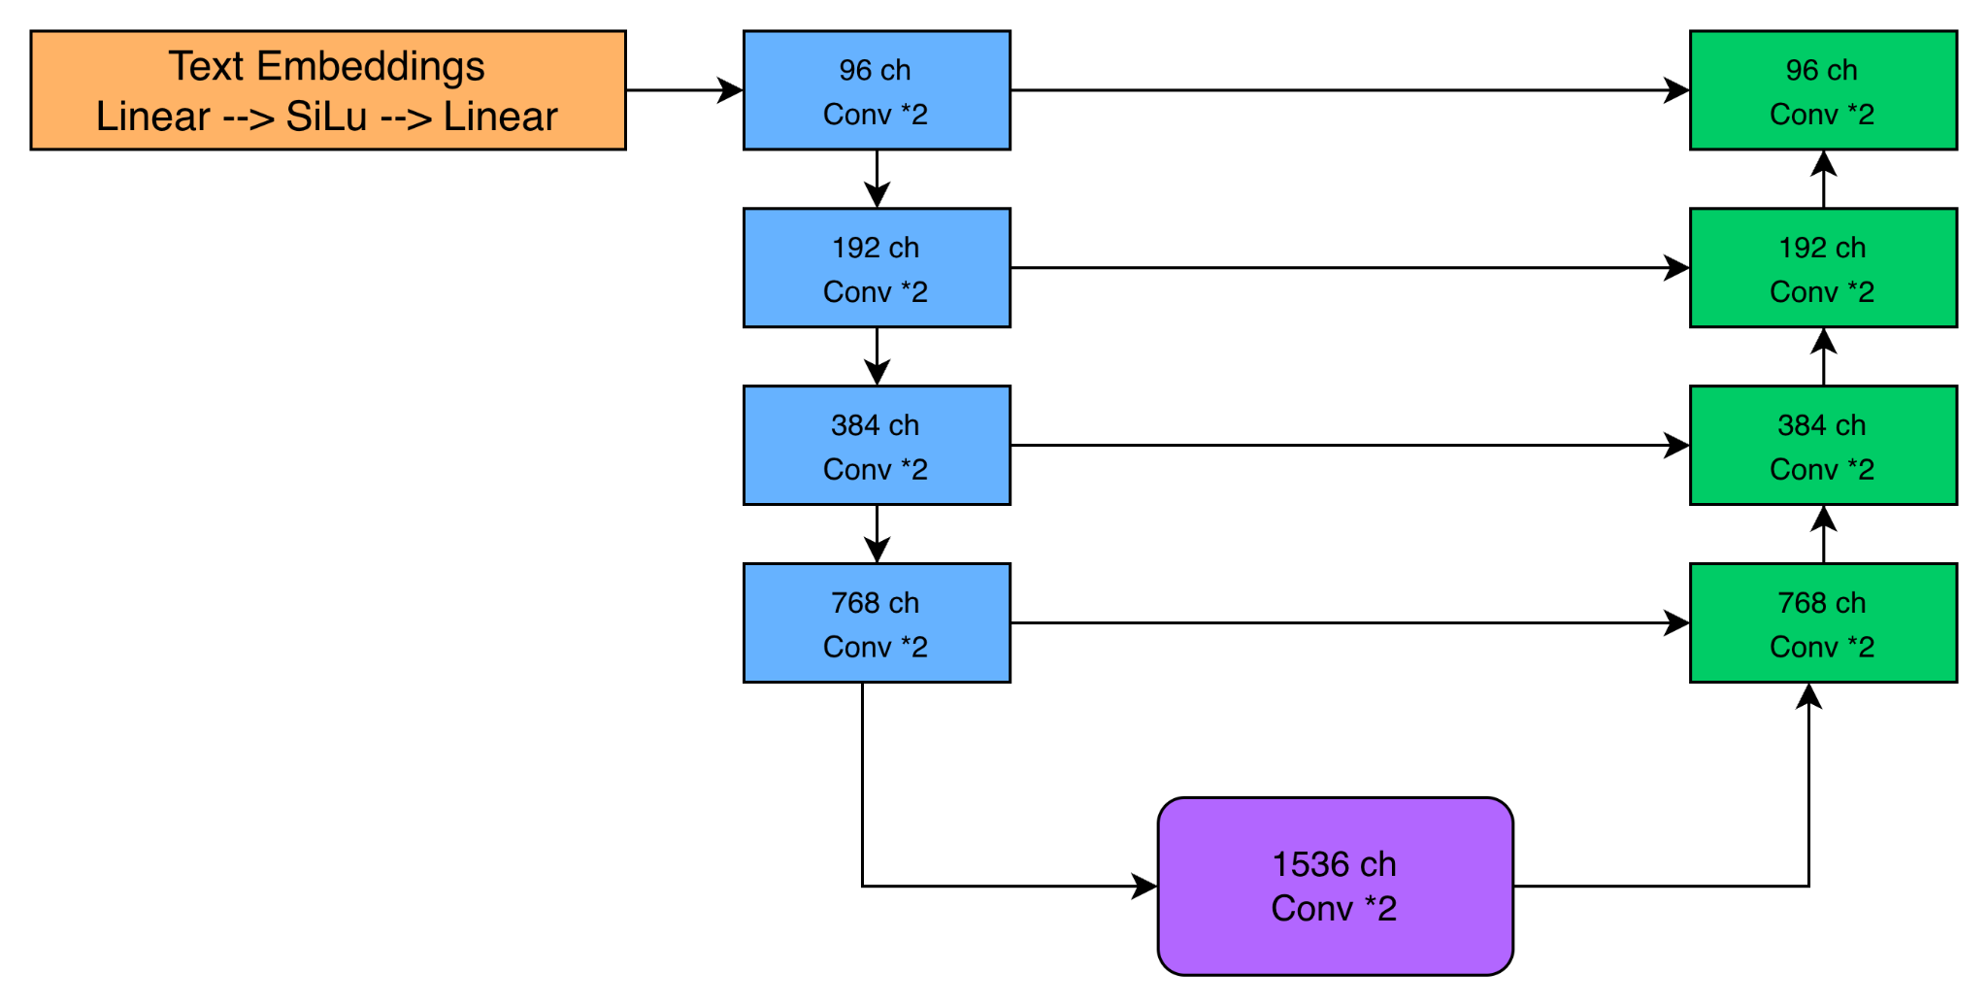
Methodology: adding language to the UNet
What changes?
• Text is embedded into a conditioning vector.
• The vector is projected into the model input.
• Backbone stays close to the UNet baseline.
Divyam Jain | 638041
8
Notes:
This slide is split from the former text-heavy methodology slide: focus only on where language enters.

Slide 10
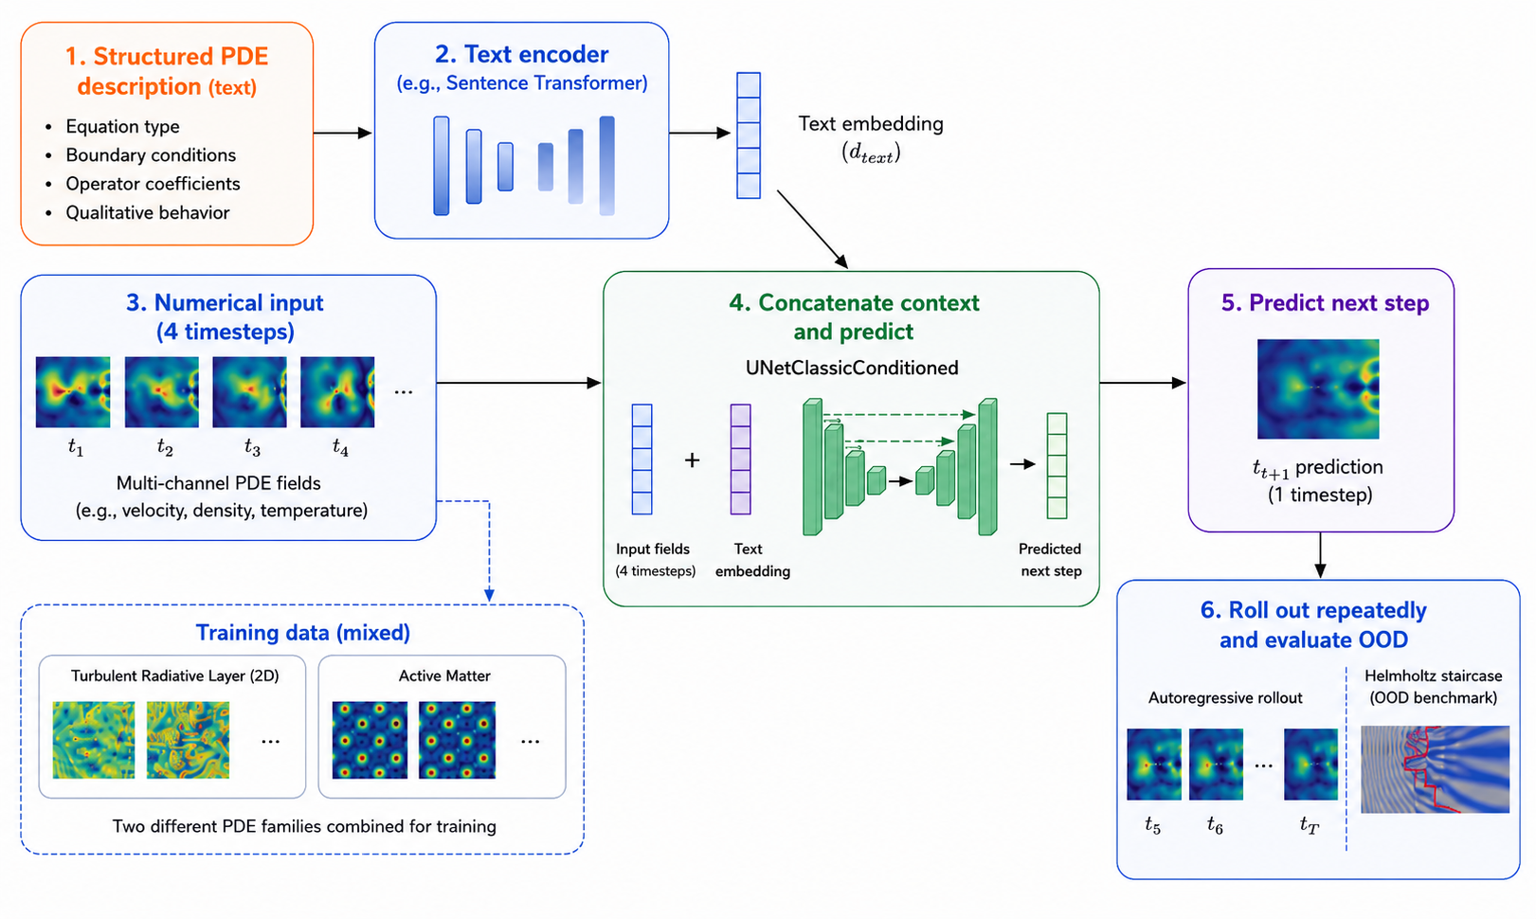
Methodology: the multimodal path
Divyam Jain | 638041
9
Notes:
This slide separates the second visual from the old Slide 9, reducing clutter.

Slide 11
Methodology: AViT tests whether global attention helps
Attention sees long-range dependencies; PDE rollouts also need stable local dynamics.
• hMLP stem embeds input fields.
• Axial attention scans x and y axes.
• Transpose convolutions reconstruct outputs.
Representative comparison: ~14.84M parameters.
AViT path
Stem
Axial attention
Decode
Divyam Jain | 638041
10
Notes:
Use this slide to set up the result: attention can be powerful, but this task rewards stable local rollouts.

Slide 12
Results summary: the simplest solver wins
What this says
• UNet baseline is strongest on OOD rollout.
• Text conditioning does not improve this setup.
• AViT is about 3.0x-3.5x worse than UNet.
• Architecture matters more than light text fusion.
Model
Test loss
Observation
UNetClassic
0.13623
best OOD rollout
UNetClassicConditioned
0.13802
slightly worse
AViT run A
0.41496
high loss
AViT run B
0.48020
high loss
Lower is better
Main takeaway: the current text signal is not yet aligned with rollout dynamics.
Divyam Jain | 638041
11
Notes:
The table stays on the left and the interpretation is on the right, as requested.

Slide 13
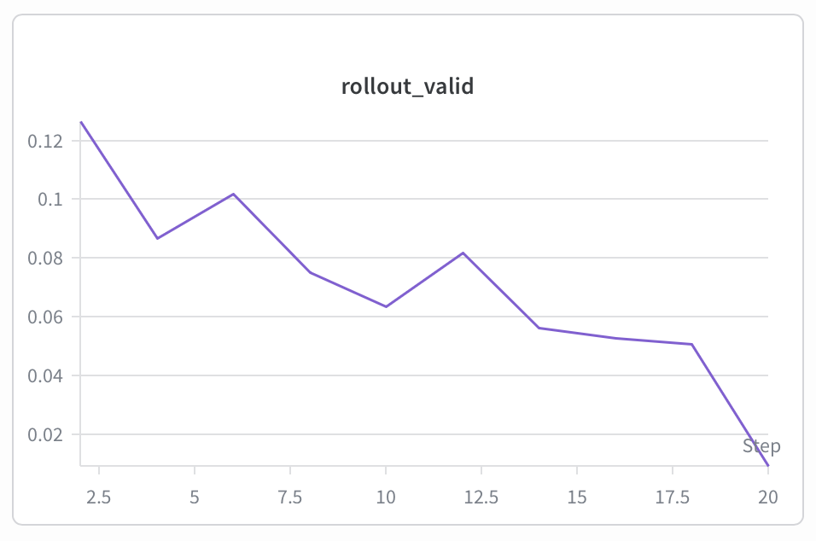
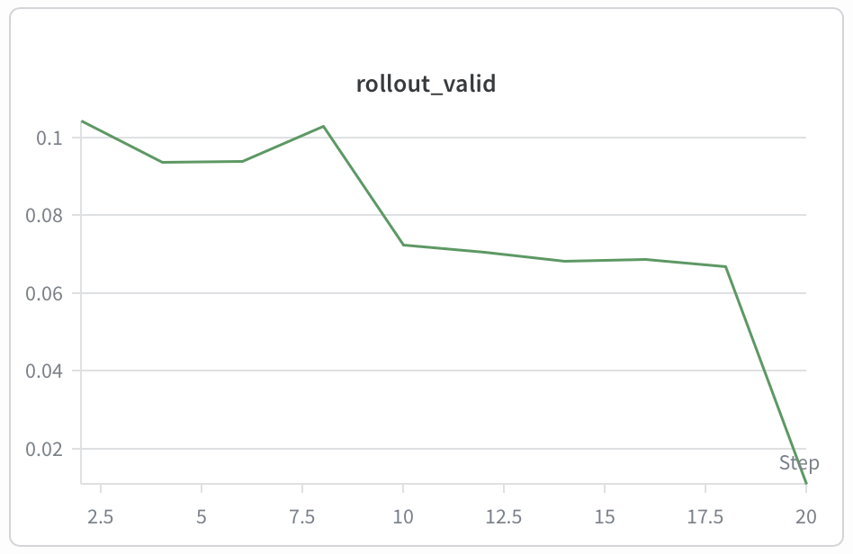
Qualitative rollout: UNet family
UNet baseline
UNet conditioned
• The conditioned curve stays close, but does not beat the baseline.
Divyam Jain | 638041
12
Notes:
First qualitative slide only compares the two UNet variants to avoid crowding.

Slide 14
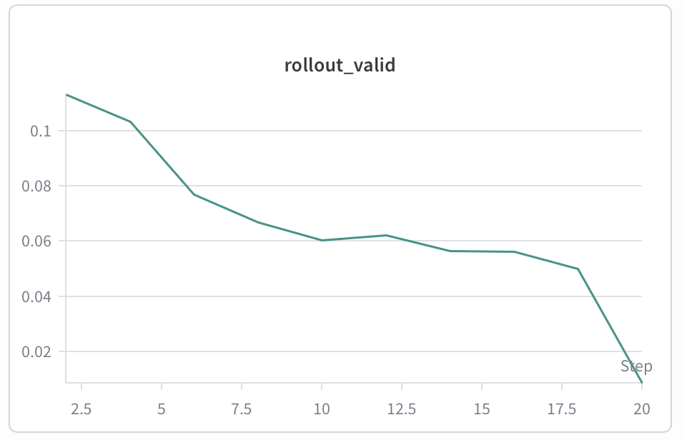
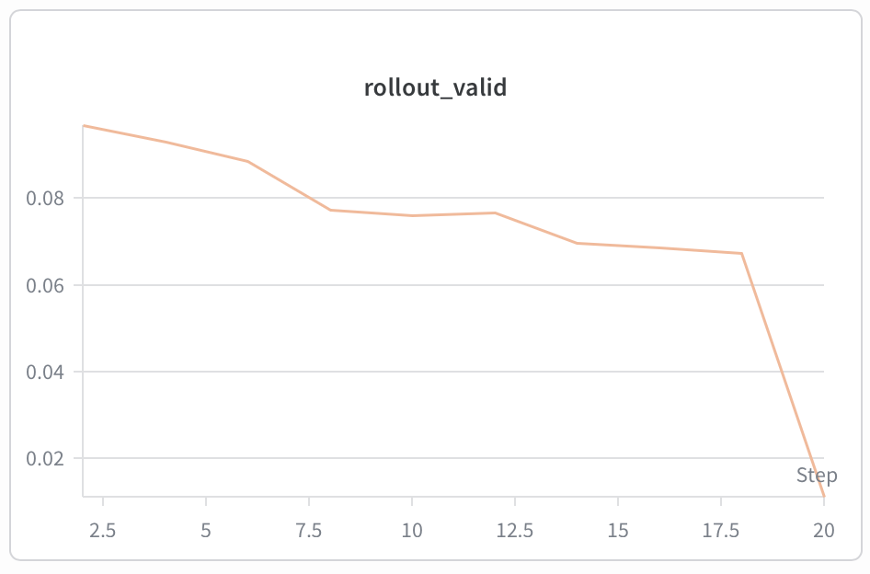
Qualitative rollout: AViT runs
AViT run A
AViT run B
• Both AViT runs show higher rollout loss than the convolutional baseline.
Divyam Jain | 638041
13
Notes:
Second qualitative slide gives the two AViT plots their own space.

Slide 15
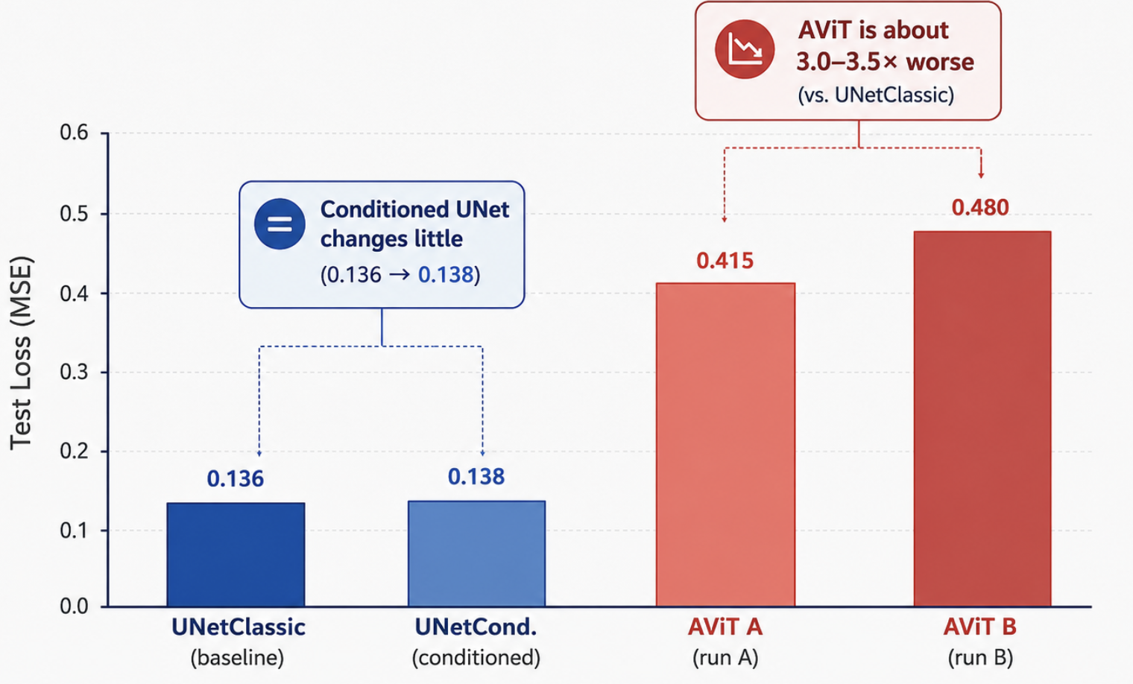
Interpretation: why the text did not help yet
Text conditioning underperformed
• Dataset identity may already be encoded in channels.
• Added embedding parameters can overfit.
• Text and UNet features may not align strongly.
AViT underperformed
• Local PDE dynamics are hard to preserve.
• More data or training may be required.
• Temporal rollout stability is the bottleneck.
Divyam Jain | 638041
14
Notes:
Interpretation should be framed as evidence-based: not that text is useless, but that this fusion strategy is too weak.

Slide 16
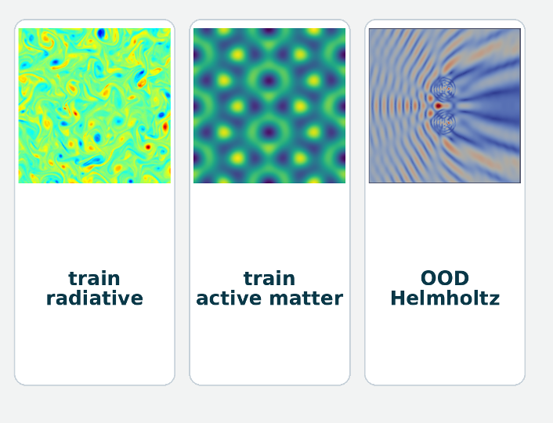


Limitations and next steps
Limitations
• Input-level fusion is simple.
• OOD evaluation uses one main benchmark.
• AViT is a representative comparison, not a tuned conditioned transformer.
Next steps
• Fuse text at multiple feature scales.
• Use richer embeddings and PDE metadata.
• Run broader ablations across more PDE families.
Divyam Jain | 638041
15
Notes:
Focus on future design, not only on negative results.

Slide 17
Conclusion
For this PDE setup, better architecture beats light text conditioning.
• UNet remains the strongest OOD rollout model.
• Text is promising, but fusion must be stronger.
• Future work should align language with PDE dynamics, not only concatenate embeddings.
Story outcome: the negative result is useful—it tells us where multimodal PDE solvers need to improve.
What this means
Best OOD: UNet
Fusion must be stronger
Useful negative result
Divyam Jain | 638041
16
Notes:
End with a constructive takeaway: text has not failed; this form of fusion is the weak link.

Slide 18
References
• Zhou et al. (2024). Unisolver: PDE-Conditional Transformers Are Universal PDE Solvers.
• Zhou et al. (2025). Text2PDE: Latent Diffusion Models for Accessible Physics Simulation.
• Brandstetter et al. (2022). Message Passing Neural PDE Solvers.
• Lorsung & Barati Farimani (2024). Using LLMs to Improve PDE Surrogate Models with Text.
• Wuwu et al. (2025). PINNsAgent: Automated PDE Surrogation with LLMs.
• Li et al. (2025). CodePDE: LLM-driven PDE Solver Generation.
Divyam Jain | 638041
17
Notes:
Use this as a closing and credits slide.

Slide 19
THANK YOU
Questions?
Integrating text with PDE solvers is promising — but the fusion has to be smarter.
Divyam Jain
Research Project Presentation
Divyam Jain | 638041
18

