Slide 1
PRESENTED BY
Divyam Pathak
SUBSPACE.
MONEY
Subscribe to anything, delivered in minutes- Subscriptions . Sharing . Rentals

Slide 2


COMPANY AT GLANCE
Rs. 36.5 Cr ARR
FY2025 — bootstrapped, zero external funding
>$2M / month
Monthly revenue run-rate as of 2026
Founded 2021
Bengaluru | IIT Madras alumni founders
90%+ AI Ops
Operations powered by autonomous AI agents
3 Verticals
Subscriptions | Sharing | Rentals

Slide 3

RESEARCH METHODOLOGY
STUDIED THE ONLYTECH COMMUNITY FORUM
15+ pages of user-generated reports primary source for complaint patterns and root cause identification
USED THE PRODUCT AS A NEW CUSTOMER
RESEARCHED THE COMPETITIVE LANDSCAPE
Mapped the website and app flow from the entry point, documented every screen, CTA, and gate
CRED Money (July 2024 launch, Account Aggregator framework, 252.9M accounts), PhonePe, Google Pay
READ ALL GUIDES AND BLOG CONTENT IN FULL
APPLIED PRODUCT FRAMEWORKS
Sharing guide: identified three distinct sharing models. Blog: 17 categories including a hidden student ICP
Jobs-to-Be-Done for ICP separation, Porter's Five Forces for competitive positioning

Slide 4

5 FEEDBACKS — OVERVIEW AND PRIORITY
FEATURES / SERVICES
Three sharing models operate in parallel with no disclosure to buyers
COMPETITOR ANALYSIS
CRED Money is the primary competitive threat absent from Subspace's competitor framing
FEATURES / SERVICES
The Negotiate API is a passive, user-triggered button the stated moat does not exist
GTM & ICPS
The student segment is a content category, not a customer acquisition strategy
POTENTIAL COLLABORATIONS
Coupon driven SEO and no community presence produce a low-retention user base

Slide 5

COMPETITOR ANALYSIS
THE MISSING COMPETITIVE THREAT: CRED MONEY
Subspace's current competitor analysis focuses primarily on international subscription management tools. However, the most significant competitive threat comes from CRED Money, which launched in July 2024 and leverages India's Account Aggregator framework.
CRED Money automatically identifies recurring transactions across connected bank accounts, eliminating the need for manual subscription tracking. With millions of active users and free access, it directly competes for the same customer segment targeted by Subspace.
This suggests that subscription tracking alone is no longer a sustainable differentiator. Instead, Subspace should position itself around helping users reduce subscription costs through negotiation and optimization. A more focused positioning strategy could help the company avoid competing directly against larger financial platforms.

Slide 6
SUBSCRIPTION SHARING MODELS
LACK OF TRANSPARENCY CREATES TRUST ISSUES
The sharing marketplace currently supports three different sharing mechanisms. Some subscriptions provide shared account credentials, others use official platform invitations, and some offer dedicated profile creation.
The challenge is that buyers often do not know which sharing method applies until after purchase. This can create confusion, unmet expectations, and customer dissatisfaction.
Introducing standardized labels that clearly explain the sharing method before purchase would improve transparency and reduce support issues. Such a change would strengthen customer trust while helping users make more informed purchasing decisions.

Slide 7

THE NEGOTIATE API
A STRONG VISION WITH LIMITED AUTOMATION
The Negotiate API is positioned as one of Subspace's primary competitive advantages. However, its current implementation relies heavily on users manually initiating negotiations.
Without proactive renewal tracking, automated reminders, or integrated billing calendars, users must remember to take action themselves. This limits the feature's effectiveness and weakens its competitive advantage.
A stronger approach would involve creating automated renewal alerts, subscription calendars, and proactive negotiation workflows. By helping users act before renewals occur, the platform could deliver greater savings while creating a more defensible product offering.

Slide 8
STUDENT MARKET OPPORTUNITY
A HIGH-POTENTIAL CUSTOMER SEGMENT
Subspace already produces content targeted at students, covering popular products such as Canva, Grammarly, Microsoft 365, and Duolingo. However, these efforts currently exist primarily within the content strategy rather than the product experience.
Students represent an attractive customer segment because they are highly price-sensitive, frequently share subscriptions with peers, and possess strong referral networks within campuses and hostels.
Potential initiatives include student verification programs, campus ambassador networks, referral incentives, and dedicated student subscription plans. These initiatives could significantly improve customer acquisition while building long-term user relationships.

Slide 9

CRED MONEY VS SUBSPACE COMPETITIVE COMPARISON
Dimension | CRED Money | Subspace.money
Subscription detection | Automatic via Account Aggregator | Manual entry or marketplace
Active users | 12M+ (urban, creditworty) | Undisclosed
Price to user | Free strategic decision | Paid subscriptions
Price negotiation | Not offered | Negotiate API (core moat)
P2P sharing marketplace | Not offered | Core product
AA framework access | 252.9M accounts, RBI-regulated | Not utilised
Competitor framing | Not named by Subspace | Should be named. Currently absent.

Slide 10

COMMUNITY-LED GROWTH
Beyond Coupon-Based Acquisition
Current acquisition efforts rely heavily on coupon-focused SEO content. While this approach generates traffic, it often attracts users seeking short-term discounts rather than long-term engagement.
The absence of meaningful participation in communities such as Reddit, Telegram, and Discord represents a missed opportunity. These communities already contain highly engaged users who actively discuss subscriptions, streaming services, and digital savings.
Building partnerships with relevant communities and creating valuable educational content could increase trust, improve retention, and reduce customer acquisition costs over time.

Slide 11
STRATEGIC PRIORITIES
Reposition the product against CRED Money and focus on savings rather than tracking.
Improve transparency across subscription-sharing models.
Transform the Negotiate API into a proactive, automated experience.

Slide 12
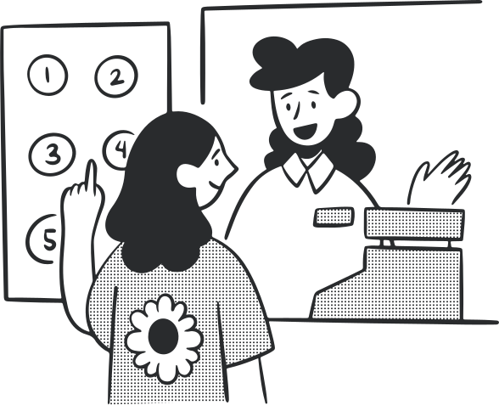
Mobile Number: +91 7900223148
Email Address: divyam.21.pathak@gmail.com
CONCLUSION
Subspace.money has built a strong foundation within the subscription economy through its combination of subscription management, sharing, and rental services. The company has demonstrated impressive operational efficiency and revenue growth while remaining bootstrapped.
Future success will depend on strengthening differentiation, improving customer trust, automating savings experiences, and building sustainable acquisition channels. By addressing these opportunities, Subspace can reinforce its competitive position and unlock the next phase of growth.

