Slide 1
Examify
An online exam platform
Divyank Agarwal
Emp Code- 190176
VWITS, Pune

Slide 2
Web Content Files
login.jsp – Handles login of student and teacher
register.jsp – Handles registration of student and teacher
studenthome.jsp – Home page of student when he successfully logins
teacherhome.jsp – Home page of teacher when he successfully logins
Startexam.jsp - When the student logins, he clicks on the start exam button present on the studenthome.jsp and it calls the StartExamServlet and displays questions on startexam.jsp file.

Slide 3
Controllers [ com.vwits.controller ]
LoginServlet – Handles login of the users from login.jsp
LogoutServlet – Handles loging out of the users and invalidating the session.
RegisterServlet – Handles the registration of the users from the register.jsp
ProcessExamServlet – When user submits the exams, the checking of the correct answers and calculating the result is process by this servlet.
NewQuestionServlet – When admin posts/adds new question to the exam, it is handled by this servlet.
StudentProfileServlet – This servlet handles the updating of student profile by student

Slide 4
Com.vwits.util
This package contains the MyDatabaseConnection file which connects to the database.

Slide 5
Data access object [ com.vwits.dao ]
UserLogin – Stores the user and this file connects to the database and inserts record successfully.
UserRegisterDAO – Handles registeration of the user from RegisterServlet, makes the object and store it in the database.
AdminPanelDAO – This file gets student’s marks, all student’s information from the database.
ExamResultDAO – Handles exam result and stores or update the score in DB
QuestionsDAO – Fetches all questions and their correct ans from DB
NewQuestionDAO – Posts new question in DB from admin panel.

Slide 6
Model [ com.vwits.model ]
User.java – User class file with getters, setters etc.
Question.java – Question class file with getters, setters etc.

Slide 7
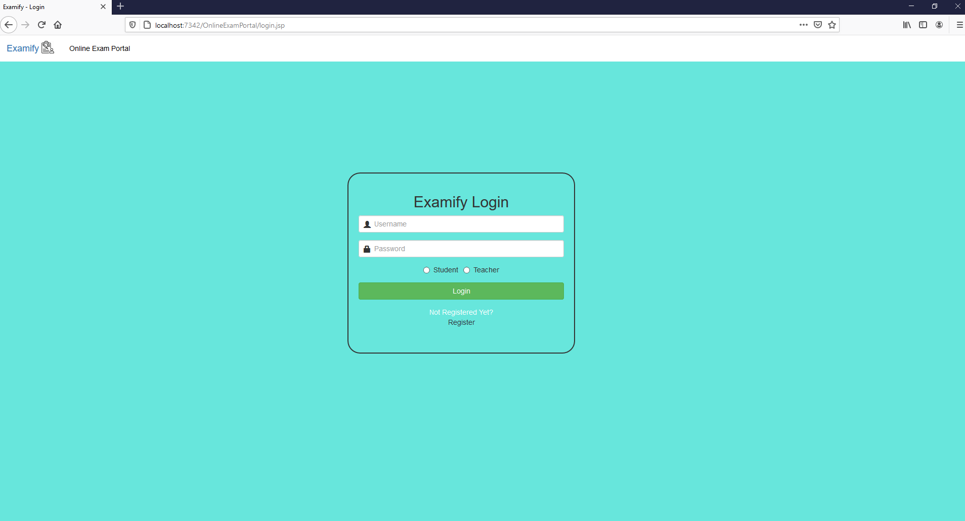
Login

Slide 8
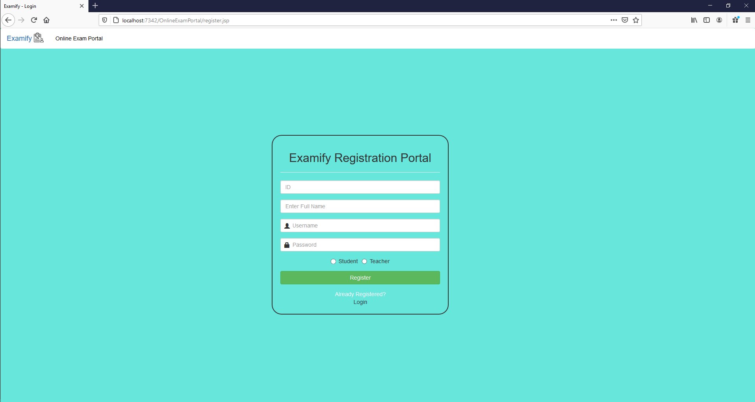
REgistration

Slide 9
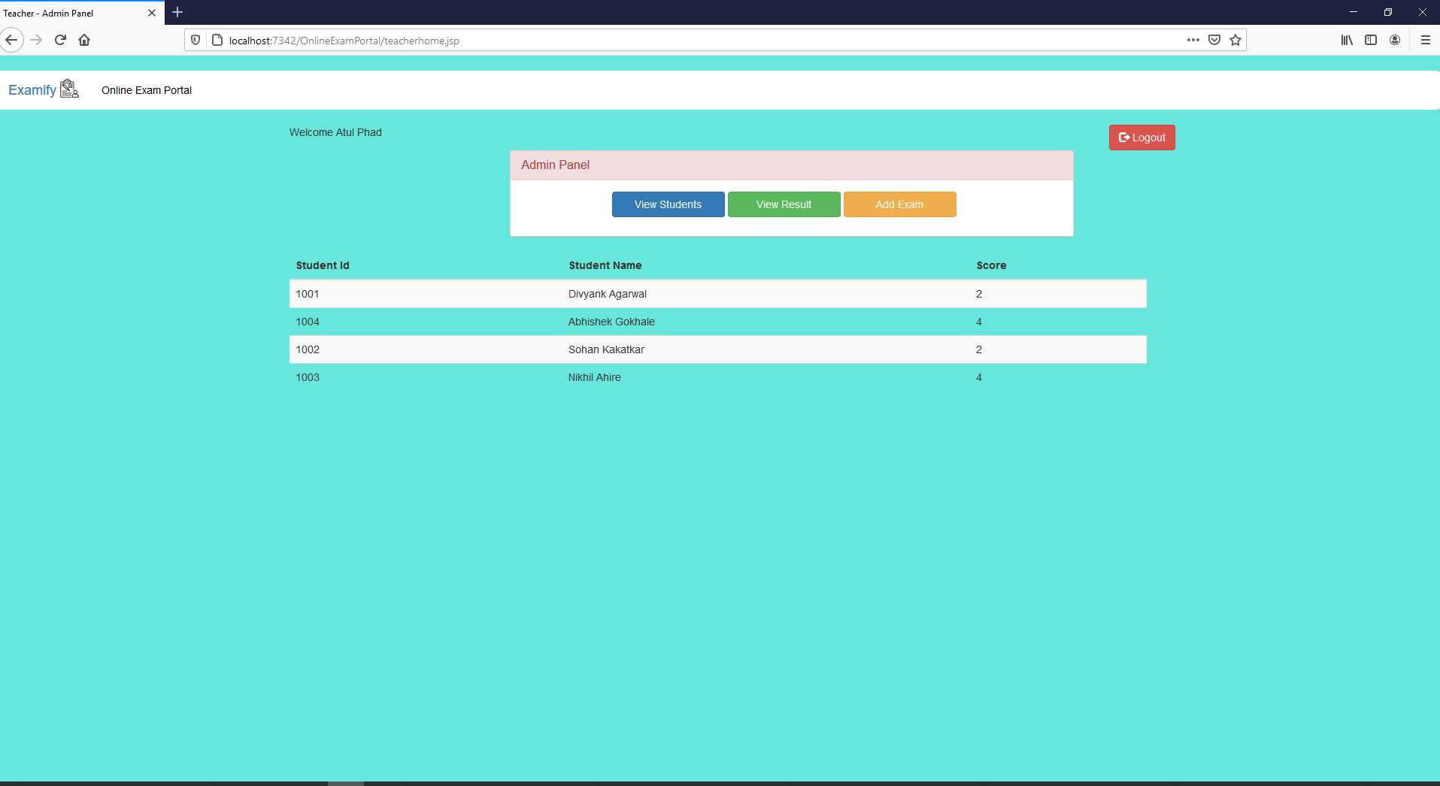
Teacher-Home

Slide 10
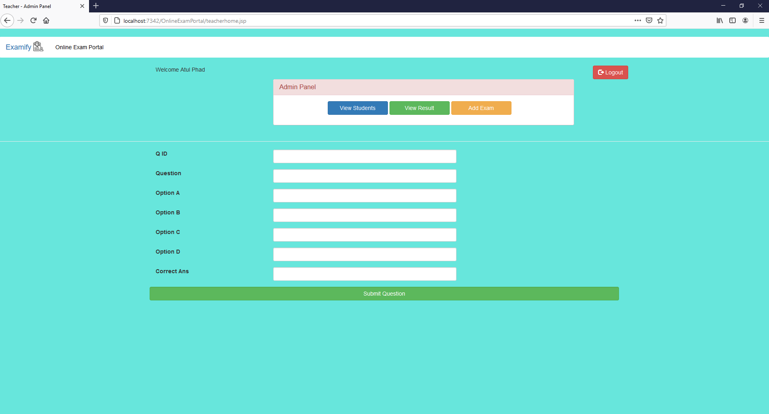
Teacher-Home

Slide 11
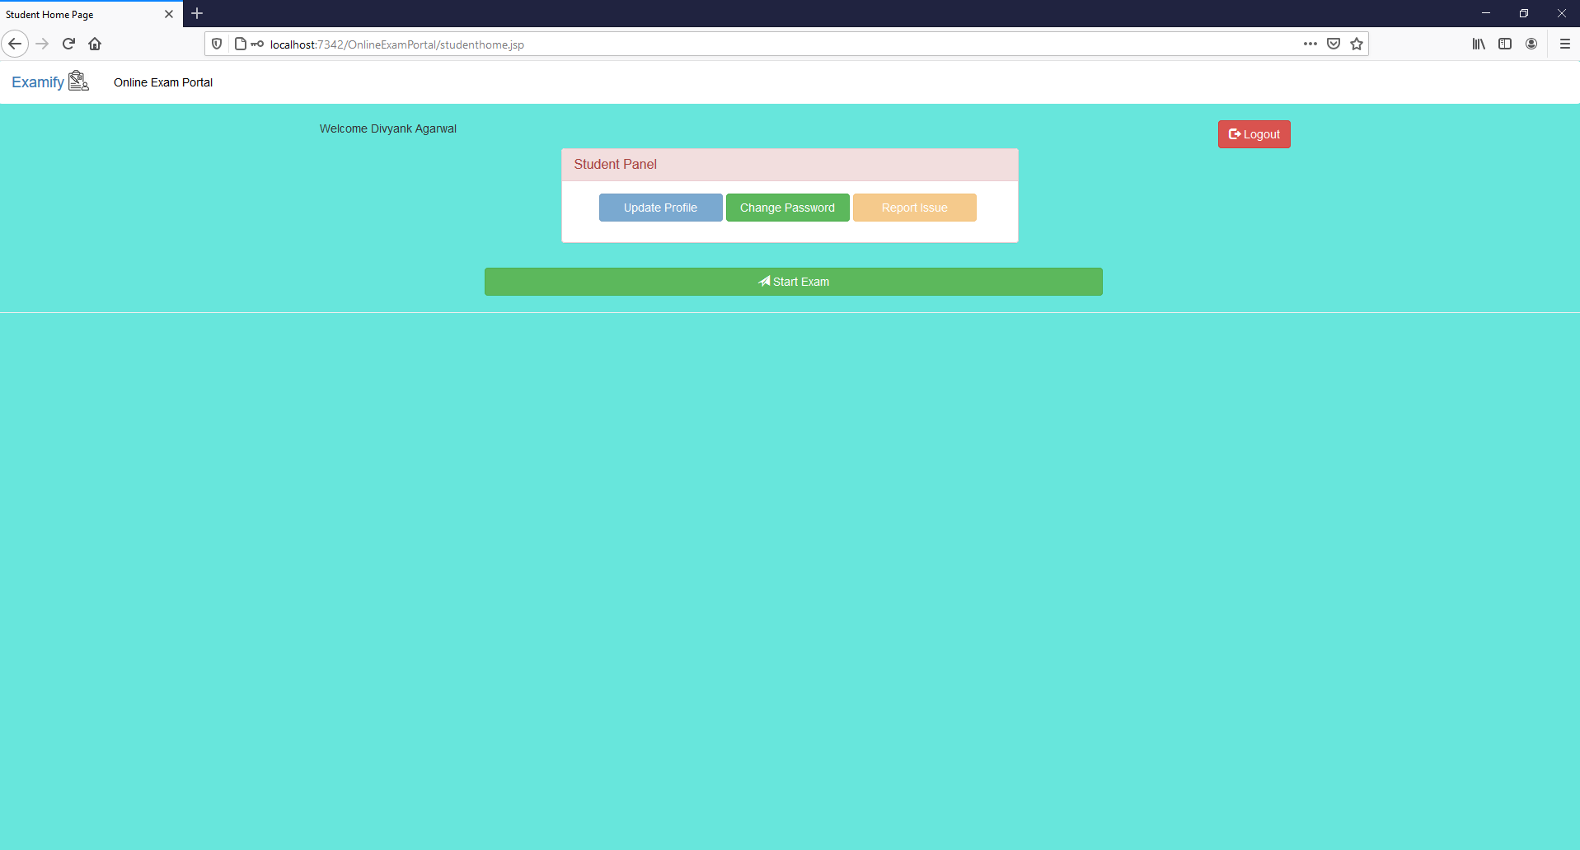
Student-Home

Slide 12
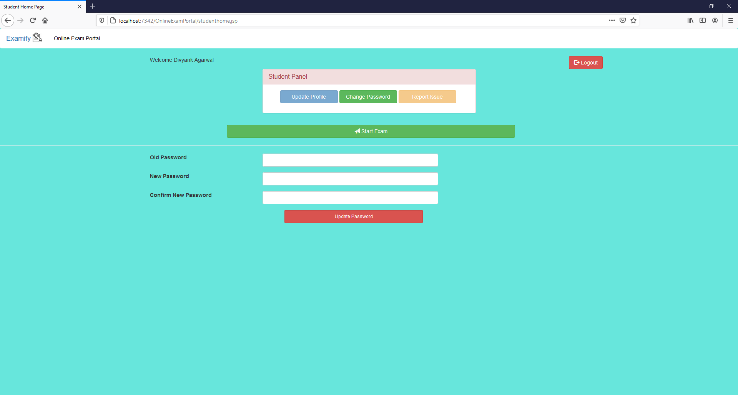
Student-Home ( Change Password ) PS: Update Profile and Report Issue option for future use. Currently disabled

Slide 13
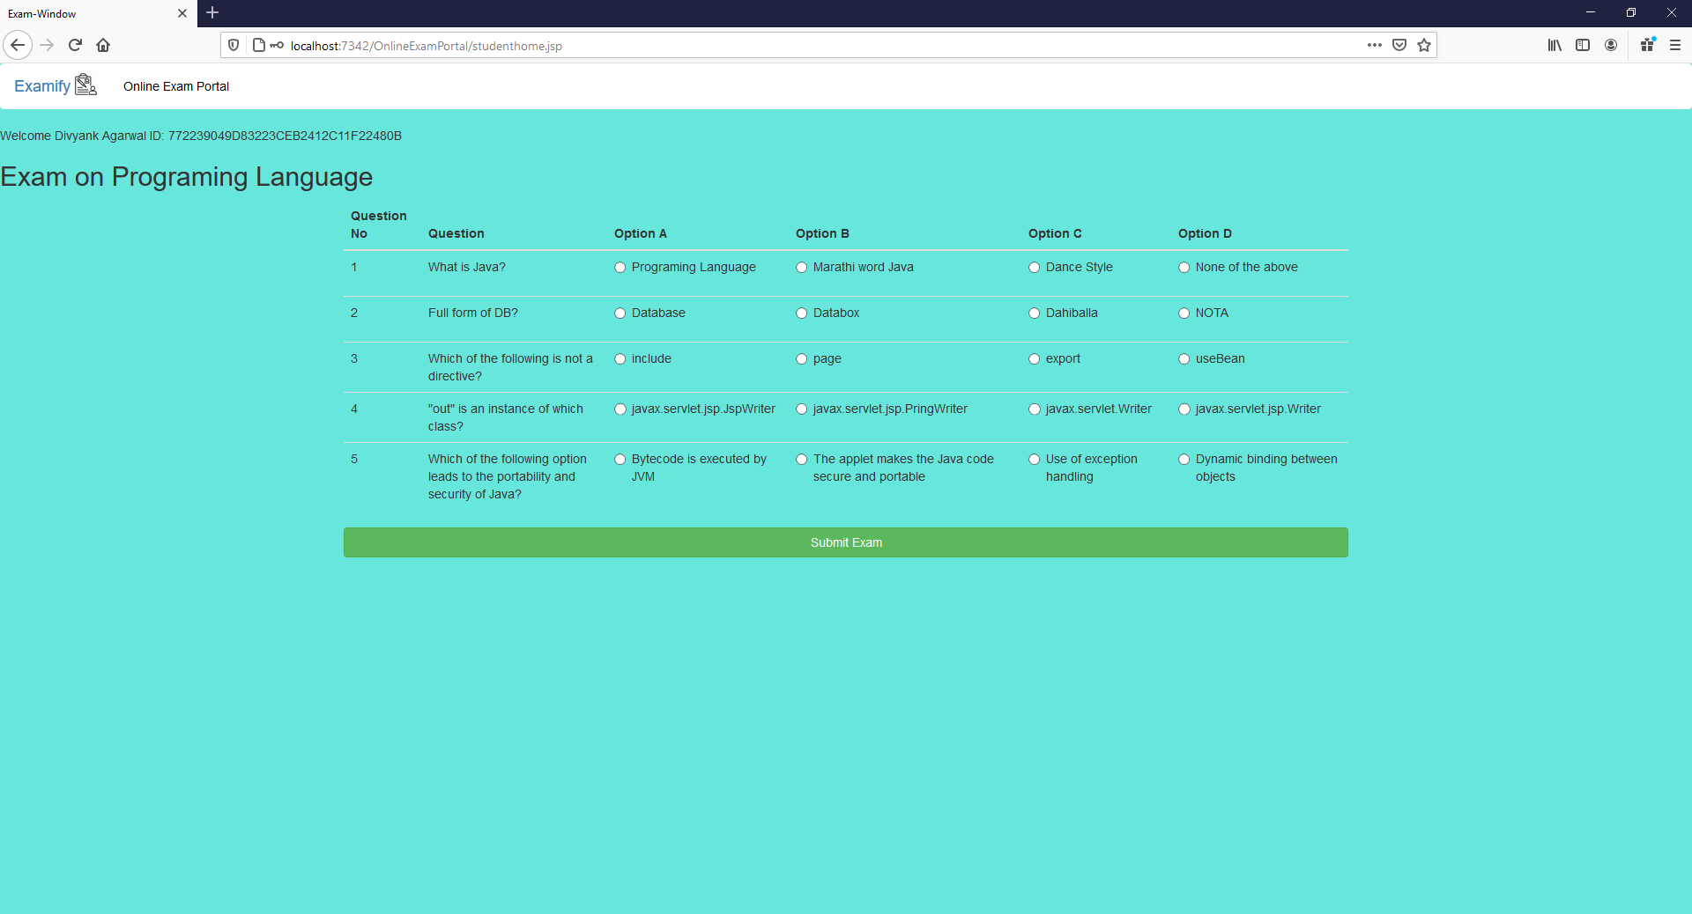
Student-Home - StartExam

Slide 14
Thank You!

