Slide 1
YouTube AI Study Assistant
Interactive Chrome Extension & Stateful RAG Backend
FastAPI • LangChain • LangGraph • FAISS

Slide 2
Introduction & Motivation
• Passive Video Consumption: Watching educational videos is passive. Viewers struggle to actively retain concepts, take notes, or test themselves during the video.
• Navigation Friction: Manually hunting for specific explanations, action items, or code snippets in 30+ minute videos requires endless seeking back and forth.
• Gemini API Rate Limits (429 Errors): Linear chat bots hitting limits break active learning sessions. There is a need for robust, cost-free local embedding models and reliable serverless LLM fail-safes.
• Stateful Learning Pipeline: Standard linear prompts lack contextual continuity. The project requires a stateful orchestrator to dynamically link summaries, quizzes, and learning roadmaps.

Slide 3
System Architecture
1. Frontend Extension
Injected directly into YouTube watch pages.
• Content Script (content.js) builds the floating sidebar DOM.
• Listens to dynamic watch URL page changes (YouTube SPA).
• Dispatches API actions and receives JSON results.
• Triggers play/seek commands directly in HTML5 player.
2. FastAPI Backend
A high-performance asynchronous REST API.
• Asynchronous handlers handle process-video, asks, and summary.
• Local FAISS vector indexes hold transcript embedding models.
• Splits transcripts recursively into overlapping chunks.
• Organized in a clean, maintainable modular structure.
3. AI Pipeline Engine
The intelligence layer running models.
• MiniLM-L6-v2 handles local CPU embeddings (100% free).
• Serverless Llama-3.1-8B-Instruct executes RAG generations.
• StateGraph (LangGraph) manages sequential pipeline routing.
• Robust parser recovers and extracts structured markdown data.

Slide 4
Key Features & Core Capabilities
• Clickable Video Timestamps: The Summarizer Agent tags key topics with standard [MM:SS] strings. The extension parses them into clickable badges that seek the video player automatically.
• Glassmorphic Tab Navbar: A premium Segmented Pill navigation bar utilizing HSL custom colors and hover scale transforms, optimizing room for mobile/panel resizing.
• On-Demand Selective Cache Clears: Clicking 'Regenerate' evicts the target item and all downstream steps from the memory store cache, triggering a partial graph execution.
• Interactive Learning Tools: Generates five-question multiple choice quizzes and step-by-step learning roadmaps embedded with checkpoints and completion status checkboxes.

Slide 5
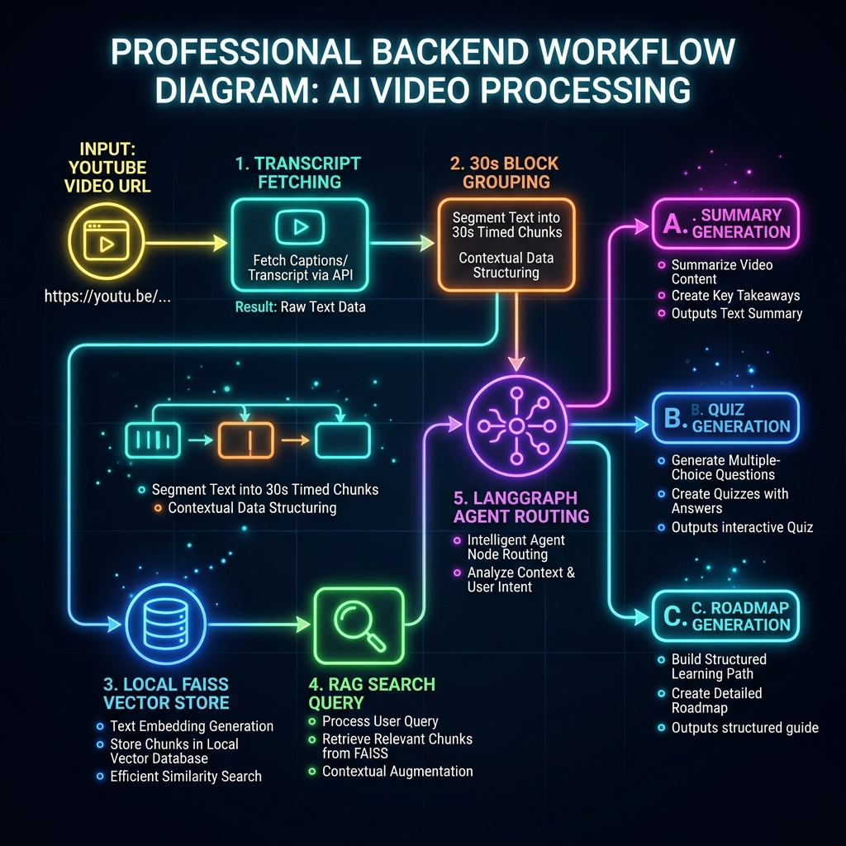
Data Ingestion & RAG Pipeline Workflow
• 30-Second Block Grouping: Rather than embedding individual sentences (which bloats context size), segments are grouped by 30-second blocks. This compression shrinks token consumption by 80% while retaining chronological stamps.
• Local Vectorization (CPU): Text chunks are embedded locally using sentence-transformers (all-MiniLM-L6-v2) on the CPU. It is 100% free, fast, and does not require paid vector database services.
• FAISS Semantic Search: User custom questions are vectorized, matched against the vector database for top-3 relevant context chunks, and passed to the LLM.
• Serverless LLM Grounding: The LLM receives the relevant transcript chunks and answers strictly based on them, completely preventing AI hallucinations.

Slide 6
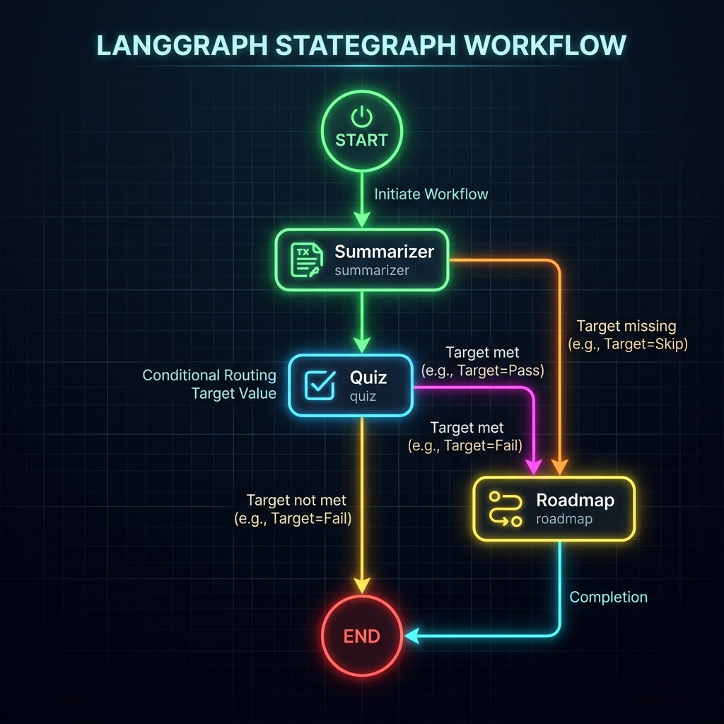
LangGraph Stateful Agents Orchestration
• summarizer Node: Processes grouped transcript segments to output custom Overview, Takeaway, and Action Markdown with timestamp tags.
• quiz Node: Receives summary as context and maps exactly five multiple-choice questions into a raw JSON array schema.
• roadmap Node: Analyzes the summary to build 3 to 5 study milestones and checklists linked to video timestamps.
• StateGraph Configuration: The StateGraph orchestrator compiles state nodes and uses conditional routing edges to route execution dynamically based on client target requests (Summary -> Quiz -> Roadmap).

Slide 7
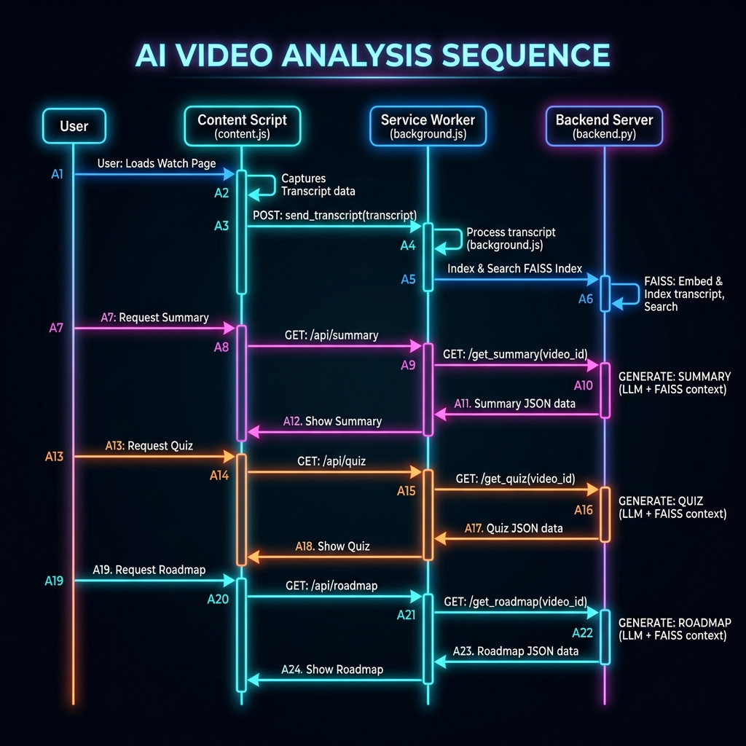
E2E Runtime System Sequence Flow
• Initial Watch Load: The Extension captures the watch video ID, prompting the background worker to invoke index vectorizing on the backend.
• Tool Click API Calls: Selecting Summary, Quiz, or Roadmap tabs triggers FastAPI endpoint calls. The backend returns structured JSON to render items interactively.
• Chat Q&A RAG Loop: Submitting custom questions retrieves localized context blocks from the FAISS database to generate grounded LLM completions.
• Direct Video Seeks: Clicking timestamp badges extracts target seconds, instructing the HTML5 video player to jump directly to the topic starting point.

Slide 8
Clean Code & Modular Architecture
• config.py: Centralizes environments loading, API keys, global Hugging Face client configurations, and caches.
• models.py: Declares all Pydantic request/response validation schemas and the LangGraph State model.
• prompts.py: Isolates the system instructions and formatting prompt templates from execution code.
• services.py: Encapsulates transcript fetching, 30s block grouping, and FAISS indexing chains.
• agents.py: Compiles the state nodes and conditional routing edges of the LangGraph Pipeline.
• main.py: Declares the FastAPI instance, manages CORS, and maps HTTP endpoint routes.
• backend.py: Acts as a path injection wrapper, providing backward compatibility to existing uvicorn watch processes.

Slide 9
Conclusion & Future Directions
• Offline Model Execution: Migrate serverless LLM prompts to run 100% offline using Llama.cpp or Ollama locally on the user's laptop, eliminating Internet and latency dependencies.
• Collaborative Learning Rooms: Implement sharing tools so users can export study roadmaps, custom quiz results, and summaries directly to classrooms or study groups.
• Multi-Video Cross-Referencing: Expand the RAG pipeline to search across entire channels or playlists, building unified multi-video learning roadmaps.

