Slide 1
YouTube AI Chat Backend
Functional Deep-Dive: RAG, LangGraph Agents, and API Endpoints

Slide 2
Backend Architecture Overview
• Modular Design: The backend is structured into separate Python modules to separate concerns (main entry, services, agents, configuration models, and prompts templates).
• Asynchronous REST Endpoints: FastAPI serves as the core ASGI server, exposing fast, non-blocking asynchronous JSON endpoints for the content extension script.
• In-Memory State Caching: We implement an in-memory database store (`video_store`) containing the FAISS vector database indices and generated structures to minimize API overhead and improve latency.
• Serverless LLM Processing: Leverages Hugging Face Hub inference client endpoints to deploy Llama-3.1-8B models, bypassing limits and ensuring high availability.

Slide 3
Functionality 1: Video Ingestion & Indexing
• Endpoint: POST /process-video: Receives the YouTube watch video ID. Verifies if the video is already indexed. Returns cached status if present, avoiding duplicate work.
• 30-Second Block Grouping: Rather than analyzing sentences line-by-line, the service groups captions into 30-second intervals (e.g. `[01:00] Text here`). This reduces token payload overhead by 80% while retaining chronological context.
• Recursive Splitting: Splits the grouped transcript text into overlapping chunks of 1000 characters using `RecursiveCharacterTextSplitter` to preserve boundary context.
• Local Embeddings: Vectorizes the text chunks locally using the CPU with `MiniLM-L6-v2` and indexes them inside an in-memory FAISS database.

Slide 4
Functionality 2: Grounded Q&A Chat
• Endpoint: POST /ask: Accepts the `video_id` and the user's custom `question`. Calls the active FAISS retriever for that video.
• Semantic Similarity Search: Compares the question vector against the local vector database, retrieving the top-3 most matching 30-second context blocks.
• RAG Grounding Prompt: Assembles the prompt containing the retrieved context, instructions to answer only based on that context, and the user's question.
• Conversational Generation: Sends the query to the serverless LLM client to output a precise answer. If the context does not contain the answer, it returns a polite fallback message.

Slide 5
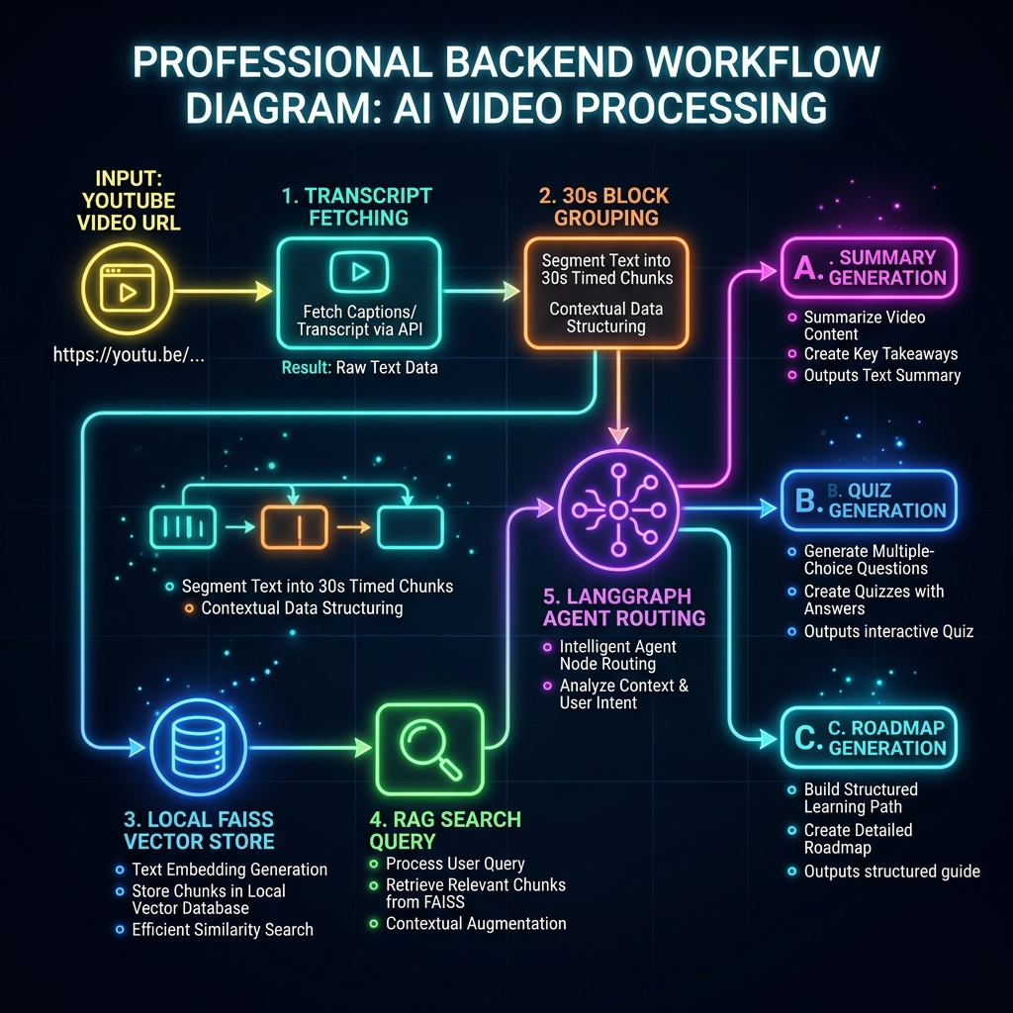
RAG Pipeline & Video Processing Flow
• Ingestion flow: Fetches subtitles, groups them, splits them, and stores the vectors locally inside the memory cache.
• Retrieval flow: Performs vector matching to retrieve matched chunks for custom Q&A user questions.
• Prompt grounding: Uses the serverless LLM to generate responses using only matched chunks, avoiding hallucinations.

Slide 6
Functionality 3: Stateful Summary Generation
• Endpoint: POST /summary: Acts as the starting pipeline node. Fetches the cached transcript or triggers ingestion on-demand.
• Token Limitation Handling: Slices the transcript to a maximum of 40,000 characters to prevent out-of-token limits while invoking the LLM.
• Overview & Key Takeaways: The LLM summarizes the video into three clean Markdown sections: Overview, Key Takeaways, and Action Items.
• Timestamp Tagging: Instructs the LLM to output [MM:SS] timestamp references in the summary text. These are converted to clickable player seek badges on the client side.

Slide 7
Functionality 4: Dynamic Assessment Creator
• Endpoint: POST /quiz: Invokes the compiled StateGraph targeting the quiz node. Ensures summary is present before running.
• Summary Context Grounding: Uses the generated summary as the context input to build a multiple-choice quiz testing the user's understanding of the video content.
• 5-Question MCQ Schema: Instructs the LLM to output exactly 5 questions, each having 4 options and exactly one correct answer (index 0 to 3).
• Robust JSON Formatting: Runs a fallback cleanup regex parser to strip markdown blocks (like ```json) and parse brackets, ensuring a reliable JSON response.

Slide 8
Functionality 5: Timeline Roadmap Builder
• Endpoint: POST /roadmap: Invokes the orchestrator workflow to build a structured learning path with milestones and outcomes.
• 3-to-5 Step Milestones: Creates a customized chronological roadmap designed to guide the viewer from basic concepts to advanced applications.
• Learning Checkpoints: Defines 2 to 3 target learning checkpoints or outcomes for each milestone step to test and verify skills.
• Chronological Seek Bindings: Extracts the exact starting timestamp where the milestone's topic is discussed, enabling direct video jumps in the browser.

Slide 9
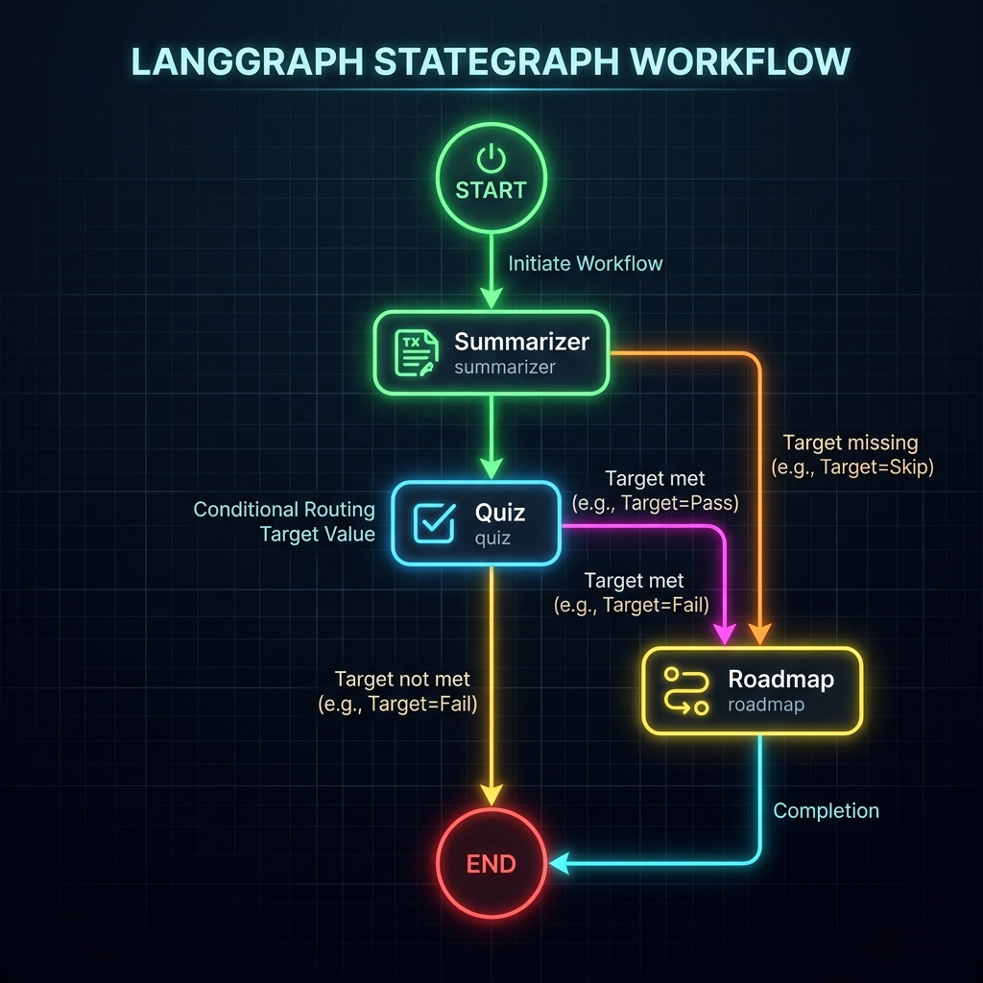
LangGraph Stateful Agents Orchestration
• Stateful Nodes: Summary, Quiz, and Roadmap tasks are mapped to independent state nodes in the Graph.
• Conveyor Belt State: Each node reads and updates a shared PipelineState clipboard tracking target outcomes.
• Conditional Routing Edges: Routing links read the target parameter to bypass or execute downstream nodes dynamically.

Slide 10
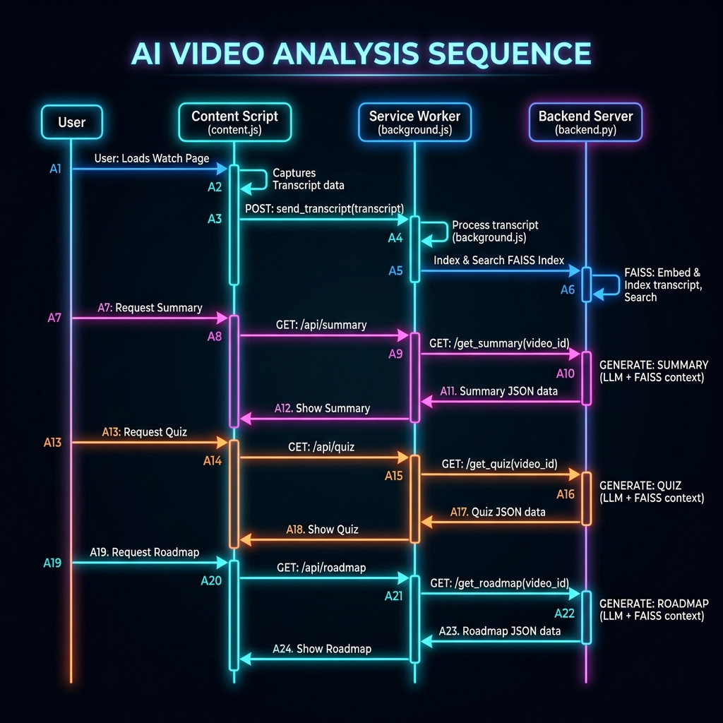
E2E Runtime System Sequence Flow
• Navigation detection: Content script watches URL navigations and triggers video index handshakes.
• Asynchronous queries: Clicking study tabs invokes endpoints, fetching cached index models or running graphs.
• Click-to-seek playback: Timeline badges parsed into seek anchors update player playback targets in real-time.

Slide 11
Cache Management & Regeneration Controls
• Force Regenerate Parameter: Requests can contain `force_regenerate = true` to instruct the server to evict existing items from the state.
• Selective Cache Eviction: Clearing a summary automatically evicts downstream items (quiz and roadmap) to preserve chronological consistency.
• Delete Endpoint: DELETE /video/{video_id}: Permits explicit removal of a video's FAISS index and generated data from memory cache.
• Garbage Collection Safety: Ensures server restarts reload the index on-demand without memory bloats or leaks.

