Slide 1
DECKMOUNT ELECTRONICS
Vision 2026: Strategic Diagnostic Hub
Ankur Sir's Executive Roadmap

Slide 2
The Strategic Framework
Every product in our 2026 lineup answers four critical questions:
• Problem Faced Before
• Why we are doing this?
• Market Differentiation
• Coming 6-Month Program

Slide 3
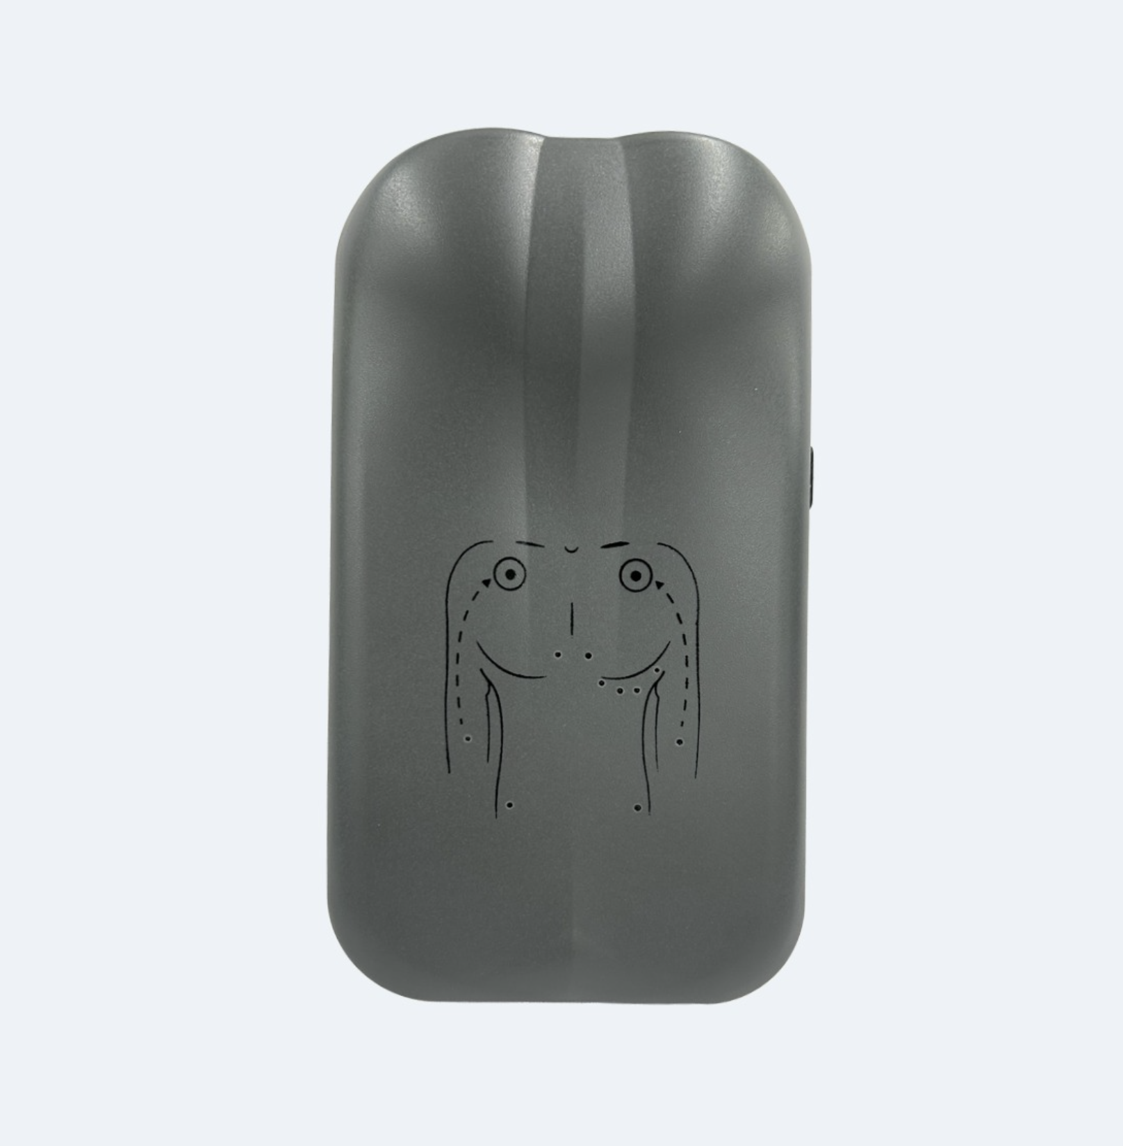
Rhythm UltraMax (AI-Portable)
Problem: Compromised signal quality in portables.
Why: 12-lead accuracy in 298g handheld.
Edge: 24-bit ADC + AI + Cloud Sync.

Slide 4
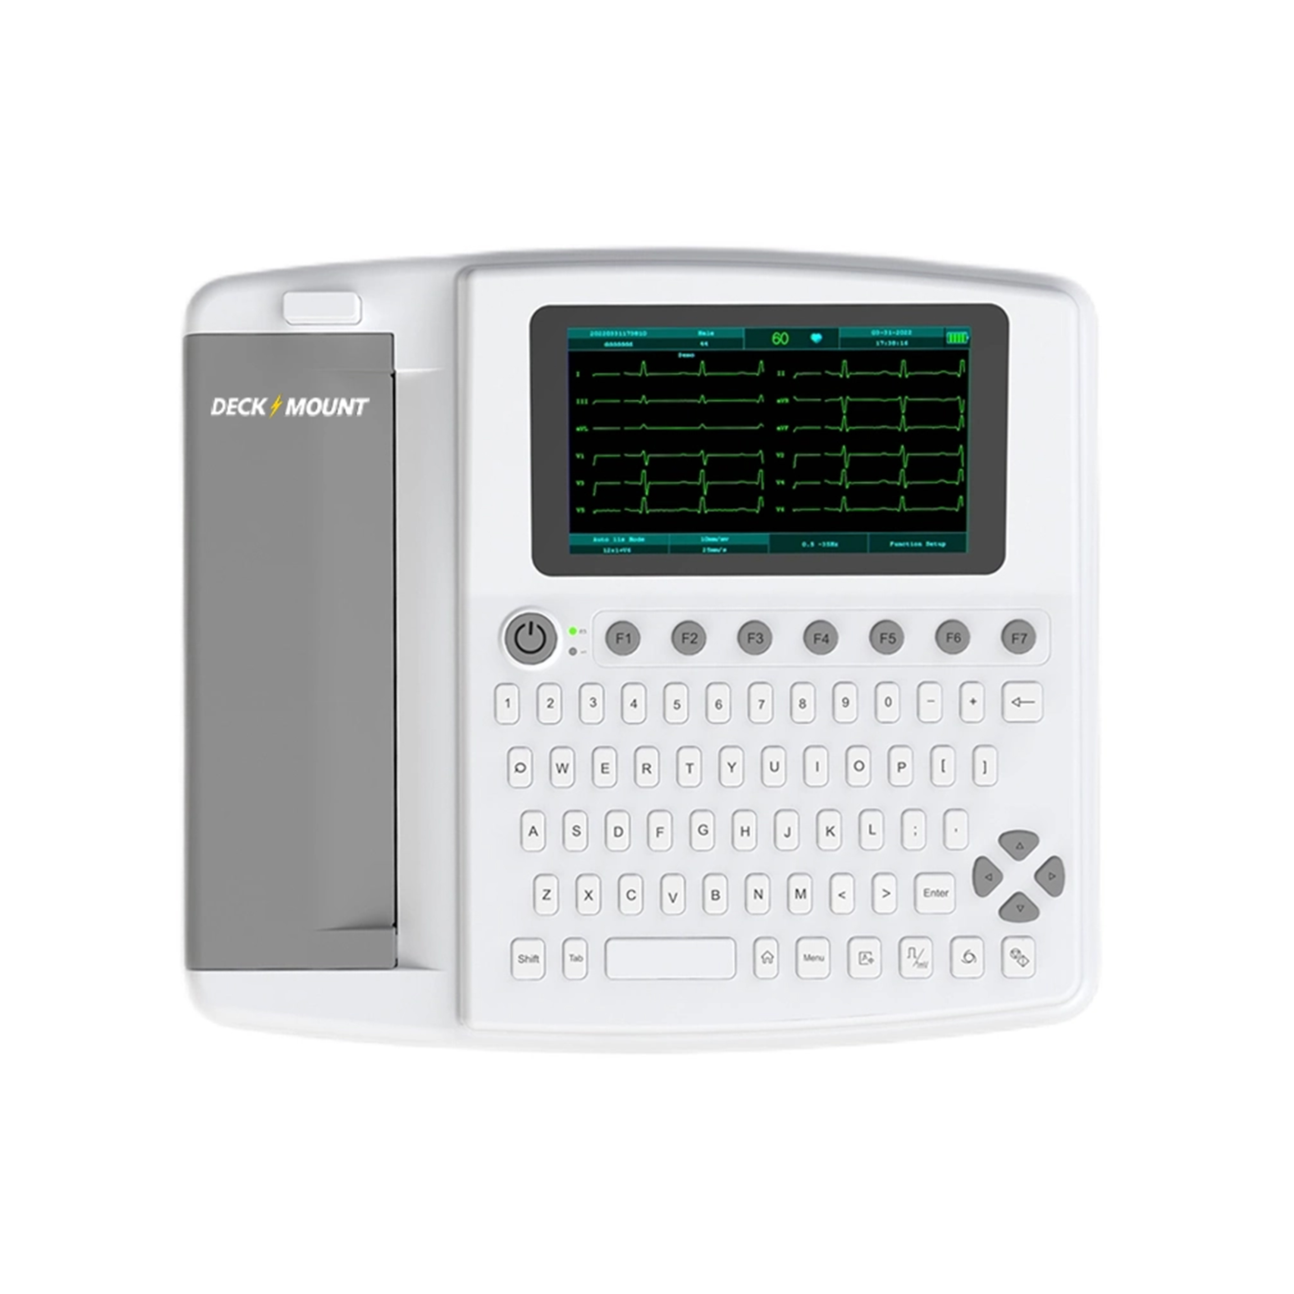
12-Channel ECG (Table Top)
Clinical Hub for PHCs
• 10s Simultaneous Acquisition
• 99.7% Clinical Grade Accuracy
• CardioX Cloud PDF Sync

Slide 5
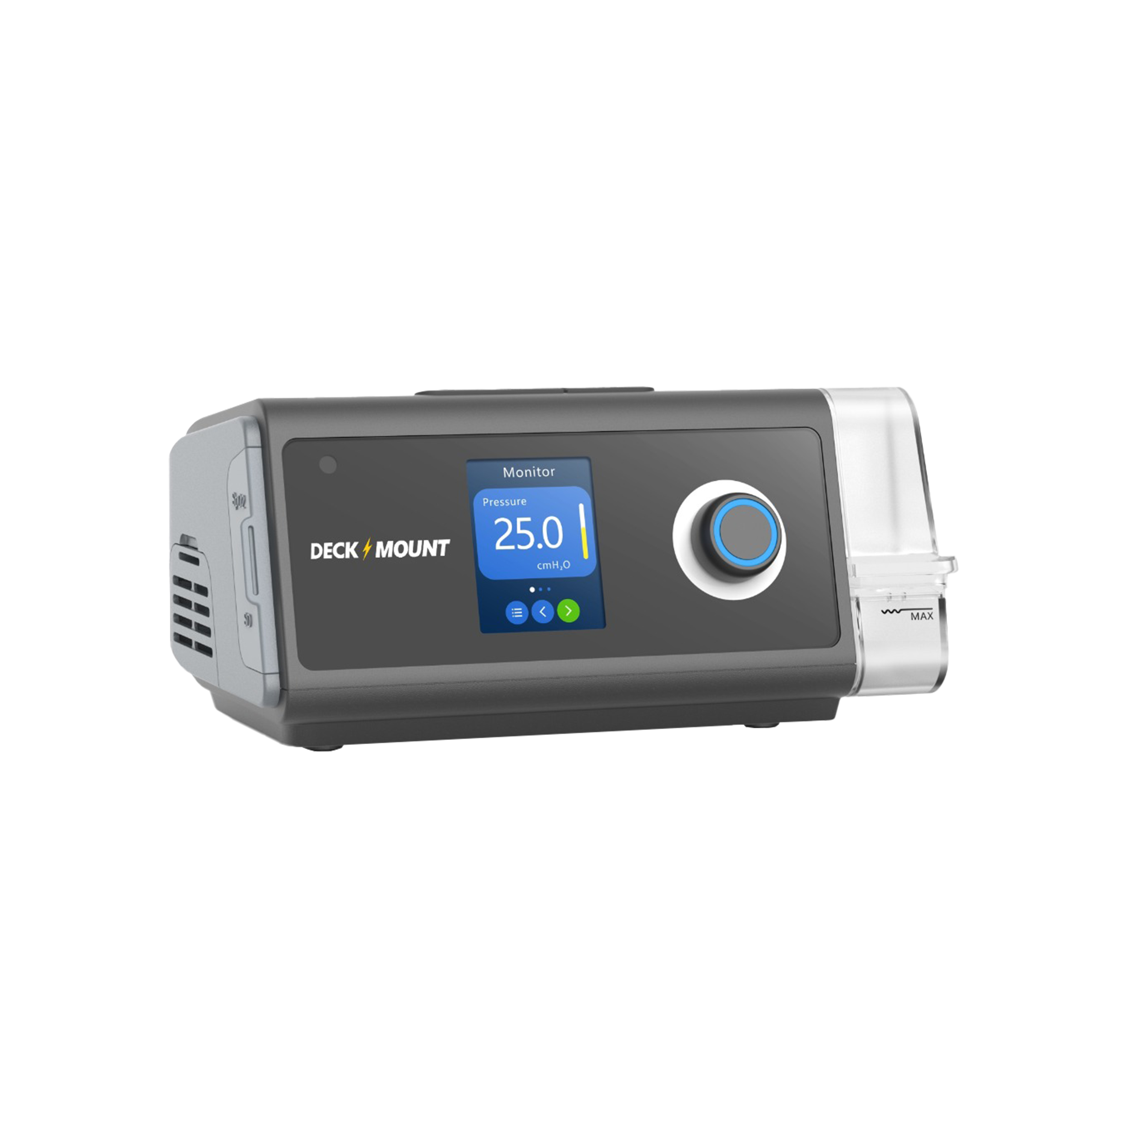
BiPAP VT Series (VT400 ST)
Pure Therapy & Advanced Ventilation
• 99.97% HEPA Filtration (PM2.5)
• Adaptive VGPS / ST Modes
• Volume Assurance up to 2000ml

Slide 6
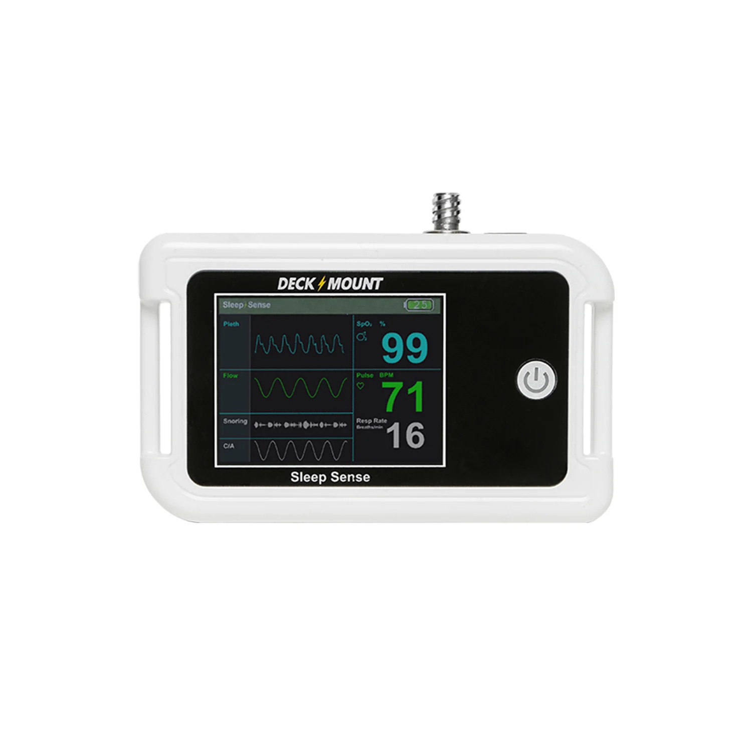
Sleep Sense Level 3 (SS100)
Home Clinical Sleep Studies
• 214g Ultra-Light Wearable
• 8GB Internal Storage (16k hrs)
• 95%+ AI Auto-Scoring Accuracy

Slide 7
CardioX: Sharpest Sensitivity Ever
Detects 30+ Critical Abnormalities
• 12 Arrhythmias: AFib, VF/VT, Brady/Tachycardia, PVC/PAC
• 10 Conduction: AV Blocks (I, II, III), RBBB, LBBB, WPW
• 08 Morphology: ST Elevation/Depression, T-Wave Inversion

Slide 8
Coming 6-Month Strategic Program
• CDSCO Scaling: UltraMax & VT Series
• Official CardioX Mobile App Launch
• PHC Deployment: 500+ Clinics
• Cloud Monitoring Dashboard v1.0

