Slide 1
B.TECH CSE (ML / AI) · MAJOR PROJECT · WEEK 2 OF 20
MFSTNet — Camera-Only Congestion
Forecasting and Signal Control
A multimodal deep-learning system that forecasts per-lane congestion 60 seconds ahead from traffic camera video alone, and a reinforcement-learning controller that acts on it — built for unstructured Indian traffic, where lane discipline cannot be assumed.
PROJECT LEAD
TEAM MEMBER
TEAM MEMBER
TEAM MEMBER
Divyansh Uniyal
KM Shivani
Abhishek Negi
Bhavya Gogia
Graphic Era Hill University
0.8941
620
18
1.5 h
Dehradun, Uttarakhand
[ Faculty Guide — name to be filled in ]
mAP50, elevated CCTV
tests passing
decisions recorded
full ablation
Every validation figure is read from a committed results CSV at build time. The two exceptions — S17's detector numbers and the timing comparison — say so where they appear.
Notes:
Open with the one-sentence version: this forecasts congestion per lane, sixty
seconds ahead, from camera video alone -- no loops buried in the road, no GPS
feeds, no vehicle radios. Then say why that matters here: those inputs do not
exist on most Indian junctions, and a camera does.
Introduce the team, then move on quickly. The four numbers on the right are
there so the panel knows this is measured work, not a proposal -- come back to
each of them later.

Slide 2
02 THE PROBLEM
2 / 19
Lane discipline is an assumption this traffic does not make
Most traffic forecasting assumes vehicles in lanes, of similar size, detected by sensors in the road. Every one of those assumptions fails here.
Vehicles do not stay in lanes.
Motorcycles filter between cars, auto-rickshaws occupy gaps. A lane occupancy figure from a loop detector describes a road this is not.
WHAT THE SYSTEM HAS TO DO
The vehicle mix is extreme.
Forecast, not report
A motorcycle and a bus differ by an order of magnitude in road space. Counting vehicles treats them as equal; the measured fleet is 45% two-wheelers.
60 s ahead, per lane, three classes
From pixels only
The infrastructure is not there.
no loops, no GPS, no V2I radio
Inductive loops need the road dug up and maintained. Cameras are already mounted at many junctions, and a phone on a footbridge is a valid sensor.
Survive an unseen camera
Off-the-shelf detection does not transfer.
the number that governs deployment
COCO has no auto-rickshaw class at all, and a detector trained on dashcam imagery scores 0.3223 on an elevated camera.
Act on the forecast
PPO controller consumes it directly
Degrade safely
counts alone, then a local Webster fallback
A forecast nothing acts on is a dashboard. The controller is what turns a prediction into changed signal timing, which is why both halves are in scope.
Notes:
This is the slide that justifies the whole project, so do not rush it.
The key line is the third bullet: cameras already exist at junctions, loops do
not. That is the practical argument for a camera-only system in an Indian city,
and it is stronger than any accuracy number.
If asked "why not just buy a detector" -- point at the fourth bullet. COCO has
no auto-rickshaw class. It is not that off-the-shelf is worse; it cannot see the
vehicle at all.

Slide 3
03 WHAT WE BUILT
3 / 19
Four subsystems, integrated late by design
Each is independently testable, which is why three of them are already measured while the fourth is still being decided.
DATASET
DETECTION
THE MODEL
CONTROL
IndiaTrafficNet
YOLOv8s
MFSTNet
PPO agent
8 India-specific classes
including auto- and
e-rickshaw, cattle
›
per-lane vehicle counts
0.8941 mAP50 at the
deployment viewpoint
›
ResNet-50 + DINOv2 ViT
gated cross-attention
per-lane forecast
›
SUMO via TraCI
consumes the forecast
as auxiliary state
THE COUPLING THAT IS EASY TO MISS
MFSTNet's output is not only a prediction — it occupies indices 11–14 of the PPO controller's 16-dimensional state vector. Changing the model's output shape invalidates every trained controller checkpoint.
Two fallbacks are required behaviour rather than nice-to-haves: if the model fails, the controller runs on raw counts with those indices zeroed — never a shortened vector; if the network drops for more than 10 seconds, the edge node switches to a Webster controller embedded locally.
Notes:
Walk left to right along the four boxes -- data, detection, model, control.
The purple box is the point of the slide. Examiners often ask how the subsystems
relate; the honest answer is that they are loosely coupled except here, where the
model's output is literally part of the controller's input vector. That is why
its shape is treated as a contract.
The fallbacks matter if anyone asks about reliability. Say plainly: we never
shorten the state vector, we zero it, because a controller silently receiving a
different-length input is worse than one receiving zeros.

Slide 4
04 THE STACK
4 / 19
Every version here is the one actually installed
Until four days ago these were aspirational: not one of the seven pinned-and-installed packages matched its pin.
VISION AND LEARNING
REINFORCEMENT LEARNING
ANALYSIS AND TESTING
torch 2.13.0+cu126
stable-baselines3 2.9.0
numpy 2.5.2
torchvision 0.28.0
gymnasium 1.3.0
pandas 3.0.5
timm 1.0.28 (DINOv2)
eclipse-sumo 1.27.1
scipy 1.18.0
ultralytics 8.4.118
traci / sumolib 1.27.1
scikit-learn 1.9.0
opencv 5.0.0.93
xgboost 3.4.1
pytest 9.1.1
WHY SCIPY AND SCIKIT-LEARN ARE PINNED BUT NOT USED
The metrics and statistics are pure standard library so the arithmetic stays auditable. These two exist so the tests can cross-check the hand-rolled implementations against them — macro F1, quadratic-weighted kappa, the paired t-test and Cohen's d are graded numbers, and a bespoke statistic nobody verifies is worse than none.
Hardware: RTX 4050 Laptop, 6 GB, sm_89 · training runs locally, not on Colab
Notes:
Do not read the version lists aloud. The two things to say:
First, these versions are the ones the environment actually has. We audited it
and found every single pinned package disagreed with its pin -- SUMO said 1.19,
the machine had 1.27. A clean install would have built a different stack from the
one every measurement was taken on.
Second, the amber box is a good answer to "did you just import a library for your
metrics". No -- the metrics are written out longhand so they can be checked, and
the libraries are there to test our implementations against.

Slide 5
05 THE DATA
5 / 19
Seven sources, and what we may do with each
Licence is not paperwork here — it decides what can be published, and one of these is unresolved.
DATASET & SOURCE
LICENCE
ROLE IN THIS PROJECT
BMD-45
CC BY 4.0
Primary training and test at the deployment viewpoint
BEFORE ANYTHING IS PUBLISHED
huggingface.co/datasets/iisc-aim/BMD-45
TrafficCAM: none declared
IDD Detection
Research use
Week-2 bootstrap; the project's only dashcam surface
checked — repo, site, download page
idd.insaan.iiit.ac.in — IIIT Hyderabad
IDD requires a citation
TrafficCAM
NONE DECLARED
Cross-camera test — and the only source of e_rickshaw
Varma et al., WACV 2019
github.com/Math-ML-X/TrafficCAM
ITD is non-commercial
ITD v1.2
CC BY-NC 4.0
Supplies the detector used for lane survey and counting
CC BY-NC 4.0 propagates
github.com/teg-iitr/ITD-Indian-traffic-dataset
BMD-45 is the clean one
Bellevue Traffic Video
Public body release
ADR-016 Phase 1 corpus — proposed, not yet used
CC BY 4.0, attribution only
github.com/City-of-Bellevue/TrafficVideoDataset
Public traffic footage
No licence is not the same as permissive: with none declared, default copyright applies. Research use is normal practice; redistributing the data or releasing weights trained on it is not granted. The authors are named and reachable, so we ask them — and cite the paper either way.
Third-party
Every MFSTNet training sequence comes from these
12 clips resolving to 11 distinct cameras
IndiaTrafficNet
Ours
ADR-006 — pending sign-off
self-collected, self-annotated
Notes:
This slide exists because a panel or a reviewer will ask where the data came
from, and because we found something while assembling it.
Go across the licence column. BMD-45 is clean, CC BY 4.0. IDD needs a citation,
which is easy. ITD is non-commercial, which constrains anything derived from it.
Then stop on TrafficCAM. It trains the detector, it is the ONLY source of
e-rickshaw examples, and it declares no licence at all -- we checked the GitHub
repository, the project website and the download page, and there is none in any
of them.
Be precise about what that means, because it is easy to get backwards. No
licence is not permissive; it is restrictive. Default copyright applies, so
nothing is granted. Using it for research is ordinary academic practice and we
are comfortable with it. Redistributing the data, or releasing weights trained
on it, is not.
So the plan is: keep using it, cite the paper properly -- Deng et al.,
arXiv:2211.09620, Cambridge and Bristol -- and email the authors for written
permission before anything is released. If asked "is this a problem", the honest
answer is: not for the project, potentially for the release, and one email fixes
it.

Slide 6
06 RESULT · DETECTION
6 / 19
Detection at the deployment viewpoint is solved
Milestone M2 was due in Week 9. It was met in Week 2, on BMD-45's Bengaluru CCTV test split.
CLASS
PRECISION
RECALL
MAP50
MAP50-95
TEST BOXES
THE NUMBER THAT MATTERS
car
0.8617
0.8989
0.9212
0.7849
2,770
motorcycle
0.865
0.8186
0.9033
0.674
5,910
auto_rickshaw 0.9186
a class COCO does not have
auto_rickshaw
0.8892
0.8654
0.9186
0.7635
2,132
e_rickshaw, cattle
bus
0.8481
0.8105
0.8832
0.7155
606
absent from this test split
truck
0.8032
0.7694
0.8442
0.6784
939
Building our own detector is justified by the classes an off-the-shelf model cannot see at all, not by a few points of mAP on the classes it can.
mean
—
—
0.8941
—
12,357
Notes:
The row to point at is auto_rickshaw, 0.9186. That is the justification for
building a detector rather than downloading one -- COCO does not have the class,
so there is no baseline to beat, only a capability that either exists or does
not.
If asked about the blank rows: e_rickshaw and cattle have zero boxes in this
particular test split, so they are honestly reported as not evaluated rather
than given a misleading score. e_rickshaw comes up again two slides later.

Slide 7
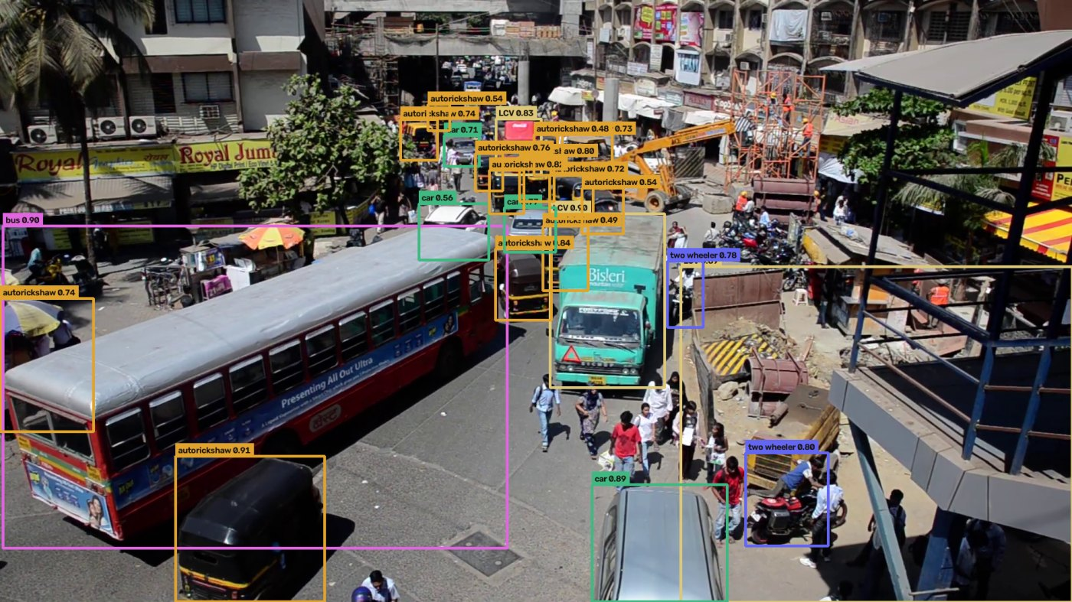
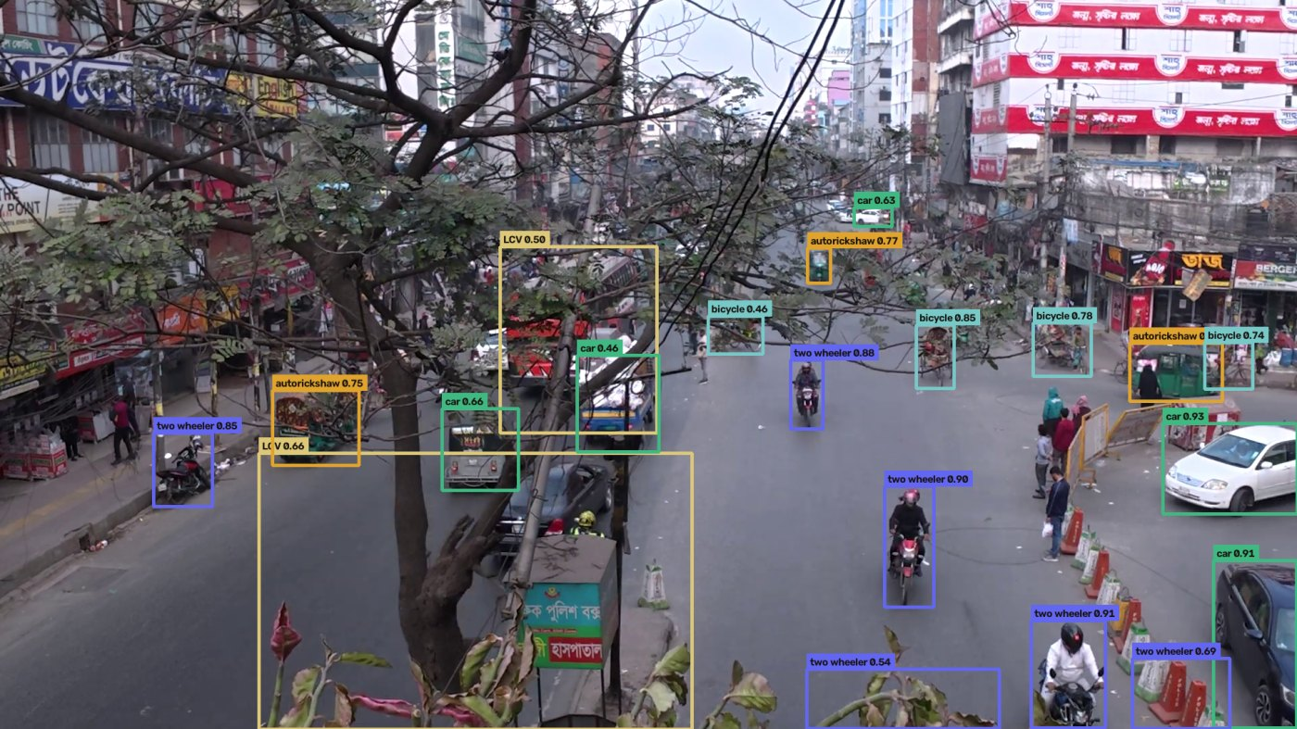
07 DETECTION · IN THE WILD
7 / 19
What "unstructured" actually means
Real output from the detector at confidence 0.45. Neither scene has lane markings a model could rely on.
Mumbai — Andheri Station
Dhaka — Rampura
23 vehicles in one frame. A bus filling a quarter of the image and motorcycles under one percent of it.
20 vehicles. The pilot camera: its quietest moment in twenty minutes still held nine vehicles.
Boxes coloured by class in the detector's own taxonomy · vehicles span 25% of the frame down to under 1%
Notes:
Let the pictures do the work; say very little.
Two things worth naming. First, the scale range -- a bus occupying a quarter of
the frame and a motorcycle occupying under one percent, in the same image. That
is a genuinely hard detection problem and it is why input resolution matters.
Second, look at how the vehicles are arranged. There is no lane structure to
exploit. That is the whole argument for treating lanes as regions a human marks
rather than something the model infers.

Slide 8
08 RESULT · VS COCO
8 / 19
+53.2% mAP over COCO on the shared classes
M2's criterion is a 10% improvement over COCO. It had been asserted and never measured, so we measured it — same test split, ground truth remapped so one validator scores both.
CLASS
COCO BASELINE
OURS
DELTA
WHERE NO PERCENTAGE IS HONEST
car
0.6048
0.7133
+0.1085
motorcycle
0.4285
0.6784
+0.2499
auto_rickshaw 0.7109
COCO has no such class
bus
0.4852
0.7141
+0.2288
cattle 0.3516
truck
0.3097
0.6958
+0.3861
COCO has no such class
shared mean
0.4571
0.7004
+53.2%
The baseline is not low here, it is undefined. Saying that is a stronger statement than any percentage would have been, and it is the difference between a result and a marketing number.
Notes:
Five times the threshold the milestone asked for, so the milestone is met
comfortably.
The important part is the panel. For auto-rickshaw and cattle we deliberately
report no improvement percentage, because COCO cannot detect those classes at
all -- the denominator does not exist. It would have been easy to write "infinite
improvement" and it would have been meaningless.
If a reviewer probes the methodology: we remapped the ground truth so that
Ultralytics' own validator scored both models on the same split. We did not
compare our number against a figure quoted in someone else's paper.

Slide 9
09 RESULT · COUNTING
9 / 19
Counting accuracy is not detection accuracy
Congestion labels come from counts, and a detector with excellent mAP can still systematically over- or under-count. So the operating point was fitted against 5,273 human-annotated vehicles.
CONFIDENCE
DETECTED / TRUE
SPARSE THIRD
DENSE THIRD
MAE PER FRAME
WHY THE LAST TWO COLUMNS EXIST
0.25
1.1724
1.2147
1.1686
1.998
0.35
1.0793
1.1207
1.0754
1.349
0.45 is pinned
ratio 0.9989, lowest error
0.45
0.9989
1.0251
0.9968
1.072
Density dependence 2.8%
0.55
0.934
0.9608
0.9271
1.165
reported, not averaged away
0.6
0.9006
0.9436
0.8917
1.361
A detector accurate on average can still be biased with density — under-counting exactly when the road is busy, which is exactly when the forecast matters. Splitting the test set by density is the only way to see it.
Notes:
This is a methodology slide and it usually earns credit.
The argument: mAP tells you whether boxes are in the right place. It does not
tell you whether the COUNT is right, and the count is what becomes the label. So
we swept the confidence threshold and picked the point where detected-over-true
is closest to one.
The sparse and dense columns are the part to emphasise. A detector can look
perfect on average while under-counting in heavy traffic -- which is precisely
when a congestion forecast matters. Ours has 2.8% residual density dependence
and we report it rather than hiding it in an average.

Slide 10
10 HONESTY
10 / 19
The number that governs deployment is 0.3500, not 0.8941
A model deployed on a junction it has never seen is in the third column. Reporting only the first would be the easiest mistake in this project.
BMD-45 — TRAINED DOMAIN
TRAFFICCAM — CAMERAS NEVER SEEN
THE COMPARISON THAT SHOWS IT
0.8941
0.3500
Dashcam-trained on CCTV
0.3223
Bengaluru Safe City CCTV, the viewpoint the detector was built for
five other Indian cities, same elevated viewpoint, different cameras
Same model, own test set
0.6201
the same weights lose 61% of their accuracy moving to cameras they were not trained on
Viewpoint, not country, is what breaks a detector. The same weights lose half their accuracy moving from a dashcam to a pole, which is why the whole data strategy targets elevated cameras.
WHAT FIXED IT, AND WHY WE DID NOT ADOPT IT
Adding 1,254 human-annotated TrafficCAM boxes moved cross-camera accuracy to 0.5734 and brought e_rickshaw from 0.000 to 0.4787 — a class the detector had been shipping an output head for without ever seeing an example. That arm still failed a sixth pre-registered criterion, so it is not adopted. The criterion was fixed before the run and is not being retuned to fit the number it rejected.
Notes:
Lead with the honesty. Say out loud: the headline number is 0.8941, and the
number that governs deployment is 0.3500. A junction the model has not seen is
the third column.
The amber box is the one to dwell on if there is time. We found something that
fixed a real gap -- e-rickshaw went from literally zero to 0.48 -- and we still
did not adopt it, because it failed a criterion we had fixed in advance. That
discipline has cost us a preferred answer four times, which is the only reason
it means anything.
If asked what happens next: the open question is whether dashcam accuracy should
still be an acceptance criterion at all, given the deployment is a fixed camera.
That is a decision we have put to the guide.
Both cards are the same detector on two test sets, deliberately. If asked about
IDD: the earlier joint detector scored 0.6174 there, but quoting it beside these
two would be putting a different model in the same comparison row.

Slide 11
11 THE CORPUS
11 / 19
Nine steps, and the expensive one runs once
Turning video into training data. The detector pass costs hours; every choice made after it re-derives in seconds.
triage
survey
place lanes
import
build corpus
which clips qualify
where traffic is
by hand, per camera
validate placement
detector → counts
relabel
audit
cache
train
thresholds
re-derive and check
frozen features
config or ablation
WHAT A CHANGE ACTUALLY COSTS
Move a lane centre
Change the thresholds
Change detector, confidence or sampling
0.66 s
seconds
hours
Notes:
The point of this slide is the purple box, not the nine boxes above it.
Lane placement is done by eye over a heat map, so it was never going to be right
first time. Before, revising it meant running the detector over every clip again
-- hours. Now the detections are stored separately from the lane geometry, so
re-placing a lane and rebuilding the labels takes under a second.
That matters more than the speed suggests: a feedback loop that costs hours gets
used once, and the placement ends up judged on how it looks rather than on the
counts it produces.

Slide 12
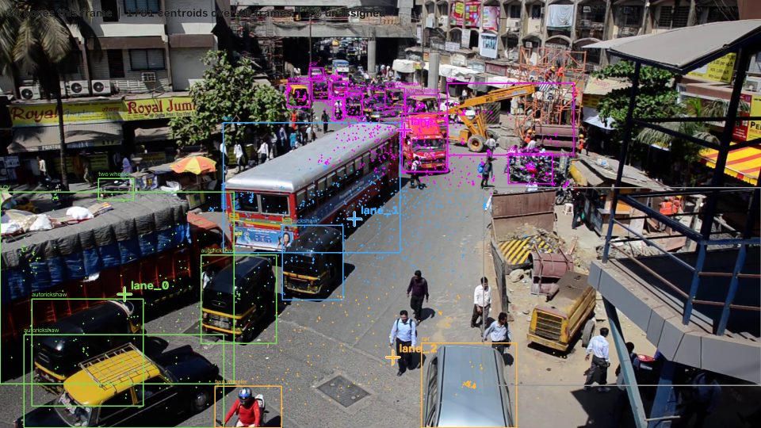
12 LANE GEOMETRY
12 / 19
A lane that moves when the tooling changes is not a property of the road
Lane centres are placed by a human over a detection heat map, and the reason is measurable.
MEASURED, NOT ASSUMED
0.164 of frame width
≈ 315 px of drift
Between two detectors
same footage, same settings
Automatic centres are a clustering of where the detector happened to fire. Swap the detector and they move. A reviewer placing them by hand is placing something about the road instead.
The count matters more than the positions. At two centres, two cameras left over a third of vehicles outside every lane; at four, the worst is 10.5%.
Notes:
The image is detection density over sixty sampled frames, with the automatic
lane centres marked.
The measurement is the argument: swap the detector and those centres move by
0.164 of the frame width, about 315 pixels. Something that moves when you change
your tooling is not a fact about the road, so we do not let the tooling decide
it.
The last line is worth saying if there is time -- how MANY lanes you place
matters more than exactly where. Two centres left a third of the vehicles
unassigned on some cameras. Four fixed it.

Slide 13
13 DECISION · A28
13 / 19
Sampling every 2 seconds instead of 5 keeps four cameras alive
The PRD fixes a 5-second interval as a bare number derived nowhere. We pre-registered a statistic to replace it before the footage existed, deliberately biased against the answer we wanted.
STEP_S
CLIP MINIMUM
SEQUENCES
INDEPENDENT SEGMENTS
CAMERAS CONTRIBUTING
WHAT THE STATISTIC RETURNED
5 — current
355 s
302
29
7 of 11
2 — proposed
178 s
359
64
11 of 11
1 or 2, in all six
three detectors × two threshold sets
1
119 s
381
101
11 of 11
Never 5
the value the PRD assumed
Fixing the statistic before seeing the data is what makes this a measurement rather than a preference. It was also chosen so that a wrong answer would favour keeping the PRD's value.
THE SEQUENCE COLUMN IS THE WEAKER ARGUMENT
Overlapping windows inflate any sequence count — measured at 5.6×. The column that matters is the last one: a 5-second interval needs 355 s of continuous footage per clip and so deletes four cameras outright. Sequences from one camera are correlated; cameras are the unit the model must generalise over, and no augmentation manufactures a viewpoint.
Notes:
Explain pre-registration first, because it is the part that makes this credible:
we wrote down the formula before we had the footage, and we chose one that would
favour keeping the PRD's existing value if it was wrong.
It returned 1 or 2 in all six combinations we tested. Never 5.
Then correct the obvious reading of the table. Do not claim "the corpus doubles"
-- overlapping windows inflate the sequence count by 5.6 times, so that number
means little. The real argument is the last column: at 5 seconds a clip needs
355 seconds of continuous footage, which deletes four of our eleven cameras
entirely, including the best Indian junction scene we have.

Slide 14
14 THE MODEL
14 / 19
Two frozen backbones, arbitrated by a learned gate
MFSTNet is the project's core contribution. The gate is a research artifact in its own right — logged every run and analysed in the paper.
ResNet-50
DINOv2 ViT-S/14
bidirectional
the gate
2048 × 7 × 7
frozen
384 × 16 × 16
frozen
cross-attention
two directions
g = σ(W[Z_A;Z_B])
F = gZ_A + (1−g)Z_B
per-lane ROI
BiLSTM + temporal
congestion head
Voronoi cells from
lane centres
attention, T = 60
LOW / MED / HIGH
60 s ahead
Freezing the backbones and caching their features is what makes an eight-config ablation feasible on a 6 GB laptop GPU. Ablation-ability is treated as an architectural constraint, not an afterthought: every module can be disabled by a config flag, with no code edit between configs.
Notes:
Walk the pipeline once, briefly. Both backbones are frozen -- we do not fine-tune
them -- and their features are cached, which is the single decision that makes
the experiment affordable.
Stop on the gate, in purple. Two cross-attention directions produce two views;
the gate learns how much to weight each, per location and per timestep. It is not
an internal detail: we log it, plot it, and analyse it in the paper, because "how
does the model balance texture against structure" is the interesting question.
If asked why frozen: with a corpus this size, fine-tuning 45 million parameters
would overfit immediately. The next slide is about what the gate actually does.

Slide 15
15 RESULT · THE GATE
15 / 19
The gate can gate — the flat gate is a fact about the data
On the pilot corpus it sits at 0.54 with a spread of 0.005: one value everywhere, which is a scalar blend rather than a gate. So we asked whether it can do more.
SEED
GATE STD
G WHEN CNN CARRIES
G WHEN VIT CARRIES
SEPARATION
WHY IT IS FLAT, EXACTLY
1
0.348205
0.41444
0.65744
0.243003
7
0.324192
0.44837
0.68359
0.235215
z_a, z_b nearly orthogonal
cosine −0.004 — different information
42
0.451591
0.44232
0.63055
0.188235
but small: std 0.035
so the sigmoid stays linear
predicted gate std 0.006
Given a task where half the samples carry the label in the CNN branch and half in the ViT, the gate moves by 50–90× its pilot spread and routes toward whichever branch is worth reading. The mechanism works; the pilot corpus simply does not demand it.
observed 0.006
The residual adds both branches back ungated, so neither can be fully suppressed. That bounds how much of the ablation's gain gating can ever explain — which belongs in the paper rather than in a reviewer's question.
Notes:
This is the slide a good examiner will push on, so know it well.
Observation: on our pilot data the gate barely moves. Rather than hand-wave, we
instrumented its input and predicted the spread from first principles -- the two
inputs are nearly orthogonal but small, so the sigmoid never leaves its linear
region. Predicted 0.006, observed 0.006.
Then we built a task that REQUIRES gating and showed the gate moves by fifty to
ninety times that, in the right direction, across three seeds. So the mechanism
has capacity; the flat reading is a statement about five cameras of data.
Volunteer the caveat before you are asked: the residual connection adds both
branches back ungated, so the gate can never fully suppress a branch. That limits
how much of the ablation difference gating can account for.

Slide 16
16 RESULT · SIGNAL CONTROL
16 / 19
Baselines reported as measured, including where they disqualify
Thirty paired seeds per regime, bootstrap confidence intervals, paired t-test and Cohen's d — the statistics the requirements ask for.
REGIME
FIXED-TIME
LONGEST-QUEUE
WEBSTER
COHEN'S D
CITABLE
TWO AUTOMATIC DISQUALIFICATIONS
light
11.92
6.28
6.59
15.99
partly
saturated
26.18
27.94
14.05
2.94
yes
Light: Webster clamps 100%
a fixed-time controller in disguise
oversaturated
71.89
70.46
66.61
0.31
no
Oversaturated: <85% arrive
a low wait measures survivors only
mean wait, seconds · headline comparison is made at saturation
Both rules were written before the runs. They exist because the flattering reading of each regime is available and wrong — a controller that finishes fewer trips can post a better mean wait simply by losing the slow ones.
Notes:
Point at the saturated row -- that is the headline, because saturation is where
signal timing actually decides the outcome. Webster is clearly best there, with a
very large effect size.
Then explain the two disqualifications, which are the interesting part. In light
traffic Webster's cycle formula hits its clamp one hundred percent of the time,
so it is not really Webster any more and the comparison is not citable. In
oversaturated traffic all three controllers fail to clear 85% of trips, and a
mean wait computed over survivors is survivorship bias.
Both rules were written before the runs. Say that -- it is the difference between
a filter and an excuse.

Slide 17
17 ENGINEERING
17 / 19
The ablation went from 12.3 hours to 1.5
Two independent faults were hiding behind one symptom, and half of every training epoch was spent on the wrong side of the bus.
CONFIG
CPU
GPU FP32
GPU FP16
GAIN
REPRODUCIBILITY MACHINERY
A · CNN only
33.2 s
20.5 s
12.7 s
2.6×
B · ViT only
20.1 s
19.8 s
9.4 s
2.1×
Pre-registered thresholds
fixed before the run that tests them
G · full MFSTNet
208.4 s
40.0 s
16.6 s
12.6×
Results written, never typed
A–H, extrapolated
12.3 h
3.8 h
1.5 h
8.2×
a short run refuses to overwrite a long one
measured on the five-camera pilot during the optimisation work; not a committed CSV
The corpus audits itself
The documented install could not work
9 checks; 7 of 7 mutations caught
It pointed at a CUDA index that no longer carries PyTorch at any version, so it silently resolved to the CPU wheel.
Results carry their environment
torch build, device, TF32, commit
The trainer had no device handling at all
A correct install would still have run on the CPU with the GPU idle. It does not error; it is just slow on a machine that looks healthy.
620 tests · 175 commits · 18 decision records · seeds fixed at 42 across Python, NumPy, PyTorch and SB3.
Features were widened too early
The cache stores fp16 and the model wants fp32. Widening before the transfer doubled what was copied and shipped — and the widening is exact, so moving it changed no result.
Notes:
Two stories here and both are short.
First, why training was slow: the install instructions in our own docs pointed at
a CUDA index that no longer exists, so following them silently gave the CPU-only
build. And even with that fixed, the training script never moved anything to the
GPU. Two separate faults, one symptom.
Second, the fp16 point is a nice engineering detail. The cache stores half
precision, the model wants single -- we were converting before the transfer, so
we copied and shipped twice the bytes. Moving the conversion after the transfer
is exact, so all eight configs produce identical numbers, 2.5 times faster.
The panel on the right is what to mention if asked about rigour.

Slide 18
18 CHALLENGES & NEXT
18 / 19
What went wrong, and what happens now
Twenty-nine defects are logged with their cause and cost. These are the ones that changed the project.
#
WHAT WAS WRONG
WHY IT MATTERED
THREE DECISIONS, THEN THE CORPUS
P21
e_rickshaw scored 0.000
IDD contains zero instances — a head trained on nothing
A28 — sampling interval
P23
Lane polygons overlapped on 11 of 12 cameras
every vehicle in the overlap double-counted
eleven cameras, or seven
P26
Every camera pooled through one camera's lanes
silent: shapes agree, loss falls, wrong region
ADR-017 — thresholds
what every congestion table means
P29
A cached window read its entire clip
26 GB of churn for 1.5 GB — segfault, no traceback
S17 — acceptance surface
which detector is the one of record
P30
No pinned package matched its installed version
a clean machine would build a different stack
Everything on the critical path is built and measured. What remains is not engineering: place the lane centres, build the corpus, audit it, run the ablation — an evening's compute.
P34
Calibration produced an impossible threshold
0% LOW — the degeneracy it exists to prevent
Three of these shared one shape — a number whose meaning depended on a fact the number did not carry. Each was fixed where it happened; the pattern was then closed once, by recording the environment beside every result.
Honest limit: 64 independent segments across 11 cameras, and 20 of them come from one clip. That concentration is the corpus's real weakness.
Notes:
Do not present the defect table as failure. Present it as evidence that the
project is being checked -- most of these were found by us, on purpose, and each
one has a test that stops it returning.
If you only mention one, mention P26: every camera was being pooled through a
single camera's lane geometry, and nothing looked wrong. The shapes agreed, the
loss fell, the numbers were plausible. That is the kind of defect that reaches a
paper.
Close on the three decisions. Be clear that they are not engineering blockers --
the pipeline runs end to end today. They decide what the numbers are OF, and two
of them cost minutes to reverse.
Finish with the honest limit rather than a flourish. Twenty of sixty-four
segments come from one clip; more footage from one junction is the only thing
that fixes it.

Slide 19
19 REFERENCES
19 / 19
Sources, and what each one obliges us to do
Written down now rather than reconstructed in Week 20. Two of these carry conditions that shape what can be released.
IDD
Varma, G., Subramanian, A., Namboodiri, A., Chandraker, M., & Jawahar, C. V. (2019). IDD: A Dataset for Exploring Problems of Autonomous Navigation in Unconstrained Environments. WACV 2019.
Citation required by the terms of use.
TrafficCAM
Deng, Z., Cheng, Y., Liu, L., Wang, S., Ke, R., Schönlieb, C.-B., & Aviles-Rivero, A. I. TrafficCAM: A Versatile Dataset for Traffic Flow Segmentation. arXiv:2211.09620. University of Cambridge & University of Bristol.
No licence declared — cite, and seek written permission before release.
ITD v1.2
Agarwal, Thombre, Kedia & Ghosh (2024). Indian Traffic Dataset. Transportation Engineering Group, IIT Roorkee. CC BY-NC 4.0.
Non-commercial: the restriction propagates to anything derived.
BMD-45
IISc AIM. BMD-45 (Hugging Face: iisc-aim/BMD-45). CVPR 2026. arXiv:2604.24419. CC BY 4.0.
Author list to be completed from the paper before submission.
Bellevue Traffic Video Dataset
City of Bellevue, Washington. TrafficVideoDataset. github.com/City-of-Bellevue/TrafficVideoDataset.
Released by a public body for research use.
Tooling
Jocher et al., Ultralytics YOLOv8 · Oquab et al. (2024), DINOv2 · Raffin et al. (2021), Stable-Baselines3, JMLR 22(268) · Lopez et al. (2018), Microscopic Traffic Simulation using SUMO, ITSC.
Cited in the paper's implementation section.
Full entries in docs/00-planning/DATASETS.md · one marked item is deliberately incomplete rather than guessed
Notes:
Do not read this slide out. It is here so the panel can see the sources are
tracked, and so the citations exist before the paper needs them.
If you say anything, say the two obligations. IDD requires a citation as a
condition of use, which we have. ITD is non-commercial, so anything derived from
it inherits that -- worth knowing if this project is ever taken further.
The BMD-45 line is deliberately marked incomplete. We have the venue, the arXiv
number and the licence, but not the author list, so it says so rather than
guessing. An examiner spotting a fabricated citation is far worse than one
spotting a gap you have already flagged.

