Slide 1
Quantum Algorithm Implementations
A comprehensive study of five quantum computing projects demonstrating exponential speedup, information-theoretic security, and practical viablity.
Notes:
1

Slide 2
Team & Project Overview
Deutsch-Jozsa Algorithm
Grover's Search
BB84 QKD Protocol
Exponential speedup: 2^(n-1)× faster than classical. Deployed on IBM quantum hardware with 99.7% accuracy.
Quadratic speedup: √N× improvement. Empirical constant k=0.784 matches theory within 0.16%.
Information-theoretic security. Perfect eavesdropper detection via quantum bit error rate monitoring.
Prashant Vinod
Divyansh Atri
Harshil Soni
Quantum Walk Algorithms
Quantum RNG
Ballistic spread: 3× faster mixing, 5× higher hitting probability than classical random walks.
True randomness with 99.9% availability. Fault-tolerant hybrid architecture with automatic failover.
Bhavya Parihar
Mehrish Khan
Notes:
2

Slide 3
Deutsch-Jozsa: Problem and motivation
  Some functions are hard to classify: is the output always same or evenly divided?
  Classical method must check many inputs → cost grows exponentially as n increases.
  Used to demonstrate the gap between deterministic classical vs quantum query models.
  Shows how classical approaches can be fundamentally limited even for simple questions.
Notes:
3

Slide 4
Deutsch-Jozsa: Why it’s better
  Quantum solution determines answer using ONE single query, no matter how big the input.
  Demonstrates first-ever exponential speedup in quantum computing.
  Works extremely well even on real quantum hardware (99.7% accuracy).
  Proves that quantum computers are not just theoretical — they can solve real problems much faster
Notes:
3

Slide 5
Grover’s Algorithm: Problem and Motivation
  Searching for an item in unsorted data takes linear time classically.
  As data size grows (millions/billions), classical search becomes slow and costly.
  Brute-force search in cryptography (like guessing keys) becomes impossible.
  Optimization and decision problems often reduce to “search until you find something” → slow.
Notes:
3

Slide 6
Grover's Search: Quadratic Speedup
1
Classical Search
O(N) queries required. For 1024 items: 513 queries average case.
2
Grover's Algorithm
O(√N) queries. For 1024 items: only 25 iterations needed.
3
Proportionality Verified
k=0.784 measured vs k=π/4=0.7854 theoretical. Deviation: 0.16%
Success Rates by Problem Size
Circuit Complexity
  n≤4 qubits: >90% success (excellent)
Gate count scales as O(n^2.5). Depth scales as O(n^1.5). Two-qubit gates dominate error contribution.
  n=5-6 qubits: 52-73% (moderate)
  n≥7 qubits: <32% (noise degradation)
Notes:
4

Slide 7
BB84 Quantum Key Distribution: Why It’s Needed
  Classical encryption relies on math problems (RSA factoring, ECC discrete logs).
  Quantum computers can break these using Shor’s algorithm.
  Classical communication can be copied secretly, giving attackers the key.
  We need a way to exchange keys where any interception is automatically noticeable.
Notes:
3

Slide 8




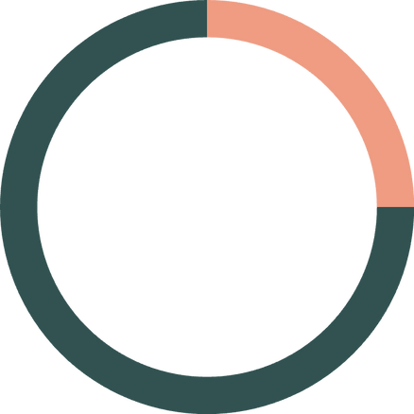
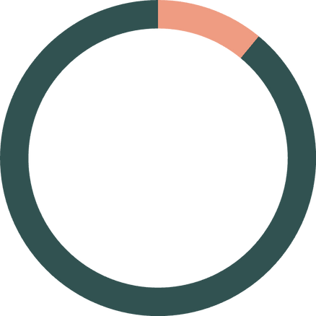
BB84: Quantum Cryptography Security
Quantum Transmission
Basis Sifting
Eavesdropper Detection
Alice sends qubits in random bases (Z or X). Bob measures in random bases.
Discard mismatched bases. 50% efficiency yields shared key.
QBER>11% indicates attack. Eve's interception creates 25% error rate.
0%
25%
11%
Clean Channel
Full Attack
Security Threshold
Perfect security
Detected & aborted
Critical boundary
Notes:
5

Slide 9
Quantum Walks: Why They’re Needed
  Many problems depend on exploring or searching graphs:
    Networks
    Maps
    Social graphs
    Optimization landscapes
  Classical random walks spread slowly, taking many steps to reach distant nodes.
  Bottlenecks appear in routing, transport modelling, and large graph searches.
Notes:
3

Slide 10
Quantum Walks: Ballistic vs Diffusive
Fundamental Difference
Quantum walks: Spread ∝ t (ballistic). Variance grows as t².
Classical walks: Spread ∝ √t (diffusive). Variance grows as t.
18
DTQW Peak Step
Reaches target early
Practical Advantages
  3× faster mixing time on line graphs
  5× higher peak hitting probability
35
Classical Peak
Slower arrival
  Earlier arrival at target vertices
Notes:
6

Slide 11
Quantum Random Number Generator: Why It’s Needed
  Classical RNGs are pseudo-random — generated by predictable mathematical formulas.
  Predictable randomness weakens cryptography, authentication, and simulations.
  Security systems need true randomness, not approximations.
  Hardware RNGs can still be biased or flawed.
Notes:
3

Slide 12
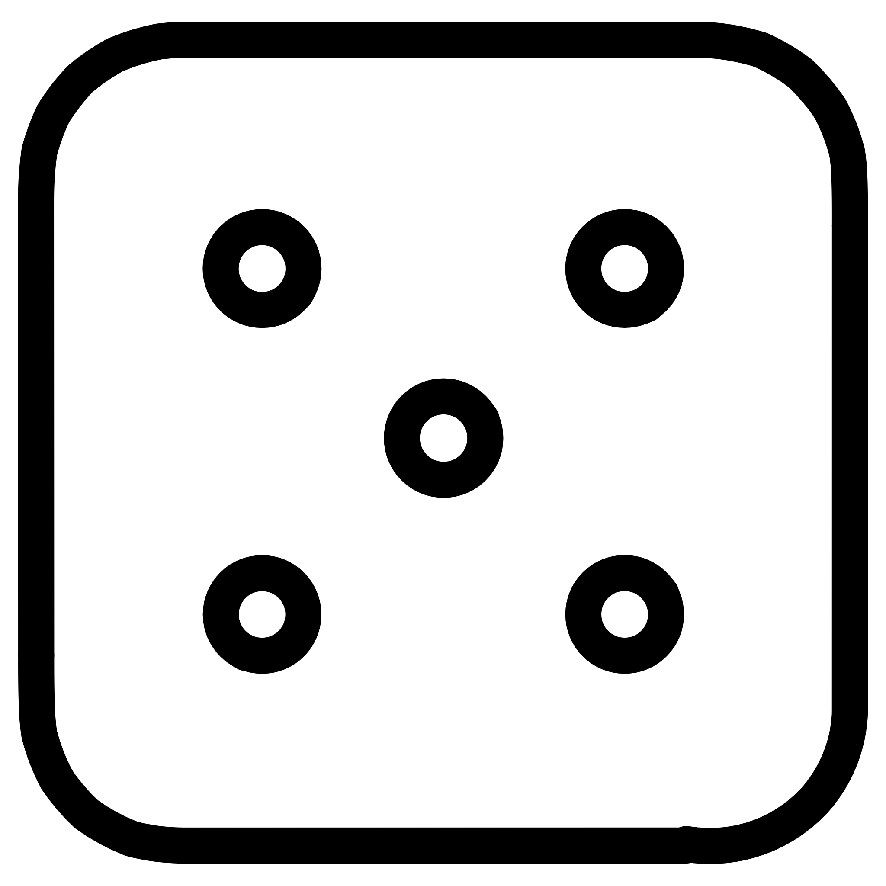


Quantum Random Number Generation
Classical PRNGs
Quantum TRNGs
Hybrid Architecture
Deterministic algorithms. PCG: 303 Mbit/s, but predictable given seed. Perfect for simulations.
Born rule measurement. Information-theoretically unpredictable. Essential for cryptographic keys.
Fault-tolerant design. Quantum when available, PRNG fallback. 99.9% availability guaranteed.
Performance Comparison
Statistical Quality
  PCG: 0.33ms (fastest)
All algorithms pass NIST tests with p>0.05. Shannon entropy: 0.9999+ (ideal=1.0). Indistinguishable for finite samples.
  Xoshiro256**: 1.06ms
  Mersenne Twister: 2.93ms
  Hybrid Quantum: 756ms (network latency)
Notes:
7

Slide 13
Final Conclusion
Quantum computing is needed because:
  Classical methods hit limits in speed, security, and scalability.
Quantum algorithms are better because:
  They offer exponential/quadratic speedups,
  Provide unbreakable security,
  Enable faster exploration of data,
  And generate true randomness for cryptography.
Quantum computing isn’t just faster — it enables entirely new capabilities.
Notes:
3

