Slide 1

Mobile Recommendation System
ADVITIYA ARYA (E23CSEU1110)

Slide 2
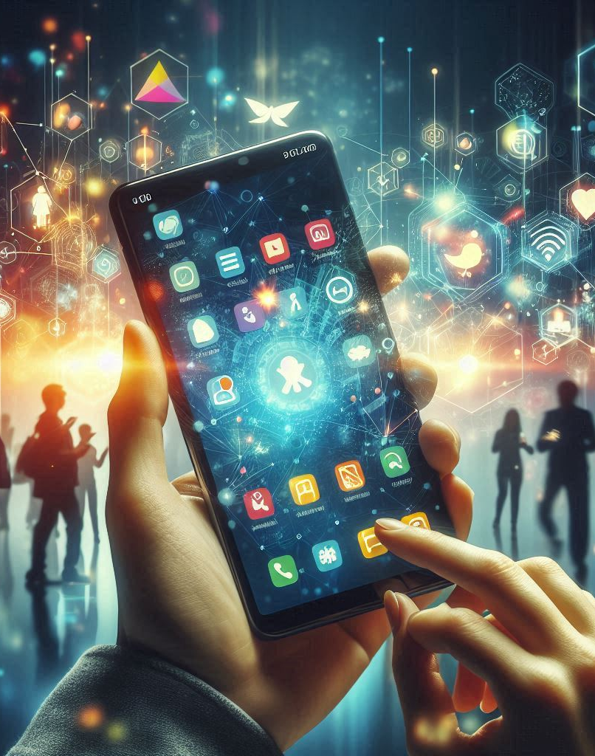
Introduction
In today's e-commerce landscape, consumers face an overwhelming choice of mobile devices with varying features and prices.
To simplify the selection process, this project develops a mobile recommendation system using collaborative filtering techniques, analyzing user interactions to provide personalized and accurate device suggestions.

Slide 3

Objective
The primary objective of this project is to build a system capable of recommending mobile devices to users based on their previous ratings and interactions.
This project focuses on developing a mobile recommendation system using collaborative filtering techniques.
The system is designed to be scalable and adaptable, capable of incorporating new user data to provide up-to-date and relevant suggestions.

Slide 4
Methodology
This dataset includes mobile device name, and associated ratings or interactions, which reflect user preferences.
The data was sourced from a public dataset, ensuring sufficient information for effective training and testing.
1. Data Collection

Slide 5
.
Data preprocessing was an essential step to ensure the dataset was clean and suitable for analysis. Missing values, duplicates, and outliers were handled to maintain data quality.
The dataset was then transformed into a user-item interaction matrix, where rows represented users and columns represented mobile devices. Each cell in the matrix contained a rating or a value indicating a user's preference for a particular device.
To improve the model's performance, normalization techniques were applied to standardize the ratings, making them
2. Data Preprocessing

Slide 6
.
User-Based Collaborative Filtering: This method identifies users with similar preferences by comparing their historical ratings. Once similar users are found, recommendations are made based on the items these users liked or highly rated.
Item-Based Collaborative Filtering: In this approach, the system finds items (mobile devices) similar to the ones the user has previously liked. It calculates the similarity between mobile devices based on user ratings and recommends devices with the highest similarity scores.
3. Collaborative Filtering Techniques

Slide 7
.
The collaborative filtering algorithms were implemented using popular data science libraries such as pandas, numpy, and scikit-learn.
An item-based collaborative filtering model was initially developed, followed by a user-based model, with both systems evaluated for performance comparison.
4. Model Implementation

Slide 8
.
The recommendation model was deployed on a web application using Streamlit, a Python-based web framework for creating interactive applications.
The web interface allows users to interact with the recommendation system in real-time, inputting their preferences and receiving personalized mobile recommendations. The simplicity and flexibility of Streamlit made it a suitable choice for visualizing data and deploying the model.
5. System Deployment

Slide 9
Conclusion
This project successfully developed a mobile recommendation system using collaborative filtering techniques to enhance the user experience in selecting mobile devices. The system effectively utilized both user-based and item-based collaborative filtering models, along with matrix factorization, to generate personalized recommendations based on user behavior.
The results of the experiments demonstrated that collaborative filtering, particularly the item-based and matrix factorization approaches, provided accurate and reliable suggestions, even in scenarios with diverse user preferences.

Slide 10
Future Scope
Data Privacy and Ethical Considerations
As recommendation systems increasingly rely on personal data, ensuring user privacy and maintaining ethical standards is crucial. Future work could explore privacy-preserving recommendation techniques like differential privacy or federated learning, where user data remains secure while still enabling accurate recommendations.
Expansion to Other Product Categories
The recommendation system, initially focused on mobile devices, can be expanded to other product categories such as laptops, tablets, smartwatches, or other electronic gadgets. The core algorithms and methodologies can be adapted to fit a wider range of consumer electronics, making the system versatile and applicable across various domains.

Slide 11
THANK YOU!!

