Slide 1
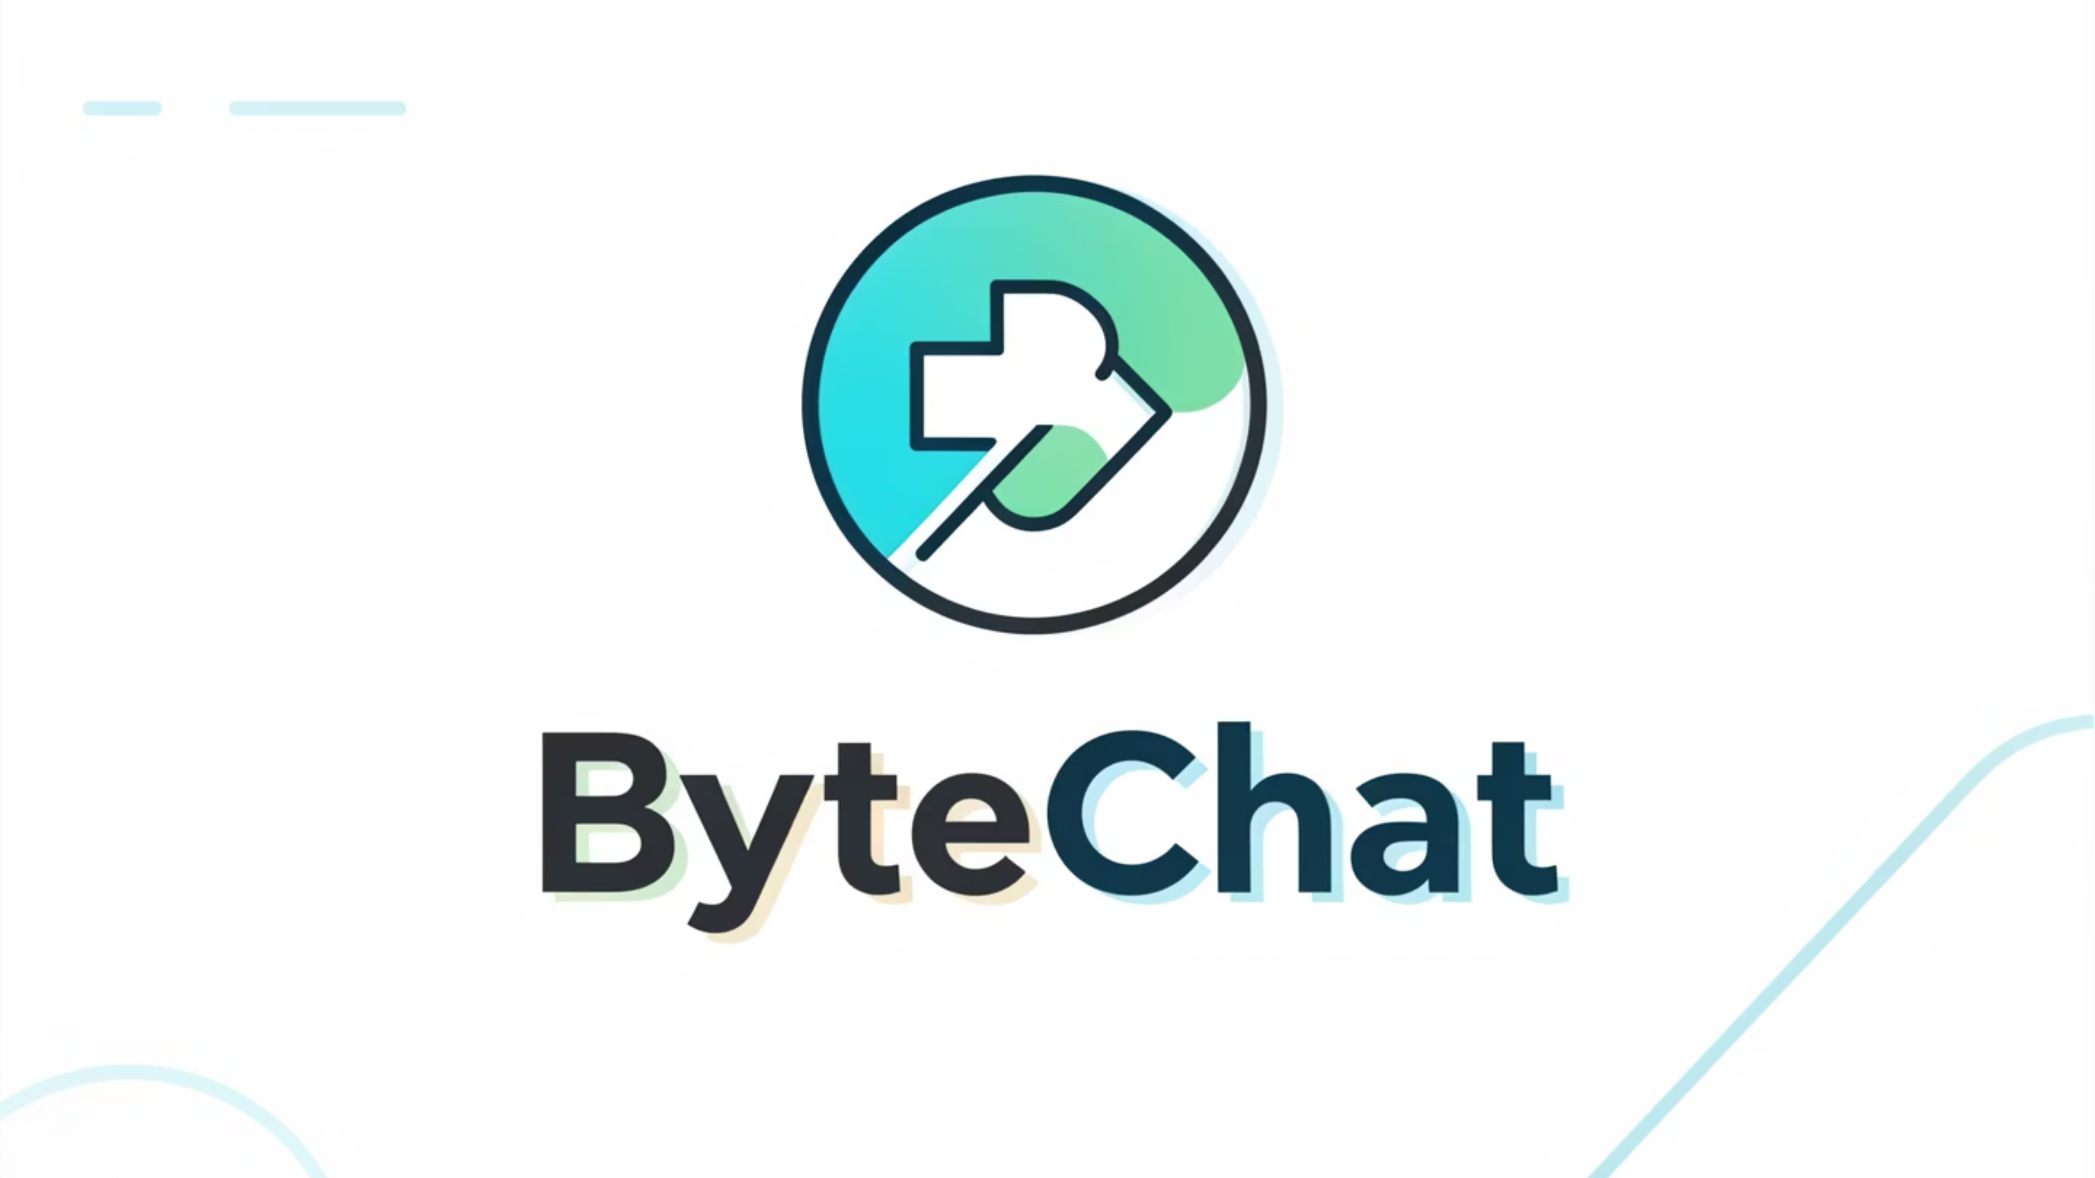
Where Voices Stay Hidden

Slide 2

What We've Done So Far
E-R Modeling
Manual Table Testing
Database Architecture
Authentication & Security
Group & Chat Features
Permission Management

Slide 3

Navigating Digital Access
An overview of user roles and permissions for our web platform.
This presentation outlines the different access levels, features, and responsibilities associated with each user role, ensuring clarity and security across our system.

Slide 4
User Roles Overview
Defining Access Levels
Guest
Unauthenticated Visitors
Public
Baseline
User
Registered Members
Standard
Normal
Group Admin
Group Creators & Moderators
Elevated
Advanced
Super Admin
DB Administrators & Developers
SUDO
Highest

Slide 5
Guest Roles: Unauthenticated Access
1
2
3
View Landing Page
View & Register
View Login Page
Access the main website content without authentication.
Navigate to the signup page and complete registration.
Access the login interface to initiate a session.
Guests can explore public areas of the platform but cannot access features requiring a registered account.

Slide 6

USER ROLES
Registered Users: Core Platform Engagement
View our Homepage and Landing Page.
Login to their personal account.
View their own profile.
Edit profile details (e.g., display name, avatar).
Delete accounts and request major profile assistance.
View other user profiles.
Initiate 1-on-1 conversations (normal and anonymous modes).
Create Public and Private Groups.
Join and Chat in Public Groups.
Limited interaction in Private Groups.
Block and Restrict users in 1-on-1 conversations.

Slide 7

USER ROLES
User Privileges: Communication & Media
1
Chat Features
Send and receive messages.
Create 1-on-1 chats.
Send friend requests.
Block other users.
Report inappropriate content.
2
Group Features
Join public groups.
Leave groups at any time.
Vote in group polls.
Send messages within groups.
View shared group media.
Media & Privacy
Users can upload files of size up to 5MB, view shared media within chats and groups, and delete their own uploaded content. They also have control over notification settings.

Slide 8
GROUP ADMIN ROLES
Group Admin: Empowering Community Leaders
Group Admins have all User Permissions, plus enhanced capabilities to manage their communities effectively.
Member Management
Content Moderation
Group Customization
Add or Remove members from Groups, Approve or Reject requests, and Ban disruptive users.
Delete inappropriate messages, Mute members, and Manage anonymous settings within private groups.
Create and Edit polls, Change Group settings, and Ensure a positive environment for all participants.

Slide 9
SUPER ADMIN ROLES
Super Admin: Ultimate System Control
Super Admins possess all Group Admin permissions, complemented by system-level access for comprehensive oversight.
Database Access
User Management
System Settings
Analytics & Reports
Full access to all database functions and data.
View, deactivate, and activate any user account.
Manage global platform configurations and parameters.
Access comprehensive analytics dashboards and bug reports.
Audit Logs
Data Export
Review detailed audit trails for security and compliance.
Export system data for analysis and backups.

Slide 10
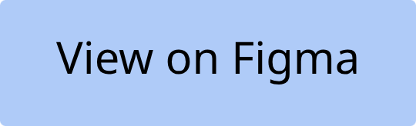
UI Flow Design
Design Prototype

Slide 11
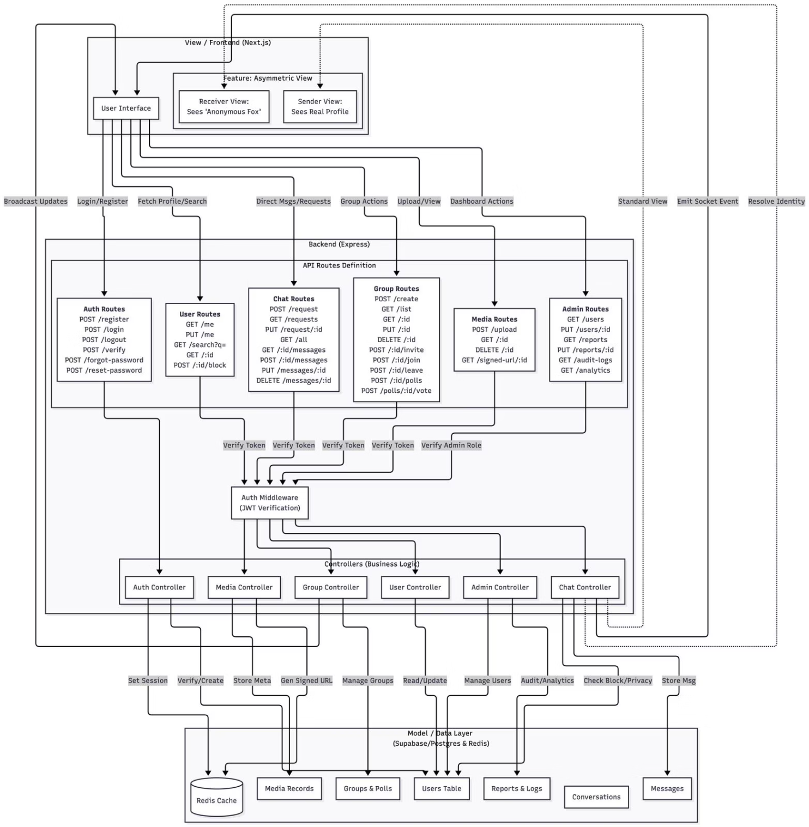
MVC Based Architecture Planning

Slide 12
Future Work Goals
1
Development of GUI forms
2
Integration of web UI with backend logic
3
UI enhancements

Slide 13
Thank You
Any Questions?

