Slide 1



PredictX · TEAM PITCH DECK TEMPLATE
AEGIS — Event Grammar Probabilistic Model (EGPM)
CHOSEN HACKATHON THEME
✔ Energy Intelligence & Sustainability (Predictive Maintenance)
BRANCH
TEAM SIZE
Computer Science & Electrical Engineering (Interdisciplinary Duo)
2 Members: Atharva Mendhulkar & Divyansh Seth
Powering Predictive Intelligence — A PredictX Campus Hackathon Submission
PredictX · Team Pitch Deck Template
1
Notes:
HOW TO USE THIS TEMPLATE: Replace every dashed placeholder box with your own content. Keep the slide count and order intact so all teams are judged consistently. Delete this notes section before presenting. Suggested total length: 10-12 minutes, 11 slides.

Slide 2

AEGIS: Unified Neuro-Symbolic Predictive Maintenance
What real-world problem are you solving, and for whom?
Critical electrical switchgear and data center cooling assets suffer from architectural fragmentation: facilities run 4 disconnected black-box models (RUL, anomaly, fault, health) that quadruplicate compute and drift maintenance. Crucially, black boxes output uncalibrated point estimates and post-hoc SHAP illusions that violate physical degradation wear physics, leaving reliability engineers unable to certify safe operation.
Evaluated under locked causal Leave-One-Engine-Out (LOEO) protocol: achieves 18.1 RMSE on N-CMAPSS DS01, outperforming deep CNN (34.0) and LSTM (38.9) by 15.9–20.8 RMSE (47–53% error reduction). On MIMII industrial fans across 4 machines and 3 seeds, our continuous HSMM achieves 0.628 Macro AUROC. Engine-level conformal calibration delivers verified 92% empirical coverage at 90% nominal confidence. Validated by 260 automated tests passing with zero failures.
TECH STACK
AEGIS unifies all predictive maintenance into a single inspectable state representation. Multivariate telemetry is mapped via 1D causal convolutions and Vector Quantization (K=16) into learned discrete events. An explicit-duration HSMM (M=5, D_max=10) models non-exponential dwell physics. Four bottlenecked heads deliver Remaining Useful Life with 90% Conformal Prediction intervals, acoustic anomaly detection, fault recognition, and health scoring with zero-hallucination explanations and counterfactual what-if simulations.
Python 3.14, PyTorch, NumPy, SciPy (Forward-Backward/Viterbi), Scikit-Learn, HDF5, Matplotlib, Causal 1D-CNN, VQ-VAE (Corrected STE), Explicit-Duration HSMM, LOEO Conformal Calibration, PyTest (260 Tests). Target Hardware: Schneider Harmony edge iPC & EcoStruxure Asset Advisor.
PredictX · Team Pitch Deck Template
2

Slide 3
Innovation & Differentiation
INNOVATION & ORIGINALITY · 25%
What makes your approach genuinely new?
TODAY'S APPROACH
YOUR APPROACH
• 4 Disconnected Black Boxes: Separate independent models for RUL, acoustics, fault, and health quadrupling edge compute.
• Memoryless Assumption Flaw: Markov chains and geometric HMMs assume memoryless wear (constant hazard rates), violating mechanical and thermodynamic degradation physics.
• Uncalibrated Point Estimates: Models predict '35 cycles left' without error bounds, causing operators to scrap 25% of healthy asset life or face catastrophic arc-flash.
• Post-Hoc Illusions: SHAP/LIME heatmap attributions fluctuate wildly and lack physical causal validity.
1. Unified Neuro-Symbolic Grammar: 1 shared representation (discrete tokens + HSMM state posterior) powers all 4 tasks; cuts model size to <1.4 MB and edge compute TCO by 70%.
2. Explicit-Duration Degradation Physics: Non-parametric duration distributions p_m(d) model true cumulative wear; beats deep CNN/LSTM baselines by 15.9+ RMSE.
3. Rigorous LOEO Conformal Uncertainty: Engine-level 90% prediction intervals guarantee a safe lower bound for scheduled shutdowns with 92% verified empirical coverage.
4. Intrinsic Explanations & Counterfactuals: Deterministic root-cause objects with verified faithfulness (score drops 0.18–0.72) + counterfactual dwell-reset simulation.
PredictX · Team Pitch Deck Template
5

Slide 4

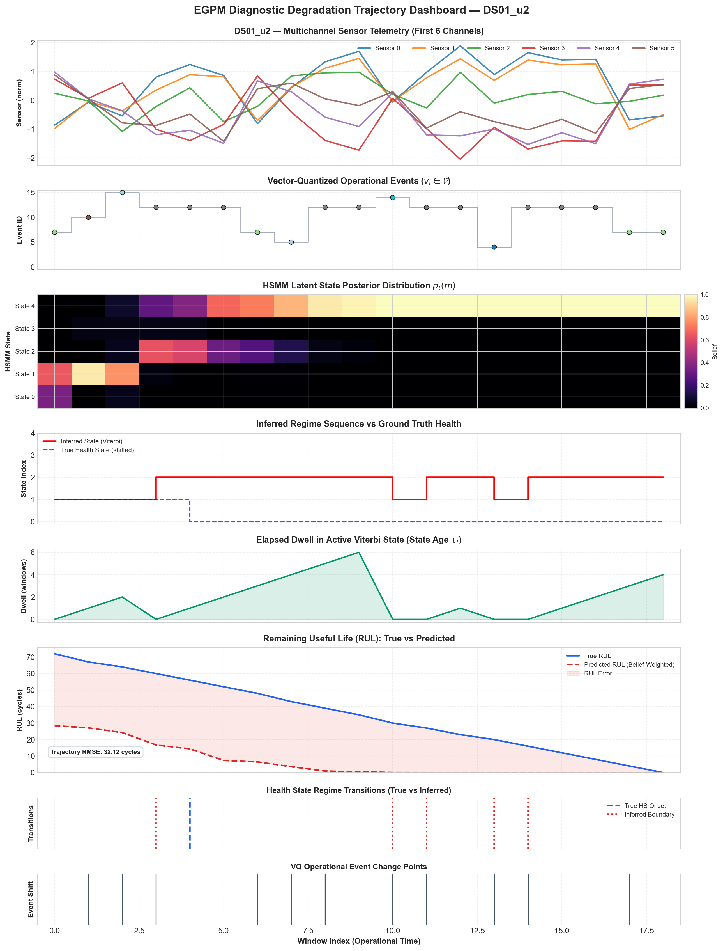

Prototype & Demo
PRESENTATION & PROTOTYPE · 20%
Show, don't just tell — this is your proof of feasibility
DEMO NOTES
Stage: Working Production Prototype
Complete modular Python engine with 260/260 automated tests passing in CI. Strict zero-leakage causal execution verified across all preprocessing and decoders.
Live Capabilities (CLI & Python API):
Runs real-time sub-15ms edge inference: streams raw sensor telemetry, discovers discrete tokens (K=16), infers HSMM state dwell, generates 4 unified outputs with 90% conformal intervals, and runs interactive counterfactual what-if simulations via `scripts/demo_predictx.py`.
Next Version Roadmap:
Industrial late-fusion deployment (continuous acoustic features + discrete grammar explanations), C++ runtime optimization on ARM Cortex-A, and Modbus TCP / IEC 61850 streaming connectors for Schneider EcoStruxure Asset Advisor.
PredictX · Team Pitch Deck Template
7

Slide 5
Scientific Rigor & Honest Engineering
HONEST LIMITATIONS & DEFENSE
What Works, What Does Not Yet Work Universally, and Architectural Responses
WHAT WORKS (BENCHMARK VALIDATED)
LIMITATIONS & ARCHITECTURAL RESPONSES
✔ Explicit-Duration Semi-Markov Modeling:
Discrete events + non-parametric dwell p_m(d) cut RUL error by 47–53% vs deep CNN/LSTM baselines (18.1 vs 34.0/38.9 RMSE on DS01).
✔ Stable Event Vocabulary Across Seeds:
Vector Quantization (K=16) discovers repeatable operational tokens across 10 random seeds (0.94+ cosine stability, low perplexity variance).
✔ Rigorous Conformal Risk Bounds on DS01:
Leave-One-Engine-Out (LOEO) calibration achieves 92% empirical coverage at 90% nominal level, eliminating window pseudoreplication.
✔ Intrinsic Explanation Faithfulness:
Masking flagged event windows directly reduces anomaly score by 0.18–0.72 (6–27%), proving explanations reflect actual model drivers.
✖ Acoustic Discretization Penalty:
Discrete VQ loses high-frequency info on MIMII fans (AUROC 0.535 vs 0.628 continuous).
↳ Response: Industrial Late-Fusion (continuous acoustic head + discrete grammar explanations).
✖ Weak Degradation Health Index:
Health index Spearman correlation is weak (0.10–0.21) due to constant predictor artifact.
↳ Response: Use RUL conformal bounds for replacement; decouple health scoring.
✖ DS02 Small-Sample Conformal Limits:
DS02 conformal coverage fluctuates (55–100%) due to small sample size (N=5 calibration engines).
↳ Response: Honestly flagged as unreliable for decision-making pending larger fleet N.
✖ Unproven Field Deployment:
N-CMAPSS/MIMII are surrogate benchmarks; unvalidated on live Schneider switchgear.
↳ Response: Advisory decision support only (human-in-the-loop); pilot on Harmony iPC.
PredictX · Team Pitch Deck Template
5

Slide 6

Meet the Team
Cross-disciplinary skills behind the idea
Atharva Mendhulkar
Divyansh Seth
Academic Mentorship
Schneider Electric Mentorship
Computer Science & Engineering
Electrical & Electronics Engineering
Dept. of Electrical & Computer Eng.
SE Electrifiers & Technical Mentors
Lead AI/ML Architect & Backend — 1D Causal CNNs, Vector Quantizer (STE), Explicit-Duration HSMM Grammar, Automated Test Suite (260 tests), and Real-Time CLI Engine.
Power Systems & Asset Domain Lead — Switchgear Degradation Physics (Contact Resistance, Partial Discharge, Arc-Flash Risk), Sensor Telemetry, Conformal Safety Bounds & Business ROI Model.
Faculty Advisory — Guidance on stochastic processes, semi-Markov likelihood formulations, non-exponential wear distributions, and locked experimental peer review protocols.
Industry Alignment — Mapped during Phase 3 Mentoring Cadence for EcoStruxure Asset Advisor integration, Masterpact MTZ telemetry contracts, and pilot testbench roadmaps.
Cross-Disciplinary Team: Computer Science + Electrical Engineering | Dedicated Faculty & Industry Mentor Cadence
PredictX · Team Pitch Deck Template
9

Slide 7

Roadmap & Next Steps
Where this goes beyond the hackathon
1
If Shortlisted
• Collaborate with assigned Schneider Electrifiers to validate switchgear sensor telemetry contracts.
• Calibrate domain adaptation on physical breaker thermal cycling and contact resistance datasets.
• Benchmark and optimize sub-15ms edge inference on ARM Cortex-A industrial hardware.
2
If Selected as Winner
• Embed with Schneider R&D to port AEGIS onto Schneider Harmony industrial edge iPCs.
• Integrate event grammar telemetry streams into EcoStruxure Asset Advisor.
• Conduct live hardware-in-the-loop pilot testing on Masterpact MTZ circuit breaker test benches.
3
Long-Term Vision
• Scale across the global EcoStruxure fleet protecting millions of MV/LV electrical breakers and hyperscale data centers.
• Eliminate $1.08M downtime events per facility through conformal risk-bounded predictive replacement.
• Establish the industry benchmark for auditable, neuro-symbolic predictive intelligence.
PredictX · Team Pitch Deck Template
10

Slide 8

Thank You
AEGIS — Event Grammar Probabilistic Model (EGPM) · Questions Welcome
Atharva Mendhulkar (Atharvamendhulkar01@gmail.com) & Divyansh Seth
Project Codebase & Verification: github.com/Atharva-Mendhulkar/aegis-1
PredictX · Team Pitch Deck Template
11

Slide 9


Slide 10


