Slide 1
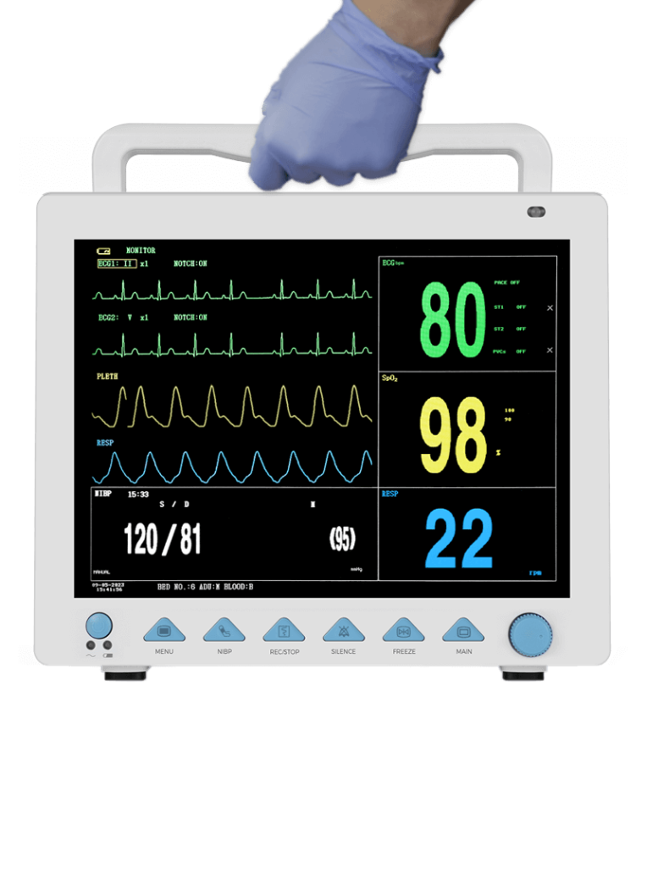
Precision-Gated Approximate-MAC FIR Filter
Dynamic DSP Architecture for Wearable Biomedical Devices
Divyansh Seth | B.Tech EEE | Pre-Final Year Project Review

Slide 2


The Power Problem in Wearable ECG Devices
Why Power Matters
⚡ High Power Draw
Wearable ECG devices run on small batteries. Continuous digital signal processing drains power rapidly, limiting clinical utility.
Full-precision MACs run continuously, even during low-information baseline intervals
🔋 Battery Constraint
Wearable form factor limits battery size — power budget is severely restricted
🎯 Key Opportunity
Not all ECG regions carry equal clinical importance — approximate computing can exploit this
FIR Filter
MAC Unit
Finite Impulse Response filter — removes noise from raw ECG signal using weighted sum of past samples
Multiply-Accumulate — the core arithmetic operation inside every FIR filter, executed thousands of times per second

Slide 3

Proposed Approach: Dynamic Bit-Truncation
The core idea is to adapt arithmetic precision based on the clinical importance of the ECG region being processed.
QRS Detection
Full-Precision MAC
Approximate MAC
Why This Works
During QRS: full 16-bit precision preserved. During baseline: lower bits truncated — expected reduction in switching activity and dynamic power.
The ECG baseline between beats carries minimal diagnostic information. Truncating least significant bits (LSBs) introduces only negligible error while significantly reducing switching activity inside the MAC unit.

Slide 4
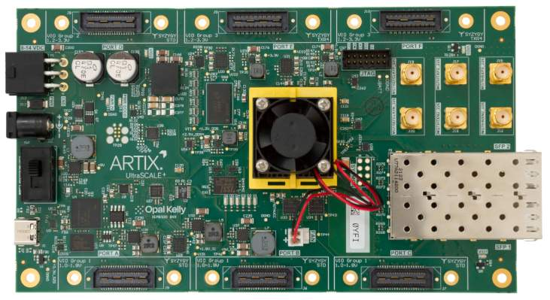
Planned Hardware Validation
Implementation Plan
01
AD8232 ECG Sensor
Analog front-end module captures real ECG signal from electrodes and outputs a clean analog waveform
02
FPGA Prototyping
Verilog RTL design synthesised on an FPGA — a reconfigurable hardware platform used to prototype digital circuits before chip fabrication

Slide 5
Syllabus Alignment
Module 4 — FIR Filters
Module 5 — DSP Architectures
Module 5 — Finite Word Length
Filter design theory, windowing methods, and frequency-domain specifications directly applied in the proposed architecture
Pipelined MAC structures, hardware-efficient arithmetic, and trade-offs in fixed-point DSP implementation
Quantisation noise, coefficient truncation effects, and precision-versus-power trade-offs — the theoretical basis for this project

Slide 6
Project Timeline
Weeks 1–2
1
Python reference model — simulate FIR filter, validate QRS detection, characterise precision requirements
2
Weeks 3–4
Verilog RTL — implement approximate MAC with dynamic bit-truncation logic and testbench verification
Weeks 5–6
3
FPGA synthesis — power and area analysis, real ECG signal validation with AD8232 sensor
All milestones are planned targets. Results will be reported honestly against defined metrics.
Thank You — Questions Welcome
Divyansh Seth | B.Tech EEE | Precision-Gated Approximate-MAC FIR Filter

