Slide 1
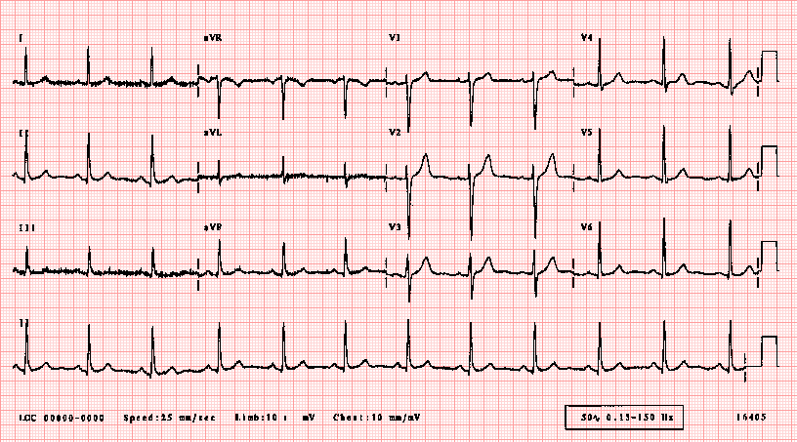
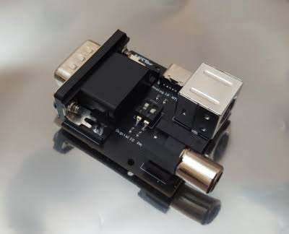
Precision-Gated Approximate-MAC FIR Filter
Dynamic DSP Architecture for Wearable Biomedical Devices
Divyansh Seth | B.Tech EEE | Pre-Final Year Project Review

Slide 2
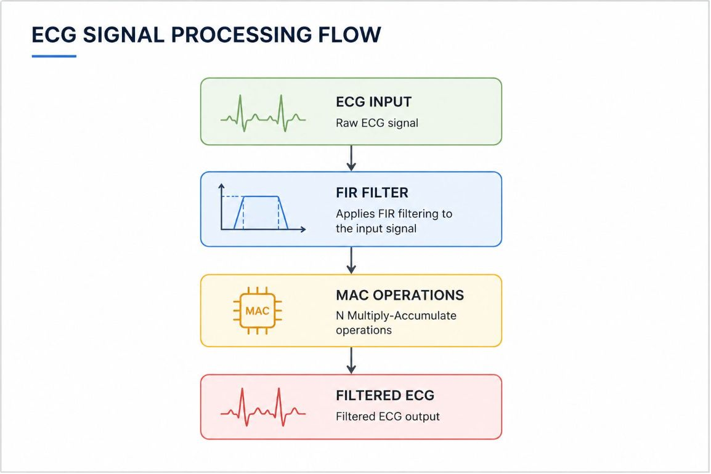

The Power Problem in Wearable ECG Devices
Wearable ECG devices run on small batteries. Continuous digital signal processing drains power rapidly, limiting clinical utility.
High Power Draw
Battery Constraint
Key Opportunity
Full-precision MACs run continuously, even during low-information baseline intervals
Wearable form factor limits battery size — power budget is severely restricted
Not all ECG regions carry equal clinical importance — approximate computing can exploit this
FIR Filter
Finite Impulse Response filter — removes noise from raw ECG signal using weighted sum of past samples
Every output sample requires N Multiply-Accumulate (MAC) operations, making the MAC unit the primary source of computational effort in FIR filtering.
MAC Unit
Multiply-Accumulate — the core arithmetic operation inside every FIR filter, executed thousands of times per second

Slide 3
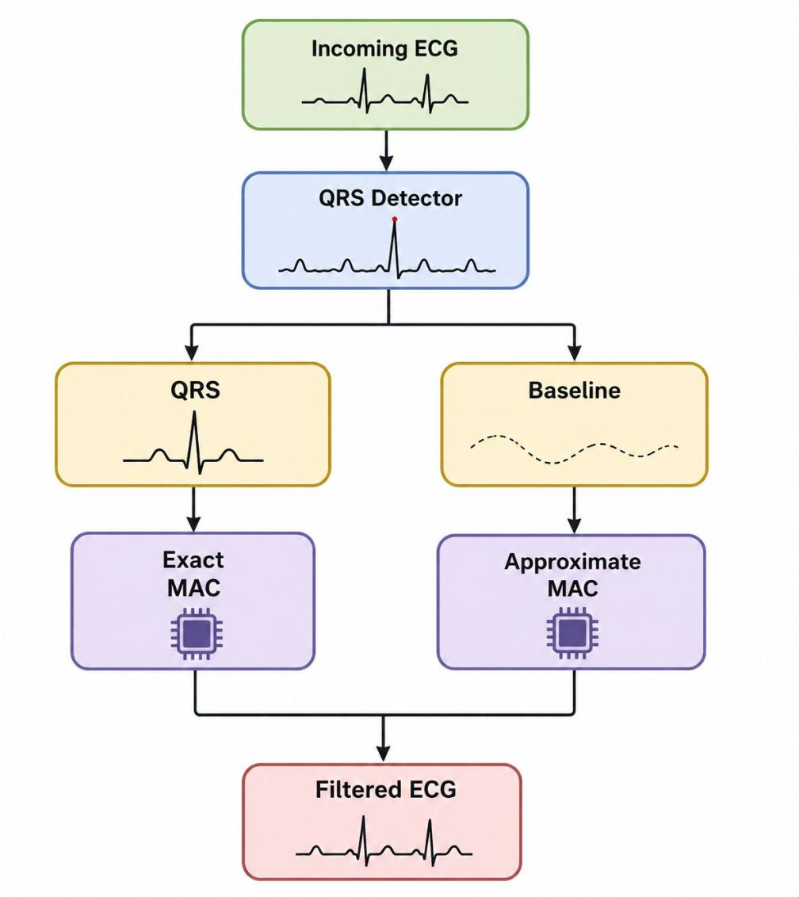

Proposed Approach: Dynamic Bit-Truncation
The core idea is to adapt arithmetic precision based on the clinical importance of the ECG region being processed.
A_{approx} = A >> k
where k = number of truncated least significant bits (LSBs).
Approximation is enabled only during low-information baseline intervals while full precision is maintained around the QRS complex.
The ECG baseline between beats carries minimal diagnostic information. Truncating least significant bits (LSBs) introduces only negligible error while significantly reducing switching activity inside the MAC unit.

Slide 4
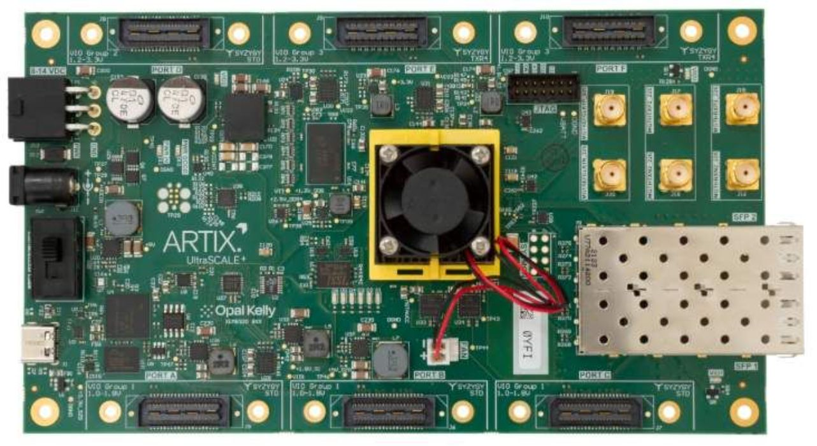
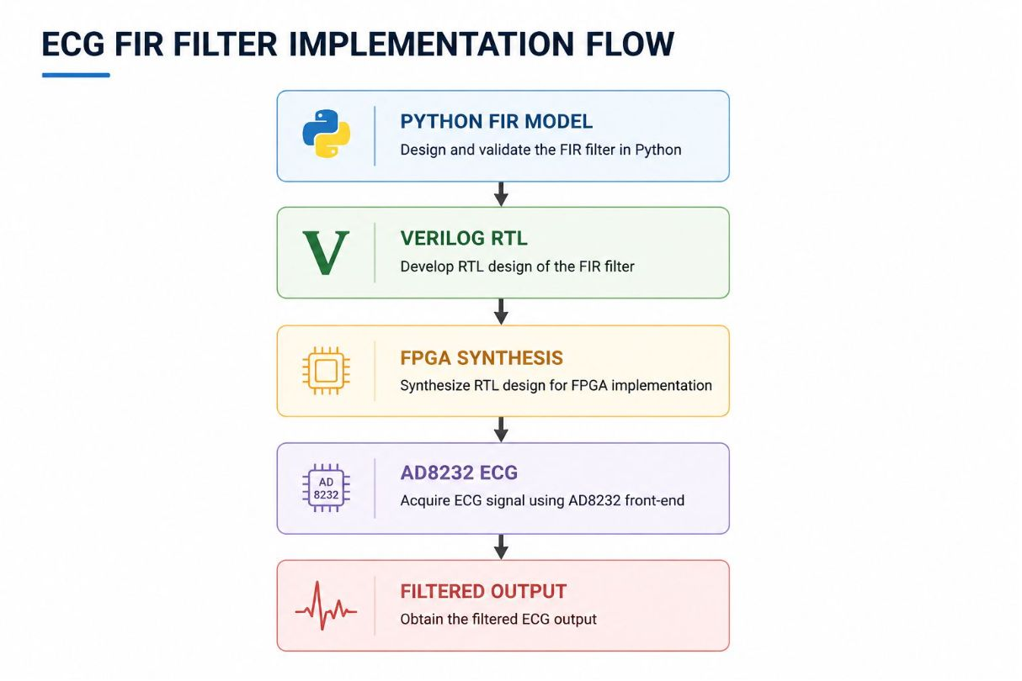


Planned Hardware Validation
Implementation Plan
AD8232 ECG Sensor
1
Analog front-end module captures real ECG signal from electrodes and outputs a clean analog waveform
FPGA Prototyping
2
Verilog RTL design synthesised on an FPGA — a reconfigurable hardware platform used to prototype digital circuits before chip fabrication

Slide 5

Syllabus Alignment
Module 4 — FIR Filters
Module 5 — DSP Architectures
Module 5 — Finite Word Length
Filter design theory, windowing methods, and frequency-domain specifications directly applied in the proposed architecture
Pipelined MAC structures, hardware-efficient arithmetic, and trade-offs in fixed-point DSP implementation
Quantisation noise, coefficient truncation effects, and precision-versus-power trade-offs — the theoretical basis for this project
P_{dynamic} = αCV²f
Dynamic bit-truncation aims to reduce switching activity (α ), thereby lowering dynamic power while maintaining ECG signal quality.

Slide 6
Project Timeline
Weeks 1–2
1
Phase 1
Python FIR reference model + ECG dataset validation — simulate FIR filter, validate QRS detection, characterise precision requirements
2
Weeks 3–4
Phase 2
Verilog RTL — implement approximate MAC with dynamic bit-truncation logic and testbench verification
Weeks 5–6
3
Phase 3
FPGA synthesis, timing, area and power analysis — real ECG signal validation with AD8232 sensor
Expected Deliverables
Functional Python model
Verified Verilog RTL
FPGA prototype
Initial power comparison
Live ECG demonstration
Thank You

