Slide 1


NEXT GEN EMPLOYABILITY PROGRAM
CREATING A FUTURE-READY WORKFORCE
Student Name :
Divyansh Jain
Student ID :
STU6456a7b888a671683400632
Mobile No:
9599433616
College Name :
Mail ID:
divyanshjain1508@gmail.com
Trinity Institute of Technology & Research

Slide 2
CAPSTONE PROJECT SHOWCASE
Project Title
Power BI Enabled Comprehensive Analysis of
Unicorn Companies
Abstract | Problem Statement | Project Overview | Proposed Solution | Technology Used | Modelling & Results | Conclusion | Q&A

Slide 3
Abstract
1
Data Visualization: Power BI allows visualizing complex data
2
Performance Metrics: Analyze unicorn companies’ financials, growth, and market position.
3
Predictive Analytics: Forecast future trends and identify opportunities.
4
Competitive Benchmarking: Compare unicorn companies within the industry

Slide 4


Problem Statement
How many unicorn companies have emerged in the past 10 years?
What is the total investment raised by these companies?
What is the overall valuation of unicorn companies?
What is the average growth time from establishment to becoming a unicorn in each region?
Which countries dominate in terms of the number and valuation of unicorn companies?
Which industries attract the most investment (top 3 industries)?
When did the investment boom occur in the past decade?

Slide 5

Project Overview
Data Collection: Gather data on unicorn companies from reliable sources.
Data Preparation: Cleanse, transform, and structure the dataset for analysis.
Exploratory Analysis:
Visualize unicorn companies’ emergence over time.
Identify geographical concentrations of unicorns.
Explore funding patterns and valuation trends.
Interactive Dashboards: Create interactive Power BI dashboards for real-time insights.
Predictive Analytics: Forecast future growth and identify potential unicorns.
Industry Benchmarking: Compare unicorn companies within specific sectors.
Reporting: Summarize findings and actionable recommendations.

Slide 6
Proposed Solution
Our objective is to gain actionable insights into the world of unicorn companies—startups valued at over $1 billion. By leveraging Power BI, we’ll explore trends, financials, and market positioning of these exclusive businesses.
Number of Unicorns: How many unicorn companies emerged in the past decade?
Total Funding: What is the cumulative investment raised by these companies?
Valuation: What is the overall valuation of unicorn companies?
Growth Time: What is the average time from establishment to unicorn status in each region?
Dominant Countries: Which countries lead in terms of unicorn count and valuation?
Top Industries: Which industries attract the most investment?
Investment Boom: When did the investment surge occur in the past decade?

Slide 7
Technology used
Power BI

Slide 8
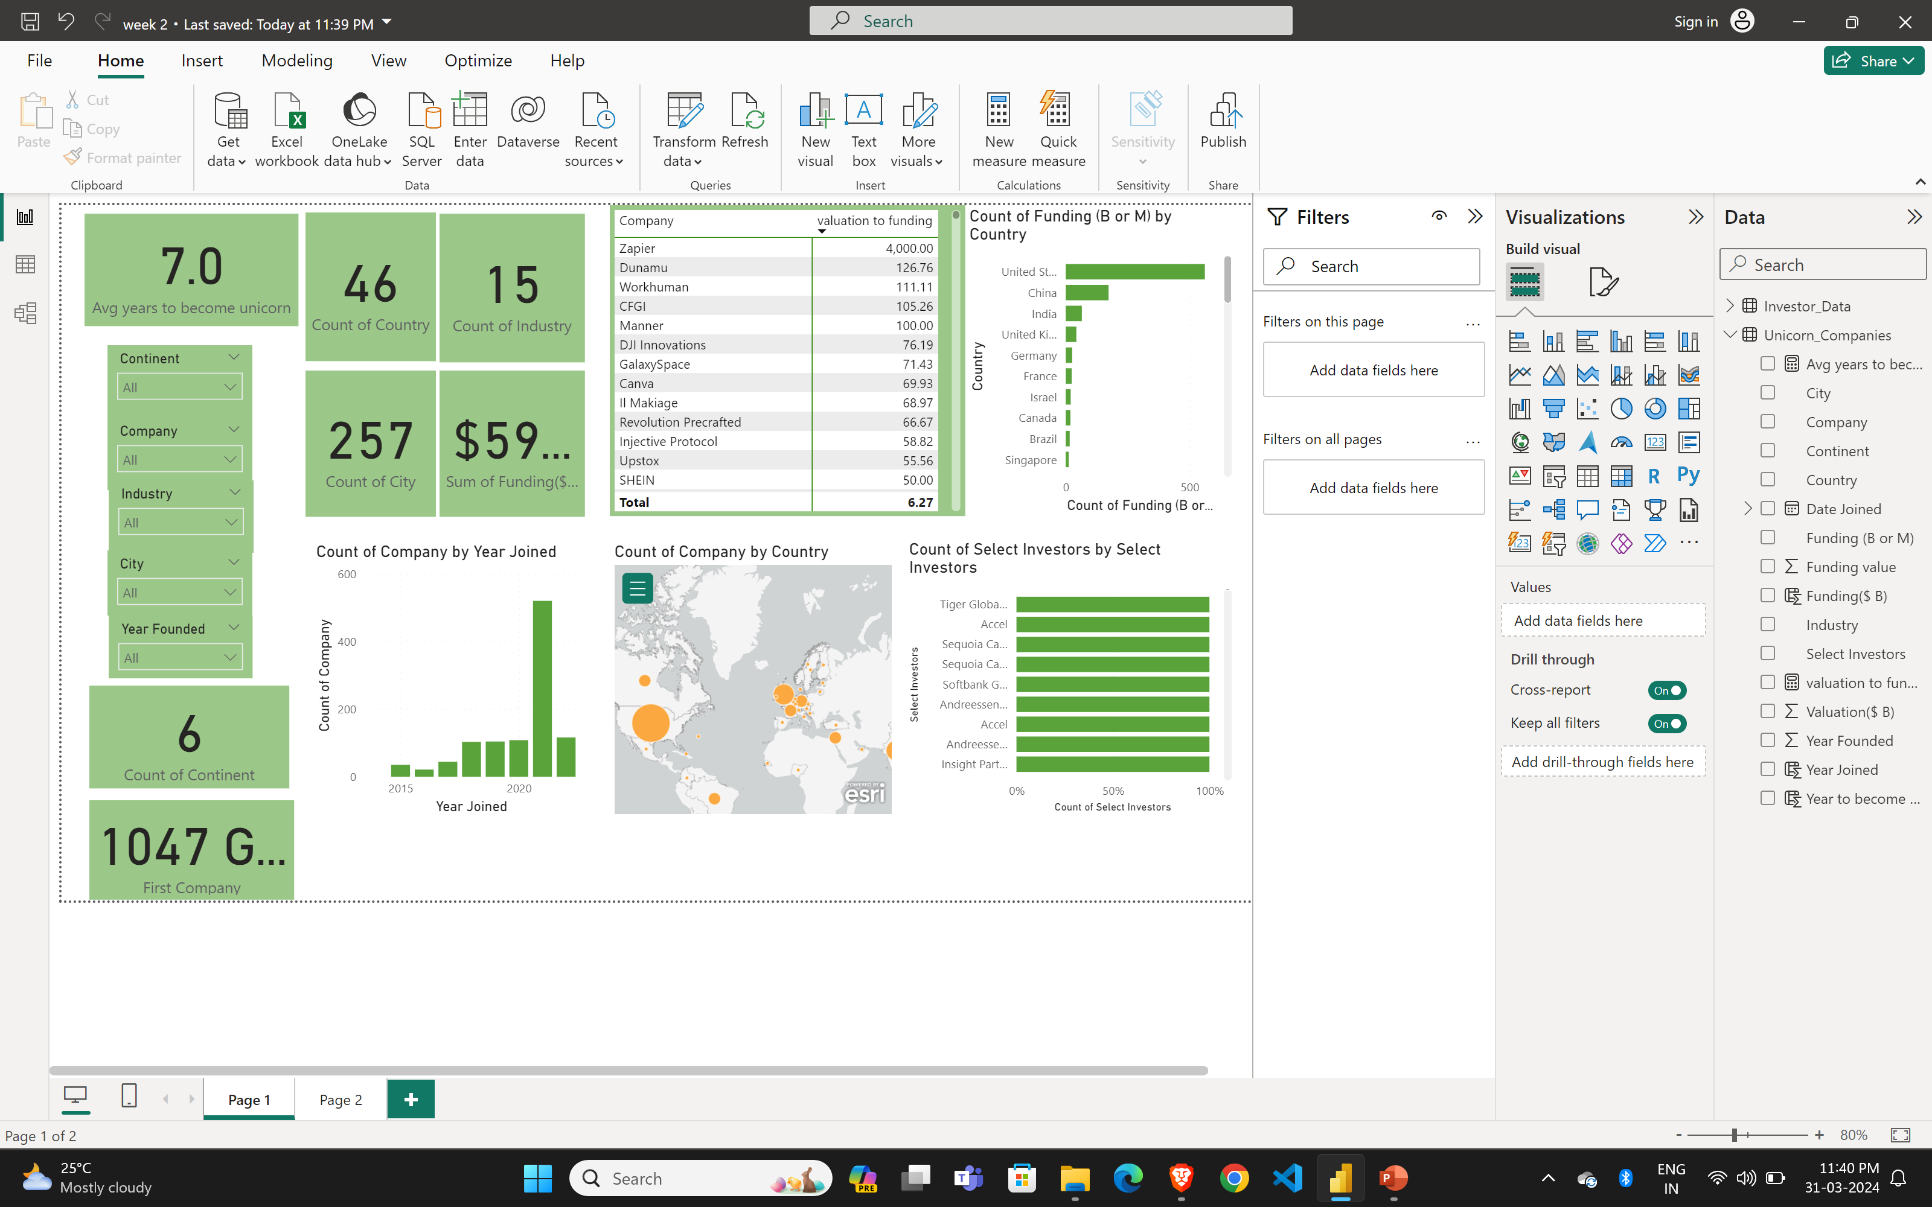
Modelling & Result

Slide 9

Conclusion
This project was not just an exercise in data analysis but also a deep dive into the dynamic world of high-value startups. The insights gained from this Power BI analysis are invaluable for understanding the evolving patterns in the investment world.
By leveraging Power BI, we’ve unveiled trends, identified key metrics, and provided actionable recommendations for investors, policymakers, and industry leaders. As unicorn companies continue to shape the global economy, this analysis serves as a powerful tool for strategic decision-making and fostering innovation

Slide 10


Notes:
Thank You !!

