Slide 1
Gesture Play
Submitted by:
Karan Srivastava 18BCS1130
Divyansh Sachan 18BCS2265

Slide 2
ABSTRACT
We have created a low cost system which uses dynamic hand gesture recognition technique to control the VLC media player. This application contains a central computation module which segments the foreground part of the frame using skin detection and approximate median technique. The recognition of gesture is done by creating a Decision Tree, that uses various features extracted from the segmented part. This hand gesture recognition technique introduces a new, natural way to interact with computers.

Slide 3
INTRODUCTION
The project “Gesture Play” is a python based application designed to provide assistance to user while a media player like VLC or windows media player to use functionalities of a media player like pause, un-pause, mute, unmute, skip forward, skip backwards etc with hand signs or gestures without pressing any buttons. The projects makes use of machine learning and image recognition technology to detect various hand signs made by the user and perform functions accordingly

Slide 4
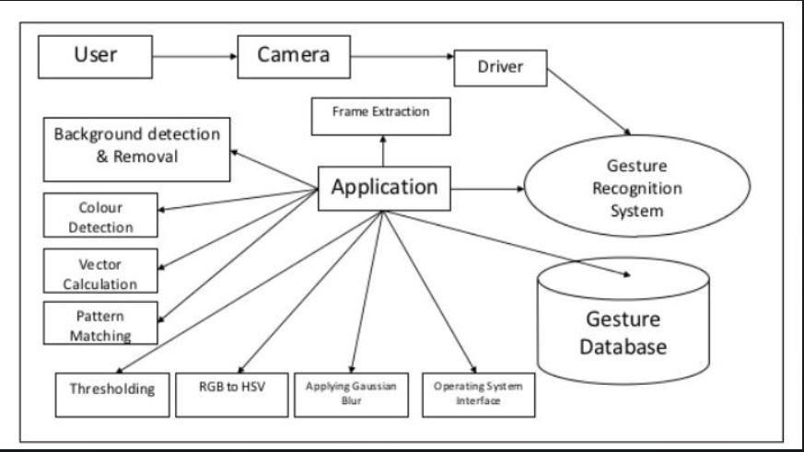
BLOCK DIAGRAM

Slide 5
METHODOLOGY
Preprocessing
Gesture registration
Gesture extraction
Gesture classification

Slide 6
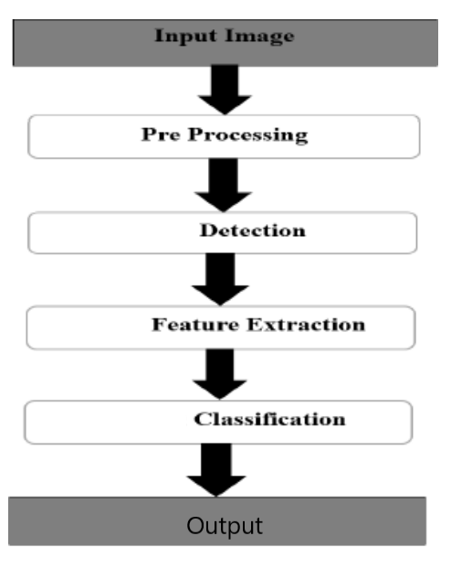
FLOWCHART

Slide 7
CONCLUSION
We have developed a software project named “Gesture Play” which implements image processing using OpenGV using python to create a more natural way to interact with computers.

Slide 8
THANK YOU

