Slide 1


RCB IPL Analysis
Prepared by: Divyansh Singh Rathaur Batch: Dec 2024

Slide 2

Content Overview
Introduction
Objectives with Problem Statement
Data Overview
Methodology
Analysis & Key finding
Strategic Recommendations
Conclusion

Slide 3
Introduction
The Royal Challengers Bangalore (RCB) has been a competitive franchise in the IPL. The analysis focuses on understanding the team's past performance, identifying key players, and optimizing strategies for better results in upcoming seasons.
Key Focus Areas:
Performance analysis across multiple IPL seasons.
Identifying high-performing players based on both batting and bowling metrics.
Analyzing home ground advantage and key matches.

Slide 4

Objectives
To Provide actionable roadmap for RCB in Mega Auction 2017
To analyze Top performers
To find the Reliable Players

Slide 5
Problem Statement
You are hired as a sports data analyst by RCB where the team is looking for top-performing and reliable players to win tournaments, considering both on-field performance and value for money in mega player auction of 2017. Your task is to come up with strategies/suggestions regarding selecting the best-performing players and optimizing player auction investments.

Slide 6
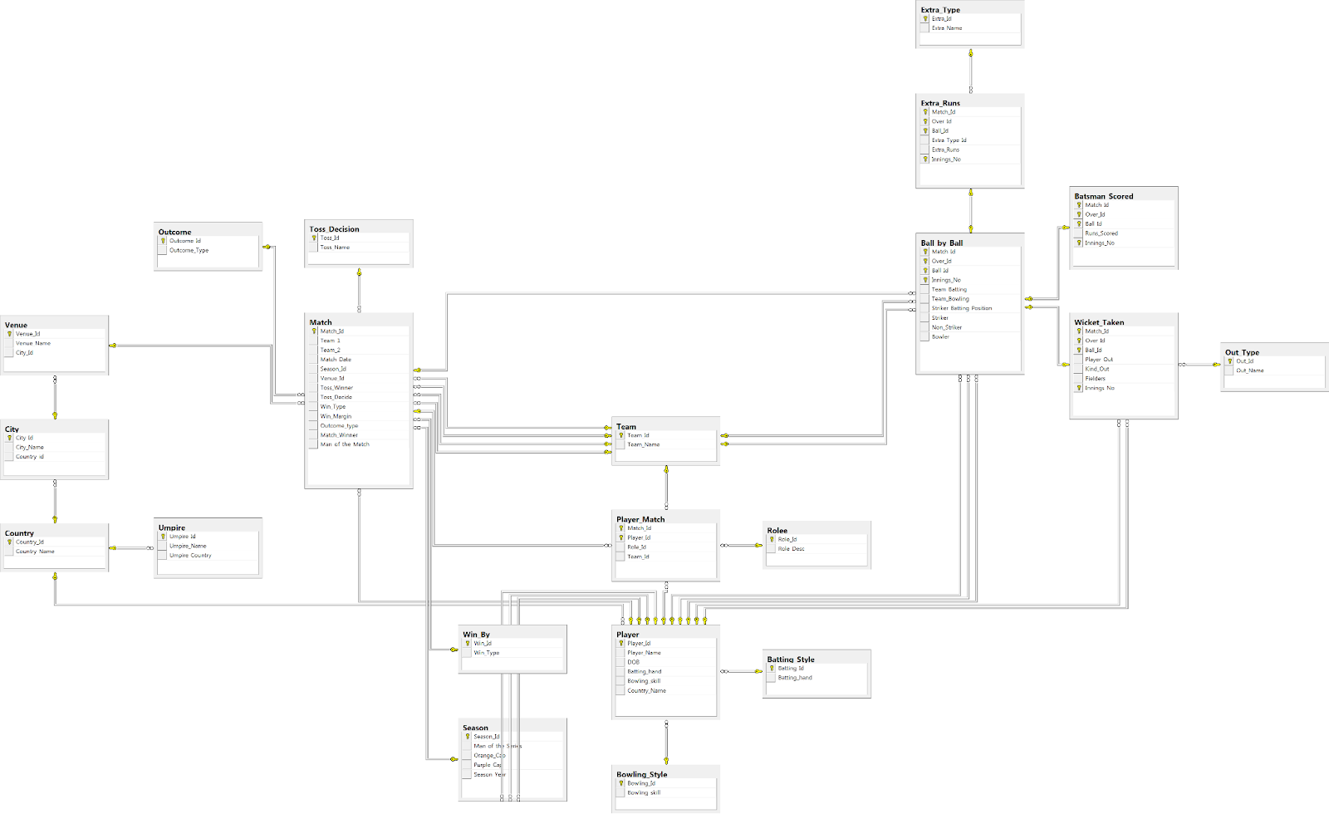
DATABASE SCHEMA

Slide 7
Data Overview
Data Source:
IPL dataset (various tables like matches, player, team, batsman_scored, ball_by_ball).
Key Metrics Analyzed:
Batting performance: Total runs, strike rate, boundaries.
Bowling performance: Wickets taken, economy rate, bowling effectiveness.
Player versatility: Contributions in both batting and bowling.
Team performance: Match wins, home ground impact.
Tools Used:
SQL Workbench for data querying and extraction.
Excel for visualization and in-depth analysis.

Slide 8
Methodology
Step 1:
Data Extraction and preprocessing. Using SQL queries to aggregate batting and bowling performance metrics for individual players.
Identifying player versatility by calculating metrics like strike rate, economy rate, and player impact.
Step 2:
Player Performance Analysis.
Step 3:
Team-Level Insights. Analyzing home ground performance to understand the impact of venue on match outcomes.
Step 4:
Recommendations and Strategic Decisions.
Formulating recommendations for RCB based on data-driven insights from player performance and team dynamics.

Slide 9
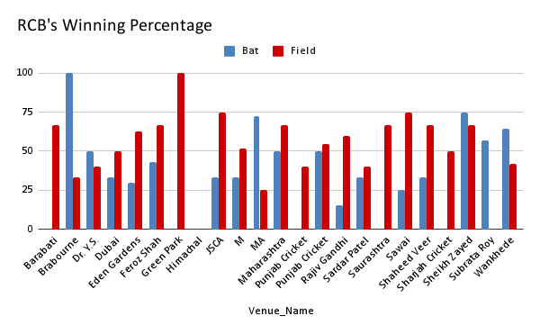
Analysis & Key finding
Home Ground Performance
Analysis:
RCB’s venue-wise winning records.
Insights:
RCB’s home win percentage fluctuates between seasons, highlighting the need for tactical adjustment at home.
RCB has had better results in chasing games at home, with a strong batting lineup taking advantage of the pitch.

Slide 10
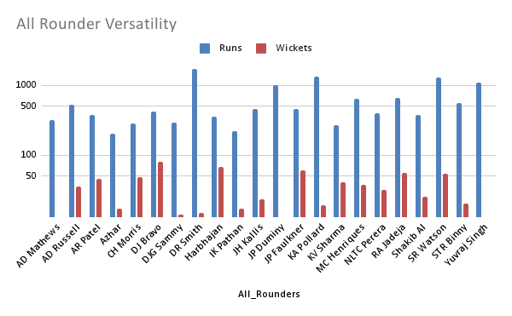
Analysis & Key finding
Player Versatility with both bat and ball
Analysis:
All rounders performing up to the mark.
Insights:
There are few players who has performed consistently
with bat as well as ball.
RCB should try and bag these players in the mega auction
like Andre Russel, Shane Watson and DJ Bravo.

Slide 11
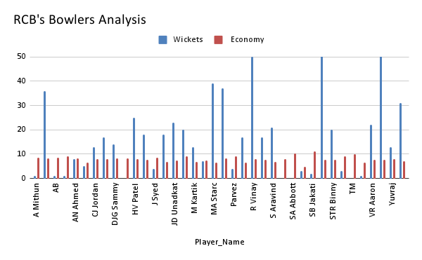
Analysis & Key finding
Bowlers and Economy rate
Analysis:
The wicket-takers in RCB and their Economy.
Insights:
RCB has only few bowlers with an economy lesser that 7
RCB has a lot of wicket takers in form of Yuzi Chahal ,
Harshal Patel if they train them and acquire economy wise.
By improving this RCB can improve the death bowling which can eventually result as a maiden title as well.

Slide 12
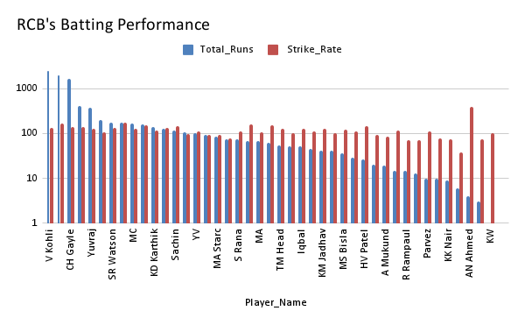
Analysis & Key finding
Batsmen and their performance
Analysis:
RCB’s Batsman and their strike-rate along
with average over the previous seasons.
Insights:
RCB is little too much dependent over the top order.
RCB needs more batters who can score consistently along with a good strike-rate.

Slide 13
Strategic Recommendations
Home Ground Advantage Utilization
Insight:
M. Chinnaswamy Stadium has a reputation as a high-scoring venue, favoring teams with explosive batsmen.
Recommendation:
Strengthen batting depth with power hitters .
RCB should consider chasing more often at home, as they have historically had higher success rates when batting second.

Slide 14
Strategic Recommendations
Prioritize Versatile All-rounders
Insight:
Players who contribute with both bat and ball have a significant impact on team flexibility, particularly in the T20 format.
Recommendation:
Focus on acquiring or retaining versatile all-rounders A D Russel, G Maxwel etc who can adapt to both offensive and defensive roles.
Use versatile players strategically during critical overs to either consolidate batting or break partnerships with bowling.

Slide 15
Strategic Recommendations
Auction Strategy
Insight:
RCB needs to Revamp the batting as well as bowling attack.
Recommendation:
RCB should acquire batsmen with great strike rate to increase the batting depth.
The bowling attack should have some economical bowlers who can slow down the pace of game and take important wickets.

Slide 16
Conclusion
By focusing on building a team around versatile players, economical bowlers, RCB can address the key challenges that have been a problem in past seasons.
Leveraging the home ground advantage, particularly with explosive batting and better bowling attack will increase the qualifying chances.
Strategic acquisition and nurturing of match winners in both batting and bowling is necessary other than the Top performing players currently.
The successful execution these strategies can help RCB lift the Title.

Slide 17
THANKYOU

