Slide 1
AUTONOMOUS PRODUCTION CHOKE CONTROLLER
Problem Statement ID - Honeywell Hackathon, Problem 3A
Problem Statement Title - Autonomous Production Choke Controller for a Single Naturally Flowing Oil Well
Theme - Industrial Process Control / Oil & Gas Automation
PS Category - Software
Student Name - Divyansh Gupta (VIT Vellore)

Slide 2
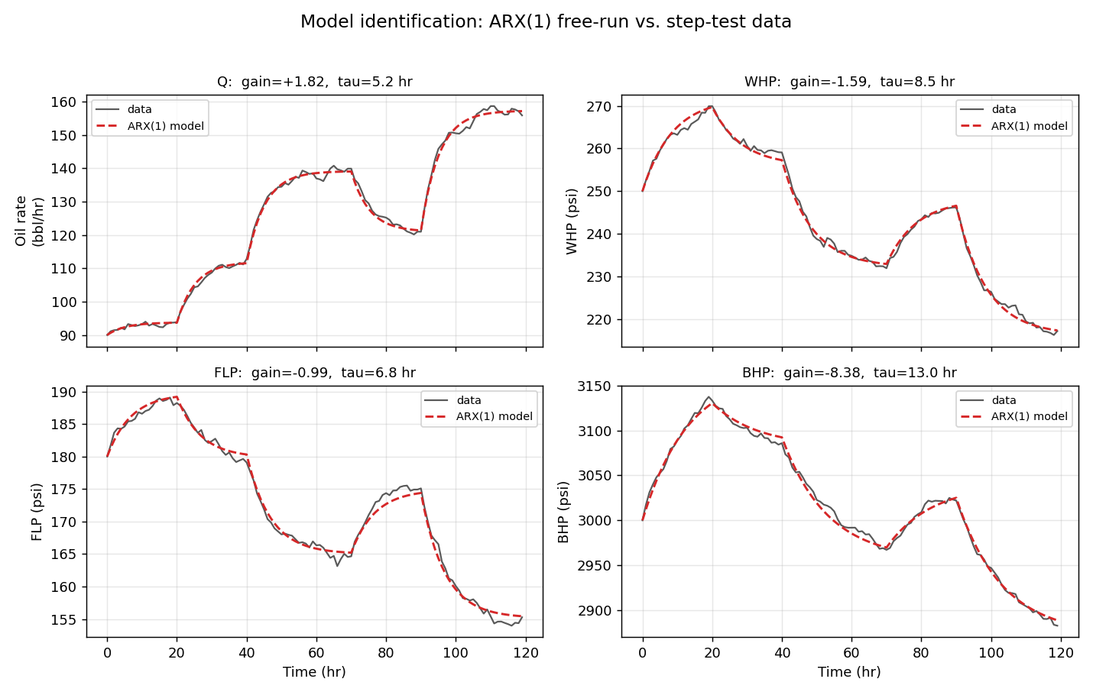
PROCESS UNDERSTANDING & MODEL
Step test: 120 hr open-loop, choke 30->40->55->45->65 %, Ts = 1 hr
Response is first-order (time constant ~5 hr on oil rate), mild noise
Opening choke RAISES oil rate but LOWERS WHP / FLP / BHP
=> the binding safety constraints are LOWER pressure bounds
Model assumptions: first-order + linear; single naturally flowing well
(no gas lift/ESP, constant reservoir & GOR); envelope limits documented
Model: ARX(1) per output by least squares
y[k+1] = a.y[k] + (1-a)(b0 + b1.u[k]); free-run fit 1.5-2.4 % of span
Identified steady-state gains (per % choke):
Q +1.82 bbl/hr WHP -1.59 FLP -0.99 BHP -8.38 psi

Slide 3
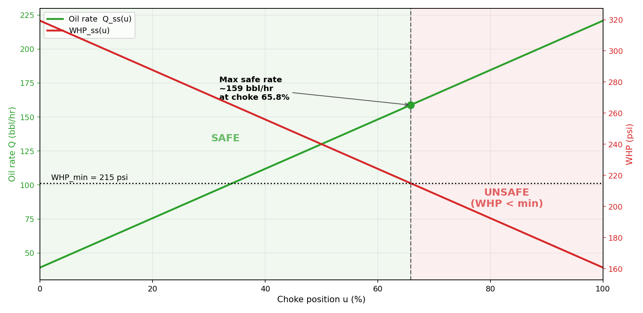
CONTROL STRATEGY
Simplified MPC by brute-force candidate search (per brief)
Each hour, enumerate choke +/- up to 5 % (ramp-feasible, fine grid)
Predict each candidate's pressures over a settling horizon + steady state
REJECT any move predicted to breach WHP/FLP/BHP + safety margin
Among safe moves, minimise (Q_ss - target)^2 + lambda.(delta choke)^2
Infeasible target => same cost settles at the highest safe rate
Monotonic first-order response: steady-state feasibility proves the
whole trajectory safe -> safe-by-construction, 0 violations

Slide 4
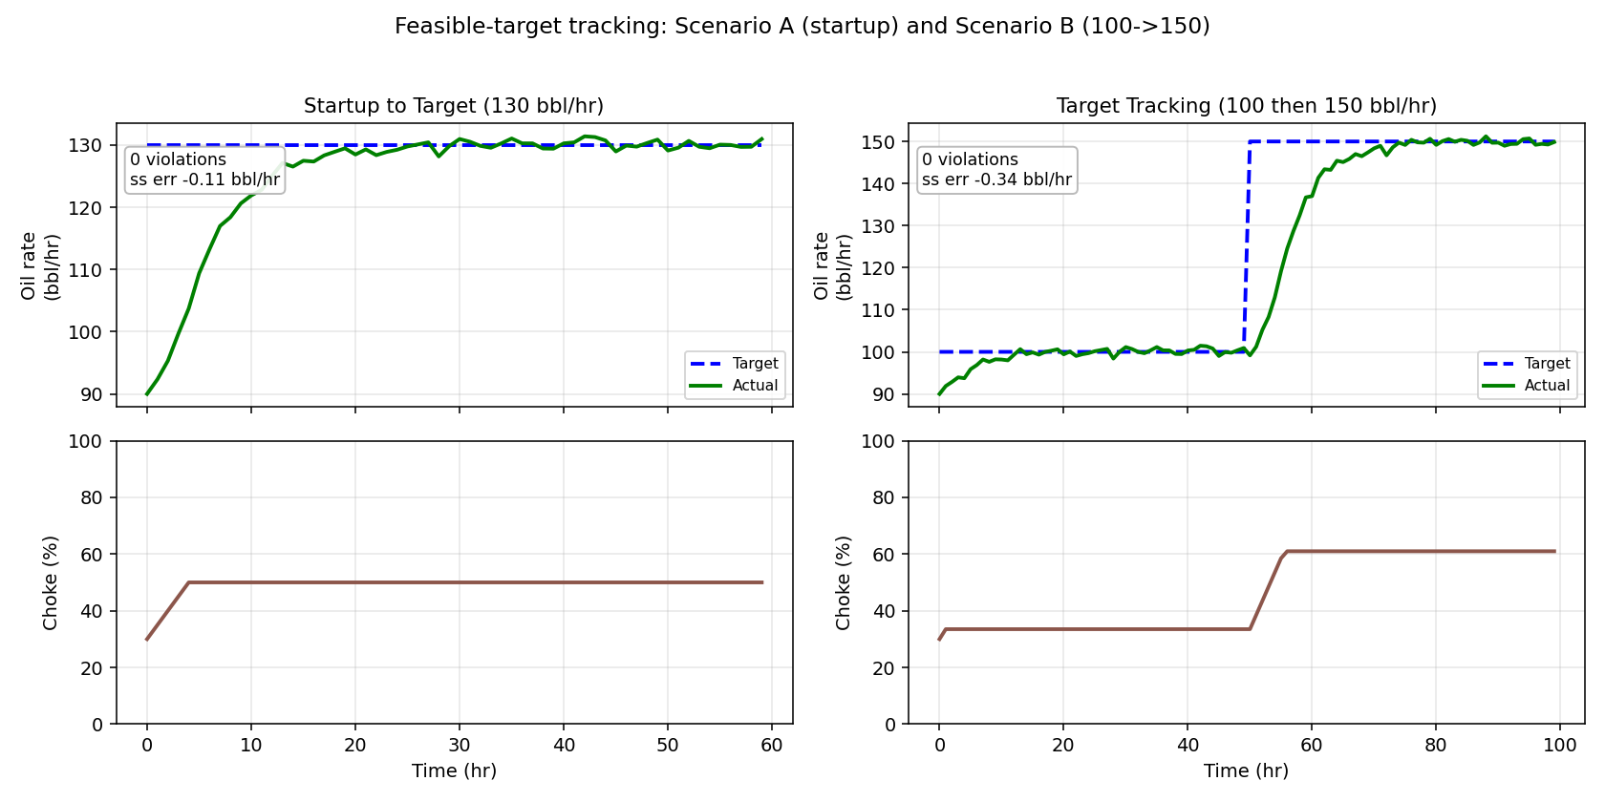
RESULTS - TARGET TRACKING (A & B)
Scenario A - Startup -> 130 bbl/hr
settles 129.9 bbl/hr, steady-state error -0.11, 0 violations
Scenario B - Target step 100 -> 150 bbl/hr
settles 149.7 bbl/hr, steady-state error -0.34, 0 violations
Pressures stay inside the envelope throughout
Choke moves are smooth and respect the +/-5 %/step ramp limit

Slide 5
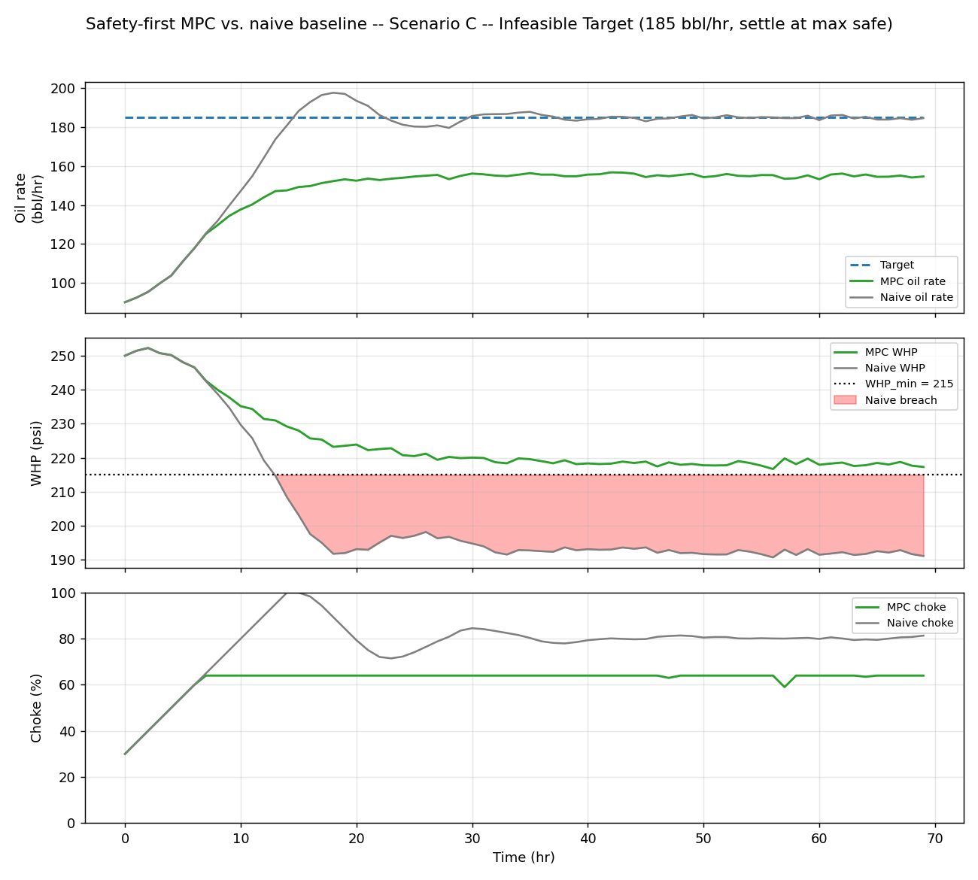
SAFETY PERFORMANCE & LESSONS LEARNED
Scenario C - infeasible 185 bbl/hr: controller REFUSES,
settles at max safe 154.9 bbl/hr with 0 violations
Robust: 0 violations under +/-20% plant mismatch, unmeasured
disturbances and 2x noise (22-case stress study, robustness.py)
Lessons learned:
Binding constraint is a lower pressure bound, not an upper rate cap
Monotonicity makes a cheap brute-force MPC provably safe
Model error costs production, never safety - margin is the dial
0
168
MPC violations (A/B/C)
naive-baseline breaches on C

Slide 6
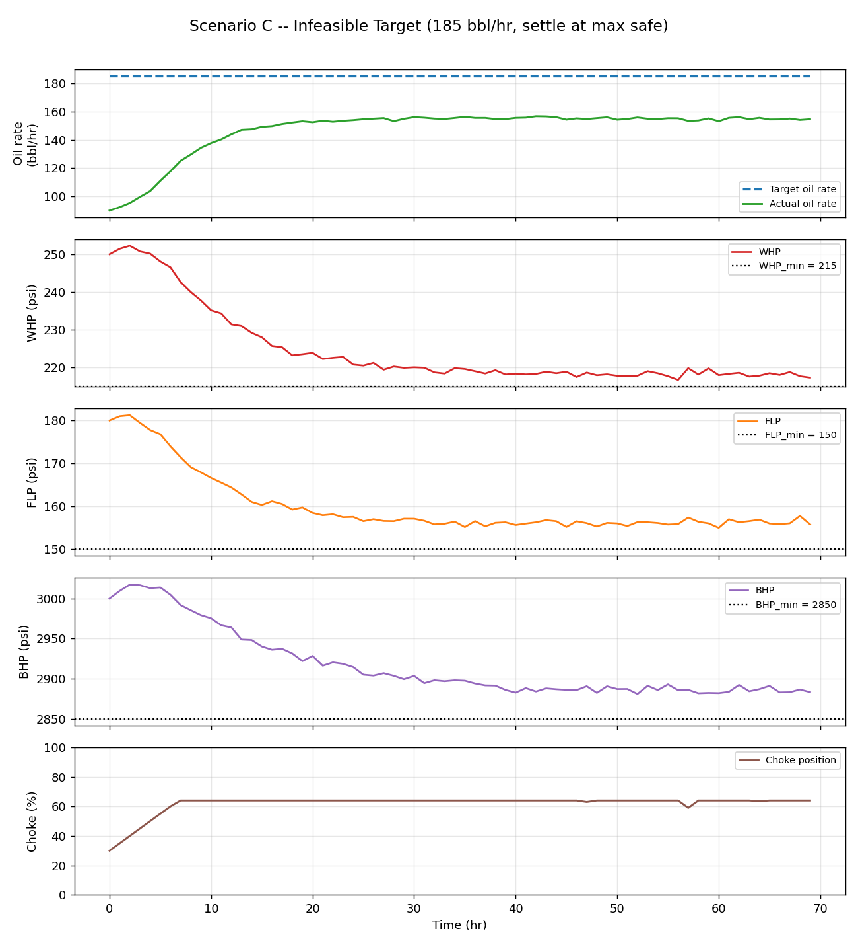
ARTIFACTS & REFERENCES
Code (flat Python modules at repo root):
dataio, model_id, envelope, simulator, controller, plotting, scenarios, main
Executed Jupyter notebook + technical report.md + results/ (plots, metrics.json)
Live dashboard: streamlit run app.py (scenario presets, per-step
MPC diagnostics: candidates rejected as unsafe, WHP margin)
Robustness: python robustness.py (22 stress cases: noise, +/-20%
mismatch, unmeasured disturbances)
Run: pip install -r requirements.txt && python main.py
main.py asserts 0 envelope violations across A/B/C
Simulator stand-in shares the official .step(choke)->(Q,WHP,FLP,BHP)
signature -> the real event simulator drops in with a one-line change
Repo: github.com/Divyansh2602/autonomous-choke-controller
References: least-squares system identification (Ljung); simplified
MPC by brute-force candidate evaluation (Honeywell brief)
Required 6-trend plot (Scenario C shown)

