Slide 1

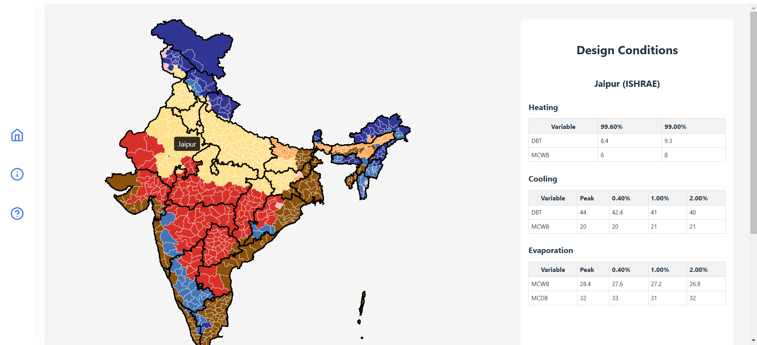
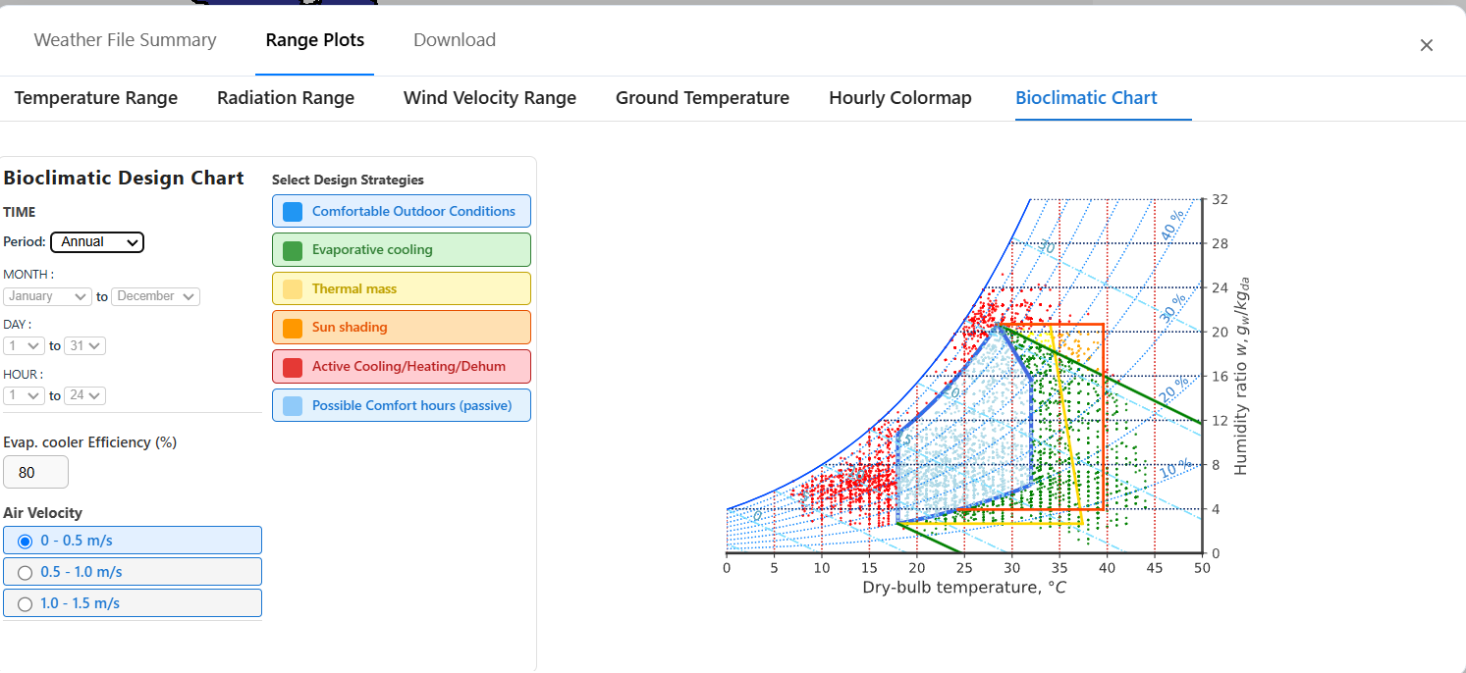
Indian Climate Analysis
Divyansh Vijayª, Prof. Jyotirmay Mathur^{b}
ª Department of Computer Science and Engineering, SVNIT
^{b} Centre for Energy and Environment, MNIT Jaipur
To develop an interactive web-based tool that visualizes district-level climate data of India with weather analysis and passive design strategy evaluation to support climate responsive building design.
1.Data Collection: Gathered district-wise climate data from ISHRAE, ASHRAE, and COLBE.
2.Climate Zoning: Classified districts into climate zones based on temperature and humidity.
3.Web Platform Development: Built an interactive map-based platform with graphs, charts, and data downloads.
4. Analysis & Visualization:
Enabled parametric weather trends, psychrometric chart analysis, and passive strategy overlays.
Objective:
Methodology:
Output
1. Interactive Climate Visualisation:
District-wise graphs and psychrometric charts for weather analysis.
2. Passive Design Strategy Overlay:
Real-time overlays for optimizing comfort and energy efficiency.
Key Features
The tool enables easy access to district-wise climate data and visualizes passive design strategies, helping users make climate-responsive building decisions. It supports sustainable design by combining real data with interactive analysis.
Conclusion
https://github.com/Divyansh2992/epw2.git

Slide 2
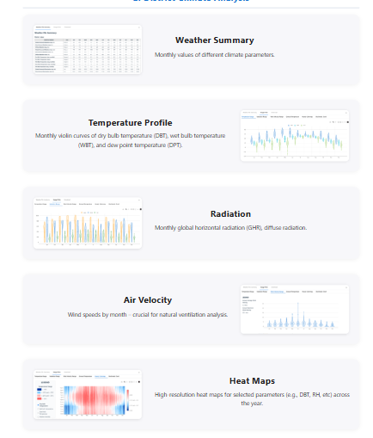
Indian Climate Analysis
Divyansh Vijayª, Prof. Jyotirmay Mathur^{b}
ª Department of Computer Science and Engineering, SVNIT
^{b} Centre for Energy and Environment, MNIT Jaipur
To develop an interactive web-based tool that visualizes district-level climate data of India with weather analysis and passive design strategy evaluation to support climate responsive building design.
1. Data Collection:
Gathered district-wise climate data from ISHRAE, ASHRAE, and COLBE.
2. Climate Zoning:
Classified districts into climate zones based on temperature and humidity.
3. Web Platform Development:
Built an interactive map-based platform with graphs, charts, and data downloads.
4. Analysis & Visualisation:
Enabled parametric weather trends, psychrometric chart analysis, and passive strategy overlays.
Objective:
Methodology:
1. Interactive Climate Visualisation:
District-wise graphs and psychrometric charts for weather analysis.
2. Passive Design Strategy Overlay:
Real-time overlays for optimizing comfort and energy efficiency.
Key Features
The tool enables easy access to district-wise climate data and visualizes passive design strategies, helping users make climate-responsive building decisions. It supports sustainable design by combining real data with interactive analysis.
Conclusion
https://github.com/Divyansh2992/epw2.git

Slide 3
To develop an interactive web-based tool that visualizes district-level climate data of India with weather analysis and passive design strategy evaluation to support climate responsive building design.
1. Data Collection:
Gathered district-wise climate data from ISHRAE, ASHRAE, and COLBE.
2. Climate Zoning:
Classified districts into climate zones based on temperature and humidity.
3. Web Platform Development:
Built an interactive map-based platform with graphs, charts, and data downloads.
4. Analysis & Visualisation:
Enabled parametric weather trends, psychrometric chart analysis, and passive strategy overlays.
Objective:
Methodology:
Indian Climate Analysis
Divyansh Vijayª, Prof. Jyotirmay Mathur^{b}
ª Department of Computer Science and Engineering, SVNIT
^{b} Centre for Energy and Environment, MNIT Jaipur
1. Interactive Climate Visualisation:
District-wise graphs and psychrometric charts for weather analysis.
2. Passive Design Strategy Overlay:
Real-time overlays for optimizing comfort and energy efficiency.
Key Features
The tool enables easy access to district-wise climate data and visualizes passive design strategies, helping users make climate-responsive building decisions. It supports sustainable design by combining real data with interactive analysis.
Conclusion
https://github.com/Divyansh2992/epw2.git

Slide 4
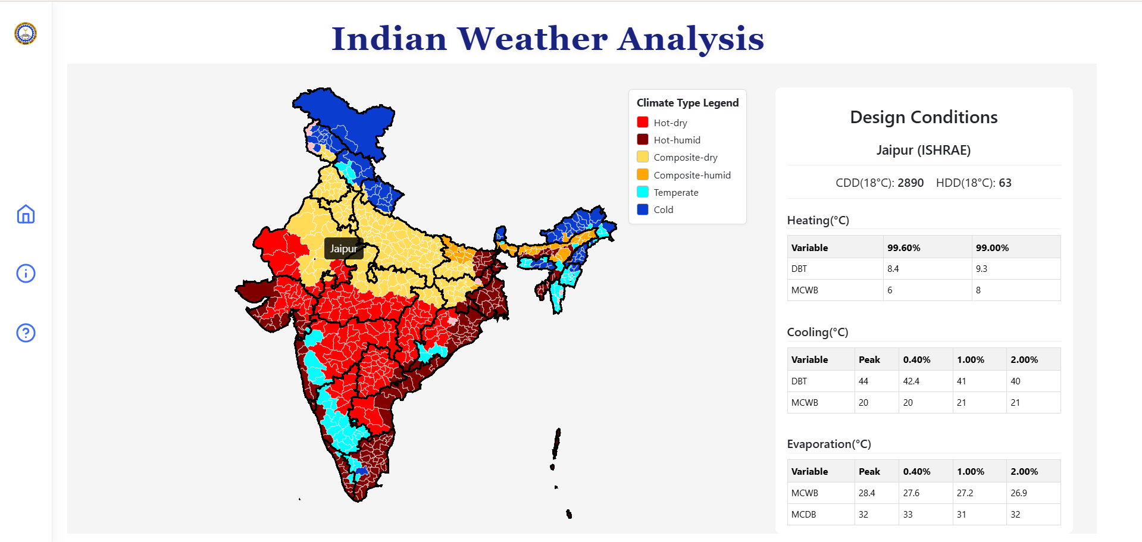
Indian Climate Analysis
Divyansh Vijayª, Prof. Jyotirmay Mathur^{b}
ª Department of Computer Science and Engineering, SVNIT
^{b} Centre for Energy and Environment, MNIT Jaipur
To develop an interactive web-based tool that visualizes district-level climate data of India with weather analysis and passive design strategy evaluation to support climate responsive building design.
1. Data Collection:
Gathered district-wise climate data from ISHRAE, ASHRAE, and COLBE.
2. Climate Zoning:
Classified districts into climate zones based on temperature and humidity.
3. Web Platform Development:
Built an interactive map-based platform with graphs, charts, and data downloads.
4. Analysis & Visualisation:
Enabled parametric weather trends, psychrometric chart analysis, and passive strategy overlays.
Objective
Methodology:
1. Interactive Climate Visualisation:
District-wise graphs and psychrometric charts for weather analysis.
2. Passive Design Strategy Overlay:
Real-time overlays for optimizing comfort and energy efficiency.
Key Features
1.Shows regional climate classifications across India.
2.Displays temperature, radiation, wind, and more.
3.Psychrometric Chart
The tool enables easy access to district-wise climate data and visualizes passive design strategies, helping users make climate-responsive building decisions. It supports sustainable design by combining real data with interactive analysis.
Conclusion
https://github.com/Divyansh2992/epw2.git

Slide 5
Indian Climate Analysis
Divyansh Vijayª, Prof. Jyotirmay Mathur^{b}
ª Department of Computer Science and Engineering, SVNIT
^{b} Centre for Energy and Environment, MNIT Jaipur
To develop an interactive web-based tool that visualizes district-level climate data of India with weather analysis and passive design strategy evaluation to support climate responsive building design.
1. Data Collection:
Gathered district-wise climate data from ISHRAE, ASHRAE, and COLBE.
2. Climate Zoning:
Classified districts into climate zones based on temperature and humidity.
3. Web Platform Development:
Built an interactive map-based platform with graphs, charts, and data downloads.
4. Analysis & Visualisation:
Enabled parametric weather trends, psychrometric chart analysis, and passive strategy overlays.
Objective
Methodology
1. Interactive Climate Visualisation:
District-wise graphs and psychrometric charts for weather analysis.
2. Passive Design Strategy Overlay:
Real-time overlays for optimizing comfort and energy efficiency.
Key Features
1.Shows regional climate classifications across India.
2.Displays temperature, radiation, wind, and more.
3.Psychrometric Chart
The tool enables easy access to district-wise climate data and visualizes passive design strategies, helping users make climate-responsive building decisions. It supports sustainable design by combining real data with interactive analysis.
Conclusion
https://github.com/Divyansh2992/epw2.git

Slide 6
Indian Climate Analysis
Divyansh Vijayª, Prof. Jyotirmay Mathur^{b}
ª Department of Computer Science and Engineering, SVNIT
^{b} Centre for Energy and Environment, MNIT Jaipur
To develop an interactive web-based tool that visualizes district-level climate data of India with weather analysis and passive design strategy evaluation to support climate responsive building design.
1. Data Collection:
Gathered district-wise climate data from ISHRAE, ASHRAE, and COLBE.
2. Climate Zoning:
Classified districts into climate zones based on temperature and humidity.
3. Web Platform Development:
Built an interactive map-based platform with graphs, charts, and data downloads.
4. Analysis & Visualisation:
Enabled parametric weather trends, psychrometric chart analysis, and passive strategy overlays.
Objective
Methodology
1. Interactive Climate Visualisation:
District-wise graphs and psychrometric charts for weather analysis.
2. Passive Design Strategy Overlay:
Real-time overlays for optimizing comfort and energy efficiency.
Key Features
1.Shows regional climate classifications across India.
2.Displays temperature, radiation, wind, and more.
3.Psychrometric Chart
The tool enables easy access to district-wise climate data and visualizes passive design strategies, helping users make climate-responsive building decisions. It supports sustainable design by combining real data with interactive analysis.
Conclusion
https://github.com/Divyansh2992/epw2.git

Slide 7
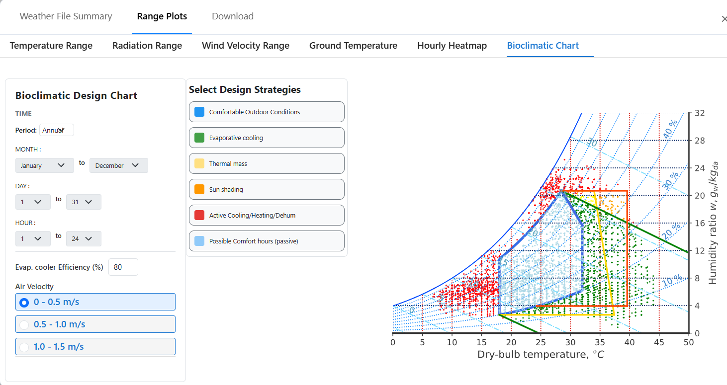
Indian Climate Analysis
Divyansh Vijayª, Prof. Jyotirmay Mathur^{b}
ª Department of Computer Science and Engineering, SVNIT
^{b} Centre for Energy and Environment, MNIT Jaipur
To develop an interactive web-based tool that visualizes district-level climate data of India with weather analysis and passive design strategy evaluation to support climate responsive building design.
1. Data Collection:
Gathered district-wise climate data from ISHRAE, ASHRAE, and COLBE.
2. Climate Zoning:
Classified districts into climate zones based on temperature and humidity.
3. Web Platform Development:
Built an interactive map-based platform with graphs, charts, and data downloads.
4. Analysis & Visualisation:
Enabled parametric weather trends, psychrometric chart analysis, and passive strategy overlays.
Objective
Methodology
1. Interactive Climate Visualisation:
District-wise graphs and psychrometric charts for weather analysis.
2. Passive Design Strategy Overlay:
Real-time overlays for optimizing comfort and energy efficiency.
Key Features
1.Shows regional climate classifications across India.
2.Displays temperature, radiation, wind, and more.
3.Psychrometric Chart
The tool enables easy access to district-wise climate data and visualizes passive design strategies, helping users make climate-responsive building decisions. It supports sustainable design by combining real data with interactive analysis.
Conclusion
https://github.com/Divyansh2992/epw2.git

Slide 8
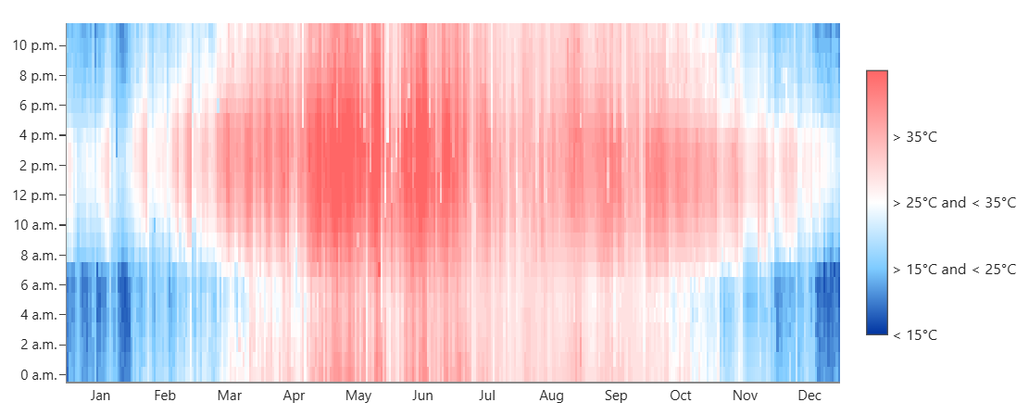
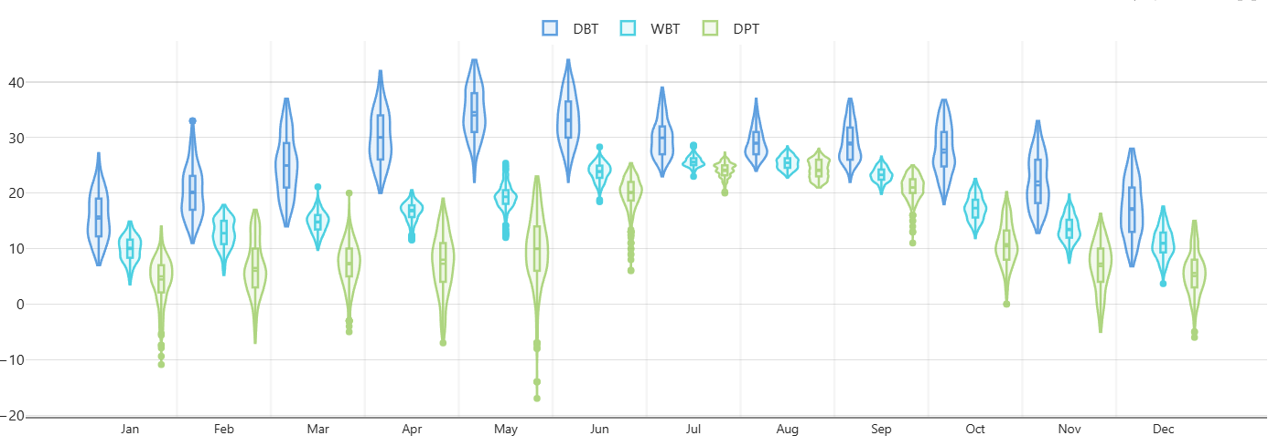
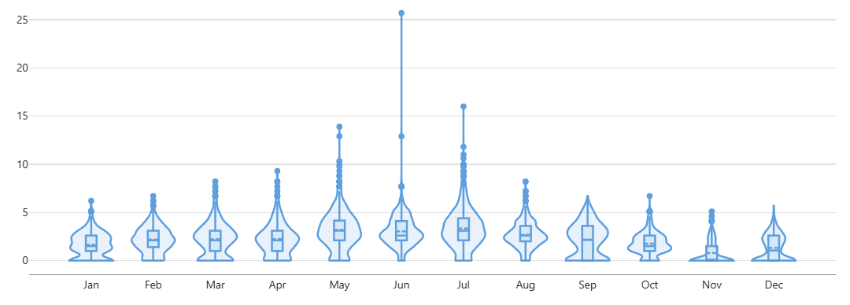
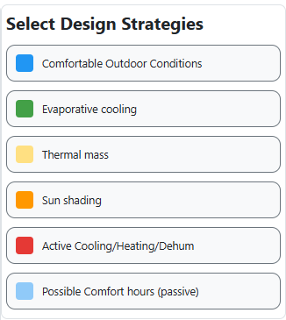
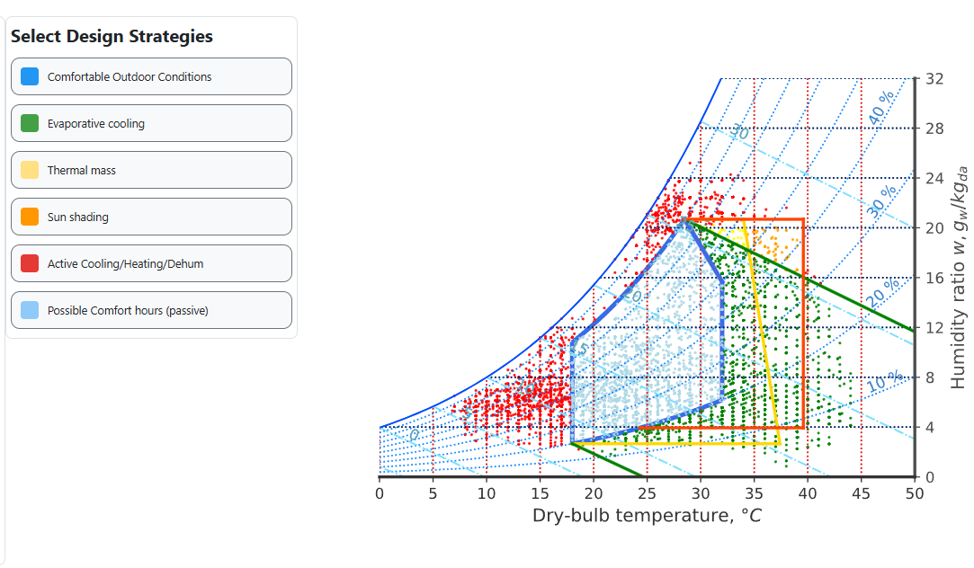
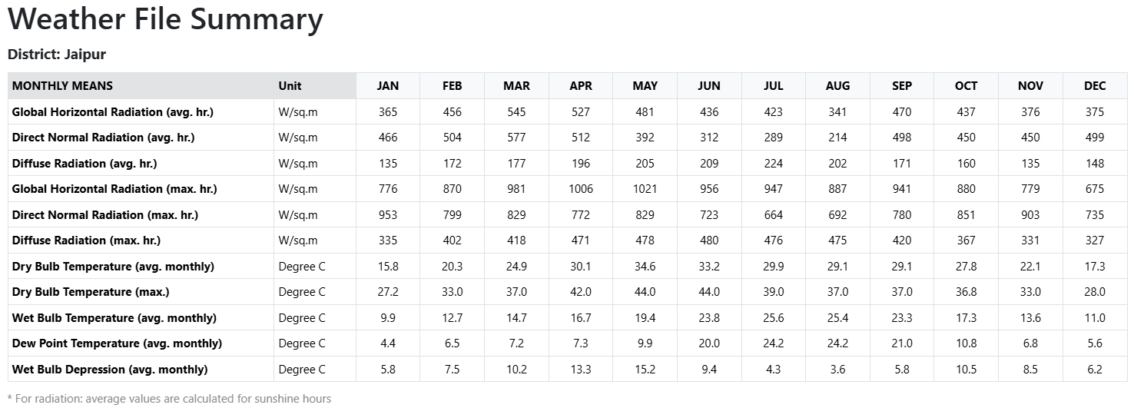
Indian Climate Analysis
Divyansh Vijayª, Prof. Jyotirmay Mathur^{b}
ª Department of Computer Science and Engineering, SVNIT
^{b} Centre for Energy and Environment, MNIT Jaipur
To develop an interactive web-based tool that visualizes district-level climate data of India with weather analysis and passive design strategy evaluation to support climate responsive building design.
1. Data Collection:
Gathered district-wise climate data from ISHRAE, ASHRAE, and COLBE.
2. Climate Zoning:
Classified districts into climate zones based on temperature and humidity.
3. Web Platform Development:
Built an interactive map-based platform with graphs, charts, and data downloads.
4. Analysis & Visualisation:
Enabled parametric weather trends, psychrometric chart analysis, and passive strategy overlays.
Objective
Methodology
1. Interactive Climate Visualisation:
District-wise graphs and psychrometric charts for weather analysis.
2. Passive Design Strategy Overlay:
Real-time overlays for optimizing comfort and energy efficiency.
Key Features
Fig.1. Regional climate classifications across India.
Fig. 2 . Air temperature, radiation, wind, and more.
Fig 3. Psychrometric Chart
The tool enables easy access to district-wise climate data and visualizes passive design strategies, helping users make climate-responsive building decisions. It supports sustainable design by combining real data with interactive analysis.
Conclusion
https://github.com/Divyansh2992/epw2.git

Slide 9
Indian Climate Analysis
Divyansh Vijayª, Prof. Jyotirmay Mathur^{b}
ª Department of Computer Science and Engineering, SVNIT
^{b} Centre for Energy and Environment, MNIT Jaipur
To develop an interactive web-based tool that visualizes district-level climate data of India with weather analysis and passive design strategy evaluation to support climate responsive building design.
1. Data Collection:
Gathered district-wise climate data from ISHRAE, ASHRAE, and COLBE.
2. Climate Zoning:
Classified districts into climate zones based on temperature and humidity.
3. Web Platform Development:
Built an interactive map-based platform with graphs, charts, and data downloads.
4. Analysis & Visualisation:
Enabled parametric weather trends, psychrometric chart analysis, and passive strategy overlays.
Objective
Methodology
1. Interactive Climate Visualisation:
District-wise graphs and psychrometric charts for weather analysis.
2. Passive Design Strategy Overlay:
Real-time overlays for optimizing comfort and energy efficiency.
Key Features
Fig.1. Regional climate classifications across India.
Fig. 2 . Air temperature, radiation, wind, and more.
Fig 3. Psychrometric Chart
The tool enables easy access to district-wise climate data and visualizes passive design strategies, helping users make climate-responsive building decisions. It supports sustainable design by combining real data with interactive analysis.
Conclusion
https://github.com/Divyansh2992/epw2.git

Slide 10
Indian Climate Analysis
Divyansh Vijayª, Prof. Jyotirmay Mathur^{b}
ª Department of Computer Science and Engineering, SVNIT
^{b} Centre for Energy and Environment, MNIT Jaipur
To develop an interactive web-based tool that visualizes district-level climate data of India with weather analysis and passive design strategy evaluation to support climate responsive building design.
1. Data Collection:
Gathered district-wise climate data from ISHRAE, ASHRAE, and COLBE.
2. Climate Zoning:
Classified districts into climate zones based on temperature and humidity.
3. Web Platform Development:
Built an interactive map-based platform with graphs, charts, and data downloads.
4. Analysis & Visualisation:
Enabled parametric weather trends, psychrometric chart analysis, and passive strategy overlays.
Objective
Methodology
1. Interactive Climate Visualisation:
District-wise graphs and psychrometric charts for weather analysis.
2. Passive Design Strategy Overlay:
Real-time overlays for optimizing comfort and energy efficiency.
Key Features
Fig.1. Regional climate classifications across India.
Fig. 2. Air temperature, radiation, wind, and more.
Fig 3. Psychrometric Chart
The tool enables easy access to district-wise climate data and visualizes passive design strategies, helping users make climate-responsive building decisions. It supports sustainable design by combining real data with interactive analysis.
Conclusion
https://github.com/Divyansh2992/epw2.git

Slide 11
INDIAN CLIMATE ANALYSIS
Divyansh Vijayª, Prof. Jyotirmay Mathur^{b}
ª Department of Computer Science and Engineering, SVNIT
^{b} Centre for Energy and Environment, MNIT Jaipur
To develop an interactive web-based tool that visualizes district-level climate data of India with weather analysis and passive design strategy evaluation to support climate responsive building design.
1. Data Collection:
Gathered district-wise climate data from ISHRAE, ASHRAE, and COLBE.
2. Climate Zoning:
Classified districts into climate zones based on temperature and humidity.
3. Web Platform Development:
Built an interactive map-based platform with graphs, charts, and data downloads.
4. Analysis & Visualisation:
Enabled parametric weather trends, psychrometric chart analysis, and passive strategy overlays.
OBJECTIVE
METHODOLOGY
1. Interactive Climate Visualisation:
District-wise graphs and psychrometric charts for weather analysis.
2. Passive Design Strategy Overlay:
Real-time overlays for optimizing comfort and energy efficiency.
KEY FEATURES
Fig.1. Climate classifications across India.
Weather File Summary
Temperature Profile
Air Velocity
Heat-Map
Fig. 2. Air temperature, radiation, wind, and more.
Fig 3. Psychrometric Chart
The tool enables easy access to district-wise climate data and visualizes passive design strategies, helping users make climate-responsive building decisions. It supports sustainable design by combining real data with interactive analysis.
CONCLUSION
https://github.com/Divyansh2992/epw2.git

Slide 12
INDIAN CLIMATE ANALYSIS
Divyansh Vijayª, Prof. Jyotirmay Mathur^{b}
ª Department of Computer Science and Engineering, SVNIT Surat
^{b} Centre for Energy and Environment, MNIT Jaipur
To develop an interactive web-based tool that visualizes district-level climate data of India with weather analysis and passive design strategy evaluation to support climate responsive building design.
1. Data Collection:
Gathered district-wise climate data from ISHRAE, ASHRAE, and COLBE.
2. Climate Zoning:
Classified districts into climate zones based on temperature and humidity.
3. Web Platform Development:
Built an interactive map-based platform with graphs, charts, and data downloads.
4. Analysis & Visualisation:
Enabled parametric weather trends, psychrometric chart analysis, and passive strategy overlays.
OBJECTIVE
METHODOLOGY
1. Interactive Climate Visualisation:
District-wise graphs and psychrometric charts for weather analysis.
2. Passive Design Strategy Overlay:
Real-time overlays for optimizing comfort and energy efficiency.
KEY FEATURES
Fig.1. Climate classifications across India.
Weather File Summary
Temperature Profile
Air Velocity
Heat-Map
Fig. 2. Air temperature, radiation, wind, and more.
Fig 3. Psychrometric Chart
The tool enables easy access to district-wise climate data and visualizes passive design strategies, helping users make climate-responsive building decisions. It supports sustainable design by combining real data with interactive analysis.
CONCLUSION
Code URL :- https://github.com/Divyansh2992/epw2.git

Slide 13
INDIAN CLIMATE ANALYSIS
Divyansh Vijayª, Prof. Jyotirmay Mathur^{b}
ª Department of Computer Science and Engineering, SVNIT Surat
^{b} Centre for Energy and Environment, MNIT Jaipur
To develop an interactive web-based tool that visualizes district-level climate data of India with weather analysis and passive design strategy evaluation to support climate responsive building design.
1. Data Collection:
Gathered district-wise climate data from ISHRAE, ASHRAE, and COLBE.
2. Climate Zoning:
Classified districts into climate zones based on temperature and humidity.
3. Web Platform Development:
Built an interactive map-based platform with graphs, charts, and data downloads.
4. Analysis & Visualisation:
Enabled parametric weather trends, psychrometric chart analysis, and passive strategy overlays.
OBJECTIVE
METHODOLOGY
1. Interactive Climate Visualisation:
District-wise graphs and psychrometric charts for weather analysis.
2. Passive Design Strategy Overlay:
Real-time overlays for optimizing comfort and energy efficiency.
KEY FEATURES
Fig.1. Climate classifications across India.
Weather File Summary
Temperature Profile
Air Velocity
Heat-Map
Fig. 2. Air temperature, radiation, wind, and more.
Fig 3. Psychrometric Chart
The tool enables easy access to district-wise climate data and visualizes passive design strategies, helping users make climate-responsive building decisions. It supports sustainable design by combining real data with interactive analysis.
CONCLUSION
Code URL :- https://github.com/Divyansh2992/epw2.git

Slide 14
INDIAN CLIMATE ANALYSIS
Divyansh Vijayª, Prof. Jyotirmay Mathur^{b}
ª Department of Computer Science and Engineering, SVNIT Surat
^{b} Centre for Energy and Environment, MNIT Jaipur
To develop an interactive web-based tool that visualizes district-level climate data of India with weather analysis and passive design strategy evaluation to support climate responsive building design.
1. Data Collection:
Gathered district-wise climate data from ISHRAE, ASHRAE, and COLBE.
2. Climate Zoning:
Classified districts into climate zones based on temperature and humidity.
3. Web Platform Development:
Built an interactive map-based platform with graphs, charts, and data downloads.
4. Analysis & Visualisation:
Enabled parametric weather trends, psychrometric chart analysis, and passive strategy overlays.
OBJECTIVE
METHODOLOGY
1. Interactive Climate Visualisation:
District-wise graphs and psychrometric charts for weather analysis.
2. Passive Design Strategy Overlay:
Real-time overlays for optimizing comfort and energy efficiency.
KEY FEATURES
Fig.1. Climate classifications across India.
Weather File Summary
Temperature Profile
Air Velocity
Heat-Map
Fig. 2. Air temperature, radiation, wind, and more.
Fig 3. Psychrometric Chart
The tool enables easy access to district-wise climate data and visualizes passive design strategies, helping users make climate-responsive building decisions. It supports sustainable design by combining real data with interactive analysis.
CONCLUSION
Code URL :- https://github.com/Divyansh2992/epw2.git

Slide 15
INDIAN CLIMATE ANALYSIS
Divyansh Vijayª, Prof. Jyotirmay Mathur^{b}
ª Department of Computer Science and Engineering, SVNIT Surat
^{b} Centre for Energy and Environment, MNIT Jaipur
To develop an interactive web-based tool that visualizes district-level climate data of India with weather analysis and passive design strategy evaluation to support climate responsive building design.
1. Data Collection:
Gathered district-wise climate data from ISHRAE, ASHRAE, and COLBE.
2. Climate Zoning:
Classified districts into climate zones based on temperature and humidity.
3. Web Platform Development:
Built an interactive map-based platform with graphs, charts, and data downloads.
4. Analysis & Visualisation:
Enabled parametric weather trends, psychrometric chart analysis, and passive strategy overlays.
OBJECTIVE
METHODOLOGY
1. Interactive Climate Visualisation:
District-wise graphs and psychrometric charts for weather analysis.
2. Passive Design Strategy Overlay:
Real-time overlays for optimizing comfort and energy efficiency.
KEY FEATURES
Fig.1. Climate classifications across India.
Weather File Summary
Temperature Profile
Air Velocity
Heat-Map
Fig. 2. Air temperature, radiation, wind, and more.
Fig 3. Psychrometric Chart
The tool enables easy access to district-wise climate data and visualizes passive design strategies, helping users make climate-responsive building decisions. It supports sustainable design by combining real data with interactive analysis.
CONCLUSION
Code URL :- https://github.com/Divyansh2992/epw2.git

Slide 16

INDIAN CLIMATE ANALYSIS
Divyansh Vijayª, Prof. Jyotirmay Mathur^{b}
ª Department of Computer Science and Engineering, SVNIT Surat
^{b} Centre for Energy and Environment, MNIT Jaipur
To develop an interactive web-based tool that visualizes district-level climate data of India with weather analysis and passive design strategy evaluation to support climate responsive building design.
1. Data Collection:
Gathered district-wise climate data from ISHRAE, ASHRAE, and COLBE.
2. Climate Zoning:
Classified districts into climate zones based on temperature and humidity.
3. Web Platform Development:
Built an interactive map-based platform with graphs, charts, and data downloads.
4. Analysis & Visualisation:
Enabled parametric weather trends, psychrometric chart analysis, and passive strategy overlays.
OBJECTIVE
METHODOLOGY
1. Interactive Climate Visualisation:
District-wise graphs and psychrometric charts for weather analysis.
2. Passive Design Strategy Overlay:
Real-time overlays for optimizing comfort and energy efficiency.
KEY FEATURES
Fig.1. Climate classifications across India.
Weather File Summary
Temperature Profile
Air Velocity
Heat-Map
Fig. 2. Air temperature, radiation, wind, and more.
Fig 3. Psychrometric chart.
The tool enables easy access to district-wise climate data and visualizes passive design strategies, helping users make climate-responsive building decisions. It supports sustainable design by combining real data with interactive analysis.
CONCLUSION
Code URL :- https://github.com/Divyansh2992/epw2.git

Slide 17
INDIAN CLIMATE ANALYSIS
Divyansh Vijayª, Prof. Jyotirmay Mathur^{b}
ª Department of Computer Science and Engineering, SVNIT Surat
^{b} Centre for Energy and Environment, MNIT Jaipur
To develop an interactive web-based tool that visualizes district-level climate data of India with weather analysis and passive design strategy evaluation to support climate responsive building design.
1. Data Collection:
Gathered district-wise climate data from ISHRAE, ASHRAE, and COLBE.
2. Climate Zoning:
Classified districts into climate zones based on temperature and humidity.
3. Web Platform Development:
Built an interactive map-based platform with graphs, charts, and data downloads.
4. Analysis & Visualisation:
Enabled parametric weather trends, psychrometric chart analysis, and passive strategy overlays.
OBJECTIVE
METHODOLOGY
1. Interactive Climate Visualisation:
District-wise graphs and psychrometric charts for weather analysis.
2. Passive Design Strategy Overlay:
Real-time overlays for optimizing comfort and energy efficiency.
KEY FEATURES
Fig.1. Climate classifications across India.
Weather File Summary
Temperature Profile
Air Velocity
Heat-Map
Fig. 2. Air temperature, radiation, wind, and more.
Fig 3. Psychrometric chart.
The tool enables easy access to district-wise climate data and visualizes passive design strategies, helping users make climate-responsive building decisions. It supports sustainable design by combining real data with interactive analysis.
CONCLUSION
Code URL :- https://github.com/Divyansh2992/IndianClimateAnalysis.git

Slide 18
INDIAN CLIMATE ANALYSIS
Divyansh Vijayª, Prof. Jyotirmay Mathur^{b}
ª Department of Computer Science and Engineering, SVNIT Surat
^{b} Centre for Energy and Environment, MNIT Jaipur
To develop an interactive web-based tool that visualizes district-level climate data of India with weather analysis and passive design strategy evaluation to support climate responsive building design.
1. Data Collection:
Gathered district-wise climate data from ISHRAE, ASHRAE, and COLBE.
2. Climate Zoning:
Classified districts into climate zones based on temperature and humidity.
3. Web Platform Development:
Built an interactive map-based platform with graphs, charts, and data downloads.
4. Analysis & Visualisation:
Enabled parametric weather trends, psychrometric chart analysis, and passive strategy overlays.
OBJECTIVE
METHODOLOGY
1. Interactive Climate Visualisation:
District-wise graphs and psychrometric charts for weather analysis.
2. Passive Design Strategy Overlay:
Real-time overlays for optimizing comfort and energy efficiency.
KEY FEATURES
Fig.1. Climate classifications across India.
Weather File Summary
Temperature Profile
Air Velocity
Heat-Map
Fig. 2. Air temperature, radiation, wind, and more.
Fig 3. Psychrometric Chart
The tool enables easy access to district-wise climate data and visualizes passive design strategies, helping users make climate-responsive building decisions. It supports sustainable design by combining real data with interactive analysis.
CONCLUSION
Code URL :- https://github.com/Divyansh2992/epw2.git

