Slide 1
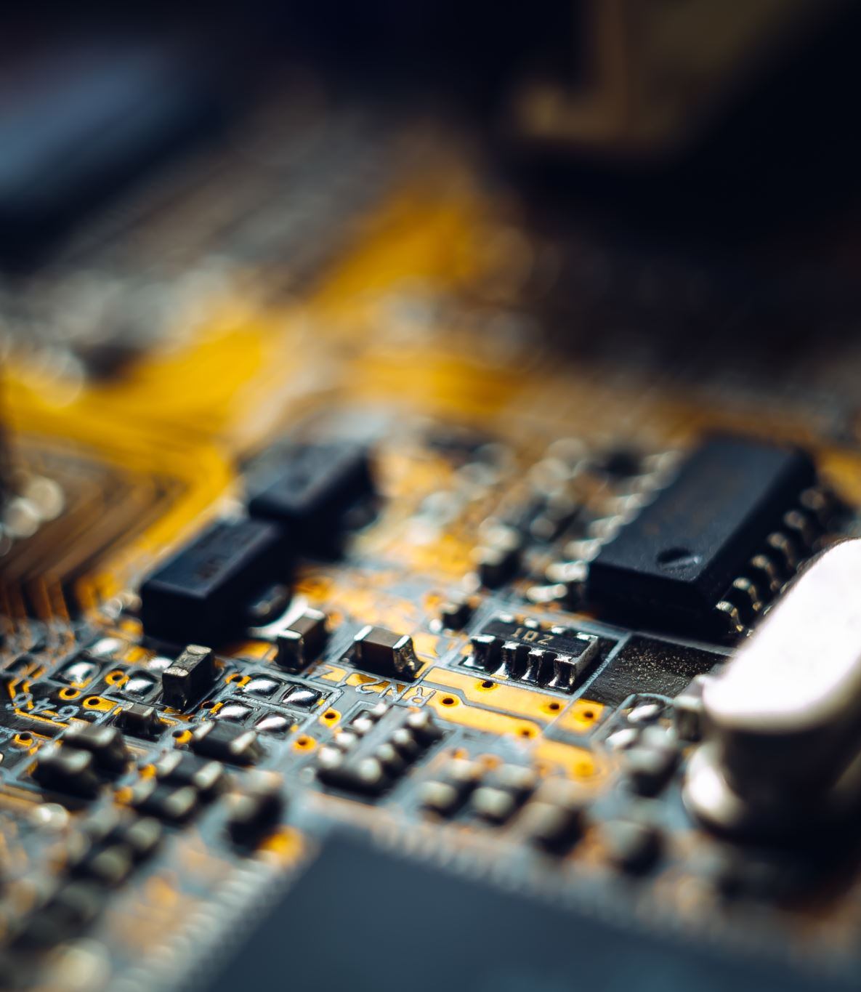
SMART IRRIGATION SYSTEM
SYED DANISH ALI –1043 –CSE 6C
DIVYANSH SHARMA -1016 –CSE 6B
AMANPREET SINGH -1008 –CSE 6C

Slide 2


Introduction
Irrigation is the artificial application of water to the land or soil.
Knowing when and how much to water is two important aspects of watering process.
To make the farming works easily, the automatic irrigation system is created.
2

Slide 3
Problems faced in Agriculture
Over Irrigation
Under Irrigation
3

Slide 4
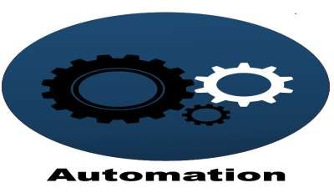

Objective
To minimize manual intervention by the farmer.
To prevent excessive wastage of water,electricity.
4

Slide 5
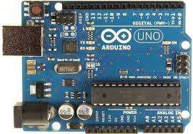
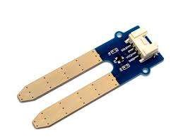
LIST OF COMPONENTS
Moisture sensors
Motor/pump
Power supply(7-12v)
Usb connector
Water sprinkler
Arduino uno
5

Slide 6

BLOCK DIAGRAM
Power supply
Motor/Pump
Arduino Uno
Extension board
Water sprinkler
Plants
Moisture sensors
7

Slide 7
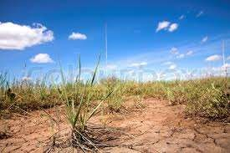
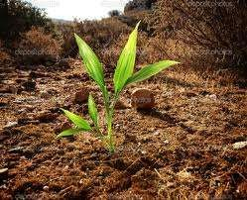
The System takes care of the moisture content of the soil And waters It accordingly

Slide 8
WORKING
This project uses Arduino Uno to controls the motor. The Arduino Board is programmed using the Arduino IDE software.
The moisture sensor measures the level of moisture in the soil and sends the signal to the Arduino if watering is required.
The motor/water pump supplies water to the plants until the desired moisture level is reached.

Slide 9
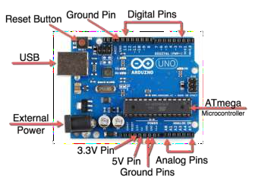
ARDUINOUNO
The Arduino Uno is a microcontroller board based on the ATmega328.
It has 14 digital input/output pins (of
which 6 can be used as PWM outputs), 6 analog inputs, a 16MHz Ceramic resonator, a USB connection, a power jack, an ICSP header, and a reset button.
The Arduino Board is programmed using the Arduino IDE software.

Slide 10
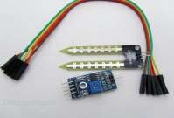
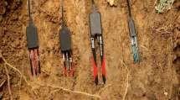
MOISTURE SENSOR
Soil moisture sensors measure the water content in soil.A soil moisture probe is made up of multiple soil
moisture sensors.
Soil electrical conductivity is simply measured using two metal conductors spaced apart in the soil except that dissolved salts greatly alter the water conductivity and can confound the measurements.
The soil electrical conductivity sensitive to variations in soil salinity and temperature as well as water.

Slide 11
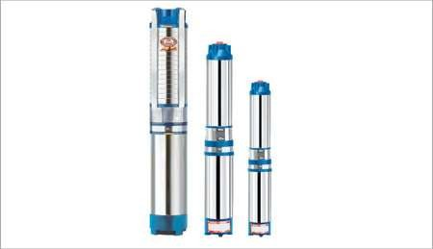
WATER PUMP
The water pump is used to artificially supply
water for a particular task.
It can be electronically controlled by interfacing it to a microcontroller.
It can be triggered ON/OFF by sending signals as required. The process of artificially supplying water is known as pumping.

Slide 12
SIGNIFICANCE OF THE PROJECT
Irrigation in fields.
Irrigation in garden,parks.
Very useful for people who do not have time to water their plants because of busy life schedule.
The project is very economical in terms of cost and power.

Slide 13
MERITS
Highly sensitive
Works according to the soil condition
Low cost and reliable circuit
Complete elimination of manpower
System can be switched into manual mode whenever required

Slide 14
conclusion
In present days especially farmers are facing
major problems in watering their agriculture fields.it’s because they have no proper idea about when the power is available so that they can pump water. Even after then they need to wait until the field is properly watered ,which makes them to stop other activities.
Here is an idea which helps not only farmers even for watering gardens also,which senses soil moisture and switches the valve automatically when the power is ON

Slide 15


