Slide 1

Counterfeit Currency
Identification Agent
A hybrid computer-vision + rule-based system for screening Indian currency notes
Track: AI for Digital Public Safety — Counterfeit Currency Identification Agent
Working prototype · Trained ONNX classifier · Explainable decision engine

Slide 2
The Problem
Counterfeit currency is a persistent, growing threat. RBI's own Annual Report data shows detections rising sharply year over year — and high-quality fakes are increasingly hard to catch through manual inspection alone at bank counters and retail points of sale.
₹500 FICN detected
1,17,722
in FY 2024-25 — up from 85,711 the year before
There is no legal way to obtain a labeled dataset of real counterfeit notes for training — so any credible system has to work within that constraint, not pretend it doesn't exist.
Total FICN pieces detected (all denominations)
2,17,396
Source: RBI Annual Report, FY 2024-25

Slide 3

Scope of This Submission
The challenge brief lists five illustrative example builds under the broader Digital Public Safety theme. This submission targets one of them directly, end to end:
Digital Arrest Scam Detection & Alerting
Counterfeit Currency Identification Agent
← this submission
Fraud Network Graph Intelligence
Geospatial Crime Pattern Intelligence
Citizen Fraud Shield (Multi-channel)
The evaluation focus areas for scam detection, fraud networks, and legal-admissibility packages belong to the other four illustrative tracks and are out of scope for this submission.

Slide 4
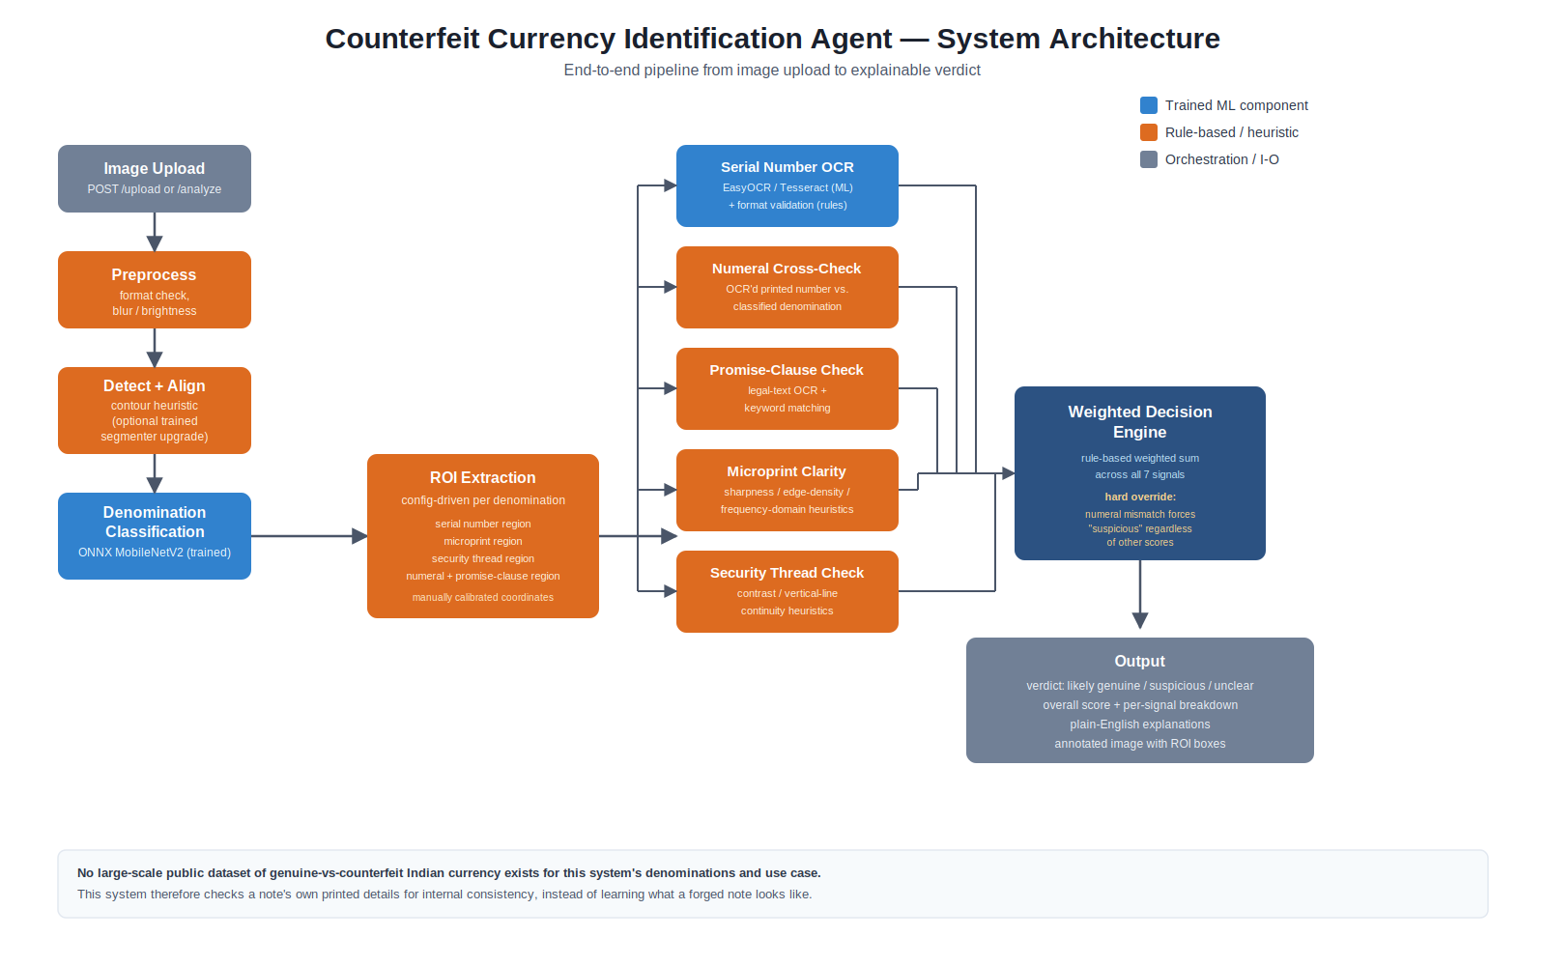
System Architecture

Slide 5
What's Actually Learned vs. Rule-Based
Being precise about this distinction is central to the design of this system.
Denomination classification
Trained ML — MobileNetV2 exported to ONNX
Note boundary / alignment
Heuristic (OpenCV contour); trained segmenter built, not yet trained
Serial / numeral / text extraction
Pretrained OCR (EasyOCR / Tesseract)
Format & consistency checks
Rule-based logic on top of OCR output
Microprint & security thread scoring
Heuristic image-quality proxies
Final verdict
Rule-based weighted sum + hard override rule
UV / IR verification
Not implemented — no data, no hardware

Slide 6

The Core Design Choice
Most “counterfeit detection” demos quietly assume a labeled fake-note dataset exists. It doesn't — not at scale, not publicly, for Indian currency across denominations.
Instead of learning what a forged note looks like, the system checks whether a note's own printed details agree with each other — denomination number, serial format, legal text, print quality, thread continuity.
Where's the “AI Agent” in this?
Gathers evidence autonomously from five independent signals, without a human choosing which checks to run
Reasons over that evidence with explicit logic — a weighted combination plus a hard override rule for a strong specific signal
Produces a decision and a plain-language justification for it, not just a number
This is honestly a rule-based reasoning agent, not an LLM-based one — stated plainly rather than dressed up.

Slide 7
Dataset & Training Pipeline
1
Roboflow currency-detection export (7 INR denominations)
Validation accuracy
96.6%
2
Cross-split near-duplicate audit (perceptual hashing) — leaked duplicates found & removed
3
Supplementary reference photos merged in for ₹500 / ₹2000
Held-out test accuracy (never touched during training)
MobileNetV2 transfer learning → ONNX export
88.5%
4
Reported this way deliberately: test accuracy is lower than validation, and that gap is shown rather than hidden.

Slide 8
The Decision Engine
Seven signals combine into one score. Every number comes with a plain-English reason.
Weighted signals (sum to 100%)
Hard Override Rule
Microprint clarity
30%
Serial number check
25%
If the OCR'd printed denomination number does not match the classified denomination, the verdict is forced to “suspicious” — regardless of how high every other score is.
Security thread check
25%
Numeral consistency*
20%
Image quality
10%
Denomination confidence
10%
This is deliberate: a confirmed numeral mismatch is a specific, strong signal that should not be averaged away by unrelated high scores elsewhere.
Promise-clause detection*
10%
*only active for denominations whose ROI template defines these checks

Slide 9
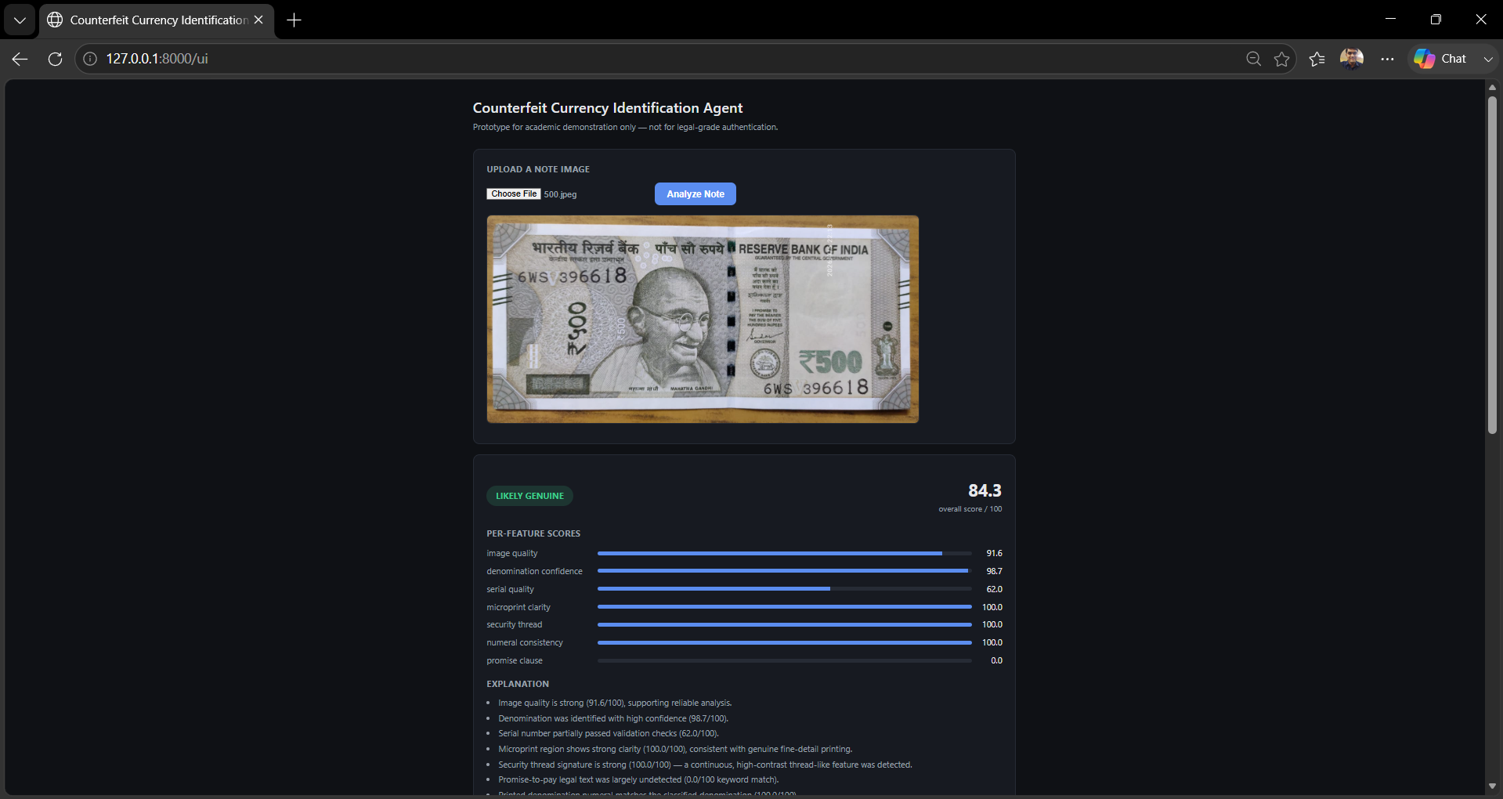
Live Demo
http://localhost:8000/ui

Slide 10
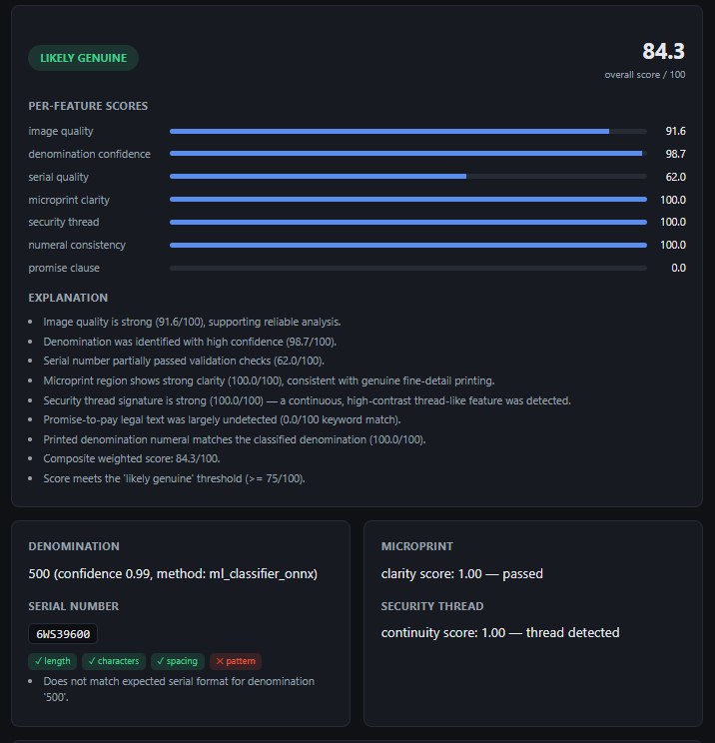
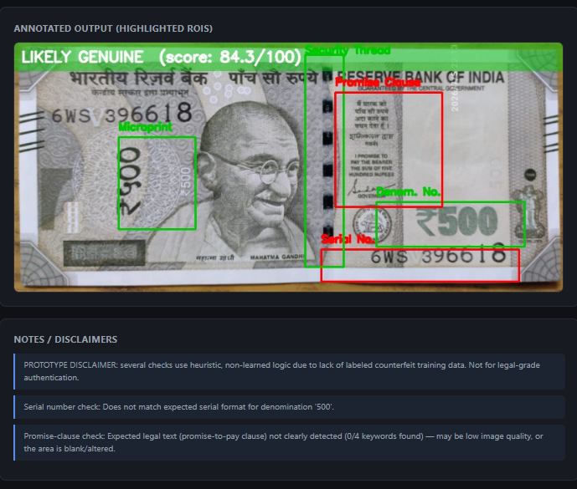
Live Demo

Slide 11
Mapped to Judging Criteria
Innovation
25%
Rule-based consistency screening as a deliberate, honest alternative to a fake-note classifier that has no data to train on
Business Impact
25%
Directly targets a quantified, growing problem (RBI FICN data); deployable at teller counters and POS terminals
Technical Excellence
20%
Trained ONNX classifier, pluggable backend architecture, dataset-leakage audit, 76-test automated suite
Scalability
15%
Stateless API, pluggable ML backends (TFLite path exists), config-driven ROI system extends to new note designs
User Experience
15%
Working demo UI, verdicts explained in plain English rather than a bare number

Slide 12
Known Limitations
Stated directly, not discovered by a judge asking a hard question.
No legal-grade or certified currency authentication claim is made anywhere in this system
UV / IR verification is not implemented — no UV imagery in any available dataset, no UV-capable capture hardware used
ROI coordinates are manually calibrated per denomination against reference photos, not learned
Microprint and security-thread checks are image-quality heuristics, not trained authenticity models — no labeled data exists to train them on
Note-boundary segmentation model is built but not yet trained; the heuristic contour detector is the active fallback

Slide 13
Future Work
Train the note-boundary segmenter
Pipeline is already built — needs a training run on the existing polygon-annotated dataset
On-device mobile inference
Wire up the existing TFLite backend template for offline field use
Currency-specific OCR fine-tuning
Replace general-purpose EasyOCR/Tesseract with a model trained on actual note fonts
Learned microprint / thread scoring
Gated on a labeled genuine/counterfeit dataset that does not currently exist — not a near-term item

Slide 14

Thank You
Counterfeit Currency Identification Agent — Questions & Discussion

