Slide 1
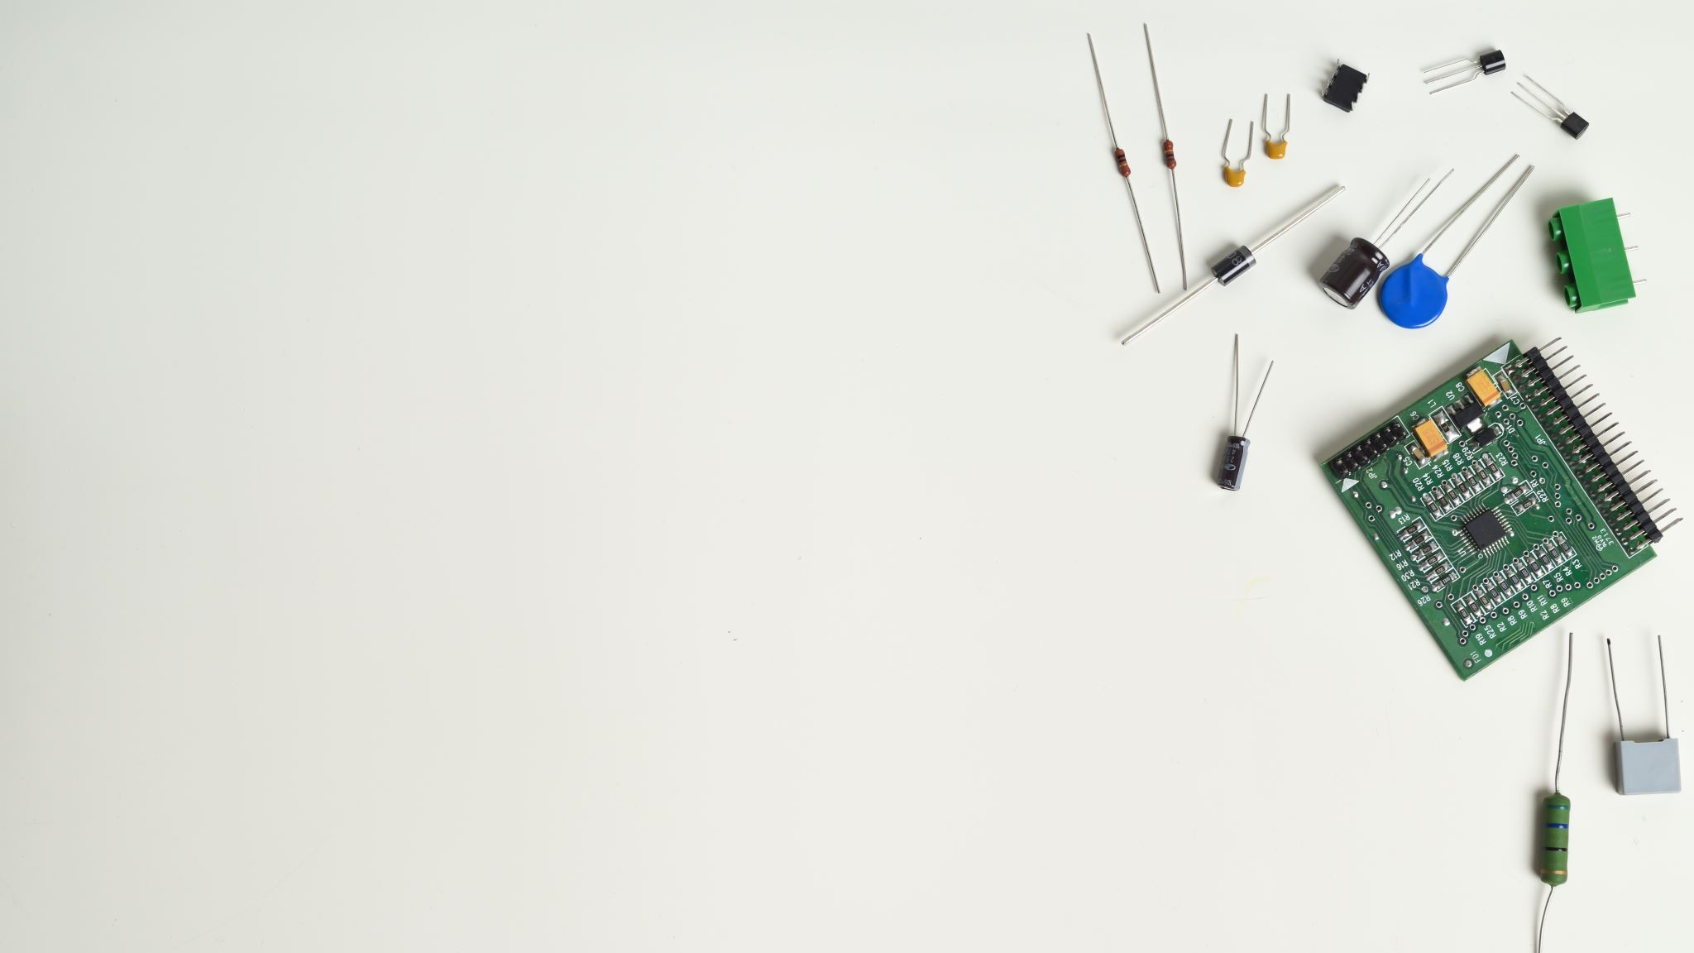
Smart Bin
Team Members
Parv kukreja
Mansi Varshney
Aashutosh vats
Divyansh Dixit

Slide 2
Introduction
Make trash bins smarter by utilizing a custom board and photoelectric sensor to reduce costs of refuse collection

Slide 3
Problem Statement
Sanitation crews visiting empty trash bins generates unnecessary costs
Reduce these costs by tasking sanitation crews with visiting only full bins
Overflowing bins increase pollution and reduces an area’s natural beauty
Use data analysis to predict when bins become full

Slide 4
Target Customers
State and local Sanitation companies
Offices
Amusement parks( Imagica, Kingdom of dreams ,Worlds of wonder)

Slide 5
Impacts
Positive
Reduce unnecessary costs by having sanitation crews only visit full bins
Increase natural beauty of an area by reducing pollution due to bin overflow
Negative
Slightly increased carbon footprint due to manufacture and assembly of the board

Slide 6
System Architecture
Devices are added upon receipt in management system (C# backed by SQL Server)
Field crews deploy the devices by installing them on bins and registering their locations against the SQL Server using a mobile app
Software embedded on the field devices (Java) issues updates to SQL Server at regular intervals
Central management system listens for these updates
Issues notifications to user, outputs set of full bin locations upon request

Slide 7
Integration Plan
Customer purchases the devices
01
Installs on bins they manage
02
SQL Server instance will either be purchased by customer or from us
03
Management software is installed and begins managing the field devices
04

Slide 8
Testing
Management system is modular, so unexpected behavior is minimized
Simply use the application while manually updating Server to ensure proper responses
Verify that data sets returned contain desired data
Cross-reference timestamps of updates with log on embedded software
Ensure sensor remains powered and responds to stimuli (placement of hand or other object in front of sensor)

Slide 9
Conclusion
This project allowed us to exhibit our acquired skills obtained throughout our education here at the University. It was challenging, and ultimately will be rewarding as we move to graduate.

