Slide 1

Future Gadgets Lab Bharati Vidyapeeth’s College Of Engineering New Delhi
Members:
Chetan Chawla Divyansh Malhotra Himanshu Kumar Yashvi Gulati

Slide 2

Meishu
Drone Based Rescue System

Slide 3
Problem
76,031 reported deaths due to natural disasters in the last 17 years in India itself.*
Lack of communication in disaster-stricken areas which cause haphazard and imbalanced scenario
Unguided rescue operations based on intentions
* According to the International Disaster Database

Slide 4
Proposed Solution
Drone based 3D mapping of the affected area to find Highest and most stable point in the area
Localised communication set up by drones to people’s smartphones
Providing directions for easy rescue
SOS facility for immobile people to aid (but not supplement) the rescue operations

Slide 5
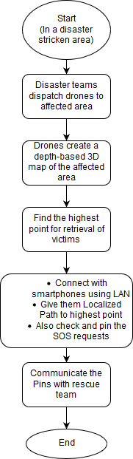
Flow Diagram

Slide 6
3D Mapping System
Using a stereo camera for capturing the Depth information or using a LIDAR sensor with geo-tagging or
A cheaper method is the use of a monocular camera along with deep learning to make a depth map of the captured area. A contour of the area to be formed.

Slide 7
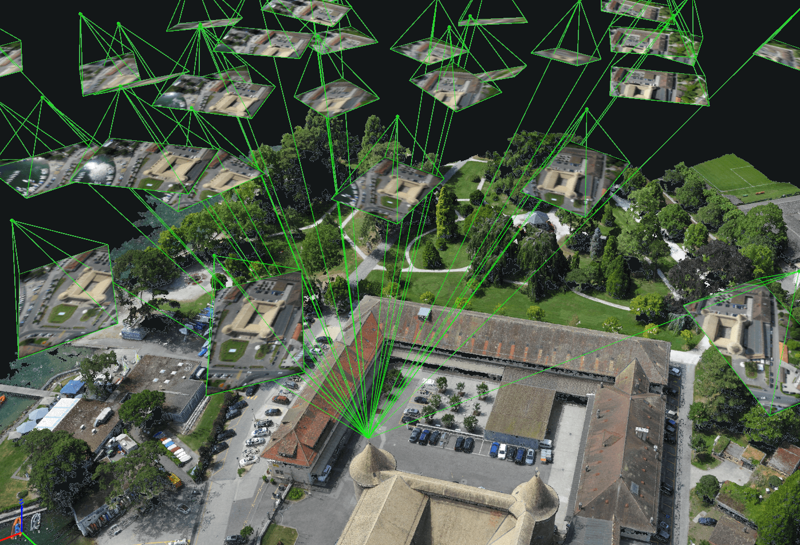
Mapping of disaster-stricken area:
Using this, we can locate the highest and most stable contour in the area from which extraction (rescuing) is feasible

Slide 8
Setting up communication
A hotspot (LAN) is set up using a NodeMCU on the drone. It is local in connectivity.
An android application helps the victims to connect to this network, making a Wireless LAN and transmitting data

Slide 9
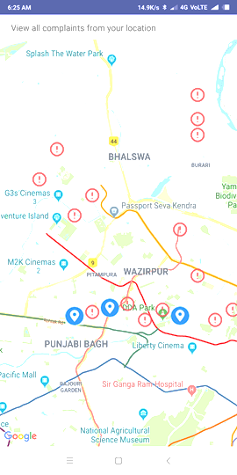
Position-localisation and alerting of victims
We also hope to achieve
Once connected, we can find the relative position of the victim using Wi-Fi positioning system
Then, in accordance to the victim’s position, he /she may be directed to the highest point of the arena through the app or location-directed help may be sent if immobile.

Slide 10
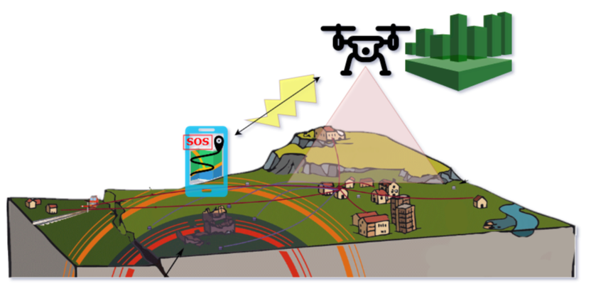
Schematic

Slide 11
Deliverables and Progress
Node MCU for Local Hotspot communication
Android Application for user side communication
Depth Mapping using Monocular Cameras for overhead images
Drone Simulation for Path Planning

Slide 12
FEASIBILITY
Cost: ~3,500 Rs Extra Expenditure (NodeMCU and Monocular Camera and Raspberry Pi 3B+ for on-board processing and data acquistion.

Slide 13
Questions and Suggestions please
Thank You!

