Slide 1

-
-
Kriti 2025
Optimization PS

Slide 2

Introduction
Our program processes a grid-based dataset to determine optimal divisions and extract key values.
It reads data from input files, performs calculations, and outputs optimized grid segmentations.
The approach involves matrix operations, sorting, and optimization techniques.

Slide 3
Code Overview
Reads input from files and initializes grid structures.
Computes factors of 10,000 to determine possible divisions.
Processes data to find optimal rectangular regions.
Outputs edges for further processing or visualization.

Slide 4
File Handling & Input Processing
Reads data from multiple input files using `freopen`.
Parses integer values and initializes matrices.
Stores values in a 2D vector for further computations.

Slide 5
Data Structures Used
vector<vector<int>> v(10001, arr(10001, 0)): Stores input values.
vector<vector<int>> pre(10002, arr(10002, 0)): Prefix sum matrix.
vector<pair<int, vector<int>>> s: Stores candidate rectangles sorted by value.
vector<pair<pair<float, float>, pair<float, float>>> edges: Stores output edges

Slide 6
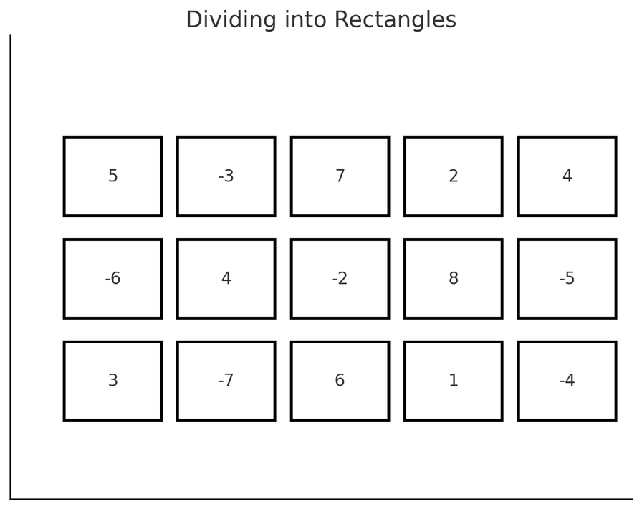
Factor Calculation and Divisions
Determines factors of 10,000 to divide the grid.
Iterates through factors to find optimal rectangular divisions.
Uses a nested loop to iterate through potential division values.

Slide 7
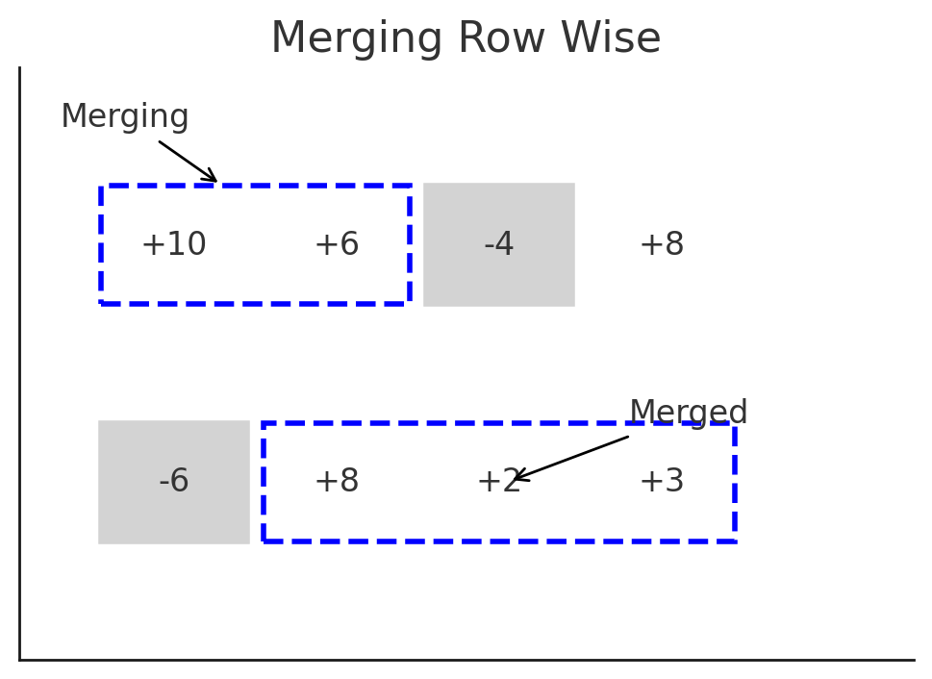
Merging Rectangles in Each Row
After forming rectangles, we iterate through each row.
Adjacent rectangles are merged if they do not enclose a total negative value.
This step reduces the number of separate regions and simplifies final polygon formation.

Slide 8
Sorting and Optimization
Calculates enclosed values for each rectangular segment.
Sorts values to maximize total sum.
Keeps the top 200 rectangles with the highest sum.
Stores best-case rectangles for further processing.

Slide 9
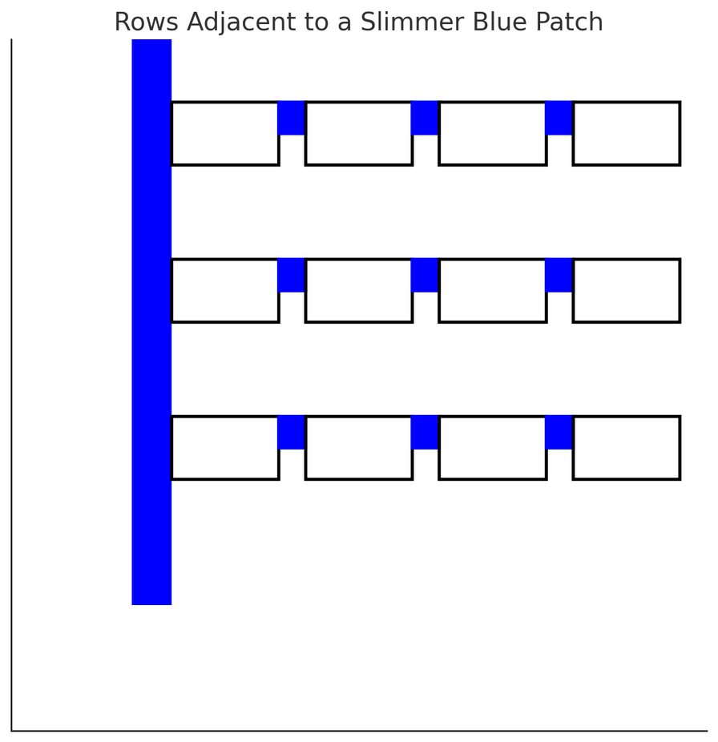
Forming the Final Polygon
Once the best-case rectangles are selected and merged, they are connected.
The program generates edges by iterating through the merged rectangles.
The result is a single, optimized polygon enclosing the highest values in the grid.

Slide 10
Edge Generation
Uses coordinate transformations to define segment boundaries.
Iterates through merged rectangles to construct the final shape.
Outputs results in a formatted structure.

Slide 11
Alternate Methods Explored
Linear Programming with variables as (x, y) coordinates of the vertices.
Constraining the vertices to form a polygon with its edges parallel to X or Y axis.
Using Ray Projection Method to find if the point is inside or outside the polygon.

Slide 12
Performance Considerations
Efficient use of prefix sums reduces computation time.
Sorting and merging optimize rectangle choices.
Complexity considerations for large grid sizes.

Slide 13
Thank You
Kriti 2025
Optimization PS

