Slide 1
E-Commerce Image Quality Inspector
Classical DIP vs. fine-tuned CNN vs. vision-language model on six marketplace image rules
Divyansh Parashar · Nakshatra Joshi — DIP course project (HSR-AIML-056)
Notes:
Goal: automatically PASS/FAIL product photos against six marketplace rules, and compare three ways of doing it.

Slide 2
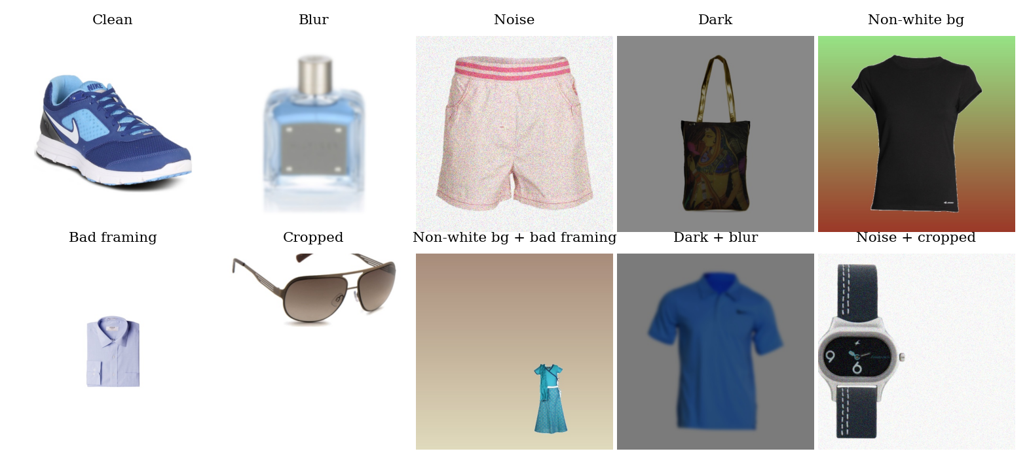
Marketplaces reject six kinds of bad product photo
Synthetic benchmark: defects injected into real white-background catalogue photos (Kaggle), so labels are exact. Test set: 352 images, source-disjoint from training.
Notes:
Photometric defects (blur, noise, dark) are measured from pixels; geometric ones (background, framing, cropping) need the product segmented first.

Slide 3
Three inspectors, one report format
1
2
3
DIP rules
CNN
Vision LLM
Baseline · no training
Supervised · GPU
Zero-shot · API
Laplacian variance, median-filter residual, histogram percentiles, LAB k-means + Otsu, morphology, connected components. Thresholds tuned on validation.
EfficientNet-B0 (ImageNet-pretrained), six sigmoid outputs, fine-tuned on a Kaggle T4 in 12.8 min with per-defect thresholds.
Gemma 4 26B via OpenRouter. Image plus rule prompt in, JSON verdict per defect out. No training data, no thresholds.
Notes:
All three return the same structured PASS/FAIL report per defect, so they are scored identically.

Slide 4
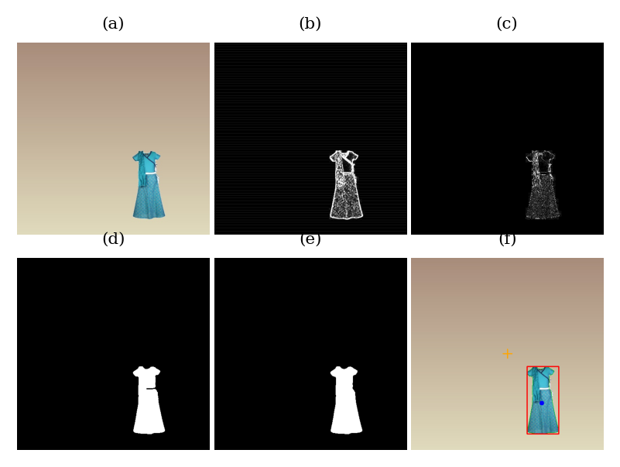
The DIP pipeline shows every intermediate step
(a) Input: non-white background, bad framing
(b) Laplacian edge map → blur score
(c) Median-filter residual → noise score
(d) Otsu mask on LAB distance from border colour
(e) Opening, closing, largest component, hole fill
(f) Product box vs. frame centre → framing, cropping
Notes:
Each decision can be traced to a measured number and a threshold, which is the main advantage of the classical approach.

Slide 5
CNN wins on accuracy; DIP is close and fully explainable
DIP rules
CNN
Vision LLM
0.853
0.995
0.662
macro-F1
macro-F1
macro-F1
False rejects
2.4%
False rejects
0.0%
False rejects
29.0%
Time / image
27 ms
Time / image
33 ms
Time / image
2.3 s
Cost
$0
Cost
$0
Cost
$0.036 / 352
Notes:
Test set, 352 images. The VLM never misses a defect (recall 1.0) but rejects 29% of clean images, and is ~70x slower.

Slide 6
DIP struggles most with cropping and framing
Notes:
Per-defect F1 on the test set. Noise and background colour are easy for DIP; cropping (0.67) is hardest, partly due to label noise.

Slide 7
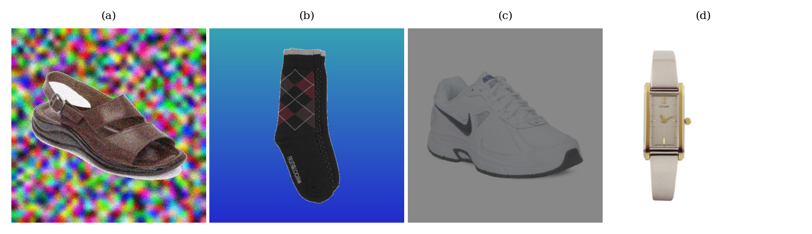
Where the DIP rules break
(a) Textured background
Mask leaks to the border → false cropped
(b) Dark saturated background
Low 95th-pct brightness → false dark
(c) Low-contrast image
Low Laplacian variance → false blur
(d) Label noise
Narrow product shifted but still fully visible
Notes:
Common theme: one feature responding to two defects. CNN errors were near zero; VLM errors were mostly over-flagging clean images.

Slide 8
Takeaways
DIP: 0.853 F1, training-free, every decision explainable
CNN: 0.995 F1, but learnt this synthetic generator — real data will be harder
VLM: catches everything, rejects 29% of clean photos
Next: real labelled listings, and fuse DIP features with the CNN
Notes:
Future work: evaluate on real human-labelled listings, fix the cropping generator, learn a classifier over DIP features, fuse DIP + CNN.

