Slide 1
IBM University Engagement Project Submission
“Exploring the Power of Machine Learning with IBM Cloud”

Slide 2
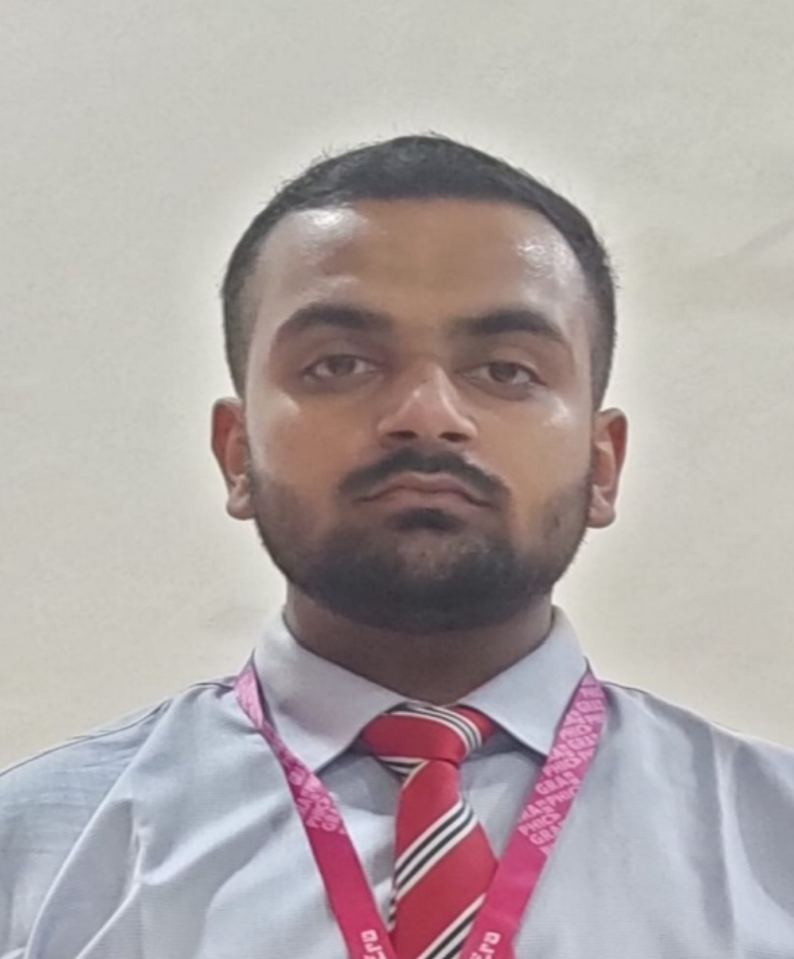
Project Tile – AI-Powered Customer Churn Prediction & Retention Analytics Platform using IBM Watson Machine Learning
Domain of Project – Telecommunications / Customer Analytics
Student Name | Recent Passport Photo | Email ID | Mobile number [WhatsApp]
Divyansh Thakur |  | divyanshthakur675@gmail.com | +91-8755529818

Slide 3
Problem Statement -
Problem Statement: Customer churn is one of the biggest challenges faced by telecom service providers. Acquiring a new customer is significantly more expensive than retaining an existing one. Customers may discontinue services due to high monthly charges, frequent service issues, contract expiration, excessive roaming charges, or dissatisfaction with available plans.
Traditional churn analysis methods rely on manual observation and historical reporting, making it difficult to identify at-risk customers in time. As customer data grows, organizations require an intelligent system that can analyze customer behavior and predict churn probability accurately.
The objective of this project is to develop an AI-powered churn prediction system that utilizes customer account information, service usage patterns, contract details, and support interactions to predict whether a customer is likely to leave the service. Early churn prediction enables telecom companies to take proactive retention measures, reduce revenue loss, and improve customer satisfaction.

Slide 4
Proposed Solution -
Proposed Solution (IBM watsonx.ai Studio – AutoAI):
We propose an AI-powered Customer Churn Prediction Platform using IBM Watson Machine Learning and AutoAI.
Customer telecom usage data is uploaded to IBM watsonx.ai Studio.
AutoAI automatically performs data preprocessing and feature engineering.
Multiple machine learning models are generated and evaluated automatically.
Hyperparameter tuning is performed by AutoAI to identify the best-performing model.
The selected model is deployed as an online prediction endpoint using IBM Watson Machine Learning.
A web application is developed using Node.js, HTML, CSS, and JavaScript.
The web application communicates with the deployed IBM model through REST APIs.
Users can enter customer details and instantly receive churn risk predictions.

Slide 5
Technology Used
IBM Cloud Services
IBM Cloud
IBM watsonx.ai Studio
IBM AutoAI
IBM Watson Machine Learning Deployment
Development Technologies
Node.js
HTML
CSS
JavaScript
REST API Integration
ML Algorithm / Model Used
IBM AutoAI Best Pipeline (Classifier generated by AutoAI)
Enhancements and Hyperparameter Tuning
Automated Feature Engineering
Automated Model Selection
Hyperparameter Optimization using AutoAI
Model Deployment through IBM Watson Machine Learning

Slide 6
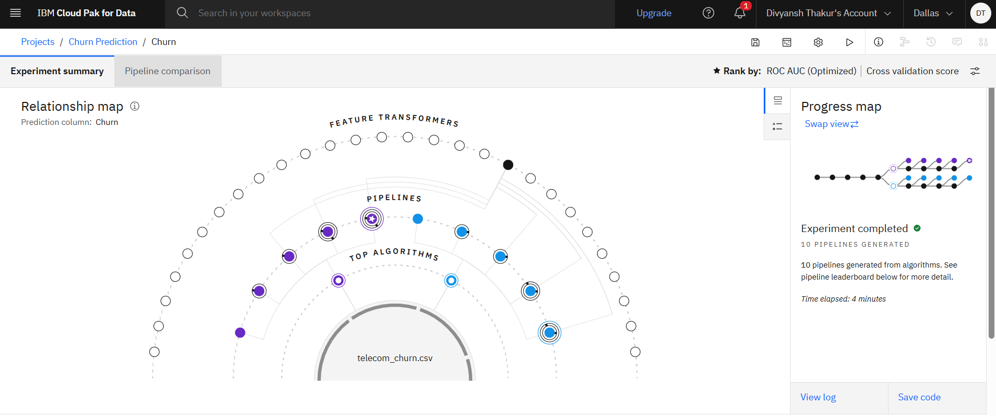
Training Screenshots-

Slide 7
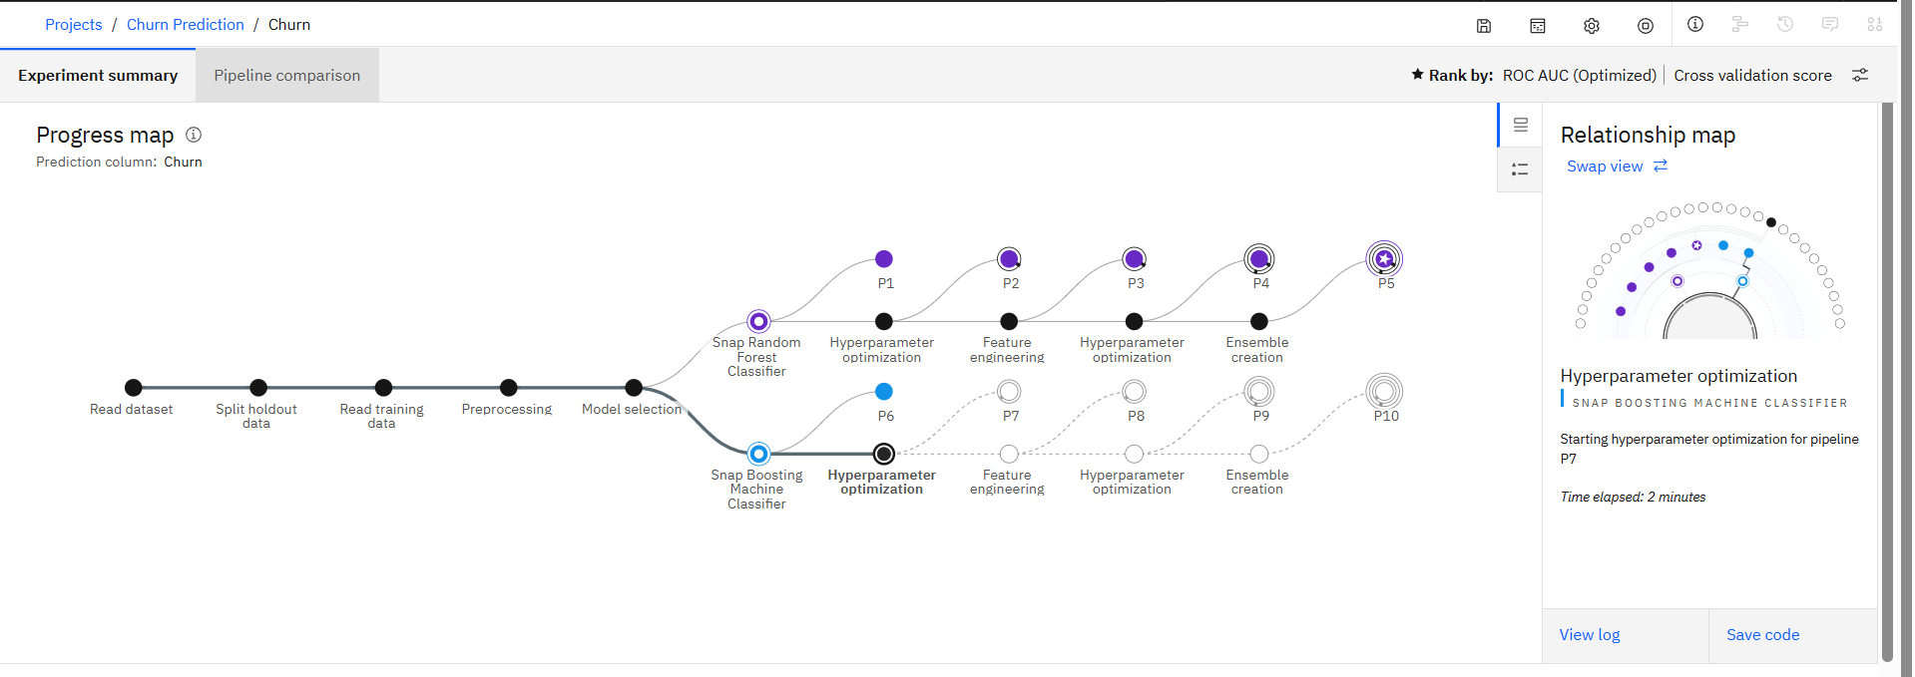
Training Screenshots-

Slide 8
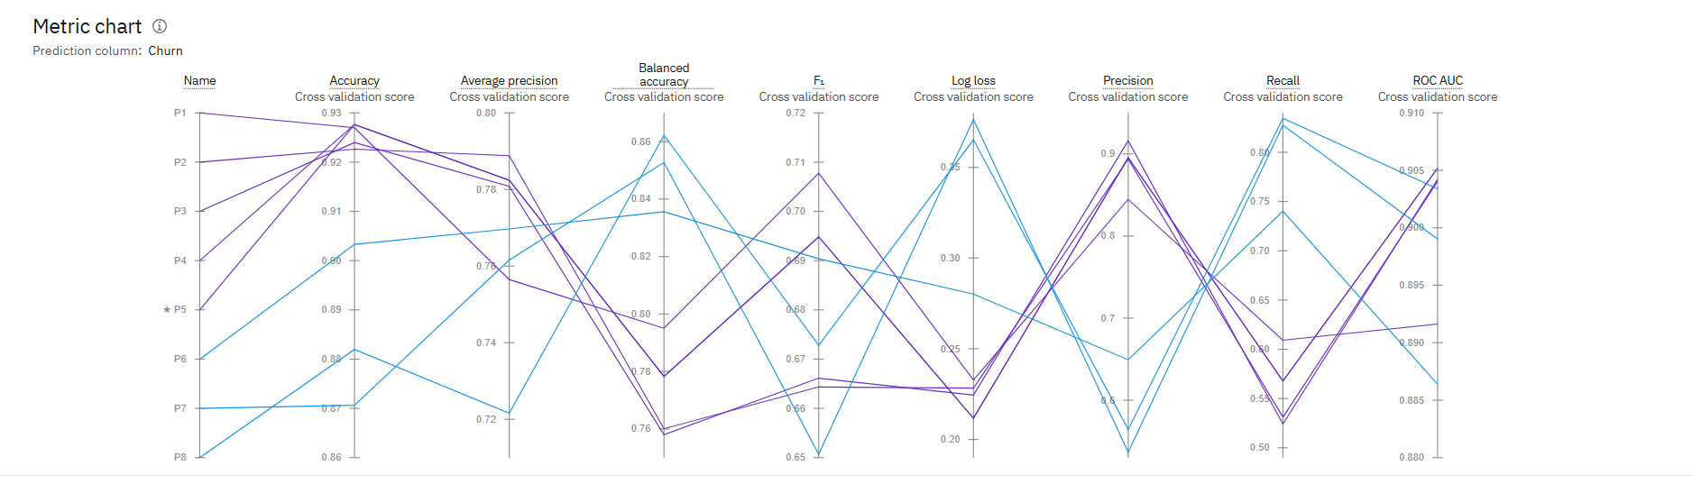
Training Screenshots-

Slide 9
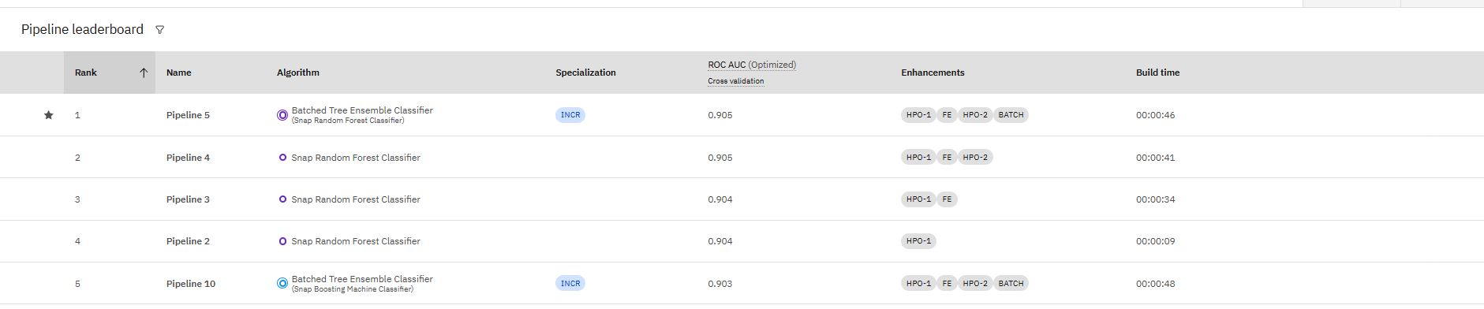
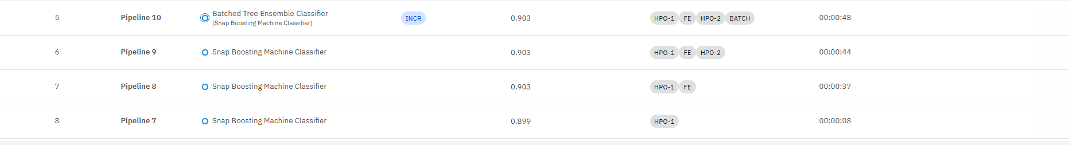
Best Model Screenshot:

Slide 10
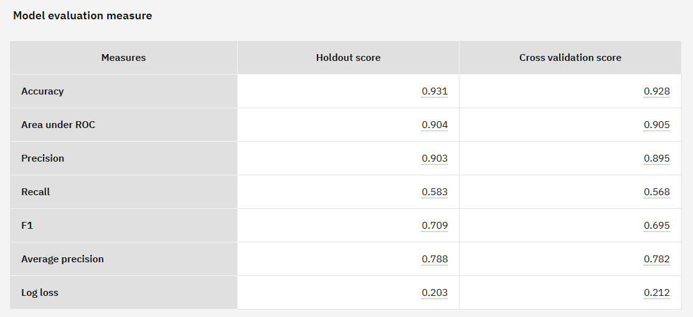
Best Model Screenshot:

Slide 11
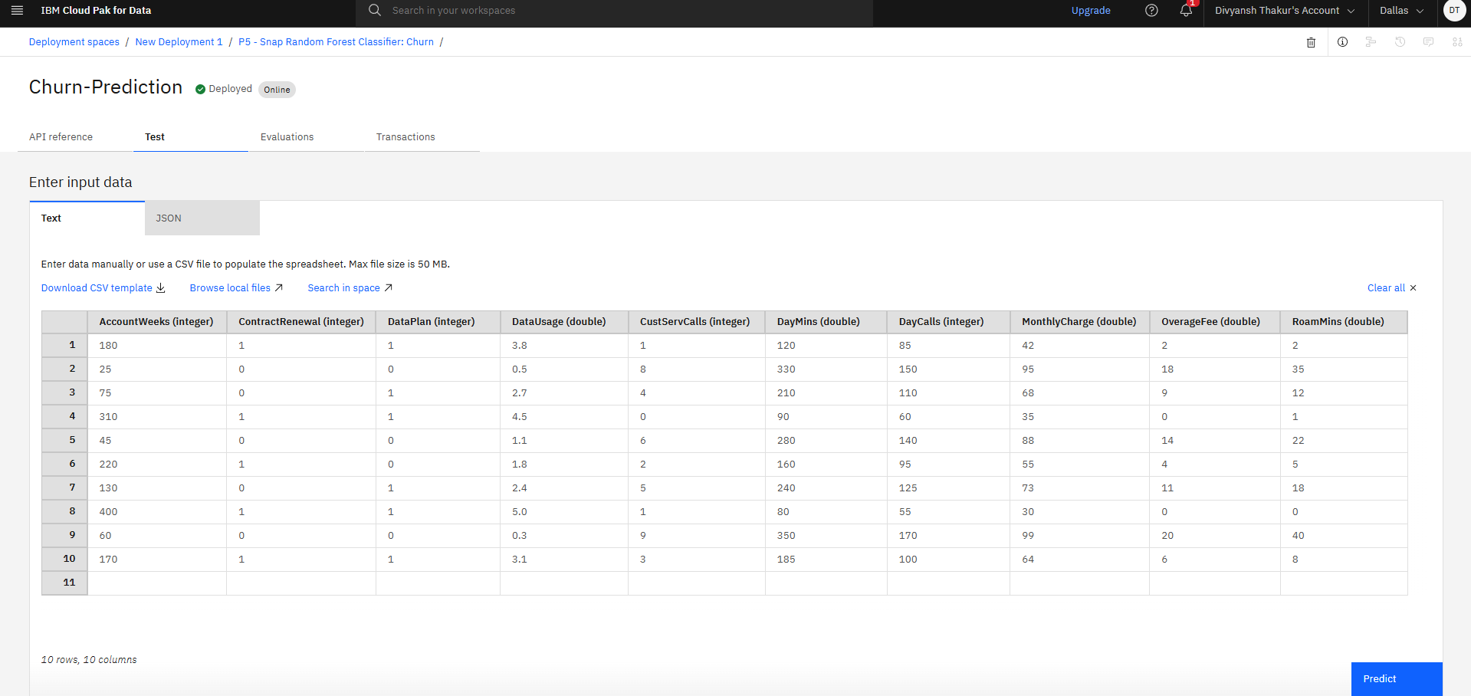
Testing Screenshot:

Slide 12
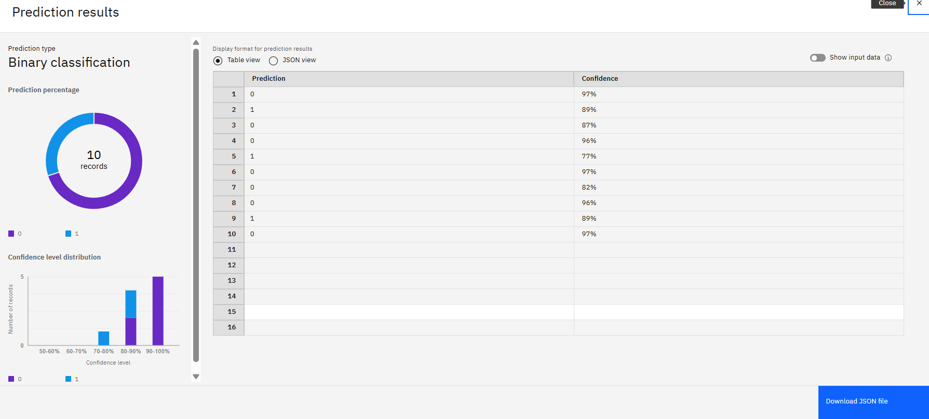
Testing Screenshot:

Slide 13
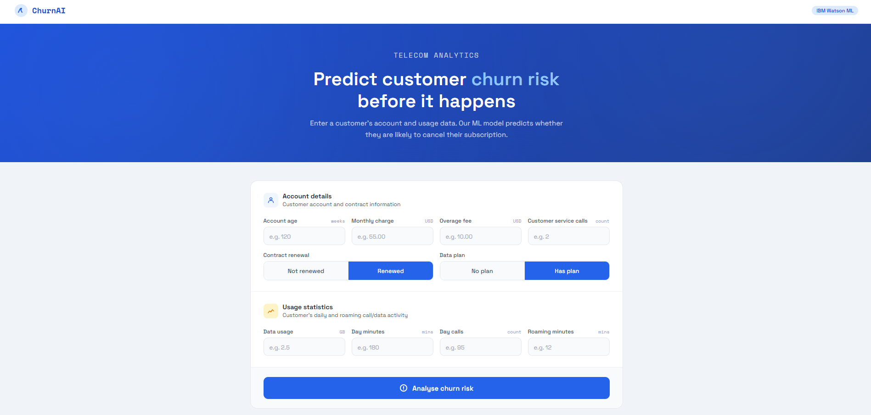
Testing Screenshot:

Slide 14
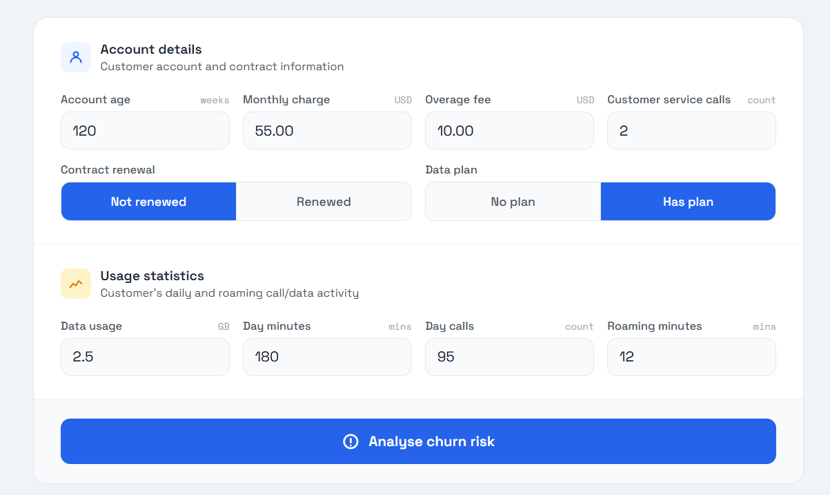
Testing Screenshot:

Slide 15
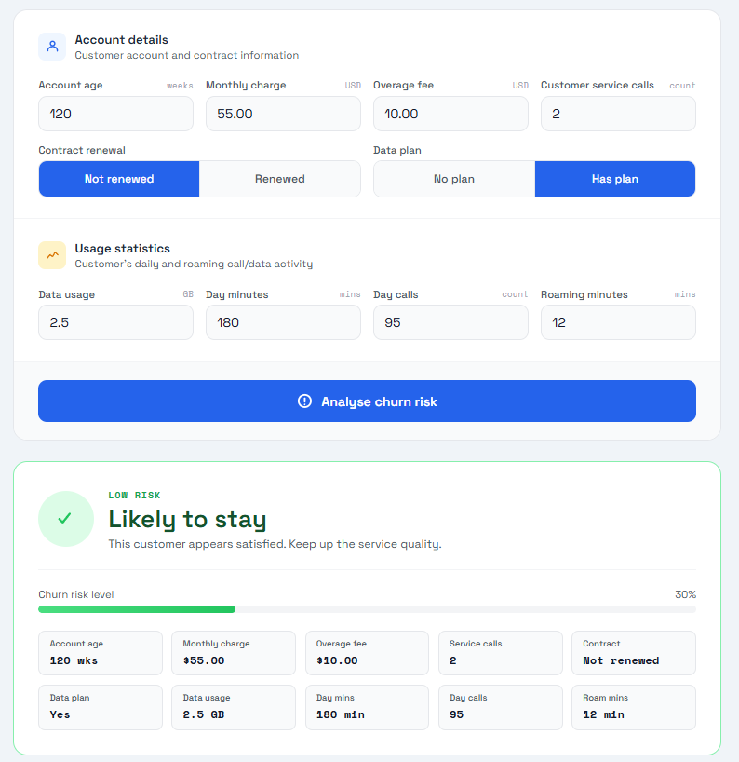
Testing Screenshot:

Slide 16
Novelty and Uniqueness
Automates customer churn prediction using Artificial Intelligence.
Utilizes IBM AutoAI for automated model generation and optimization.
Eliminates the need for manual churn analysis.
Provides real-time predictions through a user-friendly web interface.
Integrates IBM Watson Machine Learning deployment with a custom web application.
Enables businesses to identify high-risk customers proactively.
Helps reduce customer attrition and revenue loss.
Supports data-driven decision-making for retention strategies.
Demonstrates end-to-end Machine Learning lifecycle implementation on IBM Cloud.

Slide 17
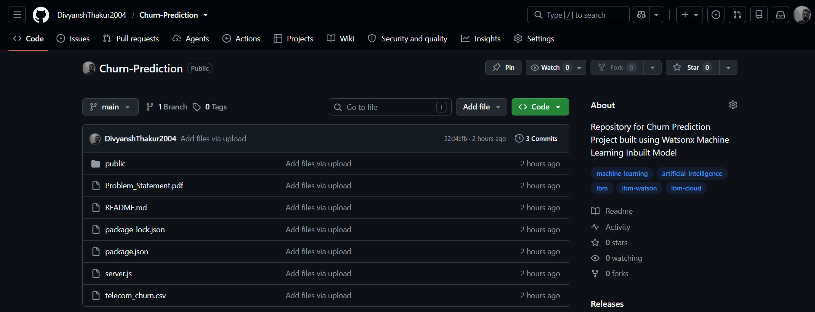
Git Hub Link
Link: https://github.com/DivyanshThakur2004/Churn-Prediction
·
·
·

Slide 18
Future Scope
Integrate customer retention recommendations using Generative AI.
Provide personalized retention offers for high-risk customers.
Support real-time telecom customer databases.
Integrate with CRM platforms for automated intervention.
Implement customer segmentation and lifetime value analysis.
Expand the platform to banking, insurance, and subscription businesses.
Develop mobile application support.
Continuously retrain models using new customer data.
Improve prediction accuracy through advanced deep learning models.

Slide 19
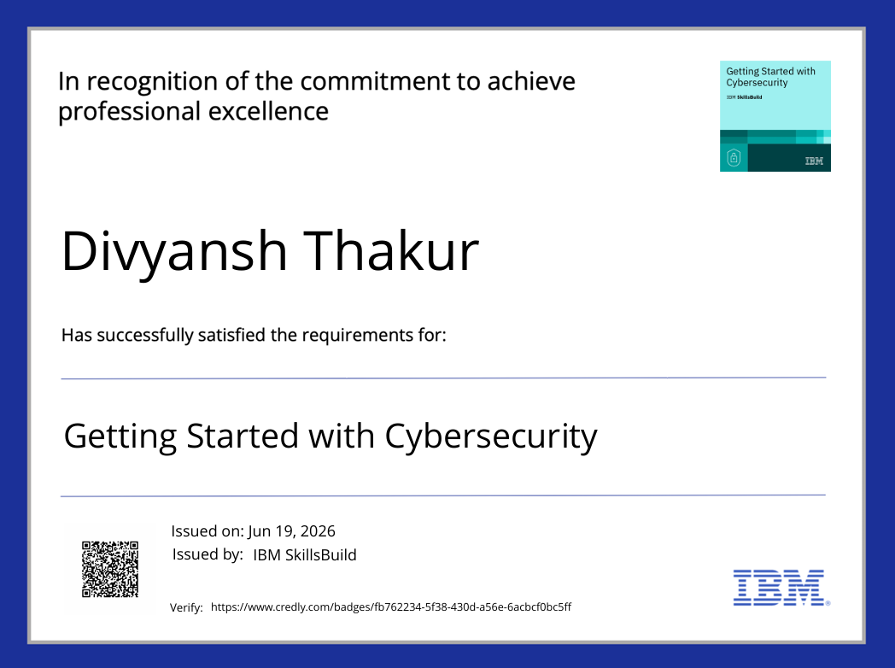
Certificates Earned:

Slide 20
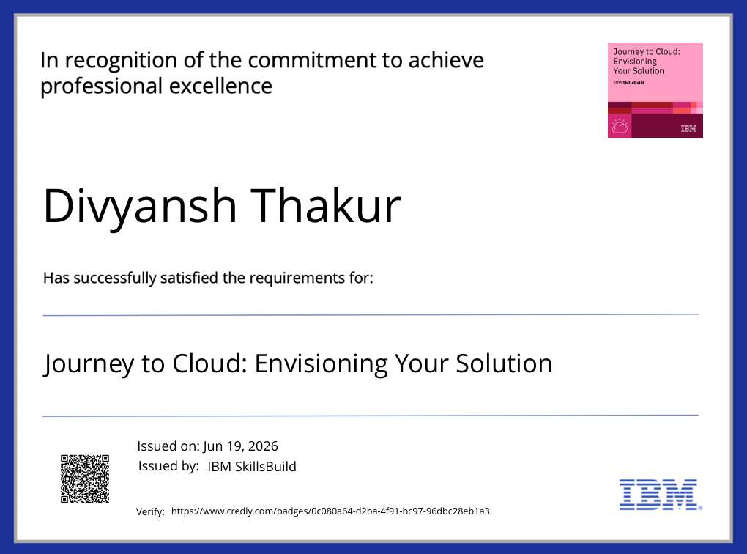
Certificates Earned:

Slide 21
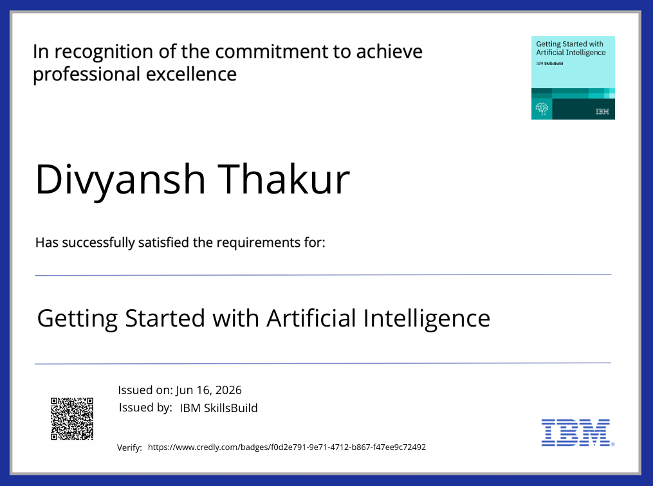
Certificates Earned:

Slide 22
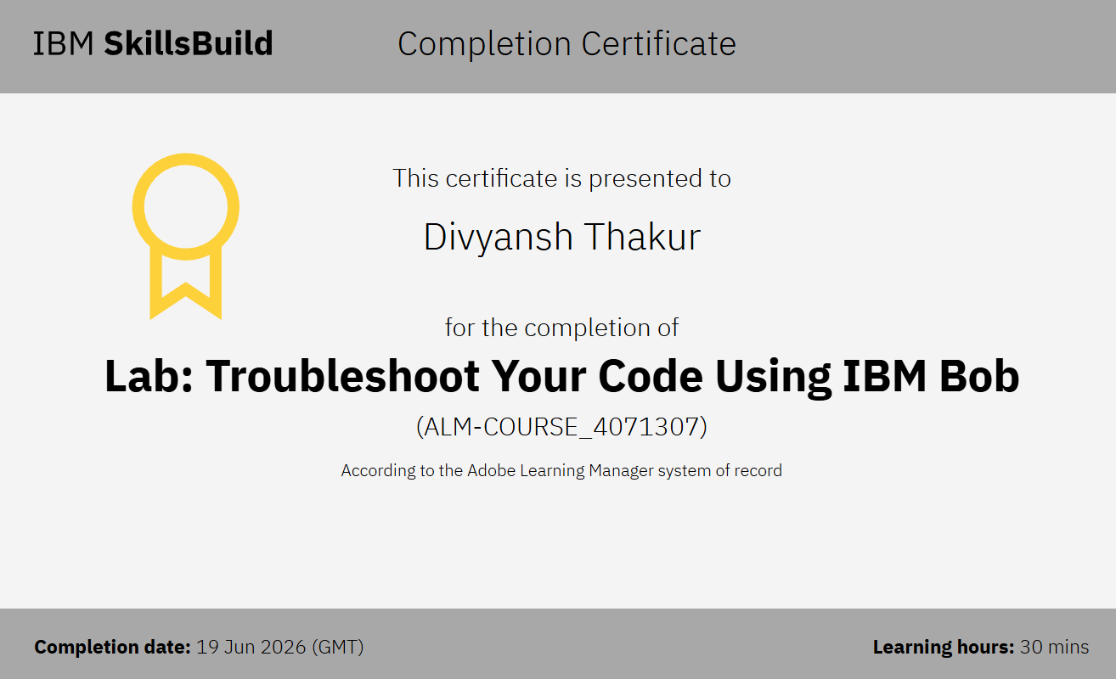
Certificates Earned:​

Slide 23


