Slide 1

EcoSip
Brand Persona & Voice Guide — Digital Marketing Internship
Prepared by: Divyansh Yadav

Slide 2


About EcoSip
Who We Are
Mission
🌱 Sustainable • 💧 Reusable • ♻️ Eco‑Friendly
Reduce plastic waste through stylish reusable bottles.

Slide 3
Brand Persona
Friendly
Eco‑conscious
Modern
Trustworthy
Energetic
Personality shown through approachable tone, environmental focus and fresh visual style.

Slide 4

Target Audience
Age 18–35
Urban & Semi‑Urban
Fitness & Travel
Young adults and early professionals.
City dwellers and nearby suburbs.
Active lifestyles—gym, outdoor, commuting.
Middle Income
Value-driven purchasers seeking quality and style.

Slide 5

Our Voice
Friendly
Positive
Motivational
Honest
"Every refill makes a difference."

Slide 6

Do's & Don'ts
Do's
Don'ts
Use simple language
Inspire people
Be honest
Encourage sustainability
False claims
Negative language
Complicated words
Ignore customers

Slide 7
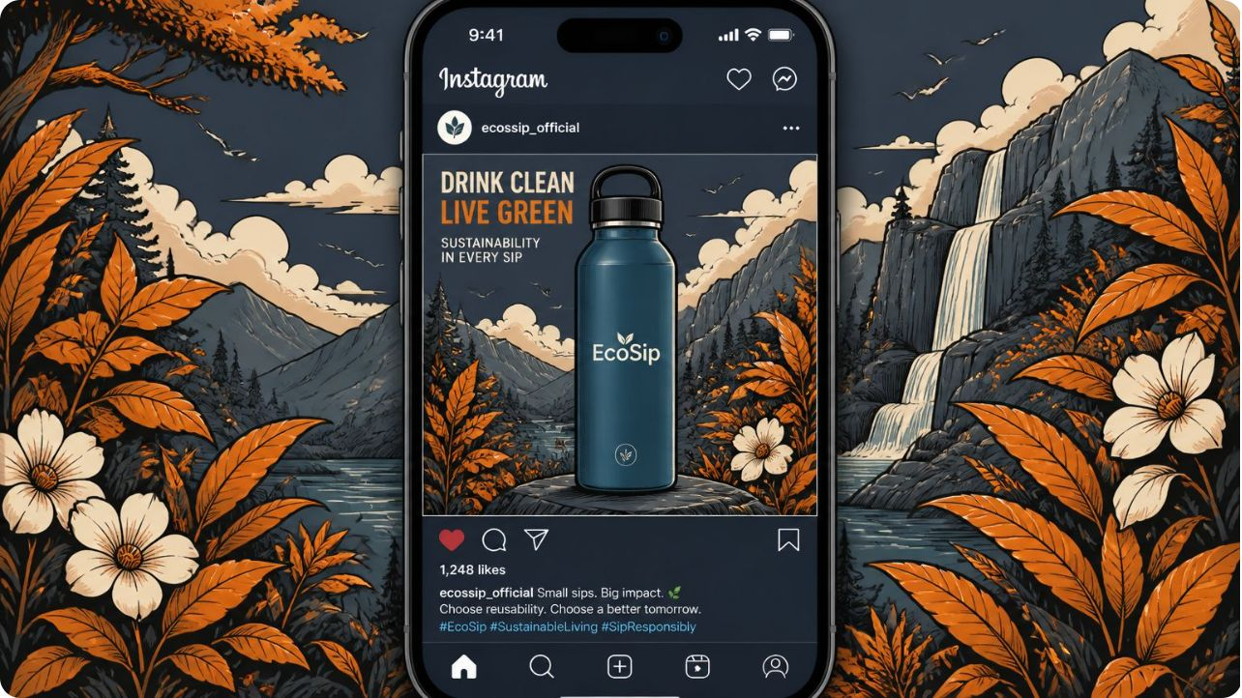
Instagram Campaign
Caption
🌿 One bottle. Thousands of plastic bottles saved.
#EcoSip #GoGreen #SustainableLiving

Slide 8

Thank You
📧 ecosip@email.com
🌐 www.ecosip.com

