Slide 1
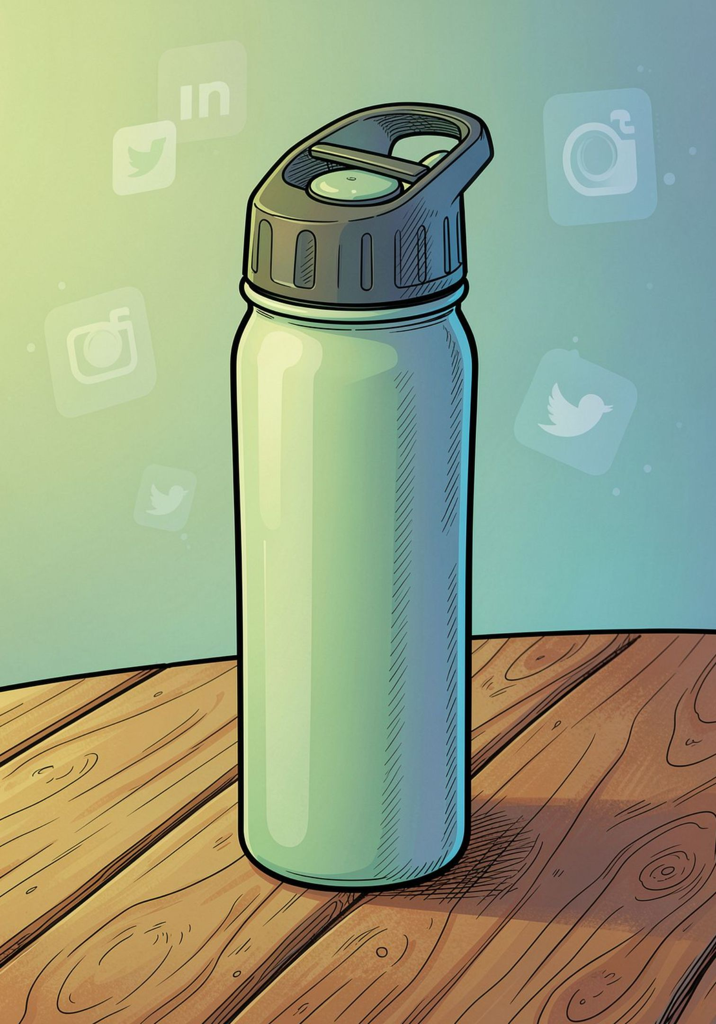
TASK 03
Analyze Competitor Social Media Strategies
EcoSip vs. Milton vs. Borosil — Digital Marketing Internship
Prepared by: Divyansh Yadav

Slide 2
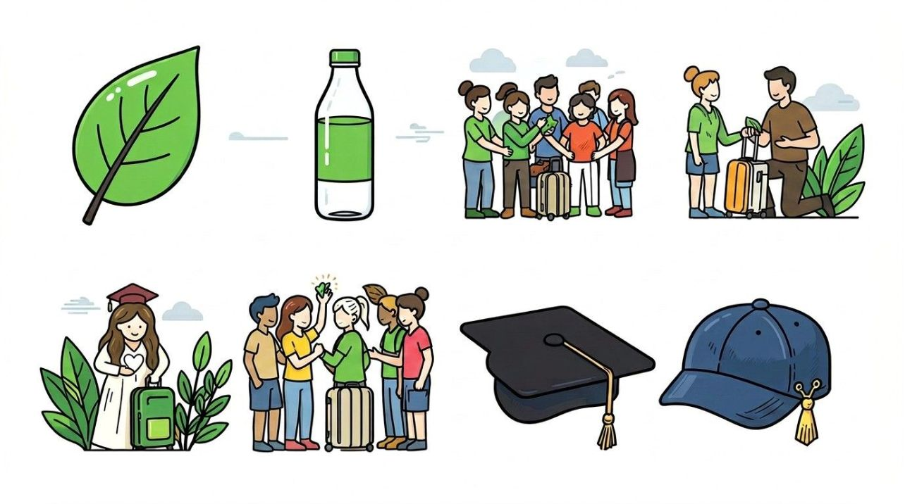
Competitive Landscape
About EcoSip
EcoSip is an eco-friendly brand offering reusable water bottles and drinkware designed for everyday use — durable, stylish, and sustainable.
Target audience
Ages 18–35: students & young professionals
Fitness, travel, and outdoor enthusiasts
Environmentally conscious shoppers (Gen Z focus)
Primary Competitors
Milton — legacy drinkware brand
Borosil — premium glass and kitchenware

Slide 3
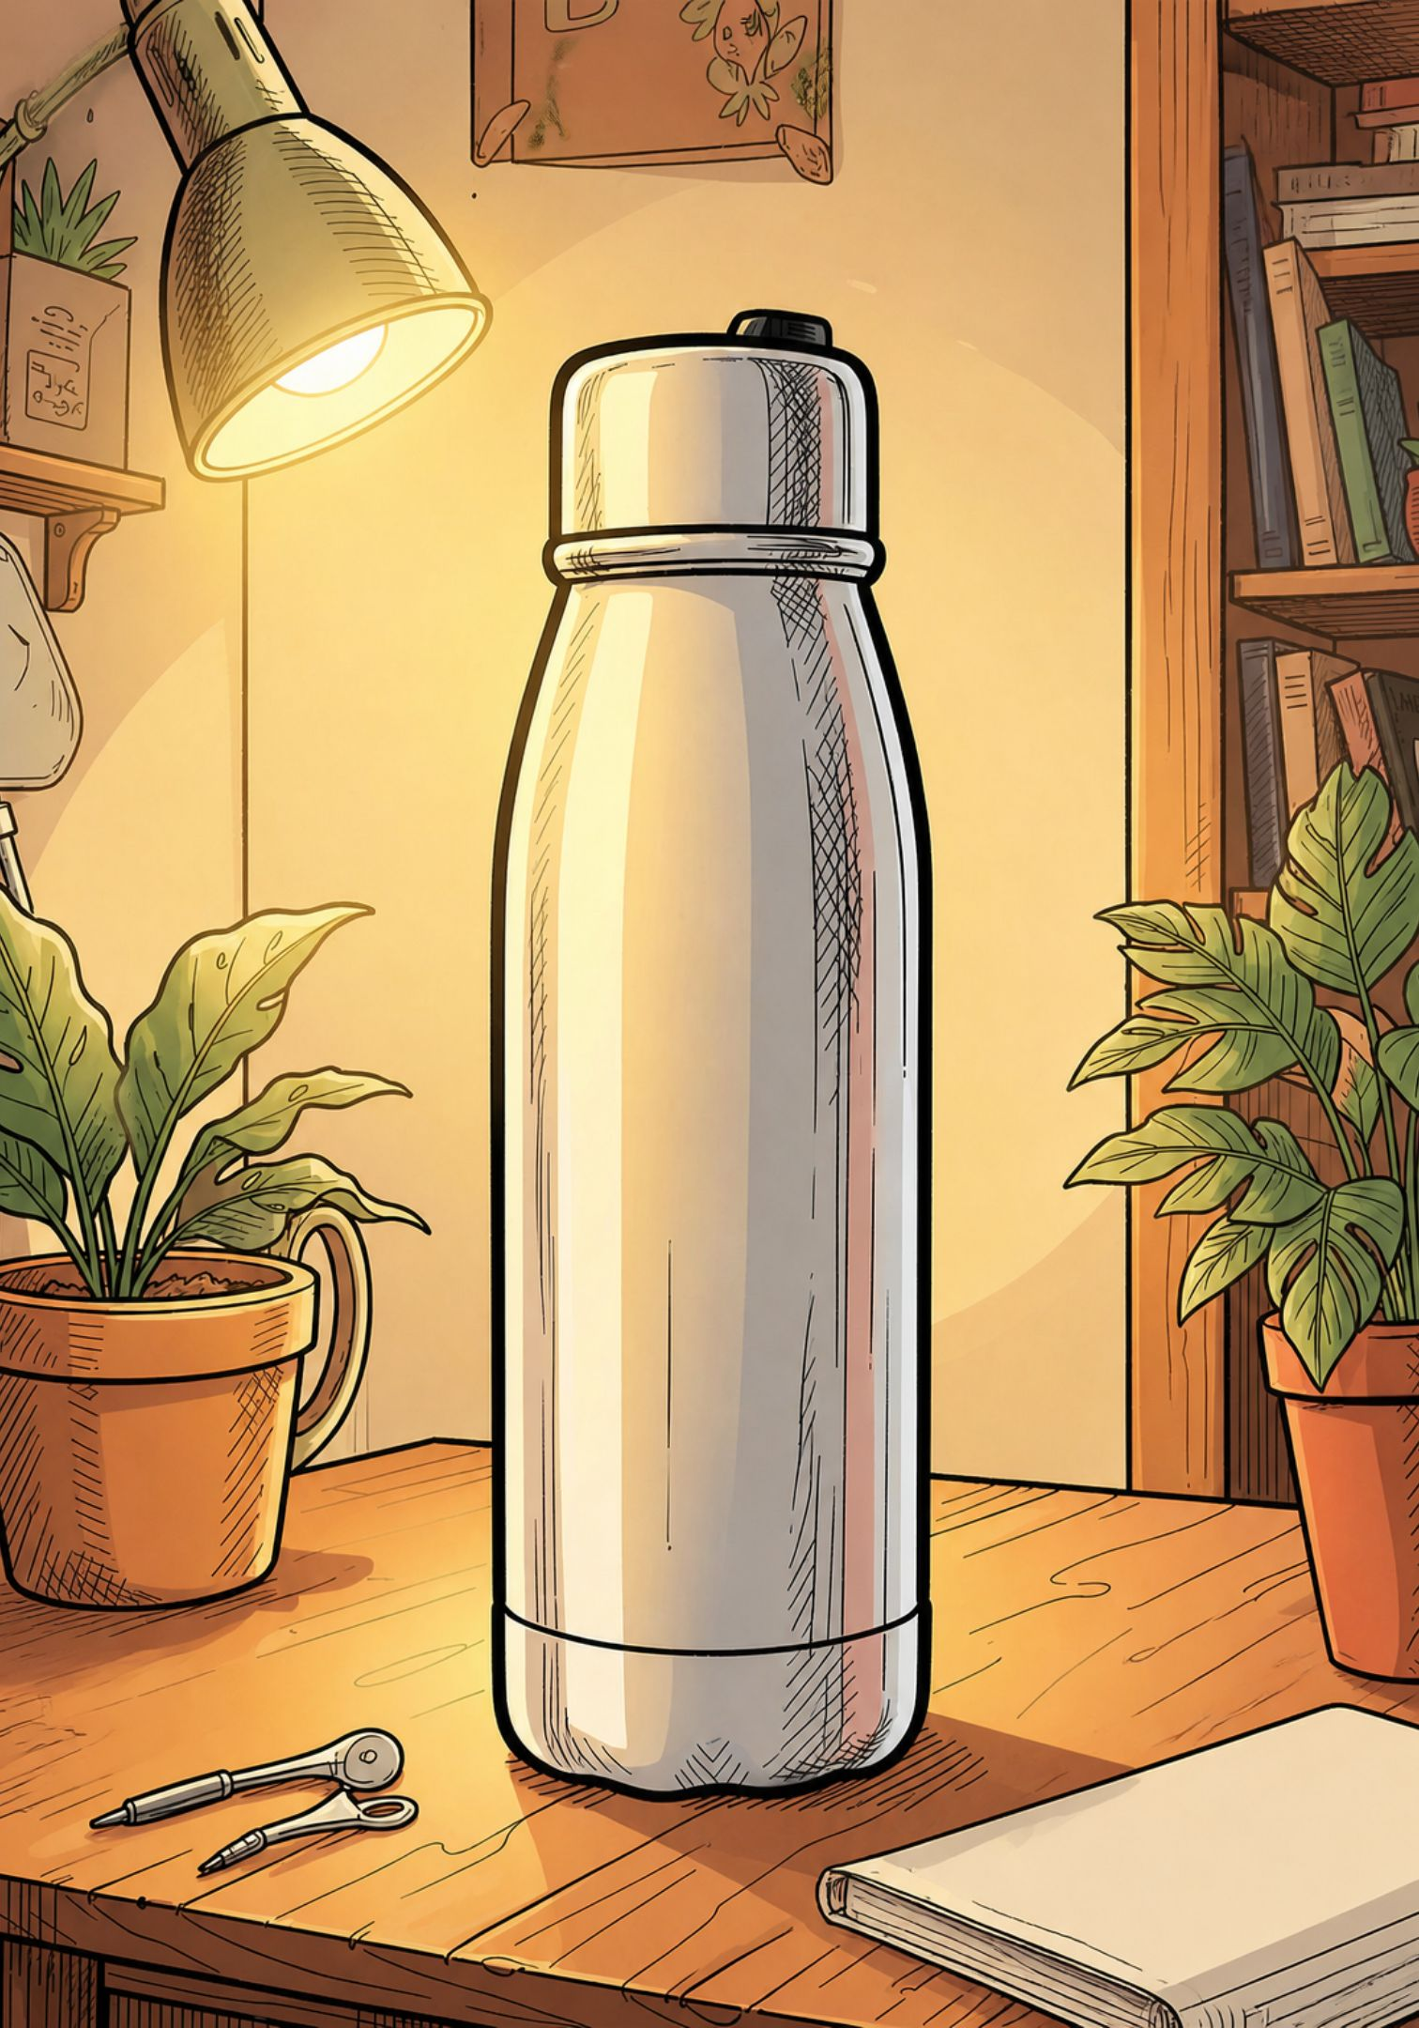
Milton — Social Media Snapshot
Content Style
Product shots, lifestyle posts, seasonal promotions, demos
Engagement Tactics
Discount offers, product demos, customer testimonials
Strategy Focus
Product visibility → broaden reach → drive conversions

Slide 4

Borosil — Social Media Snapshot
Content Style
Premium photography, kitchen & food storytelling, product education
Engagement Tactics
Influencer collaborations, lifestyle stories, community posts
Strategy Focus
Build brand trust → lifestyle positioning → product discovery

Slide 5
Competitor Comparison
Factor | Milton | Borosil | EcoSip Opportunity
Product Focus | High | High | Medium — emphasize eco differentiation
Lifestyle Content | Medium | High | Very High — target Gen Z & micro-scenes
Sustainability | Medium | High | Very High — core brand pillar
Influencer Marketing | Medium | High | High — micro-influencers & campus ambassadors
Educational Content | Medium | Medium | High — hydration + sustainability tips
Gen Z Focus | Medium | Medium | Very High — design, short-form, community

Slide 6
How EcoSip Can Differentiate
🌱Sustainability Storytelling
🎥 Short-Form Video
👥 Micro-Influencers
Share lifecycle stories: materials, manufacturing, and end-of-life impact.
Instagram Reels & Shorts: quick tips, refill routines, before/after swaps.
Partner with niche creators: fitness, travel, college life, sustainability.
💬 Community Engagement
UGC campaigns, challenges, campus ambassador programs, and socials-based rewards.

Slide 7
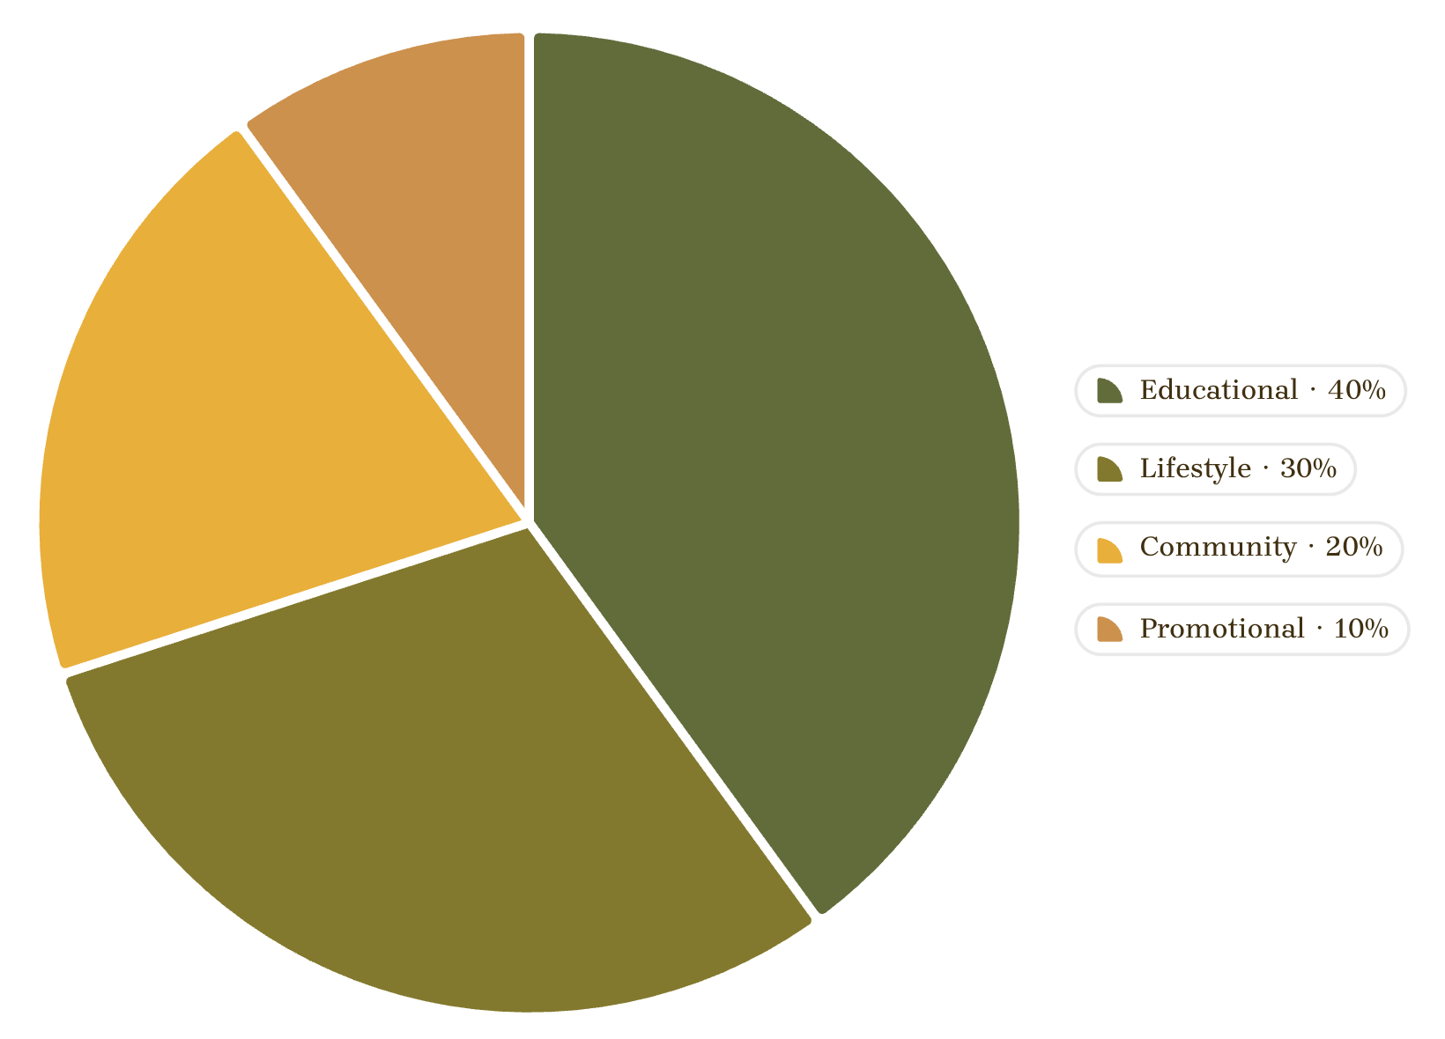
Proposed Content Mix
Execution notes:
Weekly Reels: 2 educational, 2 lifestyle, 1 community highlight
Micro-influencer seeding: 10–15 creators per campaign wave
UGC incentives: discounts, feature on brand channel, campus kits
Campaign idea: #RefillNotLandfill — encourage shares of refill habits and measurable impact.

Slide 8
Conclusion & Key Findings
Milton: product visibility and promotions drive conversions.
Borosil: premium photography and influencer partnerships build trust.
Focus for EcoSip
Final Message
Lead with sustainability storytelling, short-form video, and Gen Z community activation.
Don't just sell a bottle. Build a sustainable lifestyle.
EcoSip — Sip Smart. Live Green. 🌱

