Slide 1
Spell Checker

Slide 2
A spell checker is a software feature that checks for misspellings in a text. Spell-checking features are often embedded in software or services, such as a word processor, email client, electronic dictionary, or search engine.

Slide 3
How does it work
On the basis of 5 types of mistakes that can happen while writing or typing a word spell checker firlsty identifies the mistake.
Then on the basis of the identified mistake it rectifies error in the spelling and corrects it

Slide 4
How does it work
Incorrect spelling
Indentifies the mistke type
Algo sloves the mistake type
corrected spelling

Slide 5
5 mistakes
Type 1: Missing Character
In this type of mistake, a single character is missing from the given word.
Type 2: Extra Character
In this type of mistake, there is an extra character of an alphabet in the word.

Slide 6
5 mistakes
Type 3: Mixture of type 1 and type 2
In this type of mistake, there is an extra character and a missing character.
Type 4: Exchanged Character
In this type of mistake, one alphabet is exchanged with any other alphabet.
Type 5: Incorrect arrangement
In this type of mistake, alphabets are not in proper order.

Slide 7
Type 1
For example :
If the user enters the word "stck" but the correct spelling is "stack". So in this case, "a" is missing from the spelling "stck".
ALGO :
To solve this type of mistake we can perform the following steps:-
1. Start a loop from i = 0 to i = 25.
2. Increase the length of input to +1.
3. Add lower_alpha[i] at the end of input. For example, stcka, stckb, stckc till stckz.
4. Now, check the length of input and word from the file. If the length is equal then:-
4.1. Separate the first character of input and rest of the string i.e., s + tcka (Xinput = s and Ninput = tcka).
4.2. Sort the Ninput i.e., the rest of the string i.e., Ninput = ackt.
4.3. Now combine the first character and sorted string, i.e.,Tinput = Xinput + Ninput = sackt.
5. Repeat the step 4 for the word from the file (i.e., separate first character and rest of the string, sort the string and combine first character and sorted string, Tword = Xword + Nword = s+ackt = sackt).
6. If Tinput and Tword are equal then, print that word of the file and make found equal to 1 and break the loop.
7. return found;

Slide 8
Type 2
For example :
If the user enters "staick" but the correct spelling is "stack" therefore, there is an extra alphabet "i".
ALGO :
For solving this type of mistake follow the given steps:-
1. First, check if the (length of input - 1) is equal to the length of a word from the file. If equal then:-
2 Start a loop from i = 1 to i < length of input.
3. Remove the character from the string input of index i. For example, if input = staick then at i = 1, input will be "saick" at i = 2, input will be "stick" at i = 3 input will be "stack" and so on.
4. After removing a single character from input (i.e., after each iteration) compare it with word from the file, if two string (input and word from file) are equal then print the word from the file and make found = 1 and break the loop.
5. return found;

Slide 9
Type 3
For example :
If the user enters "tommorow" then "m" is extra and "r" is missing in this word.
ALGO :
For solving this type of mistake follow the given steps:-
1. We have to remove each an every alphabet one by one except the first character. For example, tmmorow, tomorow, tomorow, tommrow, tommoow, tommoro.
2. After removing one character from the string, add lower_alpha[i] at the end of the string. For example, tmmorowa, tmmorowb, till tommorowz.
3. Sort the input except for the first character, for example, tammoorw.
4. Follow step 3 for word from the file.
5. Compare word from file and input. If same then print word from the file and break the loop.
6. return found;

Slide 10
Type 4
For example :
If the user enters "concensus" but the correct spelling is "consensus", so first "s" in consensus is replaced with "c".
ALGO :
For solving this type of mistake follow the given steps:-
1. First, check the length of input and word from the file. if they are equal then proceed further, otherwise move to next word of the file.
2. Start a loop from i = (length of the input - 1) to i >= 0.
3. Make input string at index "i" equal to lower_alpha[0] i.e.,
Xinput = input;
Xinput[i] = lower_alpha[0];
4. Start a loop from j = 0 to j =25.
5. Check Xinput equal to word from the file. If this condition is true then make found = 1 and print that word from the file and break the loops.
6. If the condition in step 5 is not true then make Xinput[i] = lower_alpha[j+1].
7. return found;

Slide 11
Type 5
For example :
If the user enters lenght instead of length then the position of "h" and "t" are interchanged or we can say that the arrangement of both alphabets is incorrect.
ALGO :
For solving this type of mistake follow the given steps:-
1. Check the length of the word from file and input. If lengths are equal then move to the next step otherwise move to the next word of the file.
2. Separate the first alphabet from the string and sort the string. For example, lenght will be Xinput = l and Ninput = enght. Sort Ninput, after sorting it will look like this Ninput = eghnt. Now add Xinput and Ninput (Tinput = Xinput + Ninput = l + eghnt = leghnt).
3. Do the same thing for word from the file as done in step 2 (Tword = Xword + Nword, where Xword is the first alphabet of the word and Nword is the sorted string of remaining word).
4. Compare both strings Tinput and Twords and if both are same then that word is the answer. Print the word from the file and make found = 1 and break all loops.
5. return found;

Slide 12
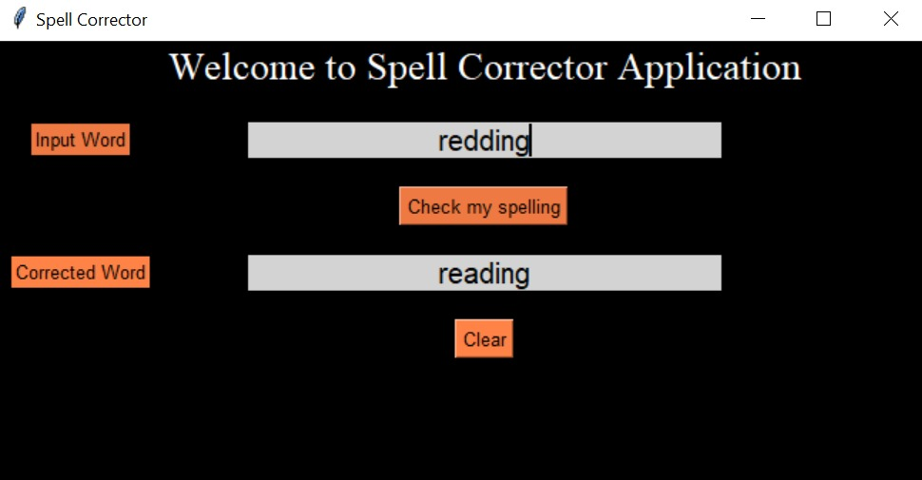
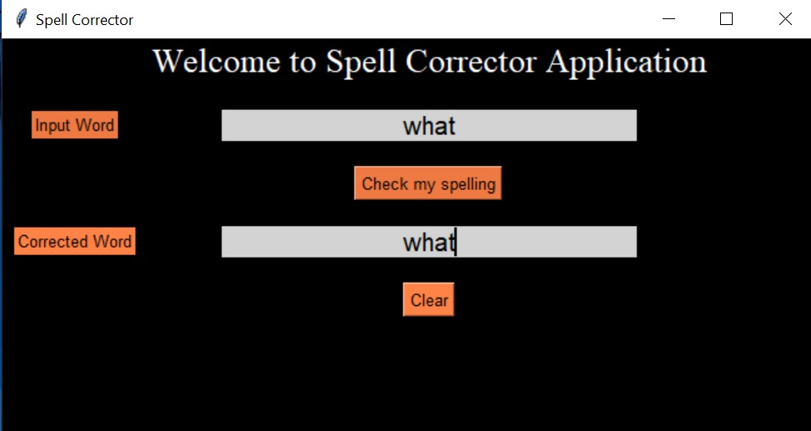
Screenshot of Prototype

Slide 13
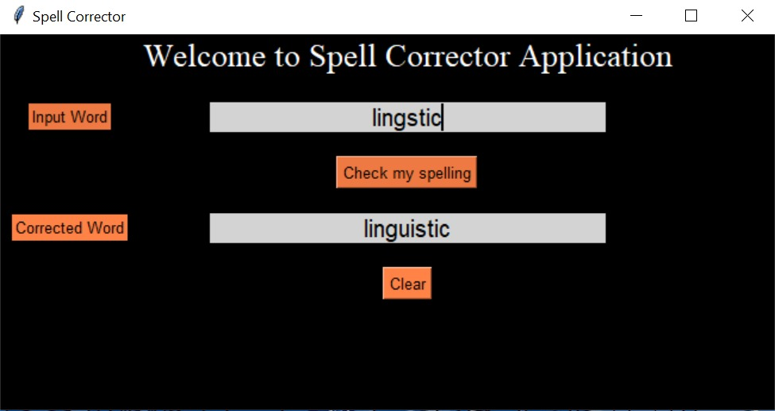
FUNCTIONALITIES
Input:
String given by the user
Output:
If the word is correct display the same string
If the word is incorrect display the incorrected string
Process:
Take the user input and copy it into different string and check for all the possible mistakes (ie . five types of mistakes discussed above) according to any one potential algorithm look above into the dictionary
and display output in the output bar.

Slide 14
Spell Checker
THANK YOU
Divyansha Tiwari

