Slide 1
Agentic Memory-Augmented Neural Machine Translation for English-Hindi with LoRA-Optimized Large Language Models
Project Supervisor: - Prof. Amit Kumar Singh
Presented By: - Divyanshi Chauhan, 21074012
26 April, 2026

Slide 2
Contents
Introduction
2. Agentic AI Framework
3. Objective of the Proposed Model
4. Proposed Model
5. Evaluation Metrics
6. Results and Analysis
7. Model Analysis
8. Future Scope and Conclusion
9. Referred Papers

Slide 3
Introduction
Seq-to-seq Models
Transformers
General Purpose
LLMs
Agentic AI
Translation
Linear translation
Static knowledge
No self-correction
Limited context
Weak for low-resource
Fluent translations
Prompt-based adaptation
Moderate reasoning
No iteration loop
Limited consistency
Iterative reasoning loop
Self-correction via agents
Memory-driven consistency
Dynamic knowledge access
Strong low-resource handling
Notes:
MT is no longer just a translation tool, it has wide applications in chatbots, voice assistants, and AI translates in many services. (Eg. Siri, Alexxa, Insta Translate)
The initial developments of MT:
RBMT
SMT
NMT, deep learning
Transformers make use of encoder-decoder layers, alongwith attention modules, introduced the concept of parallelization.
Eg. IndicTrans2, NLLB-200
General Purpose LLMs: these have huge set of parameters, and trained on large datasets, are very efficient, mainly transformers are heavily used.
Agentic AI translation are autonomous framework for mt, with almost minimal human interaction, gives direction to LLMs, iterative.

Slide 4
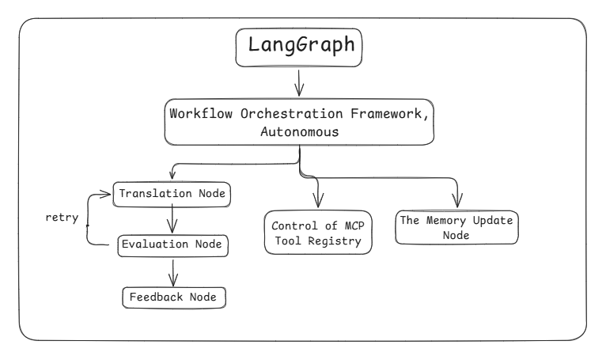
Agentic AI Framework
Notes:
Agentic AI: autonomous, and it supports agents in our model
LangGraph to implement the concept of Agentic AI.
Langgraph is a graph-based execution model.
Graph
Nodes: functions, agents, LLM calls
Edges: transitions between steps, and instructions
State: shared memory passed across nodes
Langgraph: state machine+directed graph execution
1. execute node
2. update state
3. decide next node
4. continue until END
MCP (model context protocol): It is a standard for LLMs to securely connect with external tools, data sources and systems in a structured, interoperable way.

Slide 5
Fine Tuning Process
Samanantar Dataset (10,000 pairs)
↓
Preprocessing & Formatting
↓
4-bit Quantization of OPT-1.3B
↓
LoRA Adapter Injection
↓
Forward Pass → Loss Computation
↓
Backward Pass → Gradient Update (LoRA only)
↓
Repeat for 3 epochs (30,000 steps total)
↓
Save LoRA Adapter
↓
Fine-tuned Translation Model
Notes:
LoRA (Low Rank Adaptation)
- fine-tuning technique
- parameter-efficient

Slide 6
Objective of the Proposed Model
To design a memory-augmented, agentic machine translation system for English-to-Hindi that improves semantic accuracy, consistency, and robustness through iterative feedback, multi-agent collaboration, and low-resource adaptation.

Slide 7
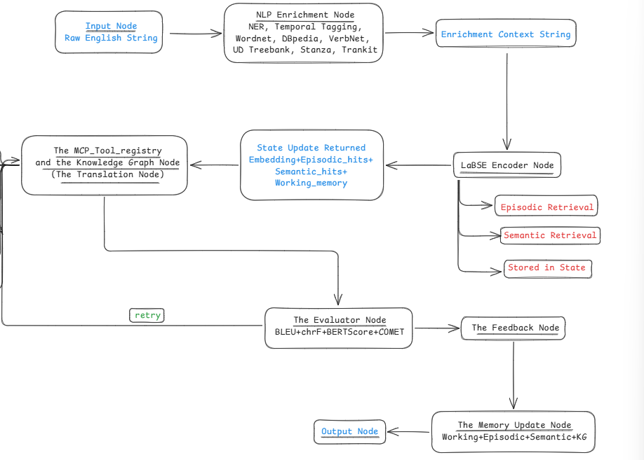
Proposed Model
Notes:
LaBSE
convert text into language-independent embeddings
(Language agnostic BERT Sentence Embedding)
is a model developed by Google that maps sentences from different languages into a shared vector space.

Slide 8
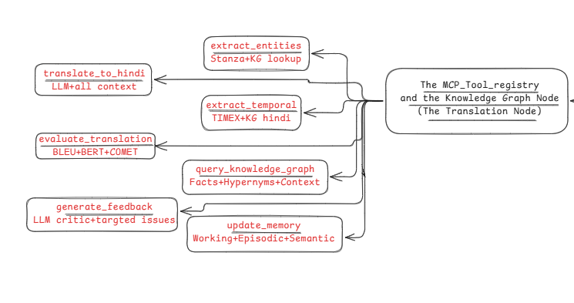
Proposed Model

Slide 9
Evaluation Metrics
BLEU (Bilingual Evaluation Understudy)
Measures the lexical overlap between the machine’s output and a human reference.
Calculates n-gram precision.
Fast and model-agnostic.
chrF (Character n-gram F-score)
Uses character n-grams, and calculates an F-score (balancing precision and recall).
More effective for morphologically rich languages.

Slide 10
Evaluation Metrics
BERTScore
Uses a pre-trained model (BERT/RoBERTa) to create embeddings for the machine translation and the human reference. Then calculates the cosine similarity between these vectors.
Rewards paraphrasing.
COMET (Cross-lingual Optimized Metric for Evaluation of Translation)
Trained neural model, takes three inputs: the Source text, the Machine Translation, and the Human Reference.
It is source-aware.

Slide 11
Results and Analysis
Performance Evaluation of the Proposed Agentic Machine Translation Model using a Large Language Model via Groq API

Slide 12
Results and Analysis
English to Hindi Translation Benchmark Table
Research/Task | Model | Dataset | Metric | Score
MDPI (2022) | Transformer | Samanantar | BLEU | 33.45-33.72
Meta AI (2022) | NLLB-200 | Flores-200 | spBLEU | 31.4
AI4Bharat (2023) | IndicTrans2 | Flores-200 | BLEU | 35.8
AI4Bharat (2023) | IndicTrans2 | IN22-Gen | chrF++ | 63-66

Slide 13
Results and Analysis
Proposed Model
Architecture: Facebook/opt-1.3b
Fine-tuning method: LoRA
Dataset: Ai4bharat/samanantar
Language Pair: En-Hi
Train Size: 10000
Epochs: 3

Slide 14
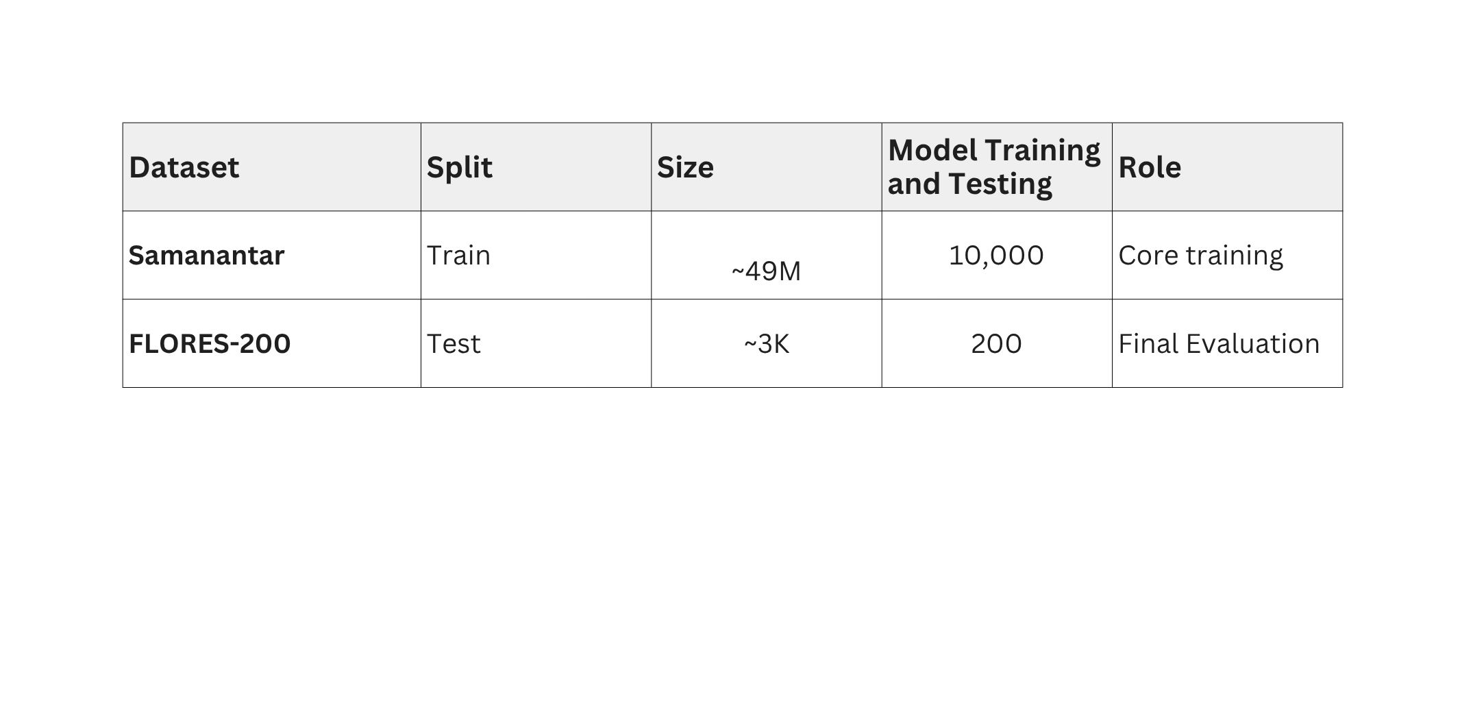
Dataset Analysis

Slide 15
Results and Analysis
Performance Evaluation of the Proposed Agentic Machine Translation Model using Fine-Tuning Method and testing on FLORES-200
Evaluation Metric | IndicTrans2_3.3B | mBART50 | Proposed Model
BLEU | 15.75 | 14.8 | 9.14
chrF | 33.21 | 27.59 | 29.87
BERTScore | 0.6142 | 0.5738 | 0.5983
COMET | 0.582 | 0.5192 | 0.5267

Slide 16
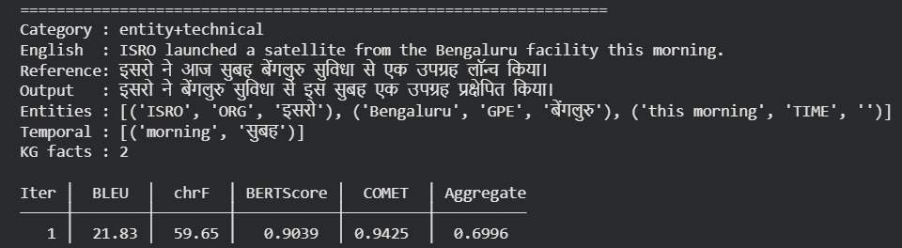
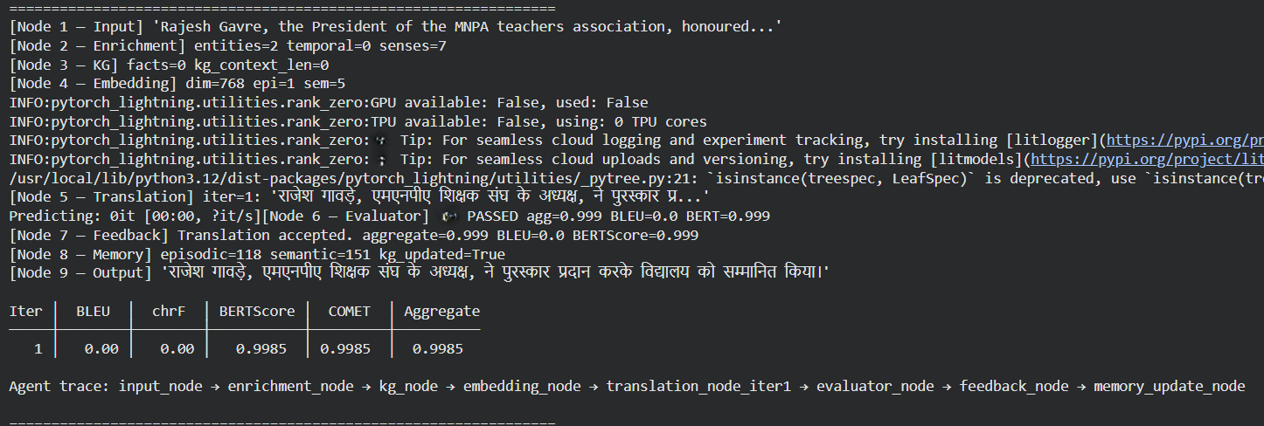
Output

Slide 17
Model Analysis
The Enrichment Node
Stanza NER uses a BiLSTM-CRF neural model trained on CoNLL data to label every token.
TIMEX tagging uses regex patterns.
WordNet sense disambiguation tokenises the sentence, POS-tags it with NLTK and then proceed with queries.
DBpedia SPARQL fires a real HTTP query.
2. The Knowledge Graph Node
Dynamic, for each entity that is recognised and translated in that session gets added via memory update node.
Backed by NetworkX.
Notes:
wordnet: Lexical database

Slide 18
Model Analysis
3. The MCP Tool Registry
Name-Value Python Dictionary.
LangGraph node initiates the call for a particular entity, MCP client looks up the tool by name and invoking it with typed arguments.
4. The Embedding Node
Encodes the sentence with LaBSE.
5. The Translation Node
Semantic Knowledge from ChromaDB.
Episodic Examples from past translations.
Working Memory from current session.
Enrichment context.
KG context.

Slide 19
Model Analysis
6. The Evaluator Node
BLEU, BERTScore, chRf, COMET
Updates all three memory tiers.
Add new entity pairs to the KG.
Proceed either to the output node or retry the translation.

Slide 20
Future Scope and Conclusion
Future Work:
Support to a wider range of low-resource languages.
2. Dealing with the adversarial examples and improving adversarial robustness.
3. Optimizing the agentic framework for latency and deployment in real-time applications.
Conclusion:
This thesis presented a comprehensive approach to English-to-Hindi machine translation by integrating agentic artificial intelligence with memory-augmented neural architectures, enabling modular and autonomous decision-making model.

Slide 21
Referred Papers
1) Are AI agents the new machine translation frontier? Challenges and opportunities of single- and multi-agent systems for multilingual digital communication, Journal: arXiv, Publication Year: 2025
2) Agent-as-a-Graph: Knowledge Graph-Based Tool and Agent Retrieval for LLM Multi-Agent Systems,
Journal: arXiv, Publication Year: 2025
3) Leveraging the Power of Large Language Models in Entity Linking via Adaptive Routing and Targeted Reasoning, Journal: Association for Computational Linguistics, Publication Year: 2025
4) Transformers: Leveraging OpenNMT and Transfer Learning for Low-Resource Indian Language Translation, Journal: Association for Computational Linguistics, Publication Year: 2025
5) Reinforcement of low-resource language translation with neural machine translation and backtranslation synergies, Journal: International Journal of Artificial Intelligence, Publication Year: 2024
6) mT5: A massively multilingual pre-trained text-to-text transformer, Journal: arXiv, Publication Year: 2021

Slide 22
Thank you
Presented By: Divyanshi Chauhan, 21074012
divyanshi.chauhan.cse21@itbhu.ac.in

