Slide 1

MUSIC RECOMMENDATION SYSTEM
Group No. 41
Under The Supervision of:-
Dr. Vinod Jain
(Asst. Professor)
Department of CEA
GLA University, Mathura
Presented By:-
Divyanshi Rajput 2242000182
Ayushi Agrawal 2242000126
Parineeta Mishra 2242000363
Neha Kumari 2242000345
Mamatesh Kumar 2242000313
Anugrah Awasthi 2242000089

Slide 2
Introduction
In today's digital age, music streaming platforms offer a vast library of songs, but users often struggle to discover new music that aligns with their tastes.
Our project addresses this challenge by introducing a personalized music recommendation system that enhances the user experience and promotes music discovery.
The problem that how the abundance of music available online makes it challenging for users to discover new songs that align with their preferences.
Personalized recommendations will not only enhance user satisfaction but also foster a deeper connection between users and the music they love.

Slide 3
Problem Statement
The project aims to solve_
The Challenge of Music Discovery
Lack of Personalization in Recommendations - Existing music recommendation systems often rely on generic algorithms that overlook the individual preferences and listening habits of users.
Impact on User Experience - The inability to discover new music tailored to their tastes diminishes the overall user experience and engagement with music streaming platforms.
The Opportunity for Innovation - Our project seeks to address these challenges by developing a highly personalized music recommendation system.

Slide 4
Objective
The goal of this project was to learn about machine learning and its fundamental concepts, as well as checking the accuracy of the model.

Slide 5
Purpose
Project aims to _
Addressing User Frustration
Tailored Music Experience
Promoting Music Exploration
Driving Platform Engagement

Slide 6
Hardware and software Specifications
Hardware Requirements:
Laptop
Software Requirements:
Python version 3.12.2
Python and Machine Learning libraries ,i.e., pandas, NumPy, streamlit, scikit-learn
Integrated Development Environment (Jupyter Notebook)
Google Chrome (to run streamlit web application)
JioSaavn API

Slide 7
Project Scope
Simple, Intelligent, Time Saving
In-expensive
User-Centric Approach - By analyzing user data and interaction patterns, the system will tailor recommendations to each user's unique tastes and interests.
Data Collection and Analysis - The scope includes the collection and analysis of user data, including listening history, genre preferences, ratings, and user interactions.
Integration with Platform - This includes developing APIs and interfaces for data exchange, as well as ensuring compatibility with various devices and platforms.
Testing and Optimization - This will include conducting A/B testing, user feedback sessions, and performance optimization to ensure the system delivers accurate and relevant recommendations.
Scalability and Performance - The project scope also considers the scalability and performance requirements of the music recommendation system

Slide 8
Tools and Technology
Python: The project will primarily utilize Python for its flexibility, extensive libraries, and robust support for machine learning and data analysis tasks. Python's ecosystem, including libraries like NumPy, Pandas, and Scikit-learn, are vital for implementing recommendation algorithms and data processing tasks
Machine Learning Libraries: Machine learning libraries are used such as Scikit-learn, TensorFlow, for developing recommendation algorithms.
Jiosaavn API: APIs are mechanisms that enable two software components to communicate with each other using a set of definitions and protocols
Development Environment: Development have taken place in an integrated development environment (IDE), i.e., Jupyter Notebook, providing a conducive environment for coding, experimentation, and debugging.

Slide 9
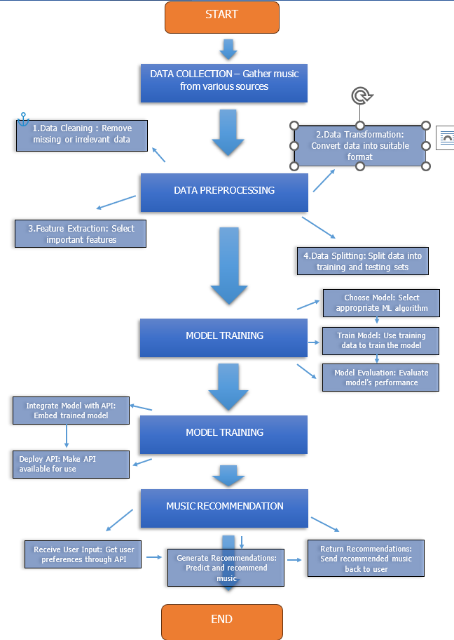
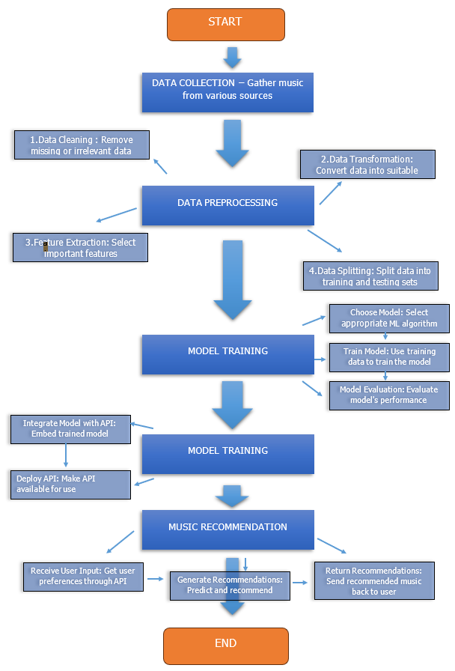
Flow Chart

Slide 10
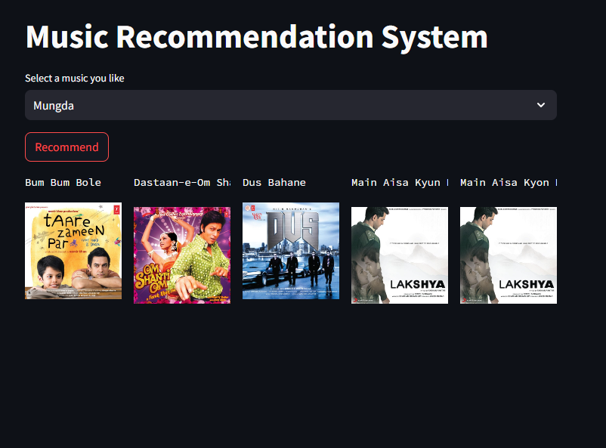
Final Result

Slide 11
Conclusion
The music supplier can forecast and then give acceptable songs to its consumers using a music recommender system based on the qualities of previously heard music.
We learned how to design a machine learning model, train it, and then test it.
Through extensive testing and refinement, the system has demonstrated its capability to provide accurate and personalized song recommendations to users.
Future iterations of the system will focus on incorporating more advanced algorithms and techniques to further improve recommendation accuracy and user engagement.
The music recommendation system has the potential to positively impact the way users discover and enjoy music, fostering a deeper connection between listeners and artists.

Slide 12
References
To be taken…
www.youtube.com
Git-Hub
Jio-Saavn
www.tutorialspoint.com

Slide 13
THANK YOU

