Slide 1


CAPSTONE PROJECT
E-Commerce Sales Dashboard using Power BI
Presented By
Student Name: Divyanshi Singh
College Name: JECRC University
Department: B.Tech - CSE
Email ID: divyanshisingh0d@gmail.com

Slide 2
OUTLINE:
Problem Statement
Proposed System/Solution
System Development Approach
Algorithm & Deployment
Result
Conclusion
Future Scope
References

Slide 3
Problem Statement:
E-commerce platforms such as Amazon generate large volumes of product and customer review data.
Traditional analysis methods make it difficult to quickly understand product performance, pricing strategies, and customer feedback trends.
Businesses require a system that can efficiently analyze product data, reviews, ratings, and discount patterns to support better decision-making.
Therefore, there is a need for an interactive dashboard that visualizes important metrics such as product count, reviews, ratings, and pricing trends.

Slide 4
Proposed Solution:
The proposed solution is to build an interactive E-Commerce Sales Dashboard using Power BI.
The dashboard analyzes product data from an Amazon dataset and visualizes key performance indicators such as:
• Total number of products
• Average product rating
• Total customer reviews
• Average discount percentage
The dashboard also provides visual insights through charts like:
• Products by Category
• Top Products by Reviews
• Price Comparison
• Rating Analysis
• Discount vs Rating relationship
The solution enables businesses to quickly identify product performance trends and make data-driven decisions.

Slide 5
System Approach:
Technology Used:
• Microsoft Power BI Desktop
• Data Analysis Expressions (DAX)
• Power Query for Data Cleaning
Dataset:
Amazon E-commerce product dataset
Development Steps:
1. Data Loading
2. Data Cleaning (removing errors and fixing data types)
3. Data Modeling
4. Creating DAX Measures
5. Creating Interactive Visualizations
6. Dashboard Design

Slide 6
Algorithm & Deployment:
Data Processing Steps:
1. Data Cleaning
• Removed error rows
• Corrected data types
2. Feature Engineering
Created calculated column:
Discount Amount = Actual Price − Discounted Price
3. KPI Measures Created Using DAX
• Total Products
• Average Rating
• Total Reviews
• Average Discount %

Slide 7
4. Visualization Development
• Bar charts
• Column charts
• Scatter charts
• KPI cards
Deployment:
The dashboard is developed in Power BI Desktop and can be shared through Power BI Service.

Slide 8
Result:
The developed Power BI E-Commerce Dashboard successfully transformed raw Amazon product data into meaningful visual insights.
The dashboard displays key performance indicators such as:
• Total number of products available
• Average product rating
• Total customer reviews
• Average discount percentage offered on products
The visualizations help analyze product performance across multiple categories. The "Products by Category" chart identifies which product categories contain the largest number of items. The "Top 10 Products by Reviews" chart highlights the most popular products based on customer engagement. The "Price Comparison" visualization compares actual prices and discounted prices, helping understand pricing strategies and discount impacts. The "Average Rating by Category" chart reveals how customer satisfaction varies across categories. Additionally, the scatter chart analyzing discount percentage versus rating provides insight into how discounts influence customer feedback and product popularity. Overall, the dashboard enables quick identification of trends, top-performing products, and pricing patterns, allowing businesses to make informed, data-driven decisions. Power BI dashboards help convert complex datasets into clear visual insights that support strategic planning and performance analysis.

Slide 9
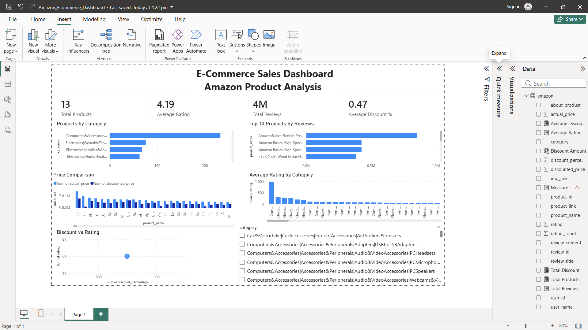

Slide 10
Conclusion:
The Power BI E-Commerce Dashboard successfully visualizes key metrics related to product performance, customer reviews, and pricing.
The dashboard provides an easy way to monitor product data and identify trends such as:
• Categories with the most products
• Products with the highest reviews
• Impact of discounts on ratings
This solution improves decision-making by transforming raw data into meaningful insights.

Slide 11
Future scope:
• Integration of real-time sales data
• Adding predictive analytics for sales forecasting
• Integration with multiple e-commerce platforms
• Use of advanced machine learning models for demand prediction
• Deployment as a live web dashboard for businesses

Slide 12
References:
Microsoft Power BI Documentation
Power BI Dashboard Design Guidelines
E-commerce Sales Analytics Resources
GitHub:

Slide 13
Thank You

