Slide 1
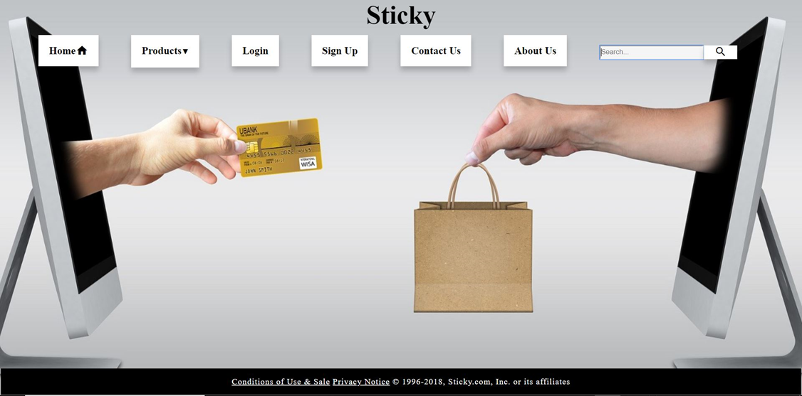
E-commerce Website

Slide 2
Contents
Introduction
Objectives
Online Shopping
Text Editors
Languages Used
Conclusion

Slide 3
Introduction
The purpose of this project is that any person can sell their product online and earn cash.
E-commerce is the activity of buying or selling of products and services online or over the internet.
Modern electronic commerce typically uses the World Wide Web for at least one part of the transaction's life cycle although it may also use other technologies such as e-mail.

Slide 4
Objectives
E-commerce is fast gaining ground as an accepted and used business paradigm.
It is reasonable to say that the process of shopping on the web is becoming commonplace.
The objective of this project is to develop a general purpose e-commerce store where any product can be bought from the comfort of home through the Internet.

Slide 5
Online Shopping
An online store is a virtual store on the Internet where customers can browse the catalog and select products of interest.
The selected items are collected in a shopping cart. At checkout time, the items in the shopping cart will be presented as an order.
At that time, more information will be needed to complete the transaction.
Usually, the customer will be asked to fill or select a billing address, a shipping address, a shipping option, and payment information such as credit card number.
An e-mail notification is sent to the customer as soon as the order is placed

Slide 6
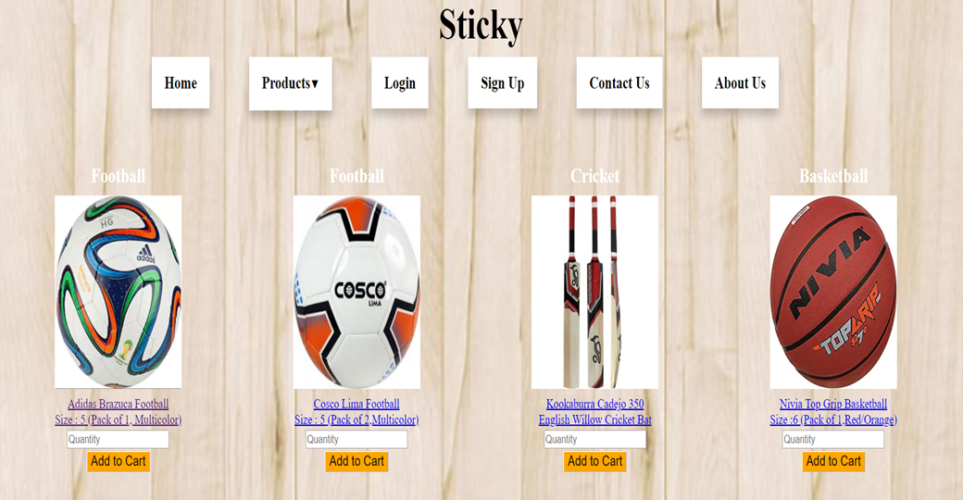
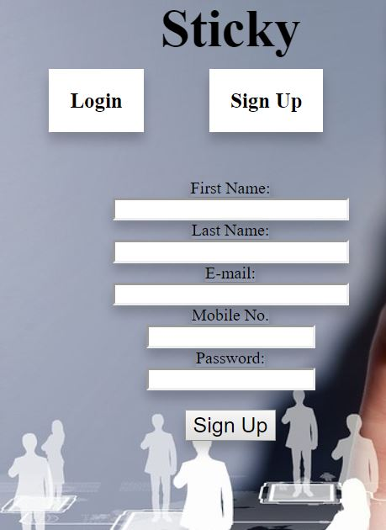
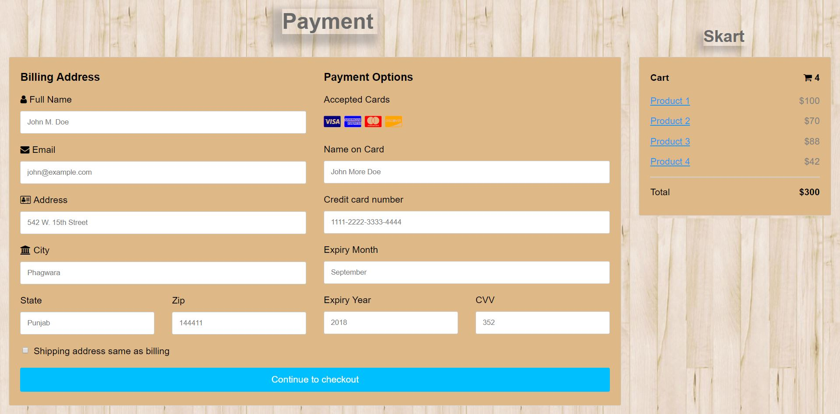

Slide 7
Technology Used
A text editor is a type of computer program that edits plain text.
The source code editor used in this project is BRACKETS which provide a very user-friendly interface.
Some features of source code editors are:
Find and replace
Duplicate and move text within the file, or between files.
Undo and redo
Ability to handle UTF-8 encoded text.
Live Preview
Suggestion library

Slide 8
Languages Used
HTML5
CSS3
JAVASCRIPT

Slide 9
Conclusion
E-commerce, or the act of selling goods or services online as opposed to selling at brick and mortar establishments, has reshaped the modern marketplace in recent years, but this new form of trade comes with its own sets of advantages and disadvantages over traditional methods.
It's important, then, for businesses to look beyond the hype and develop their own perspectives on the true value of e-commerce—to business and to consumers—because interestingly, there are many advantages for consumers that might actually be a disadvantage for e-commerce businesses.

Slide 10
Thank You

