Slide 1
Welcome
CS315: Principles of Database Systems

Slide 2
Course Details
Number: CS315
Name/Title: Principles of Database Systems
Website: https://www.cse.iitk.ac.in/users/purushot/courses/db/2024-25-a/
Discussion (Piazza): https://piazza.com/iitk.ac.in/secondsemester2024/cs315/home

Slide 3
Admin Team
Instructor: Roop
aka Puru aka Purushottam aka Sir aka Professor aka Excuse Me
Email: purushot@cse.iitk.ac.in
Course Admins
Name | Email | Office Hour | Room
Manish Agrawal | amanish23@iitk.ac.in | Mon 1700-1800 | RM 506
Manoj Daram | manojdaram23@iitk.ac.in | Mon 1700-1800 | RM 506
Prashik Ganer | prashikrg23@iitk.ac.in | Tue 1600-1700 | RM 506
Vishal Kanojiya | kanojiyavishal@cse.iitk.ac.in | Fri 0900-1000 | RM 201
Arpit Nigam | arpitn23@iitk.ac.in | Mon 1700-1800 | Samsung IOT lab
Vipul Sangode | vipul@cse.iitk.ac.in | Mon 1700-1800 | RM 505

Slide 4
Auditors
Please email the instructor purushot@cse.iitk.ac.in to get enrolled
Auditors will have access to
Lecture slides and other material
Assignment, quiz and exam questions and solutions
We regret our inability to extend the following services to auditors
Submit assignments and receive graded submissions
Appear for quizzes, examinations and receive graded answer scripts

Slide 5
Grading Scheme
20%: Mini Projects
20%: Quizzes
25%: Mid-sem Exam
35%: End-sem Exam

Slide 6
Quizzes – 20%
Two quizzes to be conducted – each worth 10%
Tentatively scheduled on Aug 23, 2024 (Fri), Oct 25, 2024 (Fri)
Only registered students can appear for quizzes (no auditors)
Syllabus for each quiz will cover roughly 3-4 weeks – short quiz
If you are regular with lectures, discussion hours, practice questions, then you should not have to prepare too much for these quizzes

Slide 7
Mini Projects – 20%
Two mini projects (individual weightages TBA)
Replaces the single semester-long project in previous offerings of CS315
To be done in groups of 4-6 students each – 2-3 weeks for each project
Start forming your group of 5 today
Will ask you to submit group details once late registration is over
Groups can only contain registered students (no auditors)
Create a homepage on CC/CSE home servers
Essential for project submission
Submission will include code + report
Code should be in Python – start learning Python today
Report should be in LaTeX – start learning LaTeX today

Slide 8
Reference Material
No single textbook for the course
[GMUW] Héctor García-Molina, Jeffrey Ullman and Jennifer Widom Database Systems: The Complete Book.
[SKS] Abraham Silberschatz, Henry F. Korth and S. Sudarshan Database System Concepts.
[ElNa] Ramez Elmasri and Shamkant Navathe Fundamentals of Database Systems.
[GeRa] Johannes Gehrke and Raghu Ramakrishnan Database Management Systems.
[BBL] Bart Baesens, Seppe Vanden Broucke and W. Lemahieu Principles of Database Management.

Slide 9
Reference Material
Python Resources: several available – choose your favourite
www.geeksforgeeks.org/python-programming-language/
LaTeX resources: several available – choose your favourite
www.overleaf.com/learn/latex/Tutorials

Slide 10
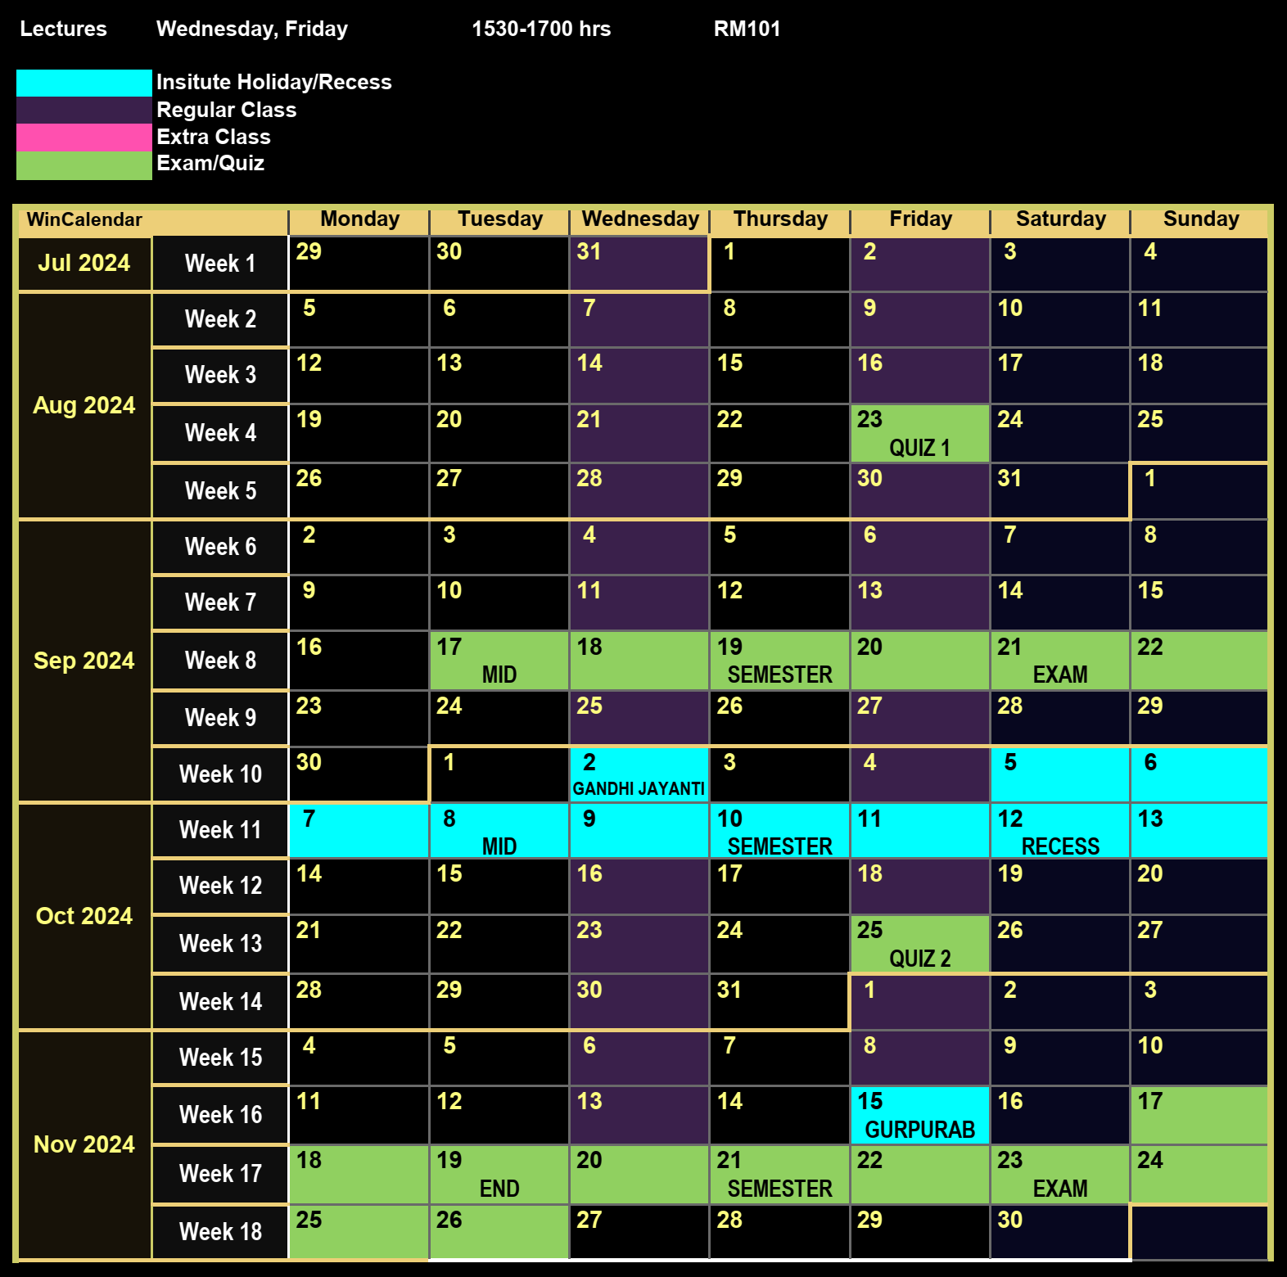





Course Website
Detailed syllabus for this course
Course calendar: schedule for holidays, exams, quizzes
Course policy: assessment, course drop, make-up
Use of unfair means, penalties and safeguards
Course etiquettes

Slide 11
A Summary of To-Dos for You
Everybody
Refresh your data structure basics – trees, lists, stacks, hashing
Start learning/refreshing Python and LaTeX skills
Create a homepage on CC/CSE home servers
Students who are already registered
Start forming groups of five (5) students – do not wait long
Students who wish to audit
Send an email to the instructor if not already done so
Students who wish to credit
Course already oversubscribed – requests to be processed as announced

Slide 12
A Teaser
What is the point of databases?
What will we explore in the course?

Slide 13


What is the point of DB anyway?
“
“
The art and science of storing, retrieving and manipulating data
DB – a “base” or “home” for data – aka सूचनालय or a तथ्यालय
What does the data do sitting in its home?
✓

Slide 14







Databases power a lot of services

Slide 15
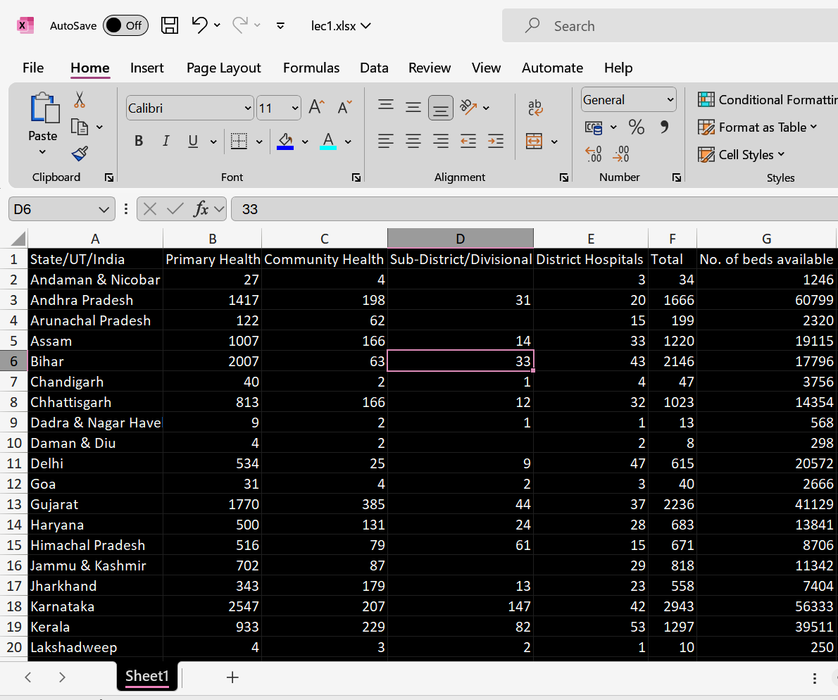
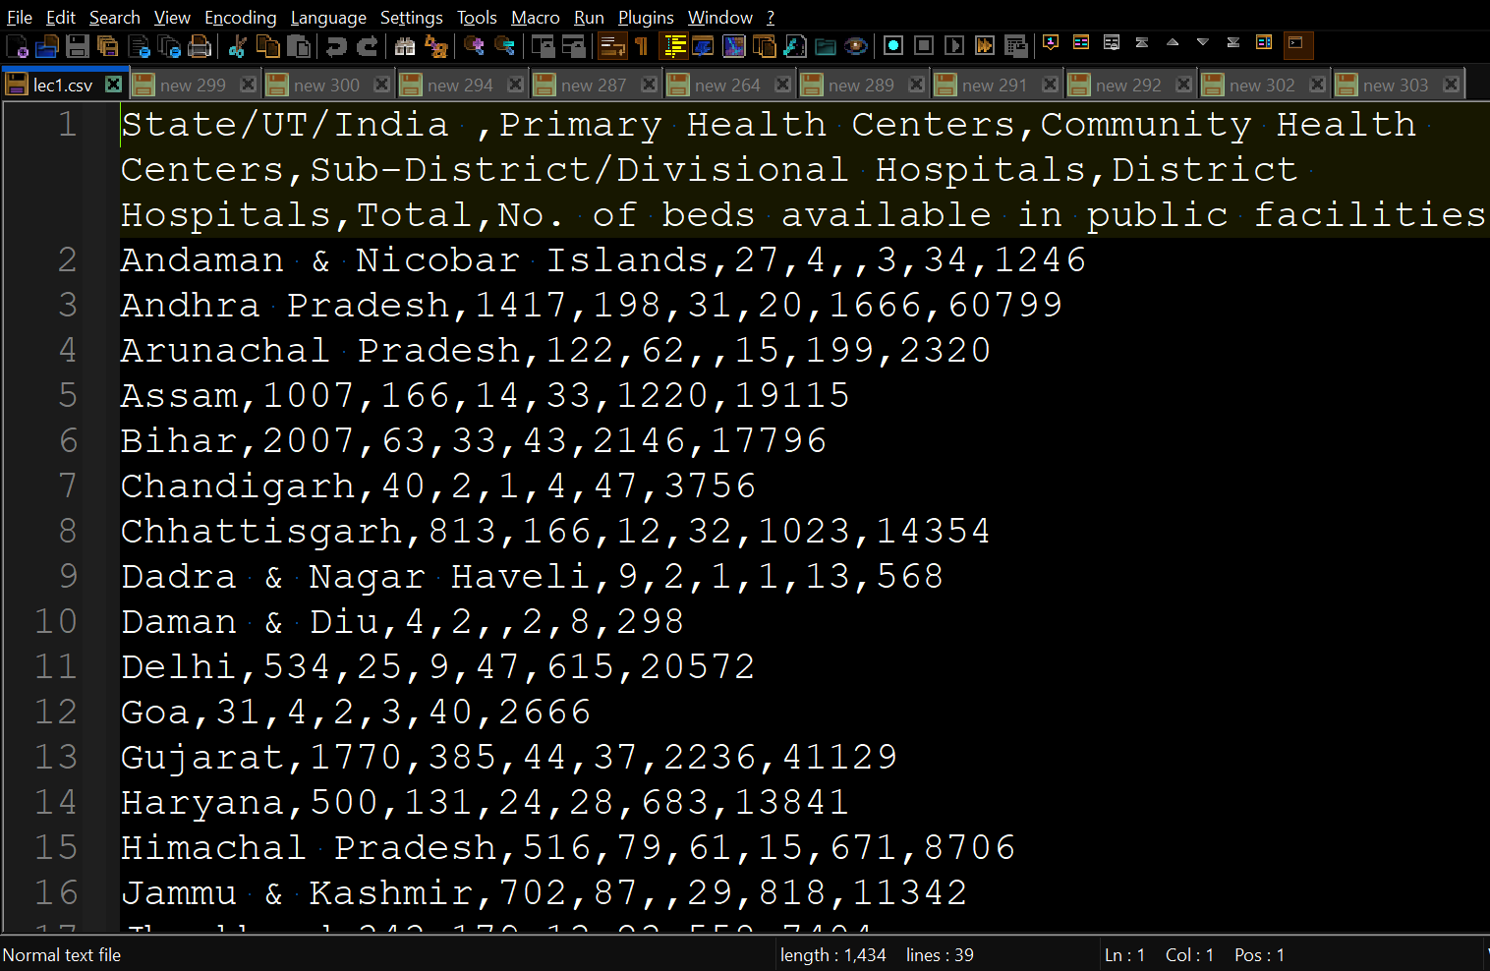
What bother with DB?
Why not just use plain simple files to store data?
Recall – storage is just one of the jobs of a DB
vs

Slide 16





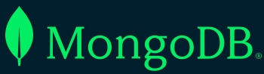

Work work work work work
DBs (or DBMS) are sophisticated objects – act as an OS for data
DBMS: Database Management Systems
Several DB concepts parallel those in OS
OS
DBMS
Store, retrieve, manipulate data
User-friendly interface, apps
Security, access-control, logins etc
Manage resources, interface with other devices peripherals etc
Store, retrieve, manipulate data
User-friendly queries, views, GUIs
Security, access-control, logins etc
Manage data views, interfaces with other DBs, online apps etc
https://wikitech.wikimedia.org/wiki/File:Mysql_logo.png https://www.mongodb.com/fr-fr/company/newsroom/brand-resources
https://en.m.wikipedia.org/wiki/File:Postgresql_elephant.svg

Slide 17
The several aspects of a DB
How data is arranged “logically”
Decided by how DB designer want users to “think” data is arranged
Examples: Relational model, Key-value model
What operations are allowed on data
Decided by demands of apps built using the DB e.g. social media or health
Examples: sorting, searching, selecting, projecting, joining
How data is arranged “internally”
Decided by what allows faster and smoother operations
Normalization theory, Physical design, Indexing, Query processing
Curious example: XLSX files
Logical appearance is tabular/relational in form of a spreadsheet
Internal representation is in form of key-value pair (XML format)

Slide 18
Logical vs Internal Representations
Open lec1.xlsx in MS Excel or OpenOffice Calc or Google Sheets
Inspect the layout of the data – what operations can you perform?
Open lec1.csv in a text editor – it contains the same data as lec1.xlsx
Are you able to perform the same operations that Excel allowed?
Change the extension of the file from .xlsx to .zip
Unzip the resulting archive and explore the internal files
Can you discover how Excel stores apparently tabular data internally?
Hint: look at the XML files

