Slide 1
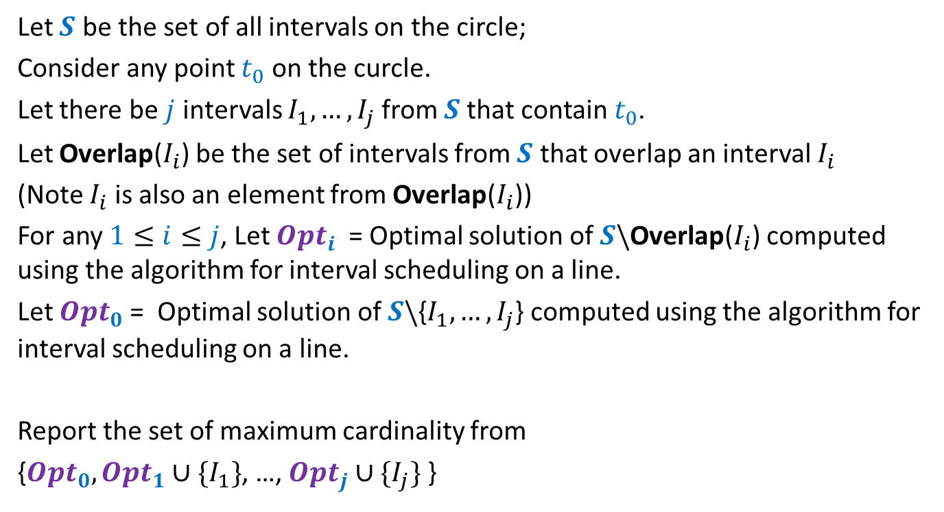
Problem 6, Practice Sheet 2
Let $S$ be the set of all intervals on the circle;
Consider any point $t_{0}$ on the curcle.
Let there be $j$ intervals $I_{1},…,I_{j}$from $S$that contain $t_{0}$.
Let Overlap($I_{i}$) be the set of intervals from $S$ that overlap an interval $I_{i}$
(Note $I_{i}$ is also an element from Overlap($I_{i}$))
For any $1≤i≤j$, Let $Opt_{i}$ = Optimal solution of $S\backslash$Overlap($I_{i}$) computed using the algorithm for interval scheduling on a line.
Let $Opt_{0}$= Optimal solution of $S\backslash${$I_{1},…,I_{j}$} computed using the algorithm for interval scheduling on a line.
Report the set of maximum cardinality from
{$Opt_{0}, Opt_{1}∪\{I_{1}\}$, …, $Opt_{j}∪\{I_{j}\}$ }

Slide 2
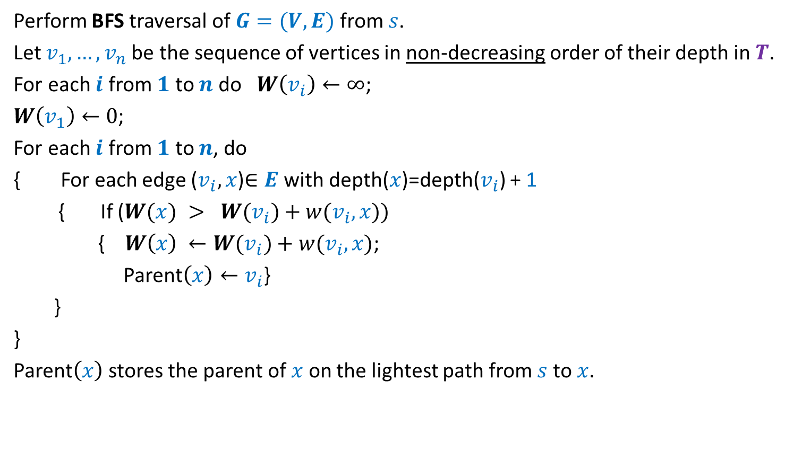
Problem 10, Practice Sheet 2
Perform BFS traversal of $G=(V,E)$ from $s$.
Let $v_{1},…,v_{n}$be the sequence of vertices in non-decreasing order of their depth in$T$.
For each $i$ from $1$ to $n$ do $W\left(v_{i}\right)←∞$;
$W\left(v_{1}\right)←0$;
For each $i$ from $1$ to $n$, do
{ For each edge ($v_{i},x$)$∈E$ with depth($x$)=depth($v_{i}$) + 1
{ If ($W(x) > W(v_{i})+w(v_{i},x))$
{ $W\left(x\right) ←W(v_{i})+w(v_{i},x)$;
Parent$\left(x\right)←v_{i}$}
}
}
Parent$\left(x\right)$ stores the parent of $x$ on the lightest path from $s$ to $x$.

Slide 3
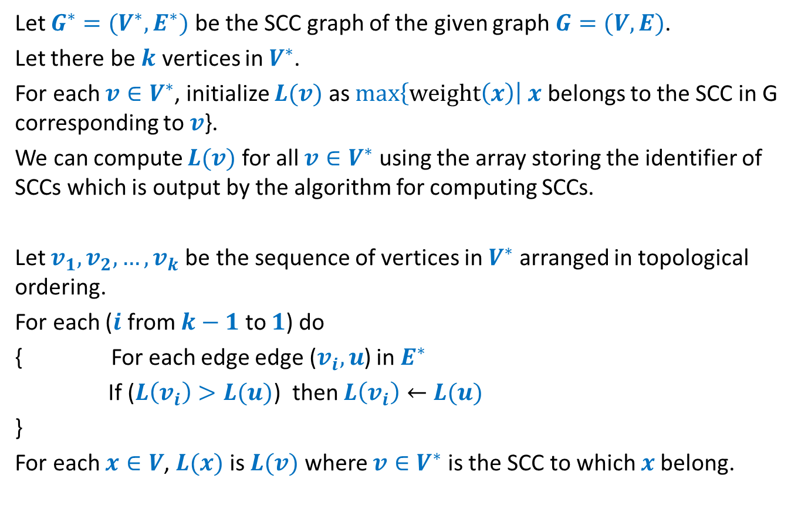
Problem 5, Practice Sheet 3
Let $G^{∗}=(V^{∗},E^{∗})$ be the SCC graph of the given graph $G=(V,E)$.
Let there be $k$ vertices in $V^{∗}$.
For each ${v∈V}^{∗}$, initialize $L(v)$ as $max\left\{weight\left(x\right)\right| x$ belongs to the SCC in G corresponding to $v$}.
We can compute $L(v)$ for all ${v∈V}^{∗}$ using the array storing the identifier of SCCs which is output by the algorithm for computing SCCs.
Let $v_{1}, v_{2},…,v_{k}$be the sequence of vertices in $V^{∗}$ arranged in topological ordering.
For each ($i$ from $k−1$ to $1$) do
{ For each edge edge ($v_{i},u$) in $E^{∗}$
If ($L\left(v_{i}\right)>L(u)$) then $L\left(v_{i}\right)←$ $L(u)$
}
For each $x∈V$, $L(x)$ is $L(v)$ where $v∈V^{∗}$ is the SCC to which $x$belong.

