Slide 1
Quiz 2

Slide 2
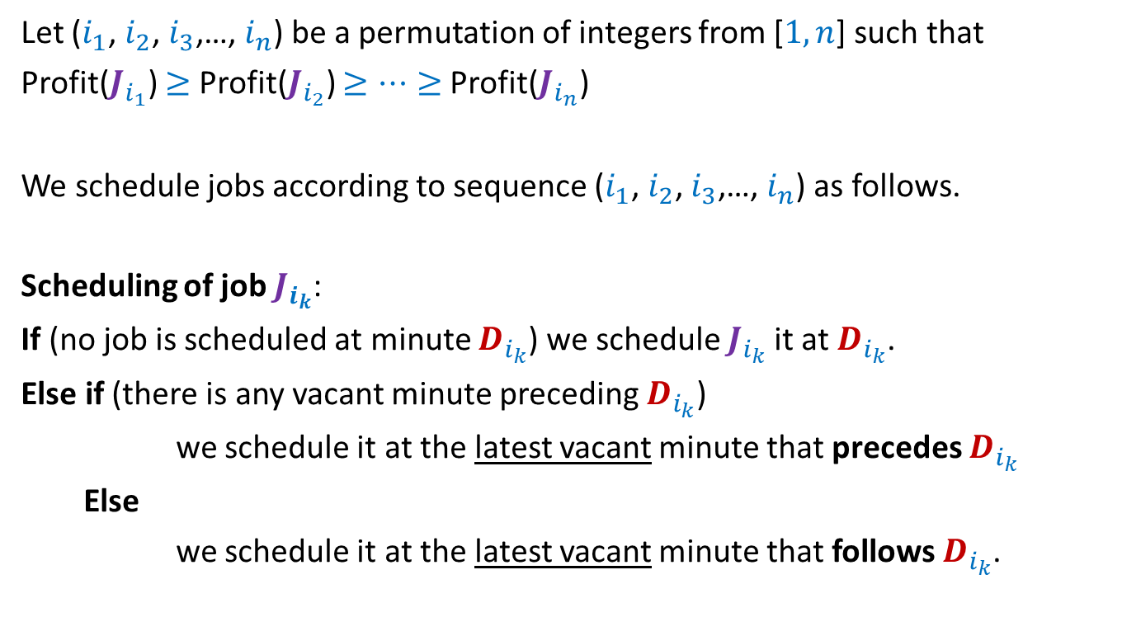
Problem 1
Let ($i_{1}$, $i_{2}$, $i_{3}$,…, $i_{n}$) be a permutation of integers from [$1,n$] such that
Profit($J_{i_{1}}$) $≥$ Profit($J_{i_{2}}$) $≥…≥$Profit($J_{i_{n}}$)
We schedule jobs according to sequence ($i_{1}$, $i_{2}$, $i_{3}$,…, $i_{n}$) as follows.
Scheduling of job $J_{i_{k}}$:
If (no job is scheduled at minute $D_{i_{k}}$) we schedule $J_{i_{k}}$it at $D_{i_{k}}$.
Else if (there is any vacant minute preceding $D_{i_{k}}$)
we schedule it at the latest vacant minute that precedes $D_{i_{k}}$
Else
we schedule it at the latest vacant minute that follows $D_{i_{k}}$.

Slide 3

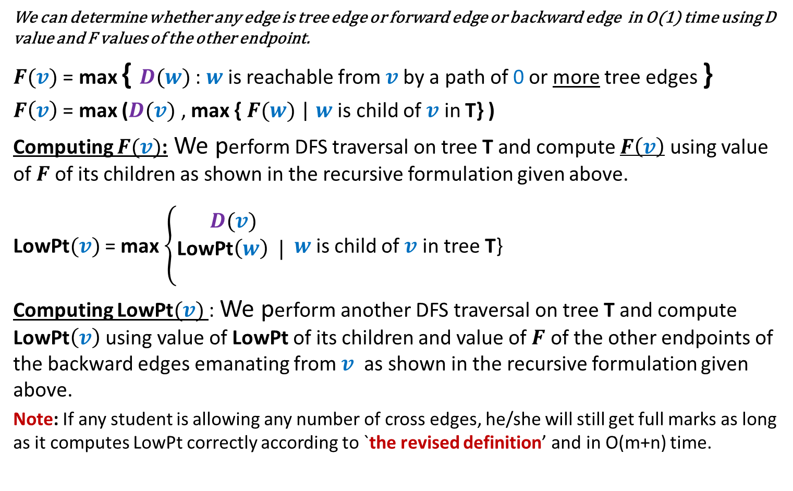
Problem 2
We can determine whether any edge is tree edge or forward edge or backward edge in O(1) time using D value and F values of the other endpoint.
$F(v)$ = max { $D(w)$ : $w$is reachable from $v$by a path of 0 or more tree edges }
$F\left(v\right)$ = max ($D(v)$ , max { $F(w)$ | $w$ is child of $v$ in T} )
Computing $F(v)$: We perform DFS traversal on tree T and compute $F\left(v\right)$ using value of $F$of its children as shown in the recursive formulation given above.
LowPt$(v)$ = max $\left\{\begin{aligned}D(v) \\ \text{LowPt}\left(w\right) | \\ \end{aligned}\right.$ $w$ is child of $v$ in tree T}
Computing LowPt$(v)$ : We perform another DFS traversal on tree T and compute LowPt$\left(v\right)$ using value of LowPt of its children and value of $F$ of the other endpoints of the backward edges emanating from $v$ as shown in the recursive formulation given above.
Note: If any student is allowing any number of cross edges, he/she will still get full marks as long as it computes LowPt correctly according to `the revised definition’ and in O(m+n) time.
{ $F\left(w\right)$ | ($v,w$) is a backward edge in T }

