Slide 1
Kernel Full Fork Linux Kernel Programming
– Group 4

Slide 2
Thread Group 4 Thread 1: Divyansh (210355) Thread 2: Divyansh Chhabria (210356) Thread 3: Rajeev Kumar (210815) Thread 4: Sandeep Nitharwal(210921) Thread 5: Soham Bharambe (210264)
Presenting:
20%
20%
20%
20%
20%

Slide 3
Kernel Full Fork (Recap) Kernel full fork is a process duplication mechanism that replicates not only the parent process but also its entire thread structure. The child process inherits an identical set of threads, enabling efficient multi-threaded process cloning and parallel execution.

Slide 4
M
T₁
T₂
Initial Process
Fork
M
T₁
T₂
M’
Initial Process
Cloned Process

Slide 5
M
T₁
T₂
Initial Process
Full_Fork
M
T₁
T₂
M’
T₁’
T₂’
Initial Process
Cloned Process

Slide 6
M
T₁
T₂
With
Address space
(fork')
Copy the execution states of the siblings
M'
T₁'
T₂'
Create thread

Slide 7
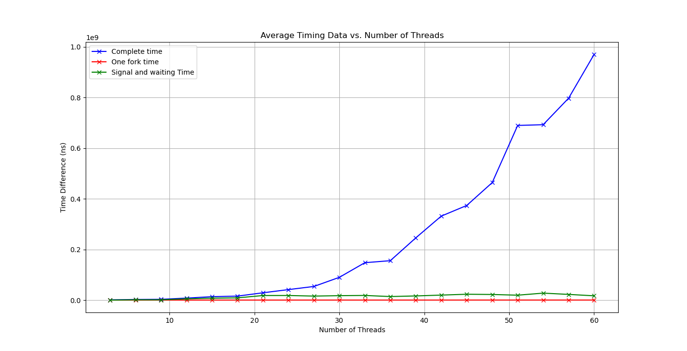
Benchmarking of fullfork vs normal fork

Slide 8
Kernel Full Fork - Cloning Process Tree

Slide 9


Why Clone a process tree?
We can checkpoint any running application, entire, and use that checkpoint to analyse the state of running application.
Applications in Docker, database queries, specially when the tasks
Require multi-threaded processes.

Slide 10

Checkpoint-Restore in User space(CRIU)
CRIU is a project which implements checkpoint/restore functionality by freezing the the state of process and it sub tasks.
CRIU makes use of ptrace to stop the process by attaching PTRACE_SEIZE request.
Then it injects parasite code to dump the process’s memory pages into the image files to create recoverable checkpoints.
Open source, 2012

Slide 11
Checkpoint-Restore in User space(CRIU)
$ ./a.out
$ sudo criu dump -t 4567 -D /temp/checkpoint --leave-running
$ sudo criu restore –D /temp/checkpoint
Docker currently has checkpointing as an experimental feature and at the backened the functionality is being supported by CRIU only.
We have modified the source to time the checkpointing process, since we plan to use this as our benchmark.

Slide 12
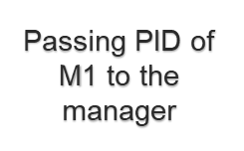
M₁
T₁
M₁’
T₁’
Full_Fork
M₂
T₂
M₂’
T₂’
Initial Process
Cloned Process

Slide 13
M₁
M₂
Cutting off previous relationship by deleting M₂’ from list of children of M₂
With Address space (fork')
M₁'
M₂'
Making a new relationship by adding M₂’ to list of children​ of M₁

Slide 14
Steps Ahead
00
01
Need to stop all the processes in the sub-tree
Cloning each node in the tree
10
11
Reparenting the newly created clones
Benchmarking and Results

Slide 15

Kernel Full Fork –Stopping the Sub-Tree
Let’s stop the sub-threads in process group and deschedule the thread leader
M₀
M₁
M₂
User: If x = PID(M₀) , Then do
./manager x
Manager: do syscall 549 with argument as the pid of the process to clone its process tree.
M
Manager M
DFS(task_struct M) {
for C in children of M
DFS();
signal(SIGSTOP);
kick_to_schedule();
}
M₃
M₄
T₁
Initial Process Tree

Slide 16
What about current?
To clone a process p, we need to have current = p
Used kick_process() function with TIF_RESCHED flag
Two cases:
- Process in user mode
- Process in kernel mode
void kick_process(struct task_struct *p)
kick a running thread to enter/exit the kernel @p: the to-be-kicked thread
Cause a process which is running on another CPU to enter kernel-mode, without any delay. (to get signals handled)

Slide 17

Kernel Full Fork – Cloning in Schedule
M_{i}
T₁
T₂
Hey Manager! I am done cloning! Please continue with the DFS
Initial Process
Parent child relationship
Call FullFork which makes a clone of the process group
i
M_{i}’
T₁’
T₂’
Wakeup(Manager)
Cloned Process

Slide 18
Kernel Full Fork – Reparenting while returning from DFS

Slide 19
M₀
M₀’
M₂’
M₁
M₂
M₁’
M₄’
M₃
M₄
M₃’
T₁’
T₁
Initial Process Tree
Cloned Process

Slide 20
Reparenting Code
Took inspiration from adoption of orphan processes by init
do_exit() -> exit_notify()->forget_original_parent()
Our reparent_code:
Iterate over the thread group
Remove each thread from original parent's children list: original_parent->children
Add to new parent's children list: new_parent->children

Slide 21
Kernel Full Fork – Final Look
M₀
M₀’
M₂’
M₁
M₂
M₁’
Full_Fork
M₄’
M₃
M₄
M₃’
./manager PID(M₀)
T₁’
T₁
Initial Process
Cloned Process

Slide 22
As far as current progress in we have implemented and tried out following things;-
Current Progress and Future Work
Implemented our original goal of fullfork implementation.
Transformed our implementation to clone a process tree.
Currently we are trying to do the 2 things majorly: 1. Making an API interface to restart the cloned process tree. 2. Extending the process cloning functionality to multi-threaded process.
Extending the functionality to multi-threaded systems
Extensive comparision with CRIU and optimization
Eventually integerate in Docker, sqlite, similar applications

Slide 23
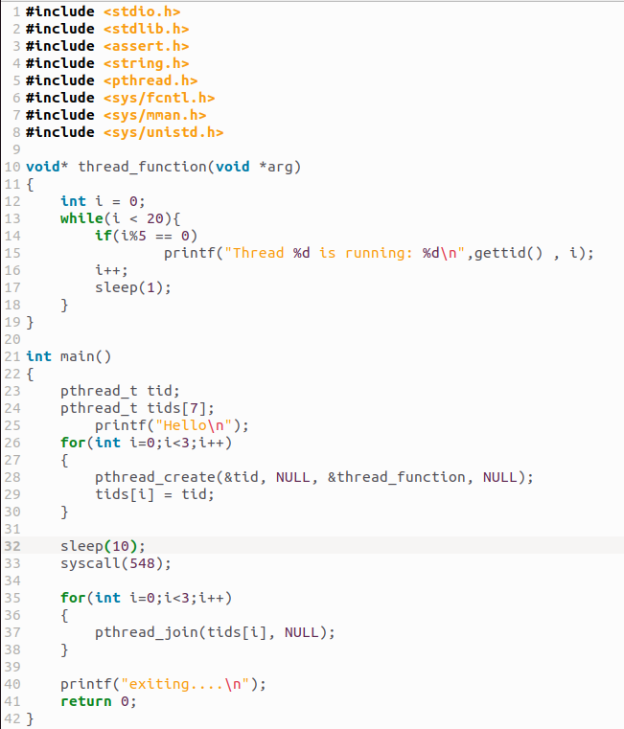
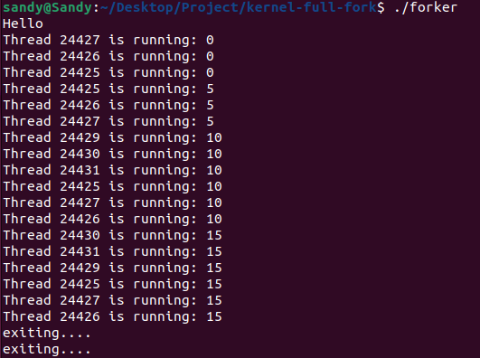
DEMO FULLFORK
In the code we are calling syscall(548) after 10 time unit from creation of threads and in the output we can see that after 10 unit of time all the 3 threads and main function get cloned.

Slide 24
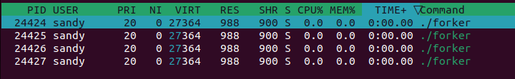
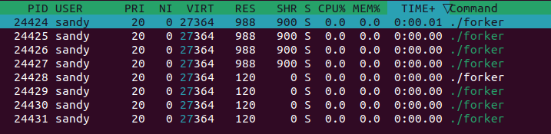
DEMO FULLFORK(Cont.)
These two figure shows initial and after fullfork cloning state of process in htop.

Slide 25
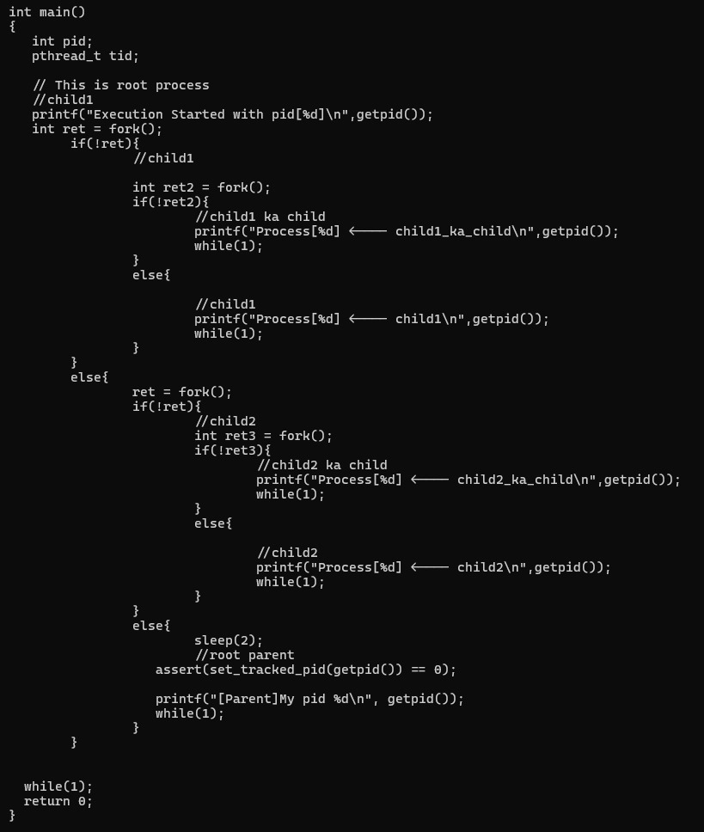
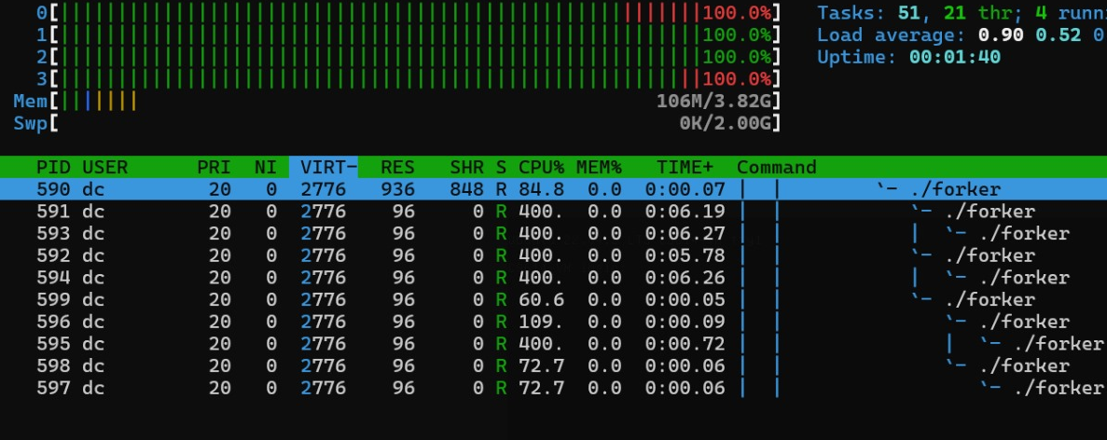
DEMO Process Tree Clone
The image on the left shows the test code which creates 5 process making a tree and on the right we have 10 process running consisting the original and cloned tree.

Slide 26
Source Code
Our implementation had both kernel modules and direct modification into source code, we have compiled all the source code and modification in the following link Gitlab link: https://git.cse.iitk.ac.in/divyanshc/kernel-full-fork
Our modified kernel source code can be found here: https://iitk-my.sharepoint.com/:f:/g/personal/divyansh21_iitk_ac_in/EoV00fHmAjhLnFMiYgOZ3ykBuKMRj0vhwlAp-JpLomeR4Q?e=YEhPaN

Slide 27
Thank You! Good Bye Kernel! Thread 1: Divyansh (210355) Thread 2: Divyansh Chhabria (210356) Thread 3: Rajeev Kumar (210815) Thread 4: Sandeep Nitharwal(210921) Thread 5: Soham Bharambe (210264)

