Slide 1

Techno Utsav

Slide 2
Facts
According to World Health Organisation Report,2008-
350 Million
Some 235 million people currently suffer from asthma. It is a common disease among children.
Most asthma-related deaths occur in low- and lower-middle income countries.
According to the latest WHO estimates, released in December 2016, there were 383 000 deaths due to asthma in 2015.
The strongest risk factors for developing asthma are inhaled substances and particles that may provoke allergic reactions or irritate the airways.
600 Million

Slide 3
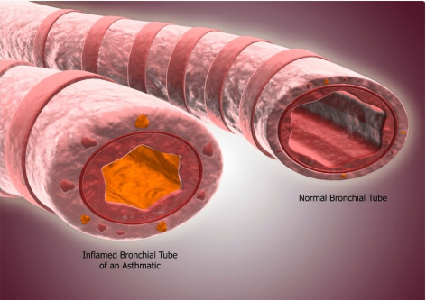

Slide 4

Unanswered Questions;
Survivors
Should I send my child to school today?Will it be safe for his/her health?
Should I play cricket with my friends today?
Will i be able to perform heavy exercises today?
What were your past records of Asthma attack?
How severe was the attack?
How much population of the world is affected from asthma? how poor is the shape of health of the patients?
Doctors
Researchers

Slide 5
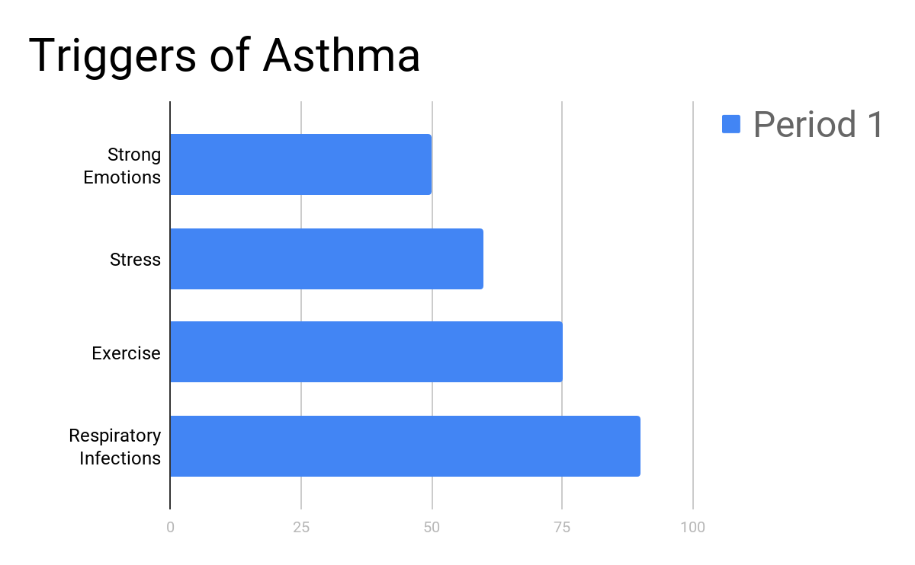

Slide 6
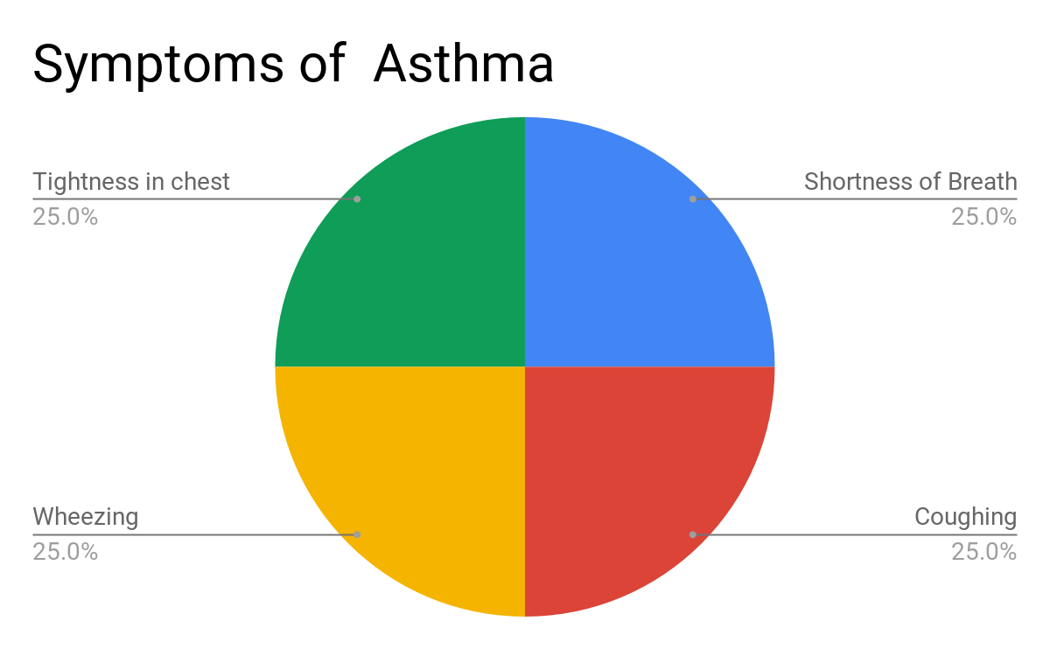

Slide 7
How does an asthma attack looks like?

Slide 8

Unanswered Questions will now be answered;
Survivors
Should I send my child to school today?Will it be safe for his/her health?
Should I play cricket with my friends today?
Will i be able to perform heavy exercises today?
What were your past records of Asthma attack?
how severe was the attack?
How much population of the world is affected from asthma? how poor is the shape of health of the patients?
Doctors
Researchers

Slide 9
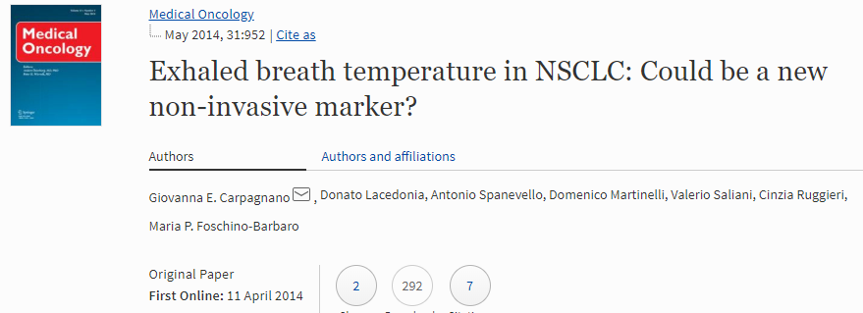
An increase of exhaled breath temperature (EBT) has been proven indeed to be correlated to airways inflammation as well as to the increased vascularity

Slide 10
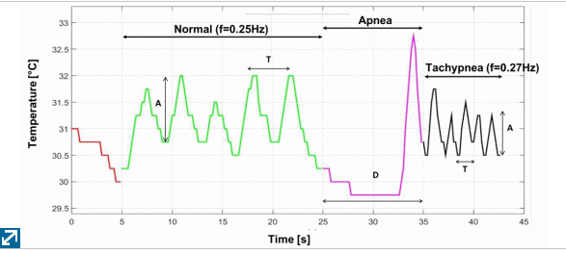
Comparison of temperature of person with normal breathing & one with slow and rapid breathing:-

Slide 11
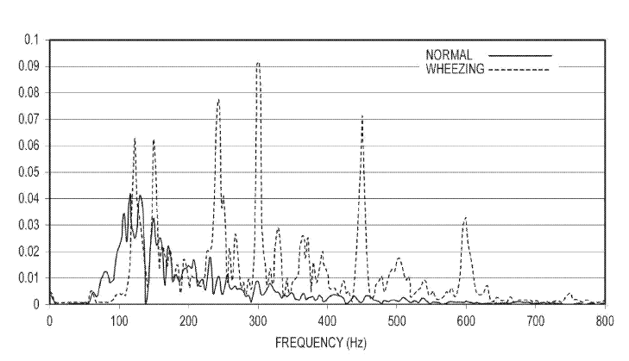
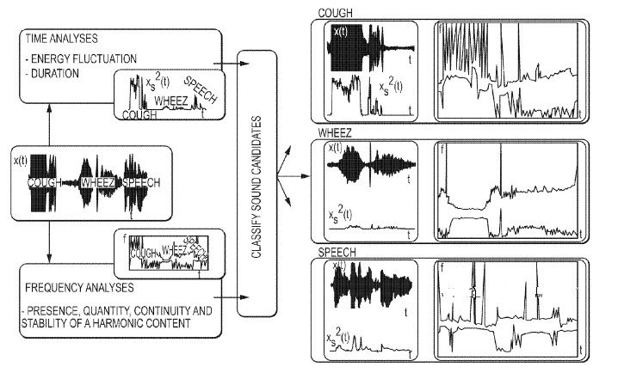
Contributing Variables-Wheezing

Slide 12
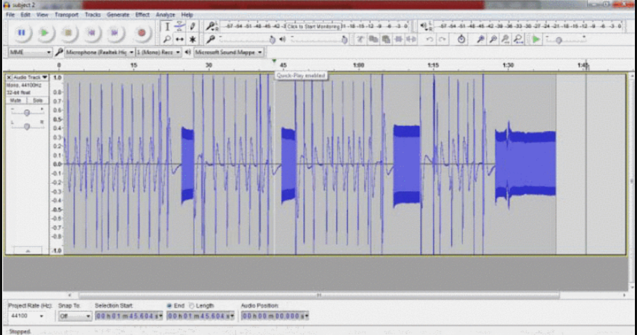
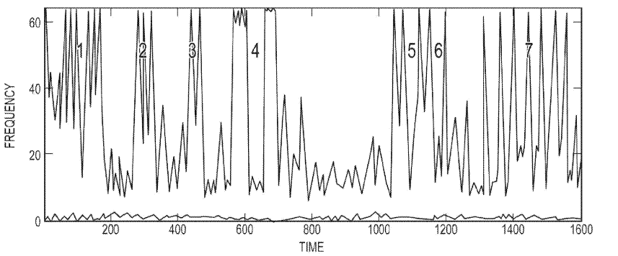
Accuracy in Measuring sound measurement
v/s
Accuracy in Measuring temperature

Slide 13
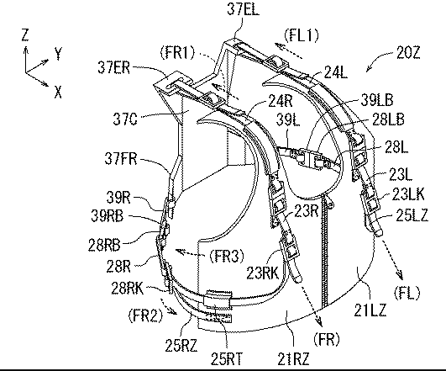
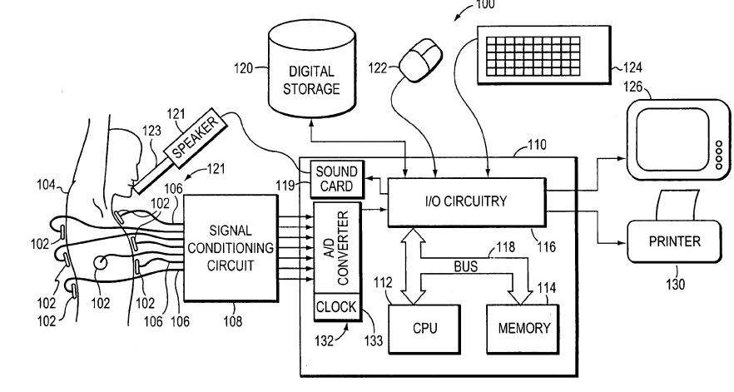
Unique Features
Portable In Nature
Improved Quality of life
Adults & Children
Friendly

Slide 14
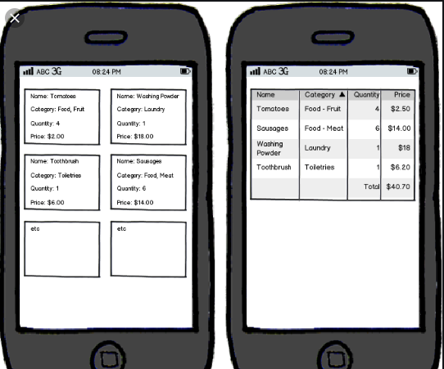


Asthma Attack Risk- Low
Risk Percentage- 24%
FIT TO GO
:)
Asthma Attack Risk-High
Risk Percentage- 73%
Time to Rest!!!!

