Slide 1

Presented By:
Abhay Pratap Singh
Divyanshu Singh
Aryan Singh
Krishna Gautam
Presented To:
Mr. Bhanu Kapoor
(Technical Trainer)
GLA University,
Mathura

Slide 2

Verse
(Music Website)
Git-hub link : https://github.com/Divyanshu050303/Mini-Project-2

Slide 3
Topics to be covered
Introduction
What is Verse?
Technologies Used
Project Model View
Features
Advantages
Conclusion

Slide 4
Introduction:
Welcome to our music web application! Our web app is designed to provide you with a seamless and enjoyable music listening experience. Whether you are looking for your favorite songs or want to discover new music, our app has everything you need.
Our app offers a variety of features that make it easy to find and enjoy music. You can browse through a vast library of songs and artists, search for specific tracks or albums, and create your own custom playlists. Our recommendation system uses your listening history to suggest new music that you may enjoy, making it easy to discover new artists and songs
So, whether you're in the mood for some classic rock, hip-hop, or jazz, our music web application has something for everyone. We hope you enjoy our app and look forward to providing you with a great music listening experience.

Slide 5
What is the need of Verse?
Music web applications fulfill several needs, both for musicians and for listeners. Here are some of the key needs that a music web application can address:
Music Distribution: Musicians and music labels need a way to distribute their music to a wider audience. A music web application provides a platform for musicians to upload their music and make it available to a global audience.
Music Discovery: With so much music available online, it can be overwhelming for listeners to find new music that they like. A music web application can use algorithms to recommend new music based on a listener's preferences and listening history, making it easier for listeners to discover new artists and songs.
Convenience: Music web applications provide a convenient way for listeners to access music from any device with an internet connection. Users can stream music without the need to download or store large files on their devices

Slide 6

Technologies Used:
React JS:
ReactJS is an open-source JavaScript library that is widely used for building user interfaces. It was developed by Facebook and is currently maintained by Facebook, Instagram, and a community of developers.
ReactJS allows developers to build reusable UI components, which makes it easier to maintain and scale applications.

Slide 7


Node JS:
Node.js is an open-source, cross-platform, server-side runtime environment built on Chrome's V8 JavaScript engine. It allows developers to build scalable, high-performance, and networked applications using JavaScript, a language traditionally associated with front-end web development.
Google Firebase:
Firebase is a mobile platform that helps you quickly develop high quality apps ,grow your user base. Firebase is made up of complementary features that you can mix and match to fit your needs ,with google analytics for firebase at the core.

Slide 8
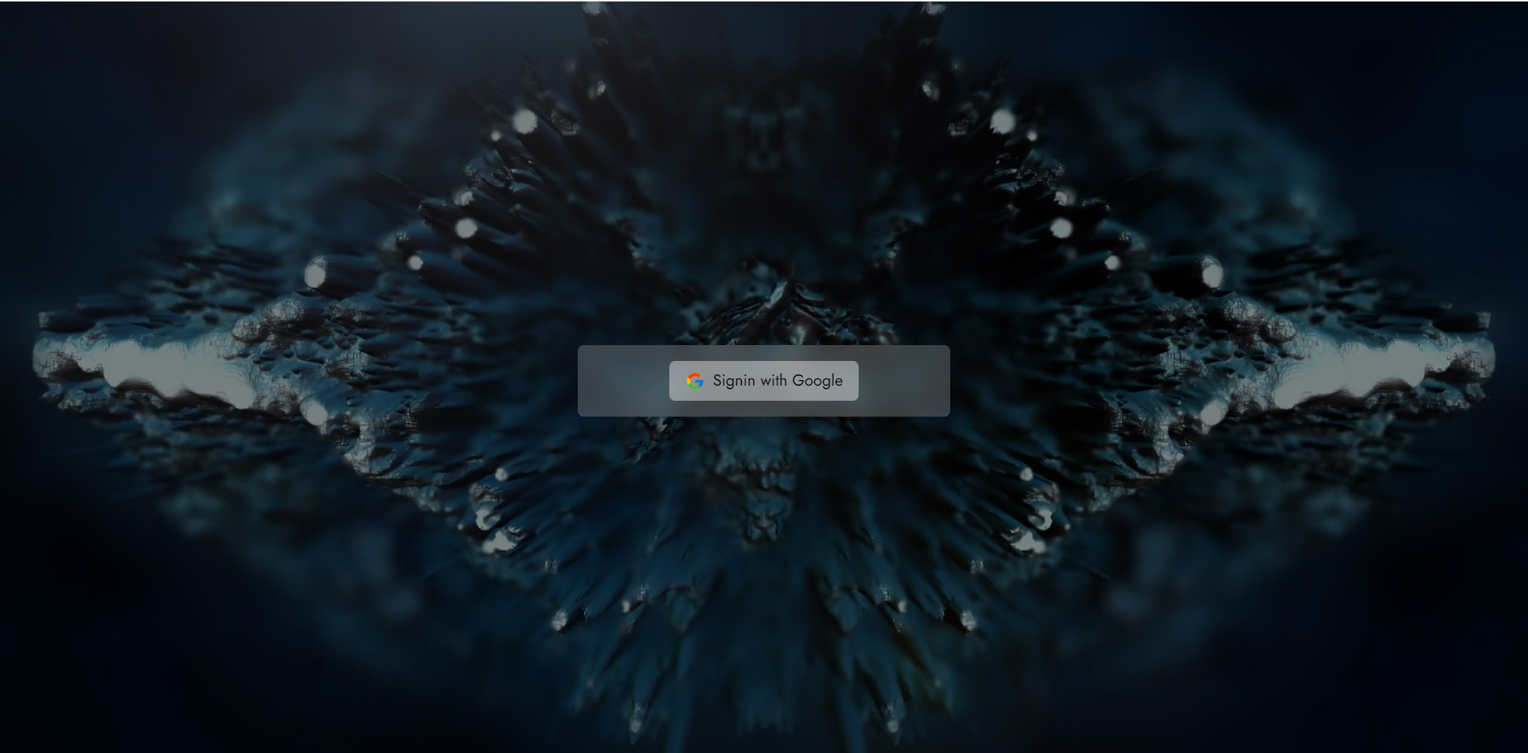
Project Model View:
For signing in to the application user must have an account on the database.
We Use Google Authentication to singin or singup the user
Sign in screen:

Slide 9
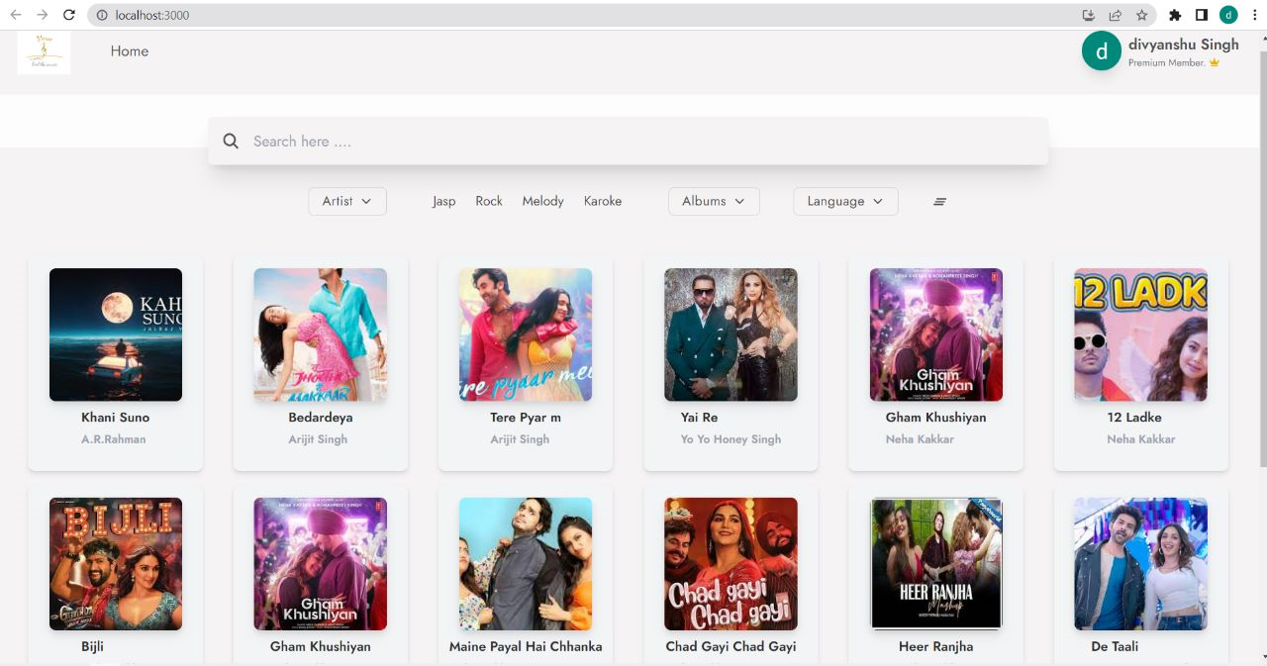
Home Page:
This is the main screen or page of the application from where user can access the whole application.
User can reach to the different sections of the application from this page.
This page shows the different categories of the Song present in the application.

Slide 10
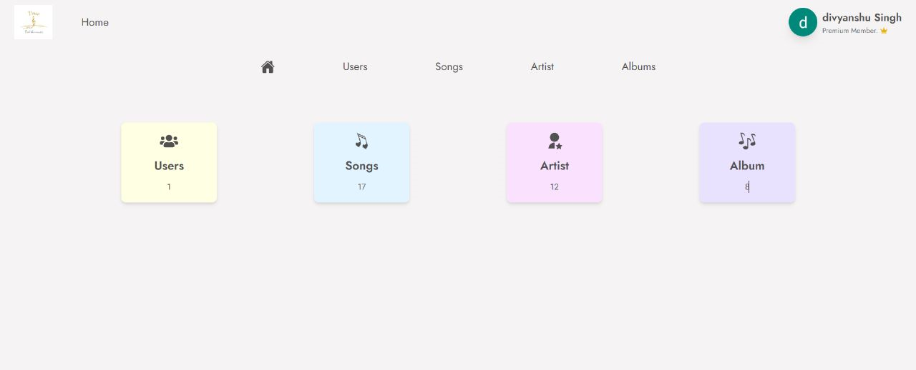
Admin Dashboard Page:
This page can be used by the admin. As a admin can mange the user add more song, playlist and artist.

Slide 11
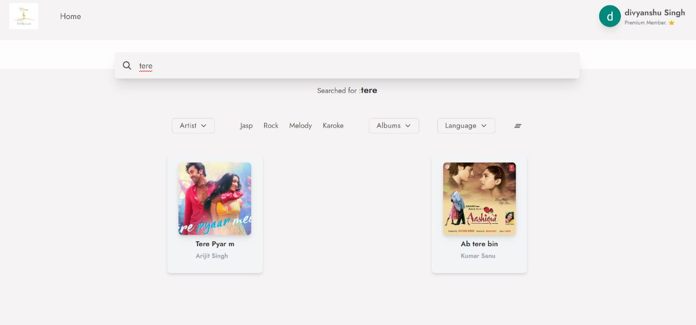
Search Page:
You can search the song on the basis of songs name, Artist name’s, Albums and language as well.

Slide 12
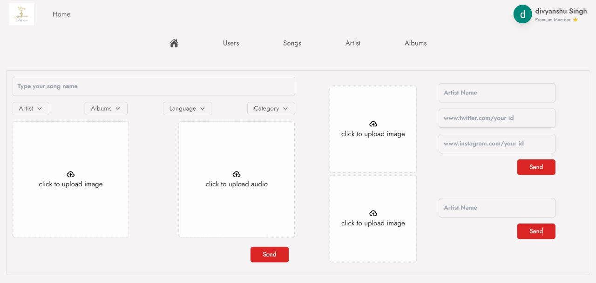
Upload Page:
Only Admin can upload songs making new playlist and add artist

Slide 13
Features:
Music Player
Search Functionality
Music Discovery
User Account
Admin dasahboard

Slide 14
Advantages:
There are several advantages to music sites, including:
Convenience: Music sites allow users to access and listen to music from anywhere, at any time, without having to physically purchase or download it. This makes it convenient for users to enjoy their favorite songs on the go, while working, or even while exercising.
Variety: Music sites offer a wide variety of music genres and artists, which means that users have access to an extensive library of songs to choose from. This makes it easy for users to discover new music and explore different genres.
Cost-effective: Many music sites offer free or low-cost options for users to access music, making it a cost-effective alternative to purchasing music albums or individual songs.

Slide 15
4.Personalization: Some music sites allow users to create personalized playlists based on their music preferences. This feature allows users to curate their own music collections and listen to their favorite songs in a customized order.
5.Community: Music sites often have social features, such as the ability to follow and connect with other music lovers. This creates a sense of community and allows users to discover new music through the recommendations of others.

Slide 16
Conclusion:
In conclusion, a music website can be an excellent platform for promoting music, providing music-related content, building a music-focused community, and generating revenue. To create a successful music website, careful planning and consideration of various aspects such as design, functionality, and technology are crucial.
A well-designed music website can provide a seamless user experience, promote engagement and loyalty, and ultimately lead to the success of the project. By fulfilling its purpose of providing a platform for music-related content and activities that meet the needs and interests of the target audience, a music website can become a valuable resource for music enthusiasts and an excellent business opportunity for website owners.

Slide 17
Thank You

