Slide 1

CyberShield AI — Intelligent Phishing URL Detection System
Project Progress Presentation
Team: Divyanshu Singh (25MCC20073) | Ishu Kaushal (25MCC20077)

Slide 2
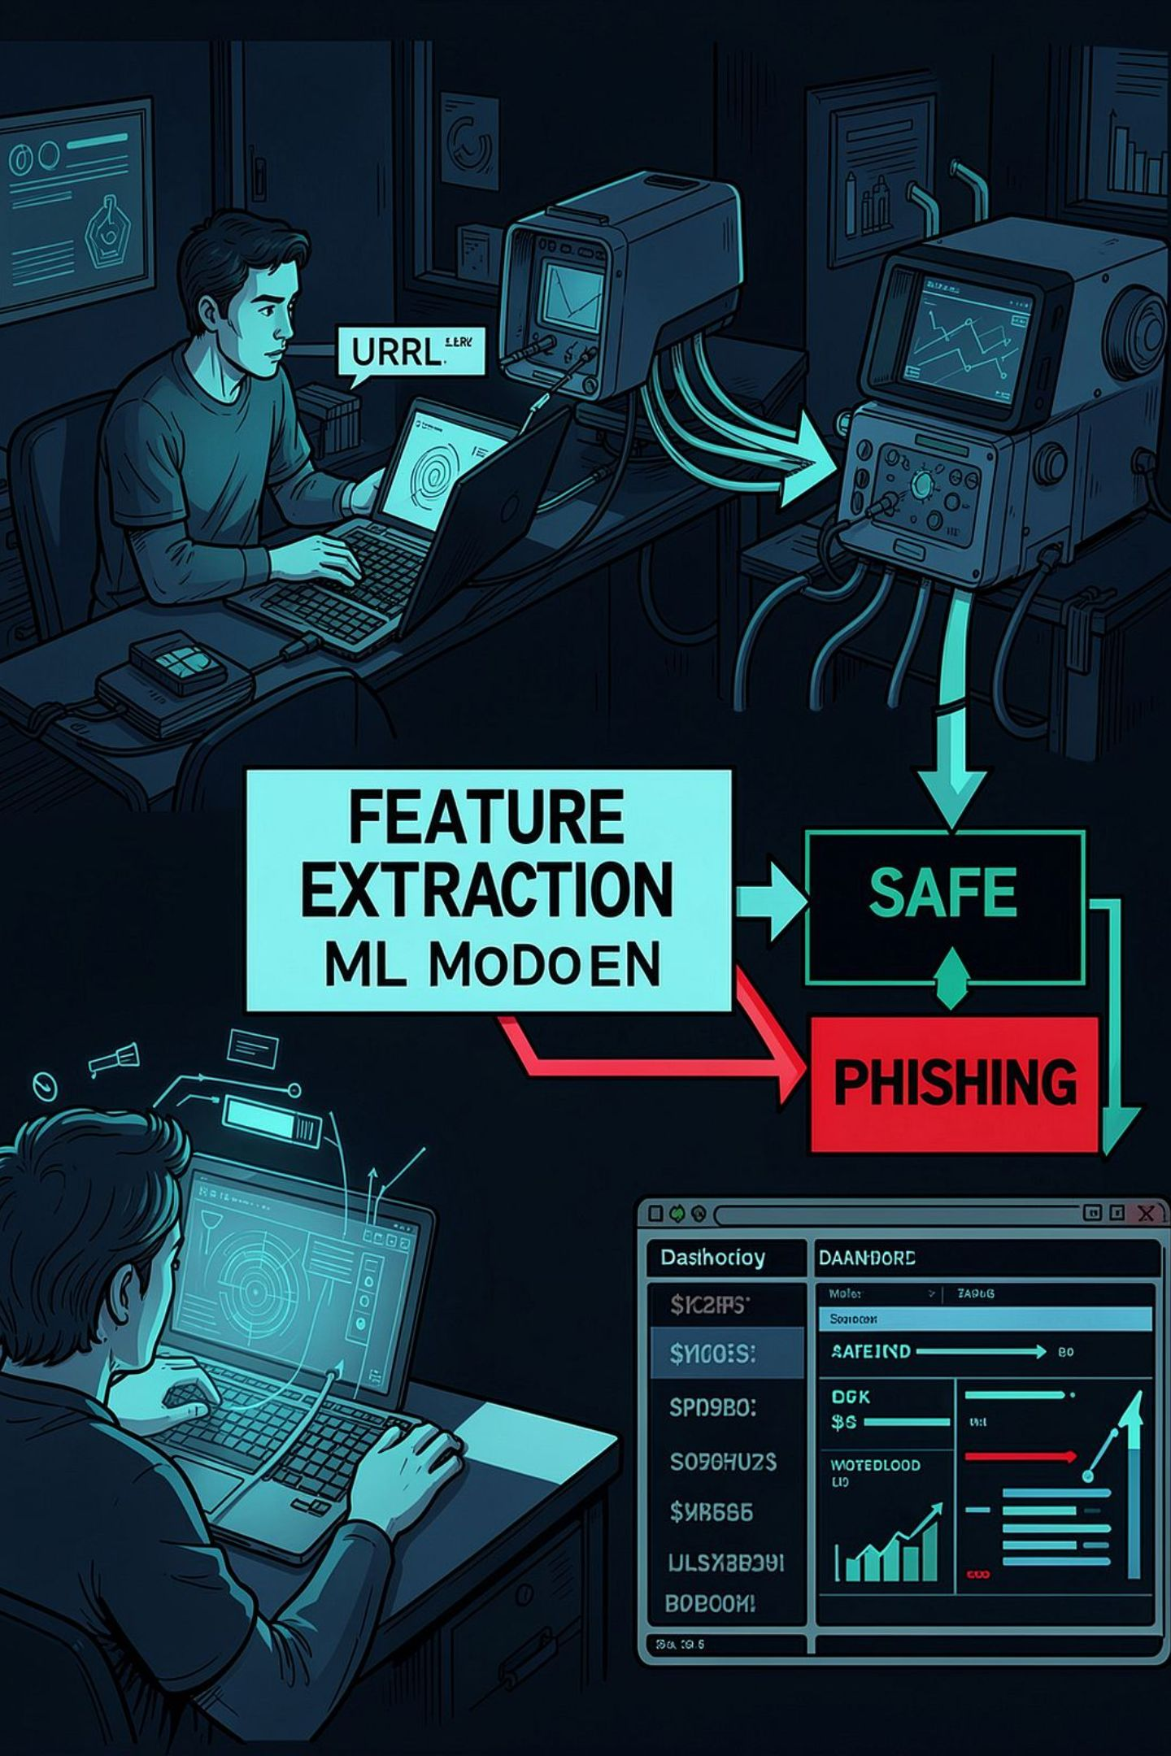
Project Overview
Phishing attacks exploit deceptive URLs to harvest credentials and data.
Users may unknowingly visit fraudulent sites and expose sensitive information.
CyberShield AI analyzes URL strings and predicts SAFE or PHISHING using ML.
System relies on URL-based feature extraction (no external APIs currently).
Web dashboard displays scan results and maintains scan history.

Slide 3
Project Objectives
Detect phishing URLs
ML-based binary classification (SAFE / PHISHING)
Analyze URL characteristics
Extract syntactic and lexical features
Provide risk score
Interpretable score to aid user decisions
Maintain scan history
Dashboard for results, trends, and records
Deliver practical web app
Usable prototype for classroom/demo

Slide 4


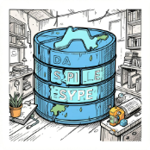

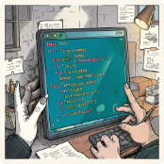
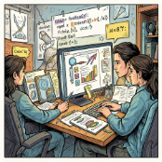
Technologies Used
Backend
Machine Learning
Data / Utilities
Development
Python • Flask
VS Code • Git • GitHub
Scikit-learn • Random Forest • Pandas
Joblib • SQLite (scan history)
Tools
Frontend
Local Flask server • Unit & integration testing
HTML • CSS • JavaScript •

Slide 5
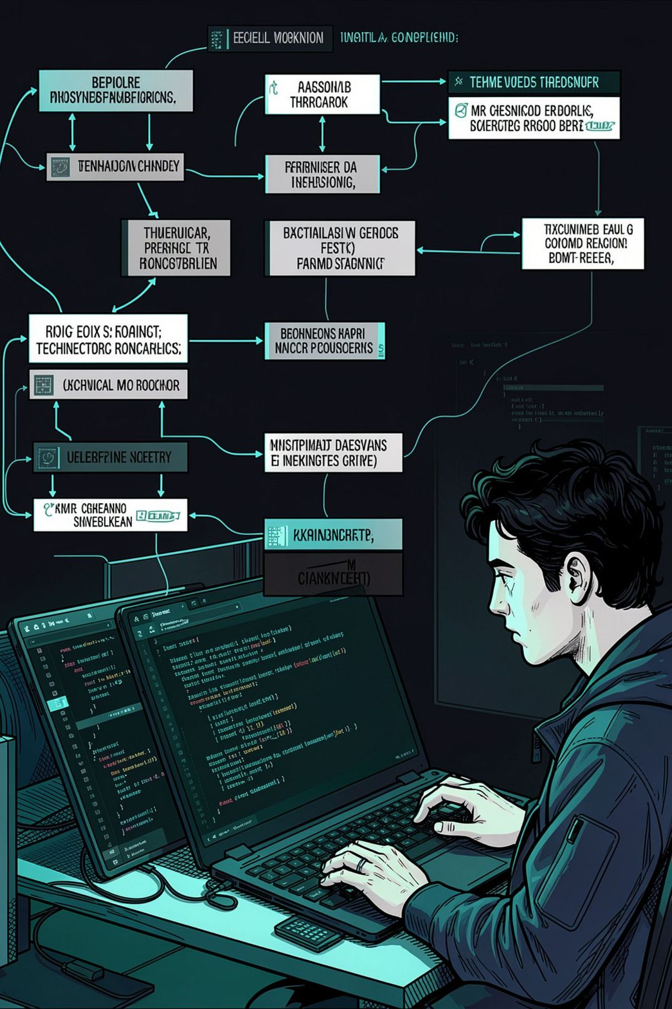
Contribution — Divyanshu
Project setup and development environment configuration.
Developed and configured Flask backend and API endpoints.
Implemented URL feature extraction pipeline (tokenization, metrics).
Integrated ML model into Flask for realtime prediction.
Implemented SAFE / PHISHING logic and risk-score computation.
Connected scanner interface to backend endpoints.
Database work for persistent scan history (SQLite integration).
Managed Git/GitHub repository and version control workflows.

Slide 6
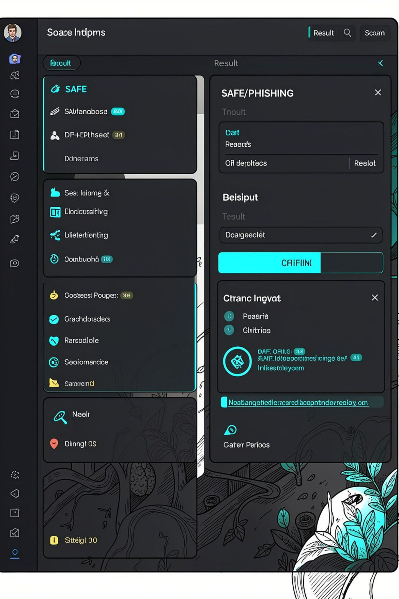
Contribution — Ishu
Designed user-facing cybersecurity interface and visual layout.
Developed URL scanning page and user input flow.
Designed prediction/result display with clear SAFE/PHISHING indicators.
Implemented dashboard UI and scan-history presentation.
Added dashboard stats cards and visual organization.
Improved responsive and user-friendly front-end elements.
Performed frontend testing and UI refinements.
Supported frontend-backend integration and system testing.

Slide 7

Current System Workflow
Feature Extraction
Input URL
User submits a URL to scan.
Compute length, HTTPS, IP, keywords.
Model Prediction
Results & Log
Random Forest classifies SAFE or PHISHING.
Risk score shown and saved to history.
Example URL features: URL length • HTTPS presence • IP address usage • Suspicious keywords • Number of subdomains

Slide 8
Progress Status
COMPLETED
IN PROGRESS
PLANNED
✓ Project setup
✓ Flask backend and API
✓ Basic ML model (Random Forest)
✓ URL feature extraction
✓ SAFE / PHISHING classification
✓ Risk score generation
✓ Scanner interface & dashboard
✓ Scan-history persistence (SQLite)
✓ GitHub repository & collaboration
⏳ Shared/permanent database architecture
⏳ Further ML model tuning and validation
⏳ Expanded unit and integration tests
○ Authentication (Login/Register)
○ Admin role and monitoring dashboard
○ Training on larger real-world phishing datasets
○ Advanced URL/security features
○ External threat-intel integration (e.g., VirusTotal)
○ Cloud deployment / online hosting
○ Optional browser-extension prototype

Slide 9
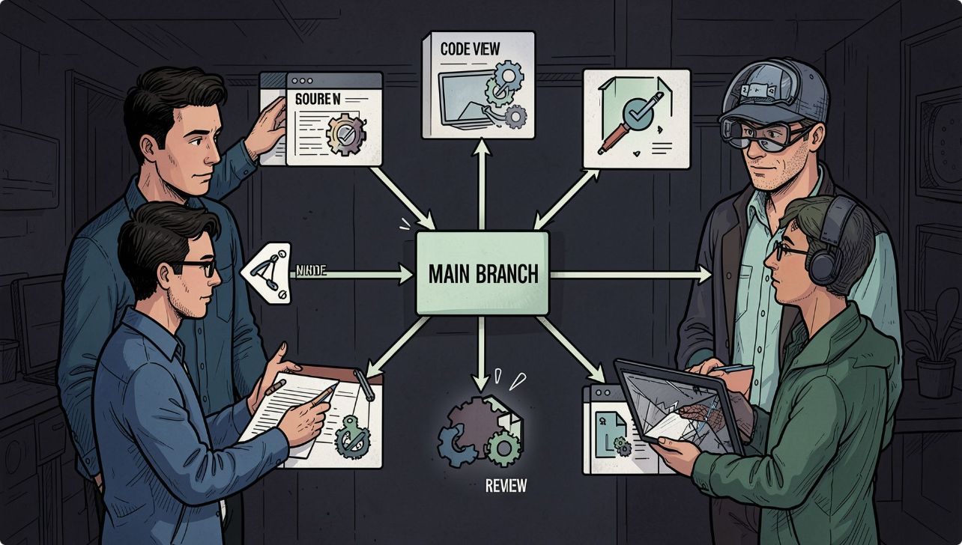

Team Collaboration & Development
GitHub used for source-code version control and issue tracking.
Both members contribute to the same repository (feature branches).
Changes reviewed via pull requests before merging to main.
Shared database and deployment plan will enable centralized scan data.
Tasks split by backend (Divyanshu) and frontend/UI (Ishu) with joint testing.
Collaboration emphasis: balanced responsibilities and joint problem solving.
Architecture: Divyanshu + Ishu → GitHub Repo → Flask App → Shared DB → Users / Admin Dashboard

Slide 10
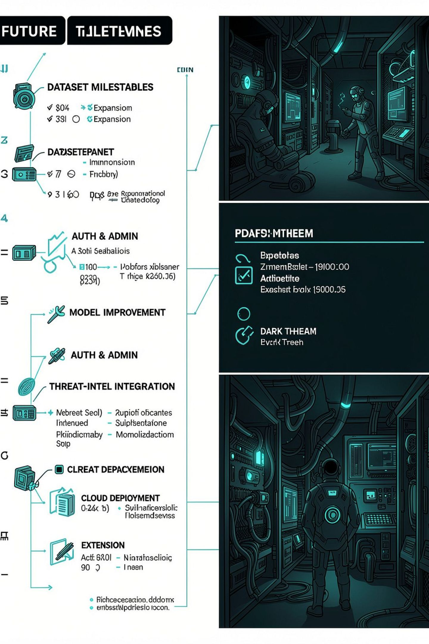
Future Scope & Conclusion
Future work: larger real-world phishing datasets & advanced URL features.
Improve model accuracy, confidence scoring, and explainability.
Add authentication, user-specific history, and admin monitoring (planned).
Integrate external threat intelligence (VirusTotal) — planned stage only.
Deploy to cloud and explore browser-extension integration (future phase).
Conclusion: Core scanning, ML classification, risk assessment, dashboard, and collaborative foundation are implemented; advanced security/deployment features planned next.
Thank you — Questions?

