Slide 1
Data Structures and Algorithms (ESO207A)
Lecture 1
An overview of the course
The motivation for the course
some concrete examples.

Slide 2
The website of the course
moodle.cse.iitk.ac.in
CSE
ESO207: Data Structures and Algorithms
(guest login allowed)
This course will be taught differently.

Slide 3
Prerequisite of this course
A good command on Programming in C
Programs involving arrays
Recursion
Linked lists (preferred)
Fascination for solving Puzzles

Slide 4
Salient features of the course
Every concept
Solving each problem
solution will emerge naturally if we ask
right set of questions
and then try to find their answers.
… so that finally it is a concept/solution derived by you
and not a concept from some scientist/book/teacher.
We shall re-invent in the class itself.
Through discussion in the class and by you as homework
Isn’t that nice ☺

Slide 5
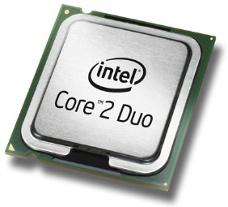
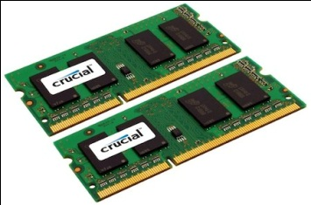

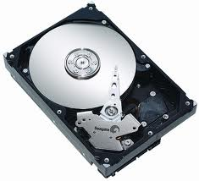


Let us open a desktop/laptop
A processor (CPU)
speed = few GHz
(a few nanoseconds to execute an instruction)
Internal memory (RAM)
size = a few GB (Stores a billion bytes/words)
speed = a few GHz( a few nanoseconds to read a byte/word)
(Solid State Drive)
External Memory
(Hard Disk Drive)
size = a few tera bytes
speed : seek time =
transfer rate= around billion bits per second
$25$-$100$ microseconds
$5$-$10$ miliseconds

Slide 6
A simplifying assumption (for the rest of the lecture)
It takes around a few nanoseconds to execute an instruction in C.

Slide 7
Algorithms

Slide 8
What is an algorithm ?
Definition:
A finite sequence of well defined instructions
required to solve a given computational problem.

Slide 9
The Data Structures

Slide 10
Aim of a data structure ?
To store/organize a given data in the memory of computer so that
each subsequent operation (query/update) can be performed quickly.

Slide 11
Efficient Algorithm and Data Structures
The AIM of the Course
we have Processors running at gigahertz.
We have RAMs that can Store Giga Bytes.

Slide 12
Revisiting problems from ESC101

Slide 13


Problem 1:
Design and implement an algorithm with the following objective:
Input: integer $x$
integer $n$
Output: $x^{n}$
int
long long int
mod $2021$

Slide 14
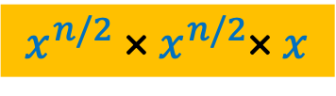
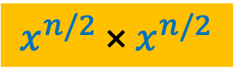
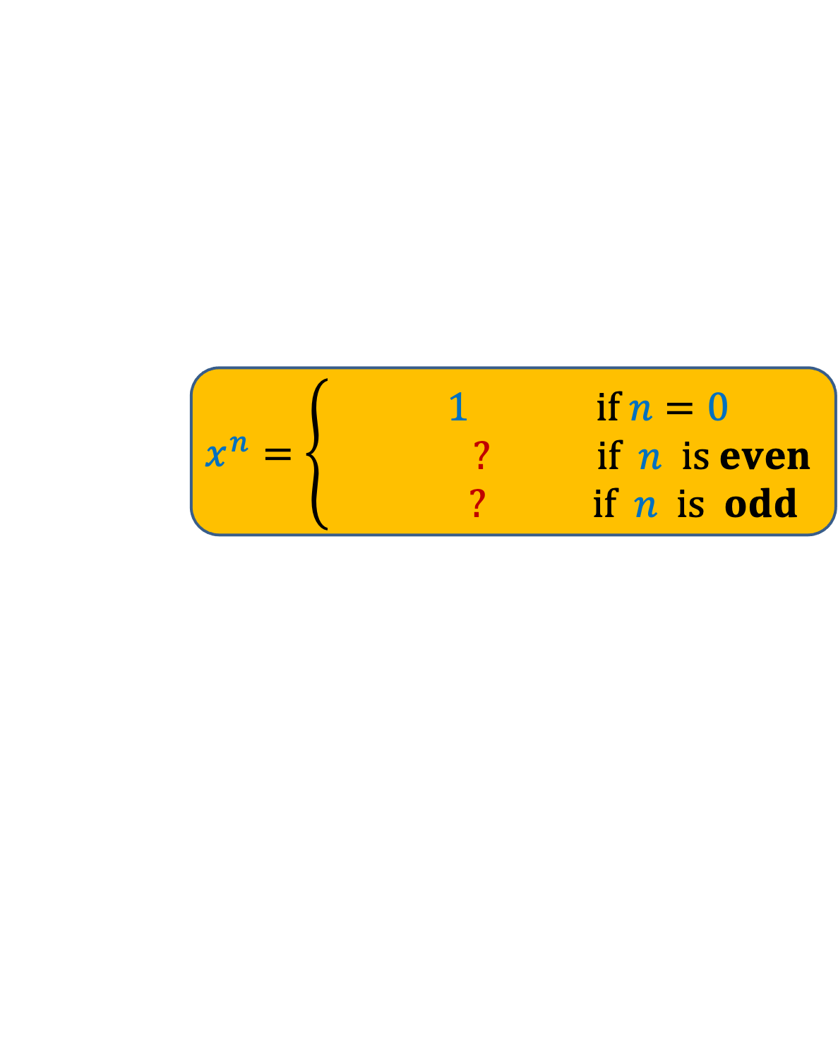
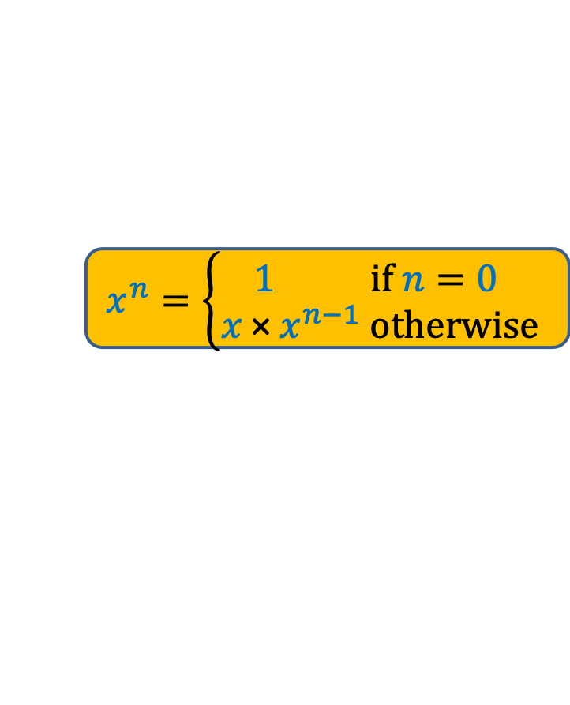
Problem 1:
Design and implement an algorithm with the following objective:
Input: integer $x$
integer $n$
Output: $x^{n}$
int
long long int
mod $2021$
Recursion
$$x^{n}=\left\{\begin{aligned} 1 if n=0 \\ ? if n is even \\ ? if n is odd\end{aligned}\right.$$
$$x^{n}=\left\{\begin{aligned}1 if n=0 \\ x \text{×} x^{n−1} otherwise\end{aligned}\right.$$
$$x^{n/2} \text{× }x^{n/2}$$
$$x^{n/2} \text{× }x^{n/2}\text{×} x$$
Homework 1
Write C code to see if it works.

Slide 15
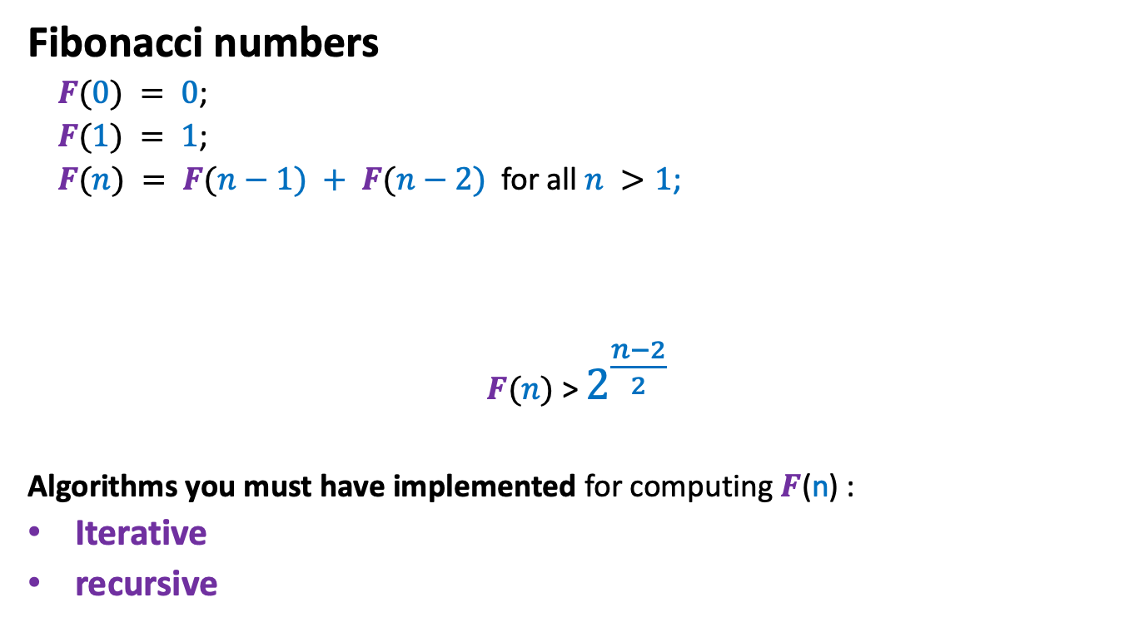
Fibonacci numbers
Fibonacci numbers
$F(0) = 0$;
$F(1) = 1$;
$F(n) = F(n−1) + F(n−2)$for all $n >1$;
$F(n)$ > $2^{\frac{n−2}{2}}$
Algorithms you must have implemented for computing $F$(n) :
Iterative
recursive
Simple exercise:
Using induction or otherwise, show that

Slide 16



Iterative Algorithm for $F$($n$)
IFib($n$)
{ if ($n=0$) return $0$;
else if ($n=1$) return $1$;
else {
$a$ ← $0$; $b$← $1$;
For($i=2$ to $n$) do
{ temp ← $b$;
$b$← $a+b$;
$a$← temp;
}
}
return $b$;
}
$$=$$
Equality operator
←
Assignment operator
Pseudocode

Slide 17




Recursive algorithm for $F$($n$)
Rfib($n$)
{ if ($n$=$0$) return $0$;
else if ($n$=$1$) return $1$;
else return( ? $+$ ? );
}
Rfib($n−1$)
Rfib($n−2$)

Slide 18

Problem 2:
Design and implement an algorithm with the following objective:
Input: an integer $n$
Output: $F$($n$) mod $2021$
long long int

Slide 19
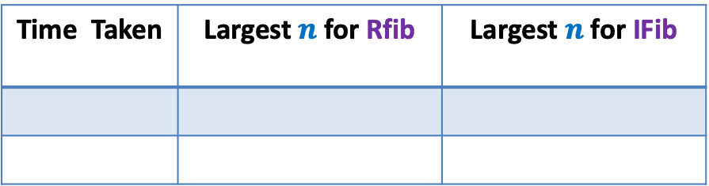
Problem 2:
Design and implement an algorithm with the following objective:
Input: an integer $n$
Output: $F$($n$) mod $2021$
long long int
Homework 2
Implement Rfib and IFib algorithm in C.
Time Taken | Largest $n$for Rfib | Largest $n$for IFib
1 minute
10 minutes
Homework 3
Ponder over an efficient algorithm for this problem.

Slide 20
Do we need efficient algorithms in real world
Search engines like Google exploits many clever algorithms.
Joint Seat Allocation

Slide 21
The Data Structures

Slide 22
Range-Minima Problem
A Motivating example

Slide 23






Range-Minima Problem
Given:
Query:
Range-minima($i,j$) :
Let $n$ = $1$million.
No. of queries = $10$ millions
an array A storing $n$numbers
report the smallest element from A[$i$],…,A[$j$]
Range-Minima($i,j$) = $−6$
A
$$3$$ | $$5$$ | $$1$$ | $$8$$ | $$19$$ | $$0$$ | $$−1$$ | $$30$$ | $$99$$ | $$−6$$ | $$10$$ | $$2$$ | $$40$$ | $$27$$ | $$44$$ | $$67$$
$$i=4$$
$$j=11$$

Slide 24
Range-Minima Problem
Applications:
Computational geometry
String matching
As an efficient subroutine in a variety of algorithms

Slide 25
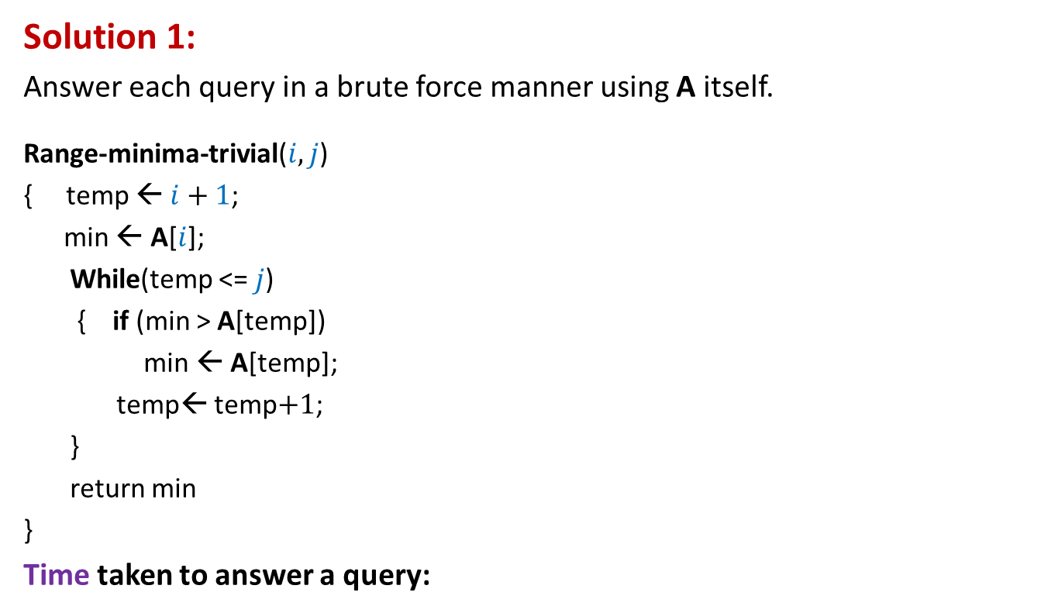
Range-Minima Problem
Solution 1:
Answer each query in a brute force manner using A itself.
Range-minima-trivial($i,j$)
{ temp ← $i+1$;
min ← A[$i$];
While(temp <= $j$)
{ if (min > A[temp])
min ← A[temp];
temp← temp$+1$;
}
return min
}
Time taken to answer a query:
Time for answering all queries:
a few hours
few milliseconds

Slide 26





Range-Minima Problem
Solution 2:
Compute and store answer for each possible query in a $n$× $n$ matrix B.
B[$i$][$j$] :
Space : roughly $n^{2}$ words.
$$j$$
Solution 2 is
Theoretically efficient but practically inefficient
$$i$$
$$3$$
Size of B is too large to be kept in RAM. So we shall have to keep most of it in the Hard disk drive. Hence it will take a few milliseconds per query.
B
the smallest element from A[$i$],…,A[$j$]

Slide 27
Range-Minima Problem
Question: Does there exist a data structure for Range-minima which is
Compact
(nearly the same size as the input array A)
Can answer each query efficiently ?
(a few nanoseconds per query)
Homework 4: Ponder over the above question.
(we shall solve it soon)

Slide 28
Concluding slide
moodle.cse.iitk.ac.in
CSE
ESO207: Data Structures and Algorithms
(guest login allowed)
An Optional tutorial session on “Recursion”
11:00 AM, 31st July, 2022
KD101 (Kadim Diwan Building)
Conducted by tutor.
(Attend it only if you are weak in Recursion)
Do the homework sincerely.

