Slide 1
Data Structures and Algorithms (ESO207A)
Lecture 11
Exploring nearly balanced BST for the directory problem
Stack: a new data structure

Slide 2
Binary Search Tree (BST)
Definition: A Binary Tree T storing values is said to be Binary Search Tree
if for each node v in T
If left(v) <> NULL, then …
If right(v)<>NULL, then …
head
46
28
67
5
35
49
83
2
25
31
41
48
53
73
96
value(v) > value of every node in subtree(left(v)).
value(v) < value of every node in subtree(right(v)).

Slide 3
Search(T,x) Searching in a Binary Search Tree
T
Search(T,33) :
Searching for 33 in T.
46
28
67
5
35
49
83
2
25
31
41
48
53
73
96

Slide 4
Search(T,x) Searching in a Binary Search Tree
Search(T,x)
{ p← T;
Found← FALSE ;
while( ?? )
{ if(value(p) = x) ?? ;
else if (value(p) < x) ?? ;
else ?? ;
}
return p;
}
Found= FALSE & p<> NULL
Found← TRUE
p← right(p)
p← left(p)

Slide 5
Insert(T,x) Insertion in a Binary Search Tree
T
Insert(T,50) :
Inserting 50 into T.
46
28
67
5
35
49
83
2
25
31
41
48
53
73
96
50

Slide 6

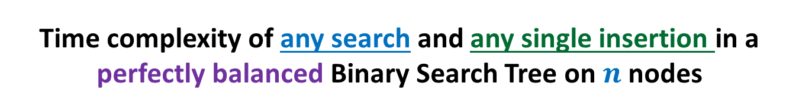
Time complexity of any search and any single insertion in a perfectly balanced Binary Search Tree on $n$ nodes
T
O( log $n$) time
46
28
67
5
35
49
83
2
25
31
41
48
53
73
96

Slide 7
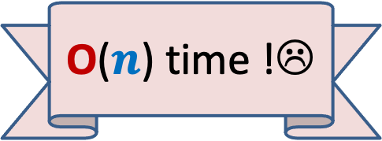
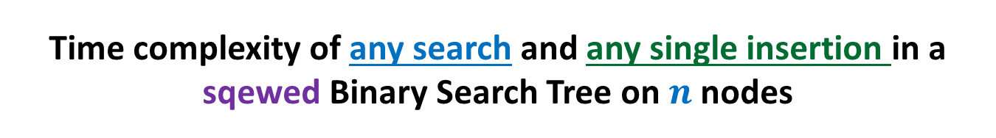
Time complexity of any search and any single insertion in a sqewed Binary Search Tree on $n$ nodes
T’
48
39
23
19
11
O($n$) time !☹
14
18

Slide 8
Our Original Problem
Maintain a telephone directory

Slide 9

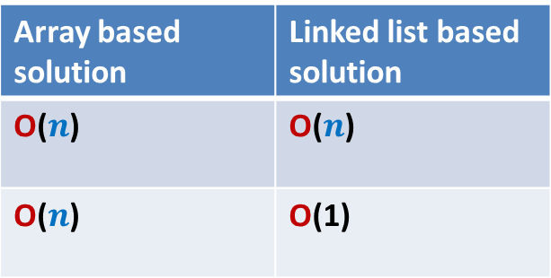
Our Original Problem
Maintain a telephone directory
Operations:
Search the phone # of a person with name x
Insert a new record (ID no., phone #,…)
Solution : We may keep perfectly balanced BST.
Hurdle: What if we insert records in increasing order of ID ?
BST will be skewed ☹
BST data structure that we invented looks very elegant,
let us try to find a way to overcome the hurdle.
Array based solution | Linked list based solution
O($n$) | O($n$)
O($n$) | O(1)
ID no.
Log $n$
Log $n$

Slide 10
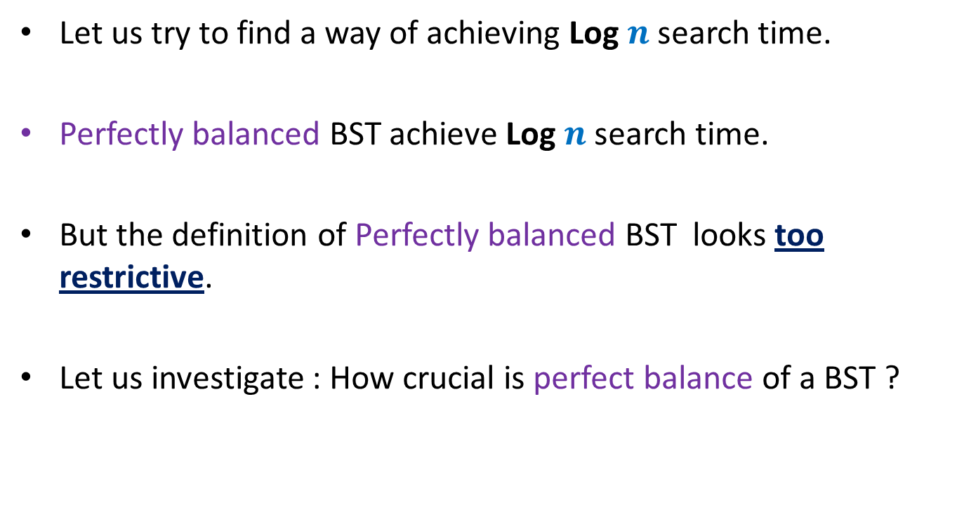
Let us try to find a way of achieving Log $n$search time.
Perfectly balanced BST achieve Log $n$search time.
But the definition of Perfectly balanced BST looks too restrictive.
Let us investigate : How crucial is perfect balance of a BST ?

Slide 11




How crucial is perfect balance of a BST ?
$H(1)$ = 0
$H(n)$ = $≤1+H\left(\frac{n}{2}\right)$
Let us change this recurrence slightly.
$$≤\frac{n}{2}$$
$$≤\frac{n}{2}$$
$$n$$

Slide 12
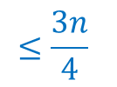

How crucial is perfect balance of a BST ?
$H(1)$ = 0
$H(n)$ $≤1+H\left(\frac{3n}{4}\right)$
$≤1+1+H\left({\left(\frac{3}{4}\right)}^{2}n\right)$
$≤1+1+…+ H\left({\left(\frac{3}{4}\right)}^{i}n\right)$
$≤$ $\log_{4/3} n$
$$≤\frac{3n}{4}$$
What lesson did you get from this recurrence ?
Think for a while before going further …
$$n$$
Lesson learnt :
We may as well work with nearly balanced BST

Slide 13
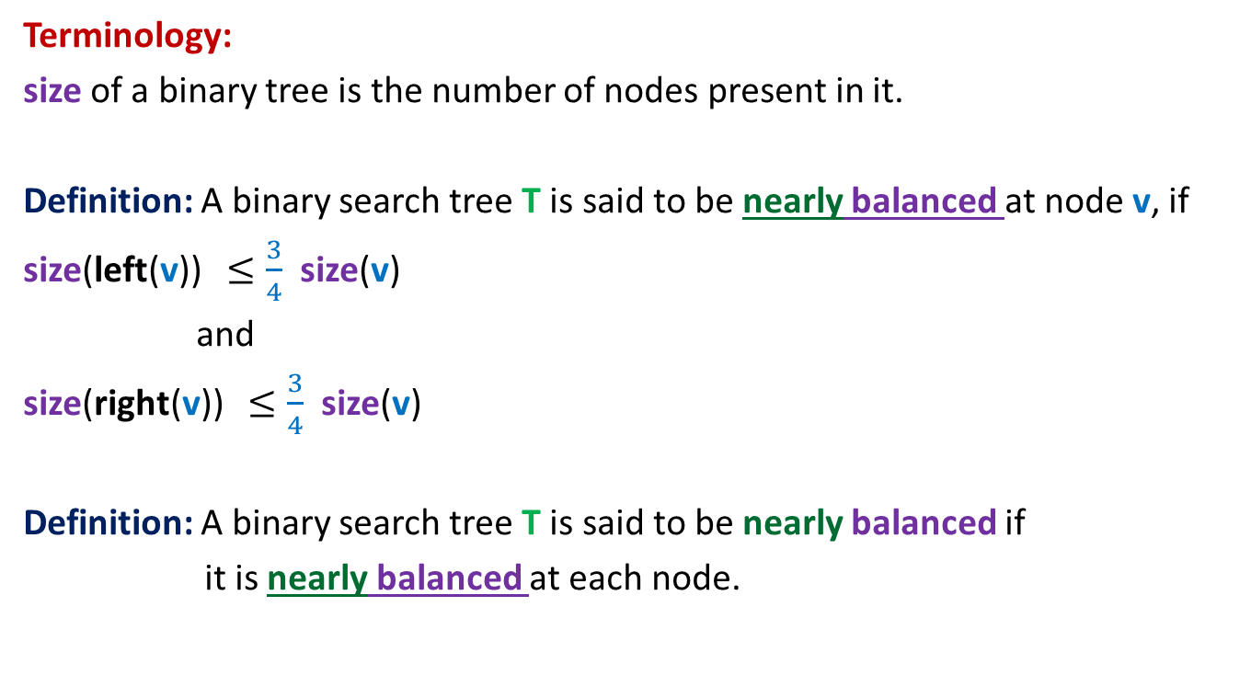
Nearly balanced Binary Search Tree
Terminology:
size of a binary tree is the number of nodes present in it.
Definition: A binary search tree T is said to be nearly balanced at node v, if
size(left(v)) $≤\frac{3}{4}$ size(v)
and
size(right(v)) $≤\frac{3}{4}$ size(v)
Definition: A binary search tree T is said to be nearly balanced if
it is nearly balanced at each node.

Slide 14
Homework

Slide 15
Just think …
How to use nearly balanced BST for our problem ?
We shall revisit it in future.

Slide 16
Stack: a data structure
A few motivating examples

Slide 17
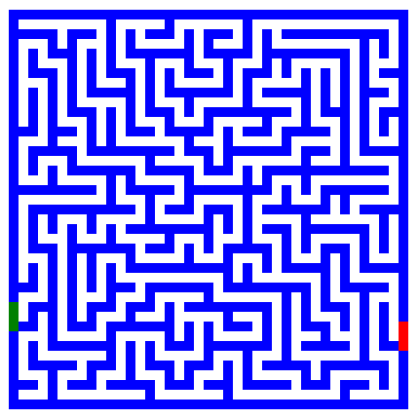
Finding path in a maze
Problem : How to design an algorithm for finding a path in a maze ?

Slide 18
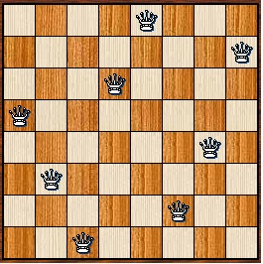
8-Queens Problem
Problem: How to place 8 queens on a chess board
so that no two of them attack each other ?

Slide 19

Expression Evaluation
$x = 3+4∗(5−6∗(8+9^2)+3)$
Problem:
Can you write a program to evaluate any arithmetic expression ?

Slide 20
Stack: a data structure

Slide 21
Stack
Data Structure Stack:
Mathematical Modeling of Stack
Implementation of Stack
will be left as an exercise

Slide 22


Revisiting List
List is modeled as a sequence of elements.
we can insert/delete/query element
L : $a_{1}$, $a_{2}$, …, $a_{i−1}, a_{i}$, $a_{i+1}$, …, $a_{n}$
at any arbitrary position in the list.
Top
$i$th element of list L
What if we restrict all these operations to take place only at one end of the list ?

Slide 23

Stack: a new data structure
A special kind of list
where all operations (insertion, deletion, query) take place at one end only,
called the top.
top
$$a_{1}$$
$$a_{2}$$
$$a_{n}$$

Slide 24
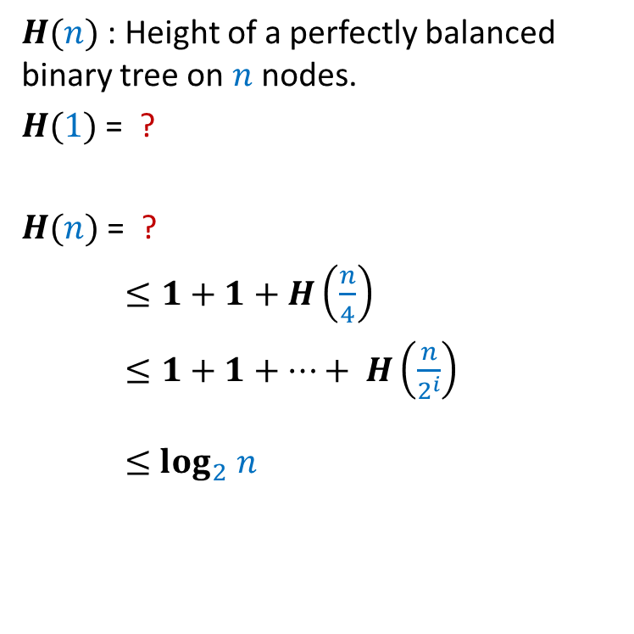
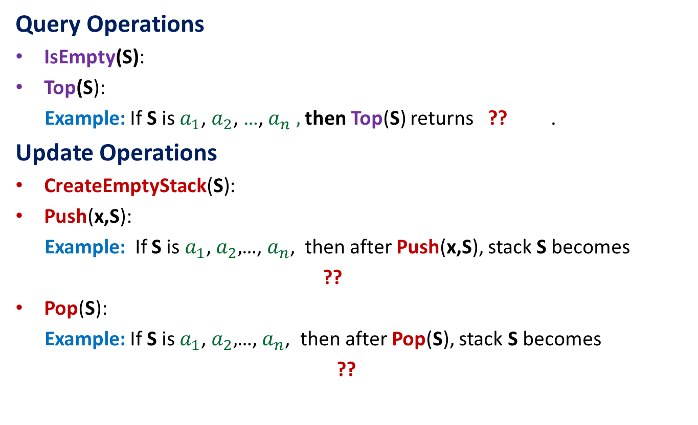


Operations on a Stack
Query Operations
IsEmpty(S):
Top(S):
Example: If S is $a_{1}$, $a_{2}$, …,${ a}_{n} ,$ then Top(S) returns ?? .
Update Operations
CreateEmptyStack(S):
Push(x,S):
Example: If S is $a_{1}$, $a_{2},$…, $a_{n}$, then after Push(x,S), stack S becomes
??
Pop(S):
Example: If S is $a_{1}$, $a_{2},$…, $a_{n}$, then after Pop(S), stack S becomes
??
determine if S is an empty stack
returns the element at the top of the stack
$$a_{1}$$
Create an empty stack
push x at the top of the stack S
${x, a}_{1}$, $a_{2}$ ,…, $a_{n}$
Delete element from top of the stack S
$a_{2}$ ,…, $a_{n}$

Slide 25

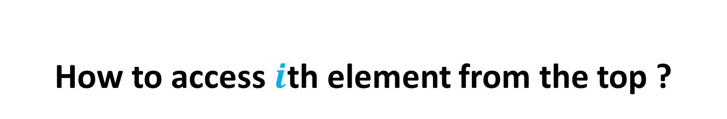
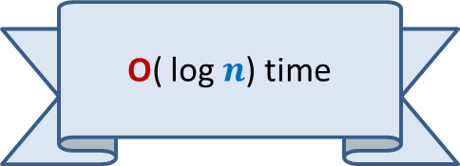

How to access $i$th element from the top ?
An Important point about stack
To access $i$th element, we must
pop (hence delete) one by one the top $i−1$ elements from the stack.
$$a_{1}$$
$$a_{i−1}$$
$$a_{i}$$
$$a_{n}$$

Slide 26
A puzzling question/confusion
Why do we restrict the functionality of a list ?
What will be the use of such restriction ?
It seems counter-intuitive at this stage.
But it works…
We shall realize it in future.

Slide 27
How to evaluate an arithmetic expression

Slide 28
Evaluation of an arithmetic expression
Question: How does a computer/calculator
evaluate an arithmetic expression given in the form of a string of symbols ?
8 + 3 * 5 ^ 2 – 9

Slide 29
Evaluation of an arithmetic expression
Question: How does a computer/calculator
evaluate an arithmetic expression given in the form of a string of symbols ?
8 + 3 * 5 ^ 2 – 9
First it splits the string into tokens which are operators or operands (numbers). This is not difficult. But how does it evaluate it finally ???
operators
operands

Slide 30
Precedence of operators
Precedence: “priority” among different operators
Operator + has same precedence as –.
Operator * (as well as /) has higher precedence than +.
Operator * has same precedence as /.
Operator ^ has higher precedence than * and /.

Slide 31
Associativity of operators
What is 2^3^2 ?
What is 3-4-2 ?
What is 4/2/2 ?
Associativity:
“How to group operators of same type ?”
A ● B ● C = ??
(A ● B) ● C or A ● (B ● C)
Left associative
Right associative

Slide 32
A trivial way to evaluate an arithmetic expression
First perform all ^ operations.
Then perform all * and / operations.
Then perform all + and - operations.
Disadvantages:
An ugly and case analysis based algorithm
Multiple scans of the expression (one for each operator).
What about expressions involving parentheses: 3+4*(5-6/(8+9^2)+33)
What about associativity of the operators:
2^3^2 = 512 and not 64
16/4/2 = 2 and not 8.
8
+
3
5
2
-
*
^
9

Slide 33
Overview of our solution
Focusing on a simpler version of the problem:
Expressions without parentheses
Every operator is left associative
Solving the simpler version
Transforming the solution of simpler version to generic

Slide 34
Step 1
Focusing on a simpler version of the problem

Slide 35
Incorporating precedence of operators
through priority number
Operator | Priority
+ , - | 1
* , / | 2
^ | 3

Slide 36
Homework
Recall ..
How did you learn evaluation of arithmetic expressions ?
Think over it. Interestingly, you can recall it, you can design an elegant algorithm. We shall do it in next class ☺.

