Slide 1
Data Structures and Algorithms (ESO207A)
Lecture 12:
Arithmetic expression evaluation: Complete algorithm using stack

Slide 2
Quick Recap of last lecture

Slide 3
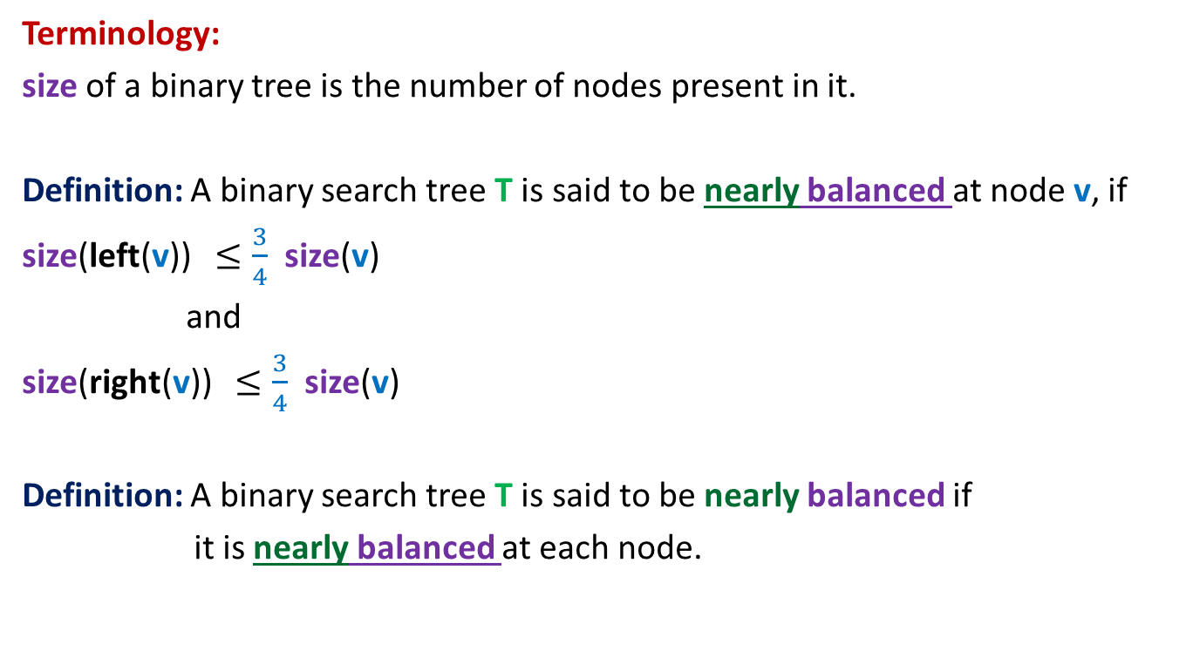
Nearly balanced Binary Search Tree
Terminology:
size of a binary tree is the number of nodes present in it.
Definition: A binary search tree T is said to be nearly balanced at node v, if
size(left(v)) $≤\frac{3}{4}$ size(v)
and
size(right(v)) $≤\frac{3}{4}$ size(v)
Definition: A binary search tree T is said to be nearly balanced if
it is nearly balanced at each node.

Slide 4
Nearly balanced Binary Search Tree
very efficient for searching. But …
Question: How to maintain it ?
Rome was not built in a day…
As first step, try to address the following easier problem as homework:
Design an efficient algorithm to transform
a nearly balanced BST to a perfectly balanced BST.

Slide 5



Stack: a new data structure
A special kind of list
where all operations (insertion, deletion, query) take place at one end only,
called the top.
top
$$a_{1}$$
$$a_{2}$$
$$a_{n}$$

Slide 6
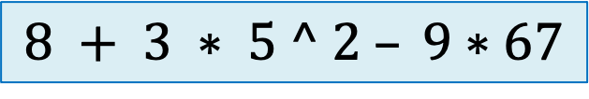
Evaluating an arithmetic operation
$$8 + 3 ∗ 5 ^ 2 – 9∗67$$

Slide 7
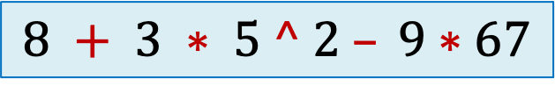
Evaluating an arithmetic operation
$$8 + 3 ∗ 5 ^ 2 – 9∗67$$

Slide 8
Evaluating an arithmetic operation
$$25∗2+6∗(49−10^2∗36/(7+3∗(((56+7∗2−20)+(4^3))−78/3)$$

Slide 9
Evaluating an arithmetic operation
Challenges
Precedence of operators
Associativity of operators
Parentheses
(A ● B) ● C
or A ● (B ● C)
A ● B ● C

Slide 10
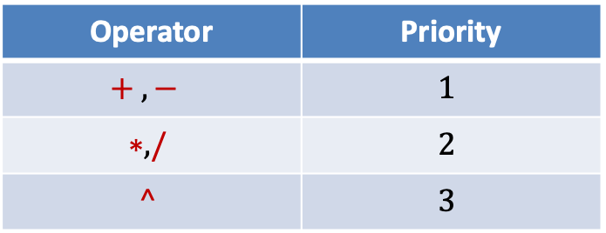
Incorporating precedence of operators
Operator | Priority
$$+ , −$$ | $$1$$
$$∗, /$$ | $$2$$
$$^$$ | $$3$$

Slide 11
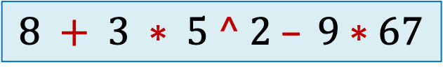

Insight into the problem
Let $o_{i}$ : the operator at position $i$in the expression.
Question: Can we execute operator $o_{i}$ immediately?
Answer: if
priority($o_{i}$) ?? priority($o_{i−1}$)
priority($o_{i}$) ?? priority($o_{i+1}$)
No
$$8 + 3 ∗ 5 ^ 2 – 9∗67$$
Yes
Can we execute this multiplication immediately ?
Can we execute this multiplication immediately ?
>
Can you use this insight to design an algorithm ?
Try for some time…
≥

Slide 12
The algorithm
Make a scan of the expression from left to right, and …
… execute an operation as soon as it is possible ...

Slide 13

Expression: $n_{1}{o_{1} n}_{2} o_{2}{ n}_{3} o_{3} n_{4} o_{4} n_{5 }o_{5} n_{6} o_{6} n_{7} o_{7}…$

Slide 14


Expression: $n_{1}{o_{1} n}_{2} o_{2}{ n}_{3} o_{3} n_{4} o_{4} n_{5 }o_{5} n_{6} o_{6} n_{7} o_{7}…$
Priority no.
$$o_{1}$$

Slide 15

Expression: $n_{1}{o_{1} n}_{2} o_{2}{ n}_{3} o_{3} n_{4} o_{4} n_{5 }o_{5} n_{6} o_{6} n_{7} o_{7}…$
Priority no.
$$o_{1}$$
$$o_{2}$$

Slide 16

Expression: $n_{1}{o_{1} n}_{2} o_{2}{ n}_{3} o_{3} n_{4} o_{4} n_{5 }o_{5} n_{6} o_{6} n_{7} o_{7}…$
Priority no.
$$o_{1}$$
$$o_{2}$$
$$o_{3}$$

Slide 17

Expression: $n_{1}{o_{1} n}_{2} o_{2}{ n}_{3} o_{3} n_{4} o_{4} n_{5 }o_{5} n_{6} o_{6} n_{7} o_{7}…$
Priority no.
$$o_{1}$$
$$o_{2}$$
$$o_{3}$$
$$o_{4}$$

Slide 18

Expression: $n_{1}{o_{1} n}_{2} o_{2}{ n}_{3} o_{3} n_{4} o_{4} n_{5 }o_{5} n_{6} o_{6} n_{7} o_{7}…$
Priority no.
$$o_{1}$$
$$o_{2}$$
$$o_{3}$$
$$o_{4}$$
$$o_{5}$$

Slide 19


Expression: $n_{1}{o_{1} n}_{2} o_{2}{ n}_{3} o_{3} n_{4} o_{4} n_{5 }o_{5} n_{6} o_{6} n_{7} o_{7}…$
Priority no.
$$o_{1}$$
$$o_{2}$$
$$o_{3}$$
$$o_{4}$$
$$o_{5}$$
$$o_{6}$$
$$n′$$

Slide 20


Expression: $n_{1}{o_{1} n}_{2} o_{2}{ n}_{3} o_{3} n_{4} o_{4} n_{5 }o_{5} n_{6} o_{6} n_{7} o_{7}…$
Priority no.
$$o_{1}$$
$$o_{2}$$
$$o_{3}$$
$$o_{4}$$
$$o_{6}$$
$$n′′$$
$$n′$$
$$o_{6} n_{7} o_{7}…$$

Slide 21

Expression: $n_{1}{o_{1} n}_{2} o_{2}{ n}_{3} o_{3} n_{4} o_{4} n_{5 }o_{5} n_{6} o_{6} n_{7} o_{7}…$
Priority no.
$$o_{1}$$
$$o_{2}$$
$$o_{3}$$
$$o_{6}$$
$$n′′$$
$$o_{6} n_{7} o_{7}…$$
$$n′$$

Slide 22


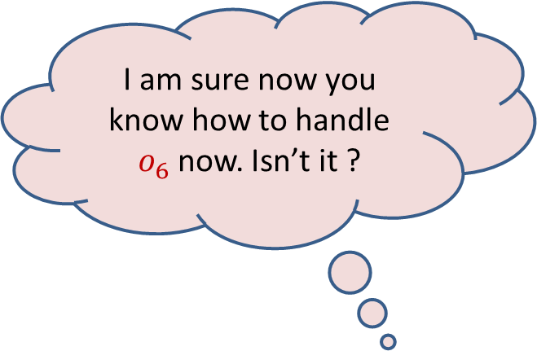
I am sure now you know how to handle $o_{6}$now. Isn’t it ?
Expression: $n_{1}{o_{1} n}_{2} o_{2}{ n}_{3} o_{3} n_{4} o_{4} n_{5 }o_{5} n_{6} o_{6} n_{7} o_{7}…$
$$o_{2}$$
$$o_{3}$$
$$o_{7}$$
Priority no.
$$o_{1}$$
$$o_{6}$$
$$o_{7}$$
$$n′′$$
$$o_{6} n_{7} o_{7}…$$
$$n′$$
Can you come up with the implementation of the algorithm ?
Try for some time…

Slide 23
Can you see the role of stack ?

Slide 24















Expression:
$$n_{1}$$
$$o_{1}$$
$$n_{2}$$
$$o_{2}$$
$$n_{3}$$
$$o_{3}$$
$$n_{4}$$
$$o_{4}$$
$$n_{5}$$
$$o_{5}$$
$$n_{6}$$
$$o_{6}$$
$$n_{7}$$
$$o_{7}$$
$$n_{8}$$
N-stack
for operands
O-stack
for operators

Slide 25

Expression:
Priority no.
$$o_{1}$$
$$o_{1}$$
$$n_{2}$$
$$o_{2}$$
$$n_{3}$$
$$o_{3}$$
$$n_{4}$$
$$o_{4}$$
$$n_{5}$$
$$o_{5}$$
$$n_{6}$$
$$o_{6}$$
$$n_{7}$$
$$o_{7}$$
$$n_{8}$$
$$n_{1}$$
N-stack
for operands
O-stack
for operators

Slide 26


Expression:
Priority no.
$$o_{1}$$
$$o_{2}$$
$$o_{2}$$
$$n_{3}$$
$$o_{3}$$
$$n_{4}$$
$$o_{4}$$
$$n_{5}$$
$$o_{5}$$
$$n_{6}$$
$$o_{6}$$
$$n_{7}$$
$$o_{7}$$
$$n_{8}$$
$$n_{2}$$
$$n_{1}$$
$$o_{1}$$
N-stack
for operands
O-stack
for operators

Slide 27


Expression:
Priority no.
$$o_{1}$$
$$o_{2}$$
$$o_{3}$$
$$o_{3}$$
$$n_{4}$$
$$o_{4}$$
$$n_{5}$$
$$o_{5}$$
$$n_{6}$$
$$o_{6}$$
$$n_{7}$$
$$o_{7}$$
$$n_{8}$$
$$n_{3}$$
$$n_{2}$$
$$o_{2}$$
$$n_{1}$$
$$o_{1}$$
N-stack
for operands
O-stack
for operators

Slide 28



Expression:
Priority no.
$$o_{1}$$
$$o_{2}$$
$$o_{3}$$
$$o_{4}$$
$$o_{4}$$
$$n_{5}$$
$$o_{5}$$
$$n_{6}$$
$$o_{6}$$
$$n_{7}$$
$$o_{7}$$
$$n_{8}$$
$$n_{4}$$
$$n_{3}$$
$$o_{3}$$
$$n_{2}$$
$$o_{2}$$
$$n_{1}$$
$$o_{1}$$
N-stack
for operands
O-stack
for operators

Slide 29



Expression:
Priority no.
$$o_{1}$$
$$o_{2}$$
$$o_{3}$$
$$o_{4}$$
$$o_{5}$$
$$o_{5}$$
$$n_{6}$$
$$o_{6}$$
$$n_{7}$$
$$o_{7}$$
$$n_{8}$$
$$n_{5}$$
$$n_{4}$$
$$o_{4}$$
$$n_{3}$$
$$o_{3}$$
$$n_{2}$$
$$o_{2}$$
$$n_{1}$$
$$o_{1}$$
N-stack
for operands
O-stack
for operators

Slide 30







Expression:
Priority no.
$$o_{1}$$
$$o_{2}$$
$$o_{3}$$
$$o_{4}$$
$$o_{5}$$
$$o_{6}$$
$$o_{6}$$
$$n_{7}$$
$$o_{7}$$
$$n_{8}$$
$$n′$$
$$=$$
$$n_{5}$$
$$o_{5}$$
$$n_{6}$$
$$n_{6}$$
$$n_{5}$$
$$o_{5}$$
$$n_{4}$$
$$o_{4}$$
$$n_{3}$$
$$o_{3}$$
$$n_{2}$$
$$o_{2}$$
$$n_{1}$$
$$o_{1}$$
N-stack
for operands
O-stack
for operators

Slide 31






Expression:
Priority no.
$$o_{1}$$
$$o_{2}$$
$$o_{3}$$
$$o_{4}$$
$$o_{6}$$
$$o_{6}$$
$$n_{7}$$
$$o_{7}$$
$$n_{8}$$
$$n′′$$
$$=$$
$$n_{4}$$
$$o_{4}$$
$$n′$$
$$n′$$
$$n_{4}$$
$$o_{4}$$
$$n_{3}$$
$$o_{3}$$
$$n_{2}$$
$$o_{2}$$
$$n_{1}$$
$$o_{1}$$
N-stack
for operands
O-stack
for operators

Slide 32

Expression:
Priority no.
$$o_{1}$$
$$o_{2}$$
$$o_{3}$$
$$o_{6}$$
$$o_{6}$$
$$n_{7}$$
$$o_{7}$$
$$n_{8}$$
$$n′′$$
$$n_{3}$$
$$o_{3}$$
$$n_{2}$$
$$o_{2}$$
$$n_{1}$$
$$o_{1}$$
N-stack
for operands
O-stack
for operators

Slide 33



Expression:
$$o_{2}$$
$$o_{3}$$
$$o_{6}$$
$$o_{7}$$
Priority no.
$$o_{1}$$
$$o_{7}$$
$$o_{7}$$
$$n_{8}$$
I am sure now you know how to handle $o_{6}$now. Isn’t it ?
$$n_{7}$$
$$o_{6}$$
$$n′′$$
$$n_{3}$$
$$o_{3}$$
$$n_{2}$$
$$o_{2}$$
$$n_{1}$$
$$o_{1}$$
N-stack
for operands
O-stack
for operators

Slide 34
A simple algorithm
Priority of $ :
Least
push($,O-stack);
While ( ? ) do
{ x ← next_token();
Two cases:
x is number :
x is operator :
while( ? >= ? )
{ o ← POP(O-stack);
Execute(o);
}
push(x,O-stack);
}
push(x,N-stack);
PRIORITY(TOP(O-stack)
PRIORITY(x)
POP two numbers from N-stack
apply operator o on them
place the result back into N-stack

Slide 35
Next step
Transforming the solution to Solve the most general case

Slide 36
How to handle parentheses ?
3+4*(5 - 6/2)
Answer:
Evaluate the expression enclosed by this parenthesis
before any other operator currently present in the O-stack.
So we must push ( into the O-stack.
Observation 1: While ( is the current operator encountered in the expression,
it must have higher priority than every other operator in the stack.
What should we do whenever
we encounter ( in the expression ?
*
+
(
O-stack

Slide 37

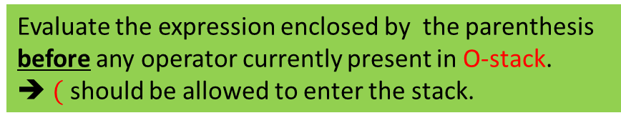



How to handle parentheses ?
$3 + 4 ∗ ( 5 – 6 / 2)$
So ( must have higher priority than every other operator in the stack.
What should we do whenever
we encounter ( in the expression ?
$$($$
$$∗$$
$$+$$
Evaluate the expression enclosed by the parenthesis
before any operator currently present in O-stack.
➔ $($ should be allowed to enter the stack.
$$\$$$
O-stack

Slide 38


How to handle parentheses ?
$3 + 4 ∗ ( 5 – 6 / 2)$
So ( must have higher priority than every other operator in the stack.
So ( must have less priority than every other operator in the stack.
What needs to be done when
( is at the top of the O-stack ?
$$/$$
$$−$$
$$($$
$$∗$$
$$+$$
The ( should act as an artificial bottom of the O-stack .
every operator that follows (
should be allowed to sit on the top of ( in the stack .
$$\$$$
O-stack
A CONTRADICTION !!

Slide 39
Take a pause for a few minutes to look closely into the contradiction
and ..
realize that we are talking about priority of ( in 2 different situations.

Slide 40
How to handle parentheses ?
$3 + 4 ∗ ( 5 – 6 / 2)$
So ( must have higher priority than every other operator in the stack.
So ( must have less priority than every other operator in the stack.
When ( is out of the stack
$$/$$
$$−$$
When ( is inside the stack
$$($$
$$∗$$
$$+$$
$$\$$$
O-stack
A CONTRADICTION !!

Slide 41
Homework
Try to handle the apparent contradiction using 2 different priorities for each operator
Priority inside the stack
Priority outside the stack
Try to handle right associativity of certain operators using different priorities.
Make sincere attempts to do this homework ☺

