Slide 1
Data Structures and Algorithms (ESO207A)
Lecture 13:
Arithmetic expression evaluation: The Final algorithm

Slide 2
Quick Recap of last lecture

Slide 3
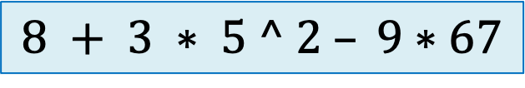
Evaluating an arithmetic operation
$$8 + 3 ∗ 5 ^ 2 – 9∗67$$

Slide 4
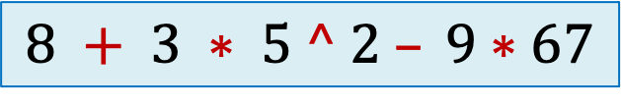
Evaluating an arithmetic operation
$$8 + 3 ∗ 5 ^ 2 – 9∗67$$

Slide 5
The algorithm
Make a scan of the expression from left to right, and …
… execute an operation as soon as it is possible ...

Slide 6




















Expression:
Priority no.
$$o_{1}$$
$$o_{2}$$
$$o_{3}$$
$$o_{4}$$
$$o_{5}$$
$$n_{1}$$
$$o_{1}$$
$$n_{2}$$
$$o_{2}$$
$$n_{3}$$
$$o_{3}$$
$$n_{4}$$
$$o_{4}$$
$$n_{5}$$
$$o_{5}$$
$$n_{6}$$
$$o_{6}$$
$$n_{7}$$
$$o_{7}$$
$$n_{8}$$
N-stack
for operands
O-stack
for operators

Slide 7












Expression:
Priority no.
$$o_{1}$$
$$o_{2}$$
$$o_{3}$$
$$o_{4}$$
$$o_{5}$$
$$o_{6}$$
$$o_{6}$$
$$n_{7}$$
$$o_{7}$$
$$n_{8}$$
$$n_{6}$$
$$n_{5}$$
$$o_{5}$$
$$n_{4}$$
$$o_{4}$$
$$n_{3}$$
$$o_{3}$$
$$n_{2}$$
$$o_{2}$$
$$n_{1}$$
$$o_{1}$$
N-stack
for operands
O-stack
for operators

Slide 8


Expression:
Priority no.
$$o_{1}$$
$$o_{2}$$
$$o_{3}$$
$$o_{4}$$
$$o_{5}$$
$$o_{6}$$
$$o_{7}$$
$$n_{8}$$
$$n_{7}$$
$$n_{6}$$
$$o_{6}$$
$$n_{5}$$
$$o_{5}$$
$$n_{4}$$
$$o_{4}$$
$$n_{3}$$
$$o_{3}$$
$$n_{2}$$
$$o_{2}$$
$$n_{1}$$
$$o_{1}$$
N-stack
for operands
O-stack
for operators

Slide 9





Expression:
Priority no.
$$o_{1}$$
$$o_{2}$$
$$o_{3}$$
$$o_{4}$$
$$o_{5}$$
$$o_{6}$$
$$o_{6}$$
$$n_{7}$$
$$o_{7}$$
$$n_{8}$$
$$n′$$
$$=$$
$$n_{5}$$
$$o_{5}$$
$$n_{6}$$
$$n_{6}$$
$$n_{5}$$
$$o_{5}$$
$$n_{4}$$
$$o_{4}$$
$$n_{3}$$
$$o_{3}$$
$$n_{2}$$
$$o_{2}$$
$$n_{1}$$
$$o_{1}$$
N-stack
for operands
O-stack
for operators

Slide 10

Expression:
Priority no.
$$o_{1}$$
$$o_{2}$$
$$o_{3}$$
$$o_{4}$$
$$o_{5}$$
$$o_{6}$$
$$o_{6}$$
$$n_{7}$$
$$o_{7}$$
$$n_{8}$$
$$n′$$
$$n_{4}$$
$$o_{4}$$
$$n_{3}$$
$$o_{3}$$
$$n_{2}$$
$$o_{2}$$
$$n_{1}$$
$$o_{1}$$
N-stack
for operands
O-stack
for operators

Slide 11
A simple algorithm
Priority of $ :
Least
push($,O-stack);
While ( ? ) do
{ x ← next_token();
Two cases:
x is number :
x is operator :
while( ? >= ? )
{ o ← POP(O-stack);
Execute(o);
}
push(x,O-stack);
}
push(x,N-stack);
PRIORITY(TOP(O-stack)
PRIORITY(x)
POP two numbers from N-stack
apply operator o on them
place the result back into N-stack

Slide 12
Next step
Transforming the solution to Solve the most general case

Slide 13




How to handle parentheses ?
$3 + 4 ∗ ( 5 – 6 / 2)$
So ( must have higher priority than every other operator.
$$($$
$$∗$$
$$+$$
$$\$$$
O-stack

Slide 14


How to handle parentheses ?
$3 + 4 ∗ ( 5 – 6 / 2)$
So ( must have higher priority than every other operator.
So ( must have less priority than every other operator.
$$/$$
$$−$$
$$($$
$$∗$$
$$+$$
$$\$$$
O-stack
A CONTRADICTION !!

Slide 15


How to handle parentheses ?
$3 + 4 ∗ ( 5 – 6 / 2)$
So ( must have higher priority than every other operator.
So ( must have less priority than every other operator.
$$($$
When ( is out of the stack
$$∗$$
$$+$$
$$\$$$
O-stack
A CONTRADICTION !!

Slide 16



How to handle parentheses ?
$3 + 4 ∗ ( 5 – 6 / 2)$
So ( must have higher priority than every other operator.
So ( must have less priority than every other operator.
$$/$$
$$−$$
When ( is inside the stack
$$($$
$$∗$$
$$+$$
$$\$$$
O-stack
A CONTRADICTION !!

Slide 17
Take a pause for a few minutes to realize surprisingly that
the contradicting requirements for the priority of (
in fact hints at a suitable solution for handling (.

Slide 18
How to handle parentheses ?
Using two types of priorities of each operator ●.
InsideStack priority
OutsideStack priority
The priority of an operator ●
when it is inside the stack.
The priority of an operator ●
when it is encountered in the expression.
$n_{1}{o_{1} n}_{2}o_{2}{ n}_{3}$ $o_{3} n_{4} { n}_{5 }o_{5}{ n}_{6 }o_{6}$
top
O-stack
O-stack

Slide 19
How to handle parentheses ?
Using two types of priorities of each operator ●.
Operator | InsideStackPriority | OutsideStackPriority
+ , -
* , /
^
(
$$1$$
$$1$$
$$2$$
$$2$$
$$3$$
$$3$$
0
4
Does it take care of nested parentheses ? Check it yourself.

Slide 20



How to handle parentheses ?
$3 + 4 ∗ ( 5 – 6 / 2)$
Question: What needs to be done whenever we encounter ) in the expression ?
Answer: Keep popping O-stack and evaluating the operators until we get its matching (.
$$/$$
$$−$$
$$($$
$$∗$$
$$+$$
$$\$$$
O-stack

Slide 21
The algorithm generalized to handle parentheses
push($,O-stack);
While ( ? ) do
x ← next_token();
Cases:
x is number : push(x,N-stack);
x is ) : while( TOP(O-stack) <> ( )
{ o ← Pop(O-stack);
Execute(o);
}
Pop(O-stack); //popping the matching (
otherwise : while( ? >= ? )
{ o ← Pop(O-stack);
Execute(o);
}
Push(x,O-stack);
InsideStackPriority(TOP(O-stack))
OutsideStackPriority(x)

Slide 22

Practice exercise for Homework
Execute the algorithm on
$$13 + 4 ∗ ( ( 23 + 4 ∗ ( 5 − 2 ) ) ) ^ 2$$

Slide 23
How to handle associativity of operators ?

Slide 24
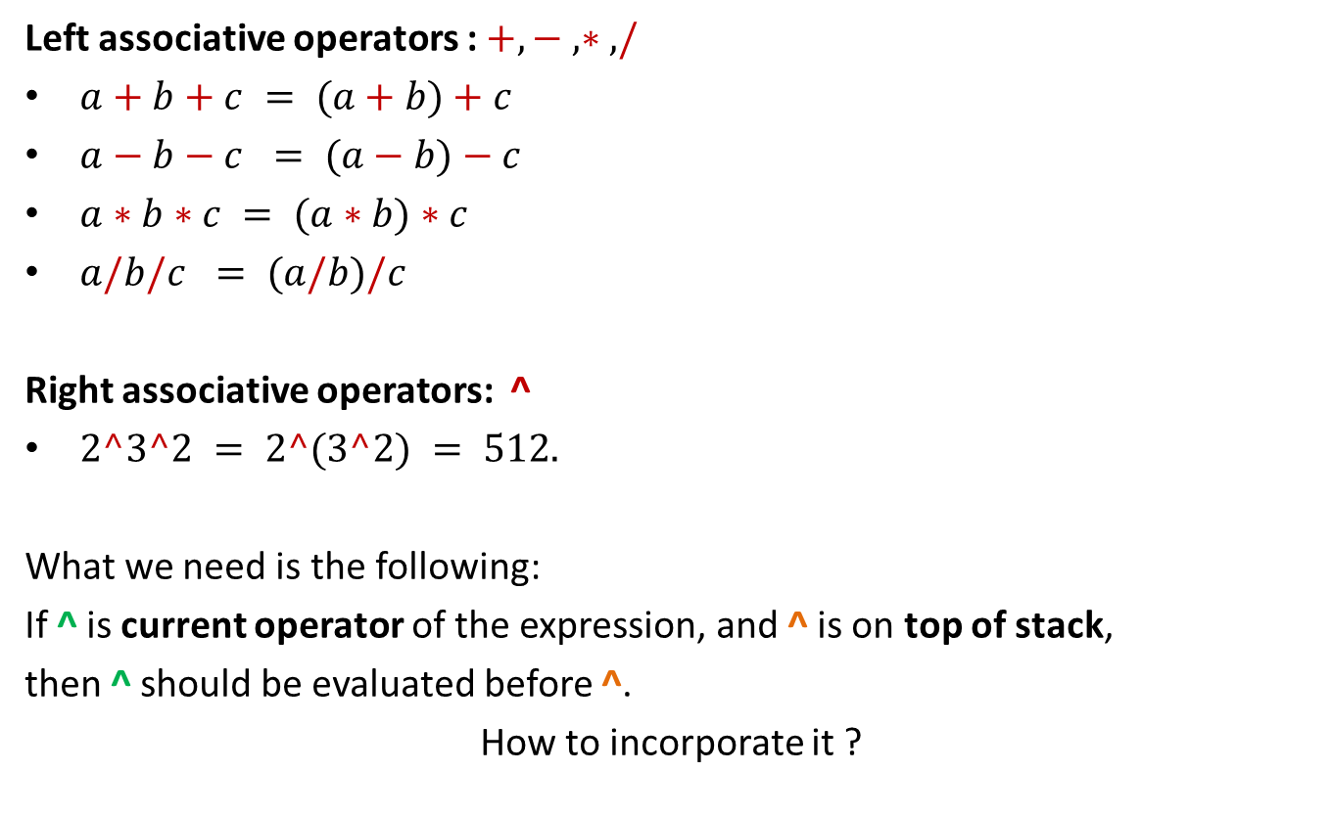
Associativity of arithmetic operators
Left associative operators : $+, − , ∗ , /$
$a+b+c = (a+b)+c$
$a−b−c = (a−b)−c$
$a∗b∗c = (a∗b)∗c$
$a/b/c = (a/b)/c$
Right associative operators: ^
$2^3^2 = 2^(3^2) = 512.$
What we need is the following:
If ^ is current operator of the expression, and ^ is on top of stack,
then ^ should be evaluated before ^.
How to incorporate it ?
We have already handled left associativity
in our algorithm.
How to handle right associativity ?
Play with the priorities ☺

Slide 25



Associativity of arithmetic operators
Left associative operators : $+, − , ∗ , /$
$a+b+c = (a+b)+c$
$a−b−c = (a−b)−c$
$a∗b∗c = (a∗b)∗c$
$a/b/c = (a/b)/c$
Right associative operators: ^
$2^3^2 = 2^(3^2) = 512.$
Play with the priorities ☺

Slide 26
How to handle associativity of operators ? Using two types of priorities of each right associative operator.
Operator | InsideStackPriority | Outside-stack priority
+ , - | 1 | 1
* , / | 2 | 2
^ | 3 | 3
( | 0 | 4
4
5

Slide 27

The Final Algorithm
push($,O-stack);
While ( ? ) do
x ← next_token();
Cases:
x is number : push(x,N-stack);
x is ) : while( TOP(O-stack) <> ( )
{ o ← Pop(O-stack);
Execute(o);
}
Pop(O-stack); //popping the matching (
otherwise : while(InsideStackPriority(TOP(O-stack)) >= OutsideStackPriority(x))
{ o ← Pop(O-stack);
Execute(o);
}
Push(x,O-stack);
$$3 + 4 ^ \left( 5 – 6 / 2 \right) ∗14$$
NOTEMPTY(O-stack)
#
Can we come up with alternate way that does not ask for changing the code ?
Proceed along the line of processing ) :
Pop all operators from the O-stack
One by one and execute them until
You encounter $. Then pop $ as well

Slide 28
The Final Algorithm
push($,O-stack);
While ( ? ) do
x ← next_token();
Cases:
x is number : push(x,N-stack);
x is ) : while( TOP(O-stack) <> ( )
{ o ← Pop(O-stack);
Execute(o);
}
Pop(O-stack); //popping the matching (
otherwise : while(InsideStackPriority(TOP(O-stack)) >= OutsideStackPriority(x))
{ o ← Pop(O-stack);
Execute(o);
}
Push(x,O-stack);
TOP(O-stack) <> #
$$3 + 4 ^ \left( 5 – 6 / 2 \right) ∗14$$
#
Take a pause and
get amazed by
the elegance of this code
and the role played by stack to solve this problem.
Just set priority of # = 0

Slide 29
How to describe your solution
Strive to express your solution at a high level than writing a C code.
You need to acquire this skill.

Slide 30
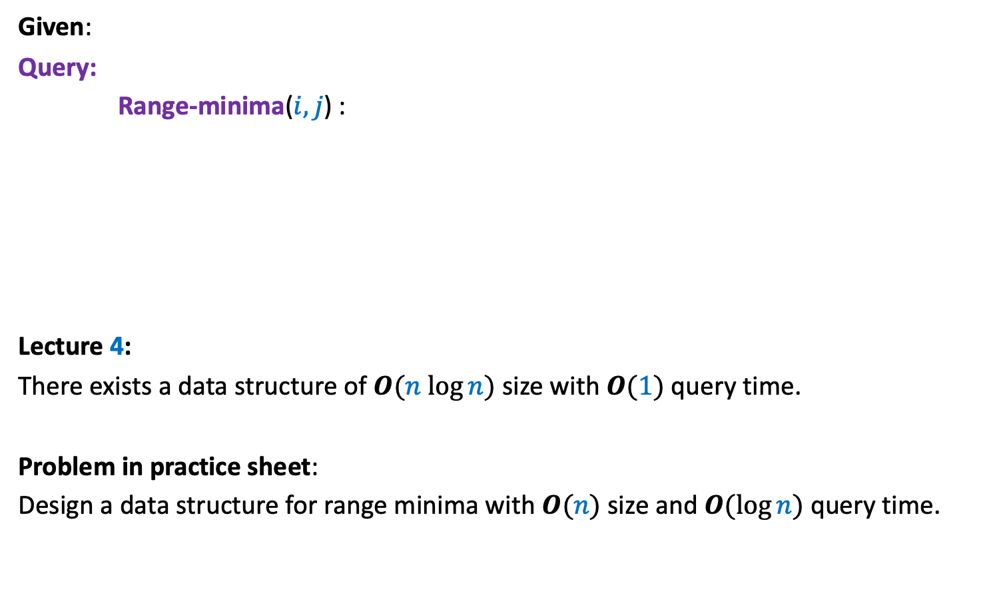



Range-Minima Problem
Given:
Query:
Range-minima($i,j$) :
Lecture 4:
There exists a data structure of $O(n log⁡n)$ size with $O(1)$ query time.
Problem in practice sheet:
Design a data structure for range minima with $O(n)$ size and $O(log⁡n)$ query time.
an array A storing $n$numbers
report the smallest element from A[$i$],…,A[$j$]
A
$$3$$ | $$5$$ | $$1$$ | $$8$$ | $$19$$ | $$0$$ | $$−1$$ | $$30$$ | $$99$$ | $$−6$$ | $$10$$ | $$2$$ | $$40$$ | $$27$$ | $$44$$ | $$67$$
$D$(A)

Slide 31







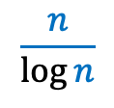
Range-Minima Problem
Without loss of generality and for the sake of simplicity,
assume $n$ is power of $2$.
That is, $n=2^{k}$ for some $k$.
$$k$$
A
$$3$$ | $$5$$ | $$1$$ | $$8$$ | $$19$$ | $$0$$ | $$−1$$ | $$30$$ | $$99$$ | $$−6$$ | $$10$$ | $$2$$ | $$40$$ | $$27$$ | $$44$$ | $$67$$
$$n$$
B
$$1$$
$$−1$$
$$−6$$
$$27$$
$$\frac{n}{\log{n}}$$

Slide 32










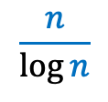

Range-Minima Problem
Description of the data structure:
A
$D$(B) : The data structure for RangeMinima from Lecture for B
$$i$$
$$1$$
$$−6$$
$$27$$
$$j$$
A
$$3$$ | $$5$$ | $$1$$ | $$8$$ | $$19$$ | $$0$$ | $$−1$$ | $$30$$ | $$99$$ | $$−6$$ | $$10$$ | $$2$$ | $$40$$ | $$27$$ | $$44$$ | $$67$$
$$n$$
B
$$1$$
$$−1$$
$$−6$$
$$27$$
$$\frac{n}{\log{n}}$$

Slide 33




Range-Minima Problem
Query algorithm for the Range-Minima($i$, $j$) :
$i′$ ← $\left\lfloor \frac{i}{k}\right\rfloor$;
If ($j^{′}≤i^{′}+1$)
Else { $α$ ←
$β$ ←
$γ$ ←
$$i$$
$$j$$
A
$$3$$ | $$5$$ | $$1$$ | $$8$$ | $$19$$ | $$0$$ | $$−1$$ | $$30$$ | $$99$$ | $$−6$$ | $$10$$ | $$2$$ | $$40$$ | $$27$$ | $$44$$ | $$67$$
B
$$1$$
$$−1$$
$$−6$$
$$27$$
$j′$ ← $\left\lfloor \frac{j}{k}\right\rfloor$;
Scan A from $i$ to $j$ and report the smallest element found;
smallest element from B[$i^{′}+1$] to B[$j^{′}−1$] found using $D$(B);
smallest element from A[$i$] to A[$(i^{′}+1)⋅k$] found by scanning A;
smallest element from A[$\left(j^{′}−1\right)⋅k$] to A[$j$] found by scanning A;
Return min($α$, $β$, $γ$) }

Slide 34
Lesson learnt …
The solution given in the previous slide is a formal solution which is complete as well as unambiguous.
Strive for writing such code in Quiz or Exams.

Slide 35
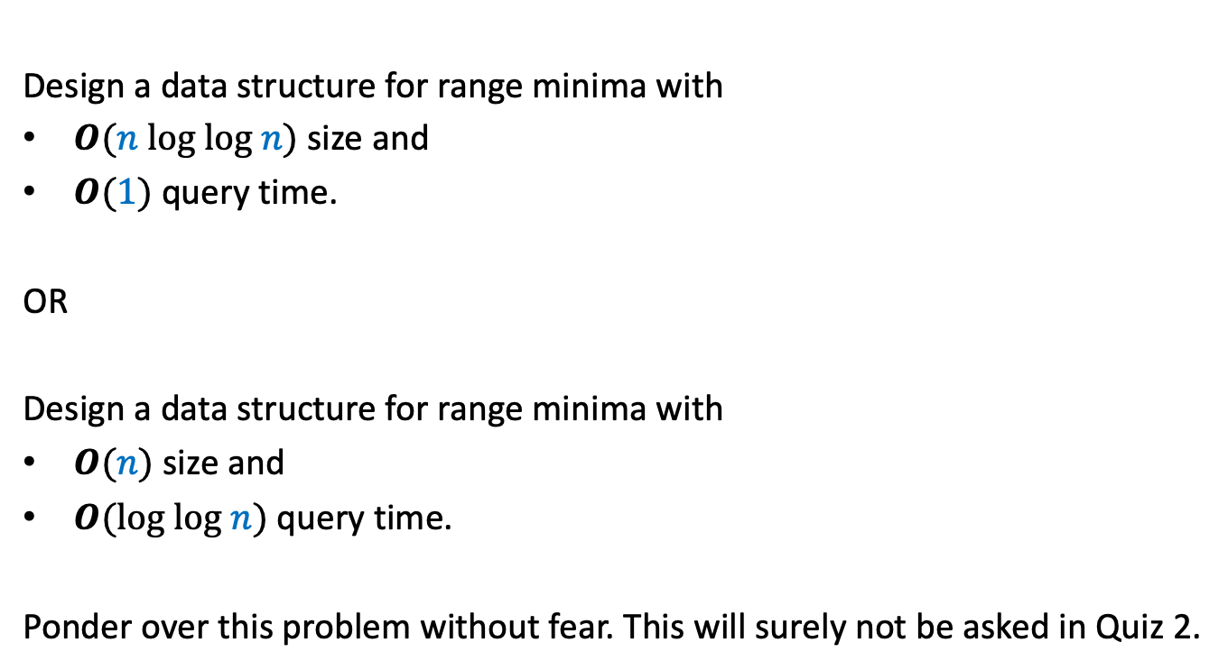
A new Problem
Design a data structure for range minima with
$O(n log log n)$ size and
$O(1)$ query time.
OR
Design a data structure for range minima with
$O(n)$ size and
$O(log log n)$ query time.
Ponder over this problem without fear. This will surely not be asked in Quiz 2.

