Slide 1
Data Structures and Algorithms (ESO207A)
Lecture 14
Queue : a new data Structure
Solving the directory problem (finally … ☺)
A new problem (for next lecture)

Slide 2
Queue: a new data structure
Data Structure Queue:
Mathematical Modeling of Queue
Implementation of Queue using arrays

Slide 3



Stack
A special kind of list where all operations (insertion, deletion, query)
take place at one end only, called the top.
Behavior of Stack:
Last in
top
$$a_{n}$$
$$a_{n−1}$$
$$a_{1}$$
(LIFO)
First out

Slide 4



Queue: a new data structure
A special kind of list based on
First in
(FIFO)
First Out
$$a_{1}$$
$$a_{2}$$
$$a_{n}$$
front
rear

Slide 5
Mathematical Modeling of Queue

Slide 6

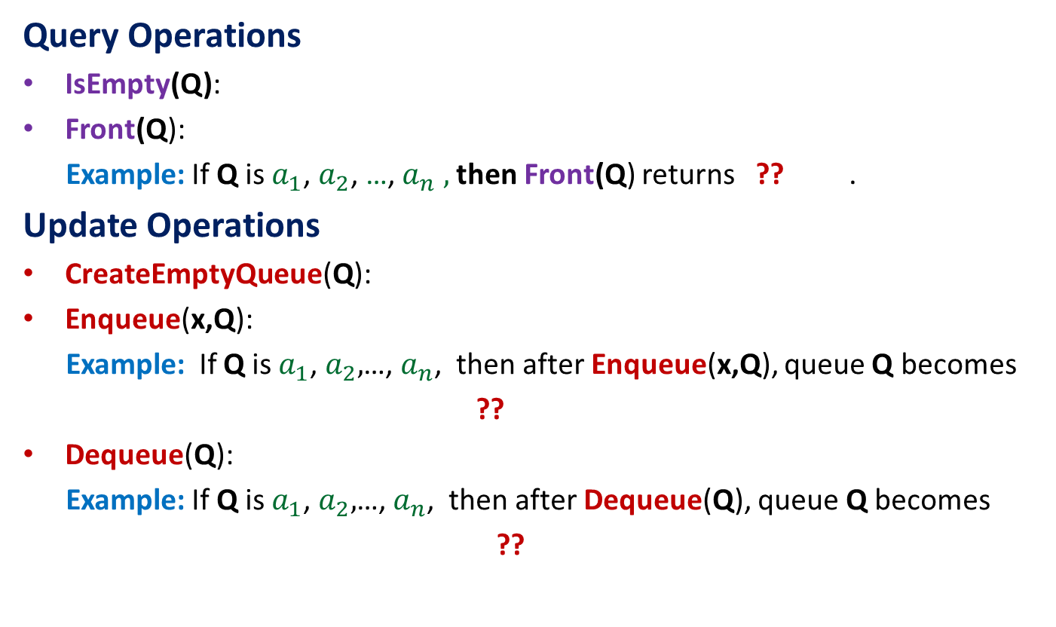
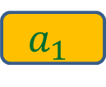

Operations on a Queue
Query Operations
IsEmpty(Q):
Front(Q):
Example: If Q is $a_{1}$, $a_{2}$, …,${ a}_{n} ,$ then Front(Q) returns ?? .
Update Operations
CreateEmptyQueue(Q):
Enqueue(x,Q):
Example: If Q is $a_{1}$, $a_{2},$…, $a_{n}$, then after Enqueue(x,Q), queue Q becomes
??
Dequeue(Q):
Example: If Q is $a_{1}$, $a_{2},$…, $a_{n}$, then after Dequeue(Q), queue Q becomes
??
determine if Q is an empty queue.
returns the element at the front position of the queue.
$$a_{1}$$
Create an empty queue
insert x at the end of the queue Q
$a_{1}$, $a_{2}$ ,…, $a_{n}$, $x$
return element from the front of the queue Q and delete it
$a_{2}$ ,…, $a_{n}$

Slide 7
An Important point you must remember for every data structure
Question: How to define a new operation on a Data structure ?
Answer:
only in terms of the primitive operations of the data structures
that are defined during its modeling.

Slide 8



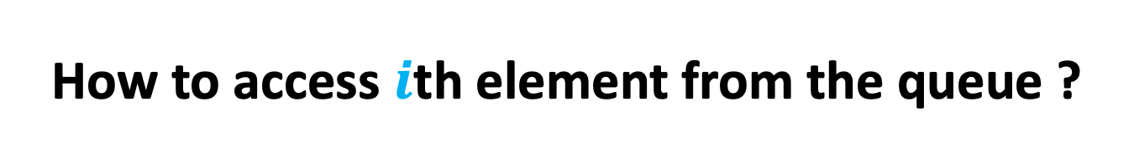


How to access $i$th element from the queue ?
$$a_{1}$$
$$a_{2}$$
$$a_{i−1}$$
$$a_{i}$$
$$a_{n}$$

Slide 9
How to access $i$th element from the queue ?
$$a_{2}$$
$$a_{i−1}$$
$$a_{i}$$
$$a_{n}$$

Slide 10
How to access $i$th element from the queue ?
$$a_{i−1}$$
$$a_{i}$$
$$a_{n}$$

Slide 11

How to access $i$th element from the queue ?
$$a_{i−1}$$
$$a_{i}$$
$$a_{n}$$

Slide 12
How to access $i$th element from the queue ?
$$a_{i−1}$$
$$a_{i}$$
$$a_{n}$$

Slide 13
How to access $i$th element from the queue ?
$$a_{i−1}$$
$$a_{i}$$
$$a_{n}$$

Slide 14

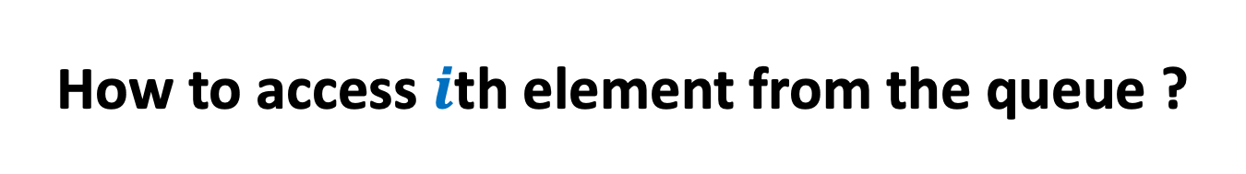
How to access $i$th element from the queue ?
$$a_{i}$$
$$a_{n}$$
$(i−1)$Dequeue operations followed by
Front(Q)

Slide 15
Implementation of Queue
using arrays

Slide 16
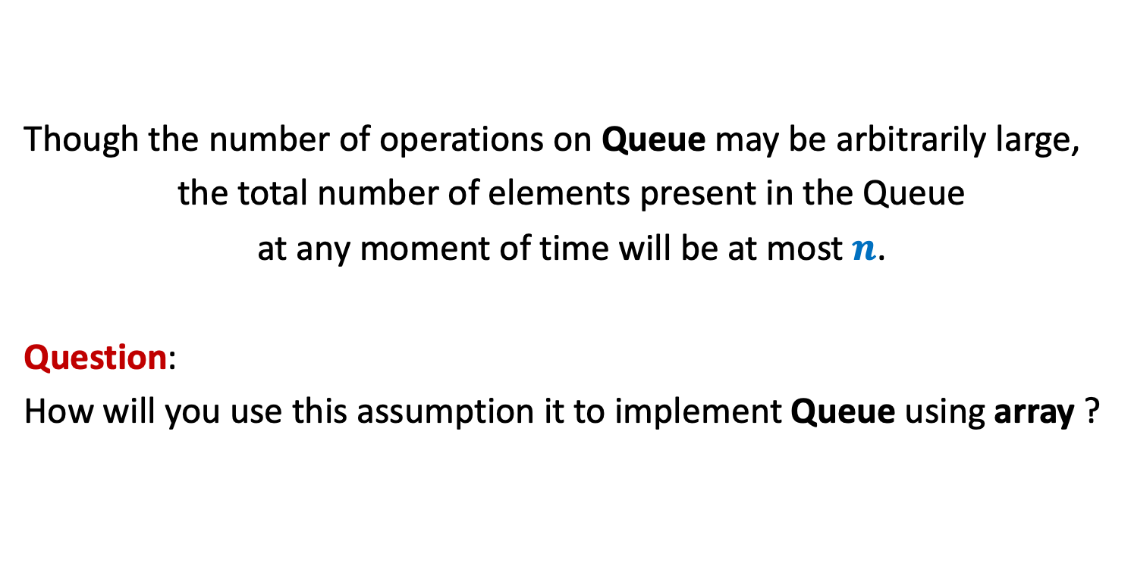
An important assumption for the implementation
Though the number of operations on Queue may be arbitrarily large,
the total number of elements present in the Queue
at any moment of time will be at most $n$.
Question:
How will you use this assumption it to implement Queue using array ?

Slide 17

Implementation of Queue using array
Keep an array of size $n$
front: the position of the first element of the queue in the array.
rear: the position of the last element of the queue in the array.
Enqueue(x,Q)
{ rear ← rear+1;
Q[rear]←x
}
Dequeue(Q)
{ x← Q[front];
front← front+1;
return x;
}
There is a serious problem !
Q
b
d
x
y
u
front
front
rear
rear

Slide 18
Implementation of Queue using array
Keep an array of size $n$
t
x
u
h
k
v
front
rear
How to perform Enqueue(t,Q) ?
How to perform Enqueue(x,Q) ?

Slide 19
Implementation of Queue using array
Keep an array of size $n$
Enqueue(x,Q)
{ rear ← rear+1;
Q[rear]←x
}
Dequeue(Q)
{ x← Q[front];
front← front+1;
return x;
}
IsEmpty(Q)
{ ?? }
(rear+1) mod n ;
(front+1) mod n ;
Do it as an exercise

Slide 20
Efficient data structure for Directory Problem

Slide 21
Nearly balanced Binary Search Tree
Homework from the past:
Design an efficient algorithm to transform
a nearly balanced BST to a perfectly balanced BST.

Slide 22
Enumerating the values in a Binary Search Tree
T
46
28
67
5
35
49
83
2
25
31
41
48
53
73
96

Slide 23
Enumerating the values in a Binary Search Tree
Traversal(T)
{ p← T;
if(p=NULL) return;
else{ if(left(p) <> NULL) Traversal(left(p));
print(value(p));
if(right(p) <> NULL) Traversal(right(p));
}
}
$$5$$ | $$13$$ | $$27$$ | $$31$$ | $$41$$ | $$46$$ | $$61$$ | $$70$$ | $$78$$ | $$98$$

Slide 24
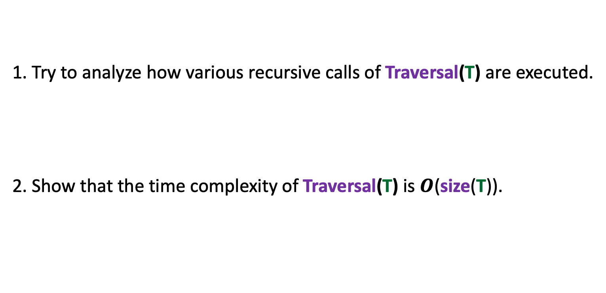
Homework
1. Try to analyze how various recursive calls of Traversal(T) are executed.
2. Show that the time complexity of Traversal(T) is $O$(size(T)).

Slide 25
Nearly balanced BST to a perfectly balanced BST
a nearly balanced BST
$$5$$ | $$13$$ | $$27$$ | $$31$$ | $$41$$ | $$46$$ | $$61$$ | $$70$$ | $$78$$ | $$98$$
a perfectly balanced BST

Slide 26
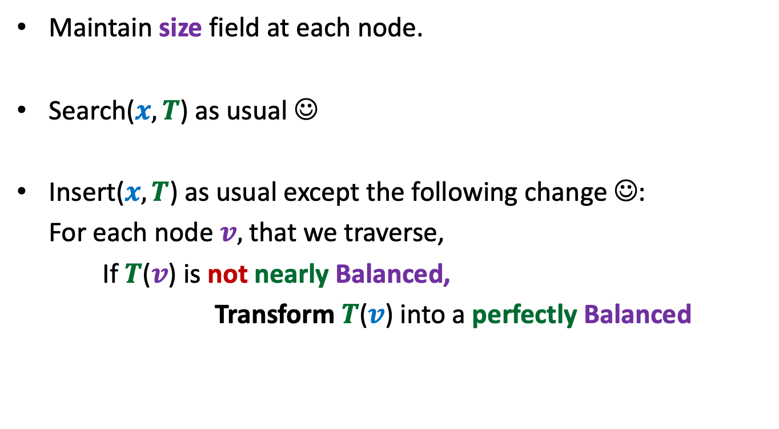
Solving the Directory Problem
Maintain size field at each node.
Search($x,T$) as usual ☺
Insert($x,T$) as usual except the following change ☺:
For each node $v,$ that we traverse,
If $T$($v$) is not nearly Balanced,
Transform $T$($v$) into a perfectly Balanced
It will work ☺
It will take total $O(n log⁡n)$time for any sequence of $n$insertions.

Slide 27


Intuition
$O(k)$ time
At least $k$ insertion
v
v
Size differs by at most 1

Slide 28
Homework
Ponder over the intuition given in the previous slide.
(It will not be asked in any exam ☺)
We shall analyse it formally in a future class.
You will get an assignment based on this to convince yourself experimentally.

Slide 29
Back to Algorithms

Slide 30

Majority element
Definition: Given a multiset $S$ of $n$ elements,
$x∈ S$ is said to be majority element if it appears more than $n/2$ times in $S$.
$S$ = {$a,b,d,z,b,w,b,b,z,b,b,b,b,c$}

Slide 31

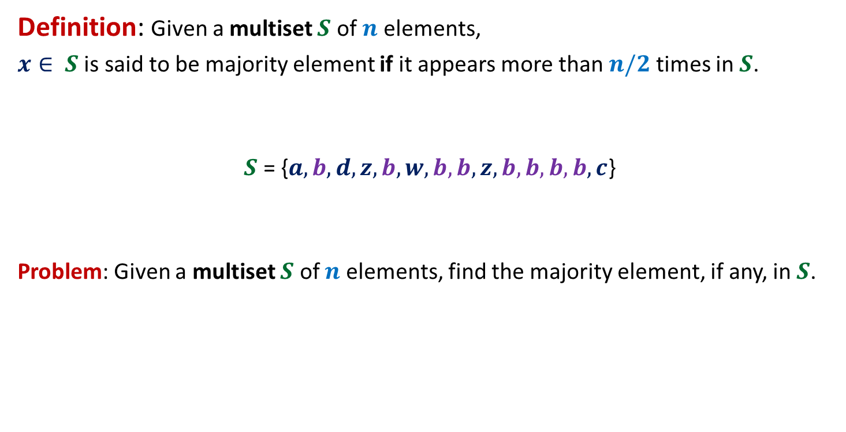
Majority element
Definition: Given a multiset $S$ of $n$ elements,
$x∈ S$ is said to be majority element if it appears more than $n/2$ times in $S$.
$S$ = {$a,b,d,z,b,w,b,b,z,b,b,b,b,c$}
Problem: Given a multiset $S$ of $n$ elements, find the majority element, if any, in $S$.
$$8$$

Slide 32

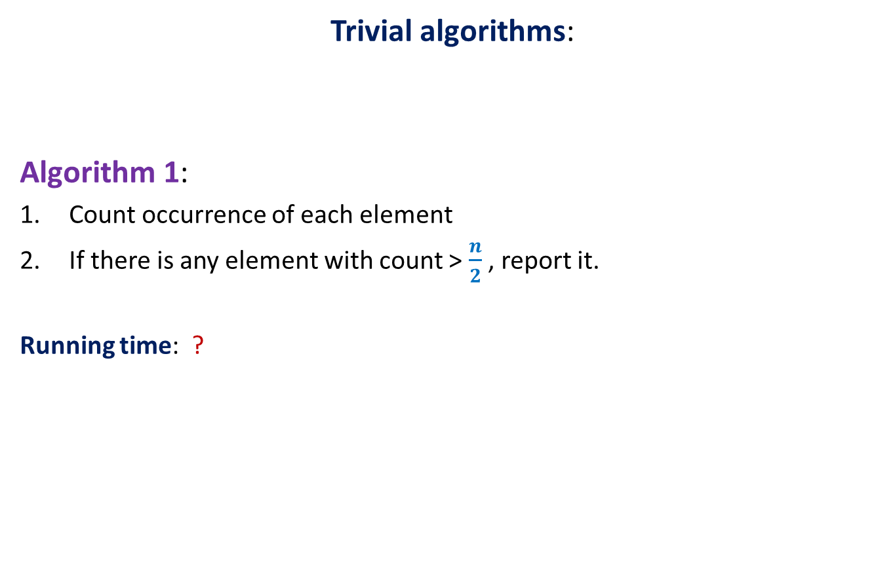
Majority element
Trivial algorithms:
Algorithm 1:
Count occurrence of each element
If there is any element with count > $\frac{n}{2}$ , report it.
Running time: ?
O($n^{2}$) time

Slide 33

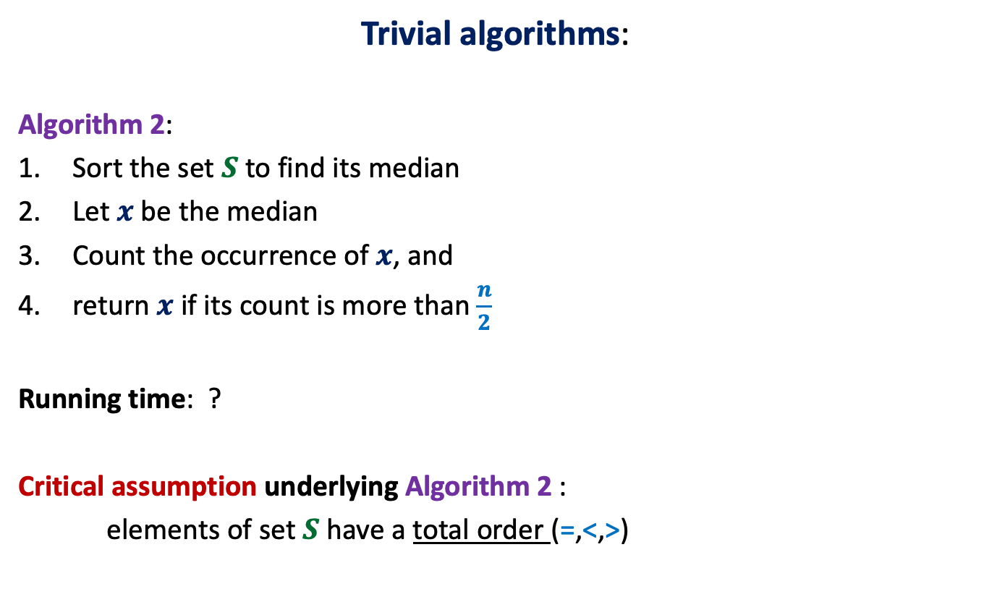
Majority element
Trivial algorithms:
Algorithm 2:
Sort the set $S$ to find its median
Let $x$be the median
Count the occurrence of $x$, and
return $x$ if its count is more than $\frac{n}{2}$
Running time: ?
Critical assumption underlying Algorithm 2 :
elements of set $S$ have a total order (=,<,>)
This assumption is
not justified in many real life applications.
O($n log n$) time

Slide 34
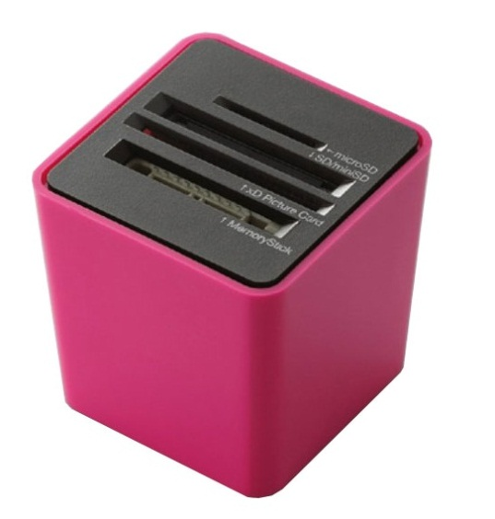
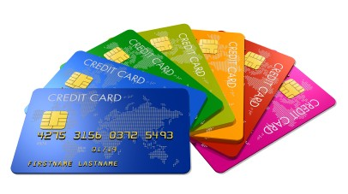
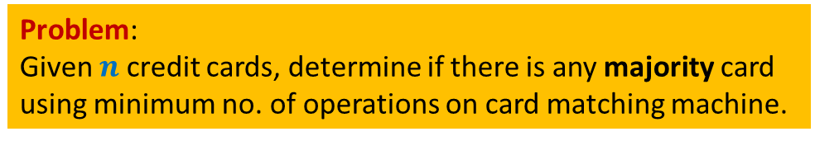
A real life application
Slots for inserting any two cards
Card-matching machine
This machine takes two cards and determines whether they are identical or not.
Problem:
Given $n$ credit cards, determine if there is any majority card
using minimum no. of operations on card matching machine.

Slide 35
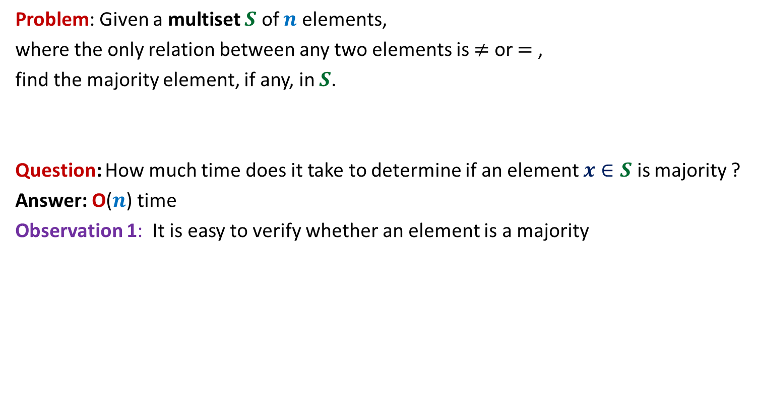
Some observations
Problem: Given a multiset $S$ of $n$ elements,
where the only relation between any two elements is $≠$ or $=$ ,
find the majority element, if any, in $S$.
Question: How much time does it take to determine if an element $x∈S$ is majority ?
Answer: O($n$) time
Observation 1: It is easy to verify whether an element is a majority

Slide 36


Some observations
Observation 1: whenever we cancel a pair of distinct elements from the array,
the majority element of the array remains preserved.
α
x
α
y
< $\frac{n}{2}$
> $\frac{n}{2}$
α
w
v
α
α
Majority
element
other
elements

Slide 37
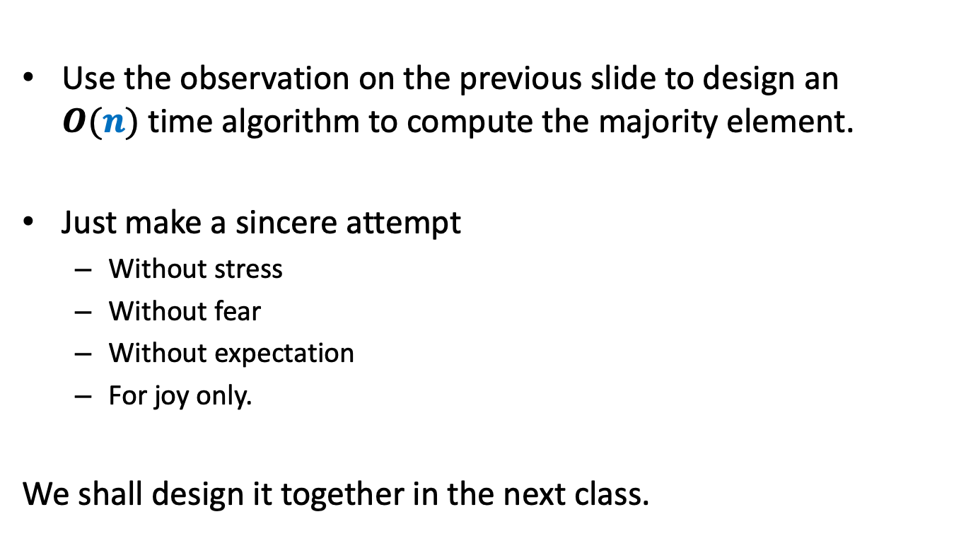
Homework
Use the observation on the previous slide to design an $O(n)$time algorithm to compute the majority element.
Just make a sincere attempt
Without stress
Without fear
Without expectation
For joy only.
We shall design it together in the next class.

