Slide 1
Data Structures and Algorithms (ESO207A)
Lecture 15:
Majority element : an efficient and practical algorithm
word RAM model of computation: further refinements.

Slide 2

Majority element
Definition: Given a multiset $S$ of $n$ elements,
$x∈ S$ is said to be majority element if it appears more than $n/2$ times in $S$.
$S$ = {$a,b,d,z,b,w,b,b,z,b,b,b,b,c$}

Slide 3

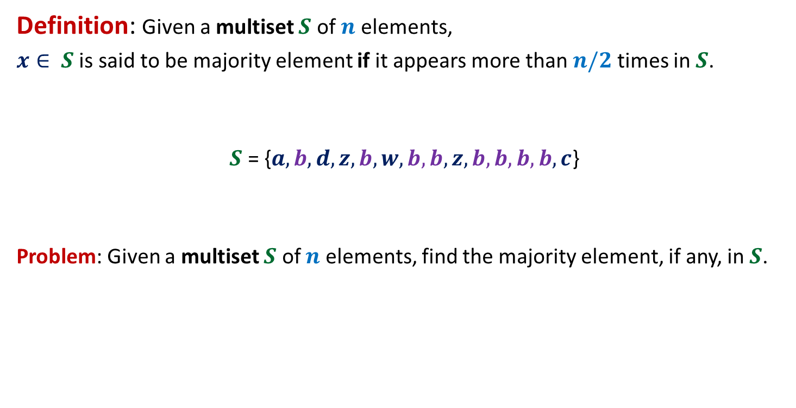
Majority element
Definition: Given a multiset $S$ of $n$ elements,
$x∈ S$ is said to be majority element if it appears more than $n/2$ times in $S$.
$S$ = {$a,b,d,z,b,w,b,b,z,b,b,b,b,c$}
Problem: Given a multiset $S$ of $n$ elements, find the majority element, if any, in $S$.
$$8$$

Slide 4

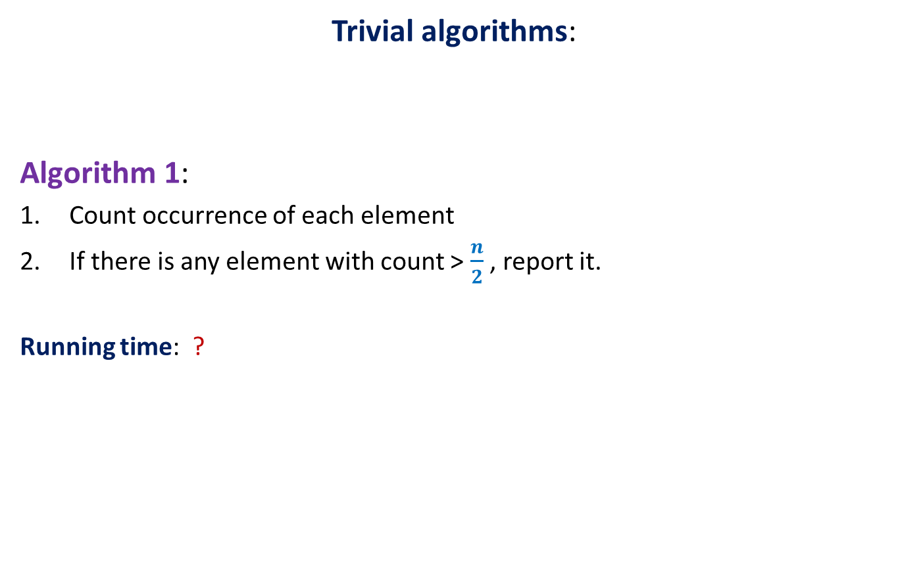
Majority element
Trivial algorithms:
Algorithm 1:
Count occurrence of each element
If there is any element with count > $\frac{n}{2}$ , report it.
Running time: ?
O($n^{2}$) time

Slide 5

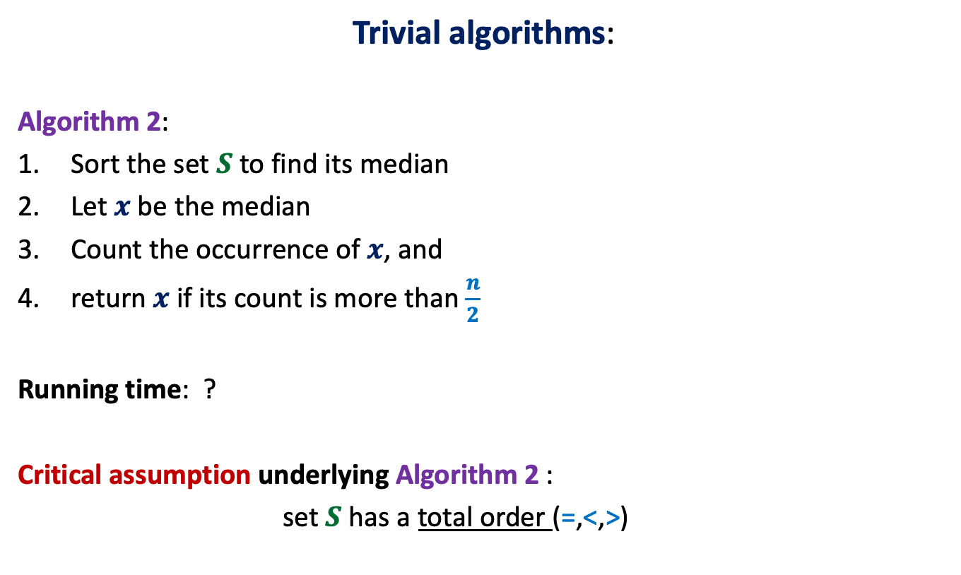
Majority element
Trivial algorithms:
Algorithm 2:
Sort the set $S$ to find its median
Let $x$be the median
Count the occurrence of $x$, and
return $x$ if its count is more than $\frac{n}{2}$
Running time: ?
Critical assumption underlying Algorithm 2 :
set $S$ has a total order (=,<,>)
This assumption is
not justified in many real life applications.
O($n log n$) time

Slide 6
Majority element
Trivial algorithms:
Algorithm 2:
Sort the set $S$ to find its median
Let $x$be the median
Count the occurrence of $x$, and
return $x$ if its count is more than $\frac{n}{2}$
Running time: ?
Critical assumption underlying Algorithm 2 :
set $S$ has a total order (=,<,>)
This assumption is
not justified in many real life applications.
O($n log n$) time

Slide 7
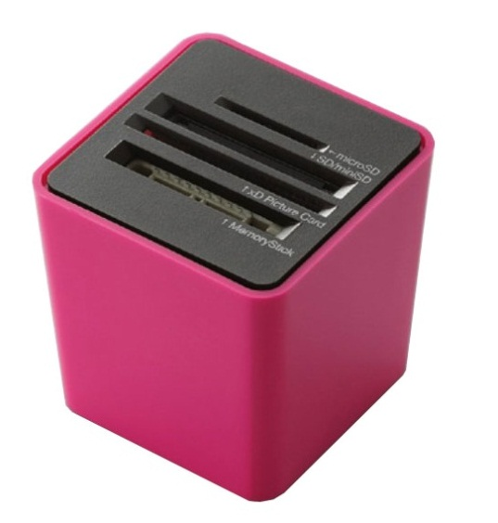

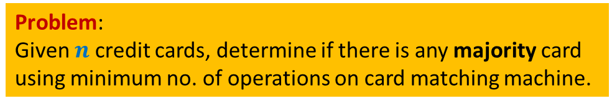
A real life application
Slots for inserting any two cards
Card-matching machine
This machine takes two cards and determines whether they are identical or not.
Problem:
Given $n$ credit cards, determine if there is any majority card
using minimum no. of operations on card matching machine.

Slide 8
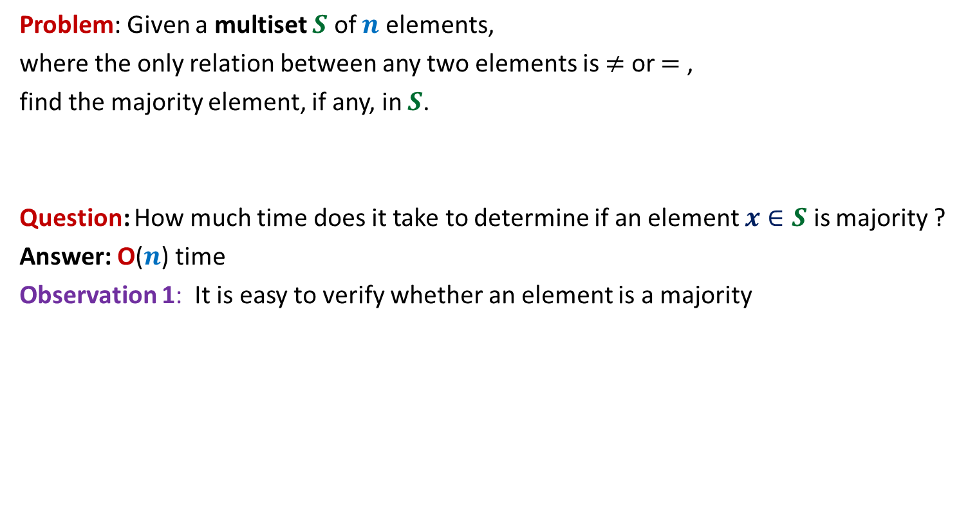
Some observations
Problem: Given a multiset $S$ of $n$ elements,
where the only relation between any two elements is $≠$ or $=$ ,
find the majority element, if any, in $S$.
Question: How much time does it take to determine if an element $x∈S$ is majority ?
Answer: O($n$) time
Observation 1: It is easy to verify whether an element is a majority

Slide 9


Some observations
Observation 2: whenever we cancel a pair of distinct elements from the array,
the majority element of the array remains preserved.
α
x
α
y
< $\frac{n}{2}$
> $\frac{n}{2}$
α
w
v
α
α
Majority
element
other
elements

Slide 10



Some observations
Observation 3: If there are $m$ pairs of identical elements, then
majority element among $2m$ elements is preserved
even if we keep one element per pair.
$a b c c c z c a b b c c c c d c$
$c c b b c c c c$
The problem size reduced by at least half.
$$c b c c$$

Slide 11

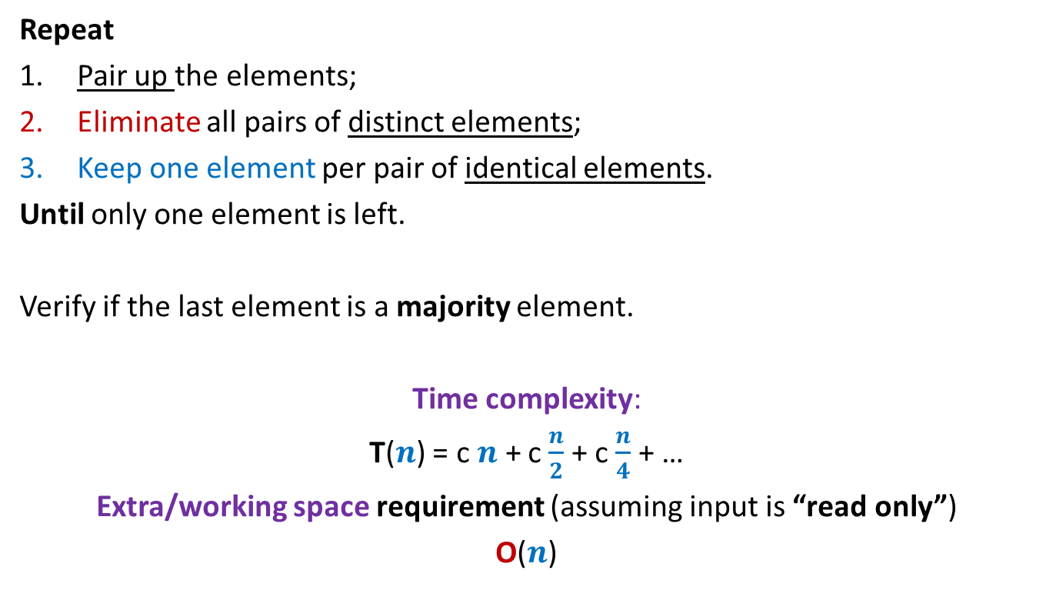
Algorithm for 2-majority element
Repeat
Pair up the elements;
Eliminate all pairs of distinct elements;
Keep one element per pair of identical elements.
Until only one element is left.
Verify if the last element is a majority element.
Time complexity:
T($n$) = c $n$ + c $\frac{n}{2}$ + c $\frac{n}{4}$ + …
Extra/working space requirement (assuming input is “read only”)
O($n$)
What if the no. of elements is odd ?
O($n$) time

Slide 12
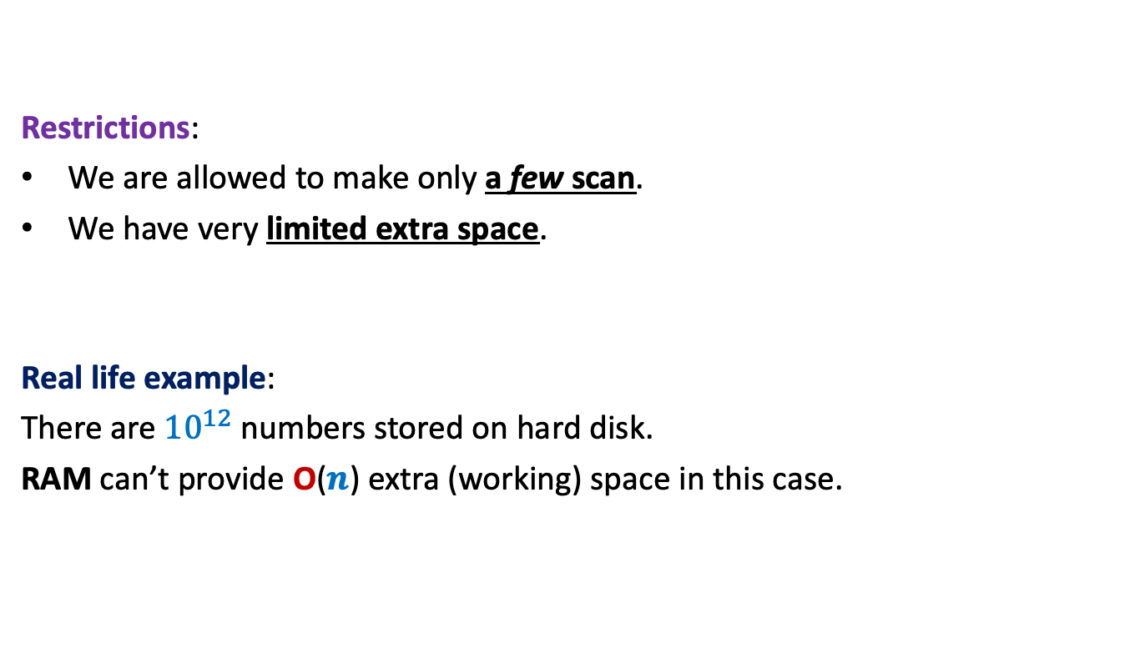
Further restrictions on the problem
Restrictions:
We are allowed to make only a few scan.
We have very limited extra space.
Real life example:
There are ${10}^{12}$ numbers stored on hard disk.
RAM can’t provide O($n$) extra (working) space in this case.
Our current algorithm doesn’t work
for this real life example.

Slide 13
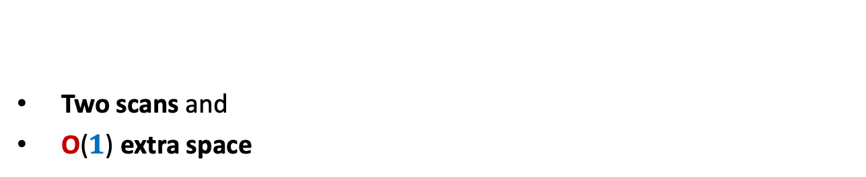
algorithm for 2-majority element
Two scans and
O($1$) extra space

Slide 14

Designing algorithm for 2-majority element $2$ scans and using O($1$) extra space
Question: Should we design algorithm from scratch to meet these constraints ?
Answer: No! We should try to adapt our current algorithm to meet these constraints.
Question: How crucial is pairing of elements in our current algorithm ?
Think over this question before going ahead.

Slide 15
Designing algorithm for 2-majority element $2$ scans and using O($1$) extra space
Insightful questions:
Do we really need to keep more than one element ?
Do we really need to keep multiple copies of an element explicitly ?
Ponder over these insights and make an attempt to design the algorithm
before moving ahead ☺
scan
$a b c c c z c a b b c c c c d c$
No. Just cancel suitably whenever encounter two distinct elements.
No. Just keeping its count will suffice.

Slide 16




The Algorithm
First scan
$a b c c c z c a b b c c c c d c$
$$a$$
$$c$$
$$c$$
$$c$$

Slide 17

The Algorithm
$a b c c c z c a b b c c c c d c$
$$c$$
$$c$$
$$c$$
$$a$$

Slide 18

The Algorithm
$a b c c c z c a b b c c c c d c$
$$c$$
$$c$$
$$c$$

Slide 19

The Algorithm
$a b c c c z c a b b c c c c d c$
$$c$$
$$c$$
$$c$$

Slide 20


The Algorithm
$a b c c c z c a b b c c c c d c$
$$c$$
$$c$$
$$c$$
$$(3)$$

Slide 21

The Algorithm
$a b c c c z c a b b c c c c d c$
$$c$$
$$(3)$$
$$(2)$$

Slide 22


The Algorithm
$a b c c c z c a b b c c c c d c$
$$c$$
$$(2)$$
$$(3)$$
Can you see the algorithm now ?.

Slide 23
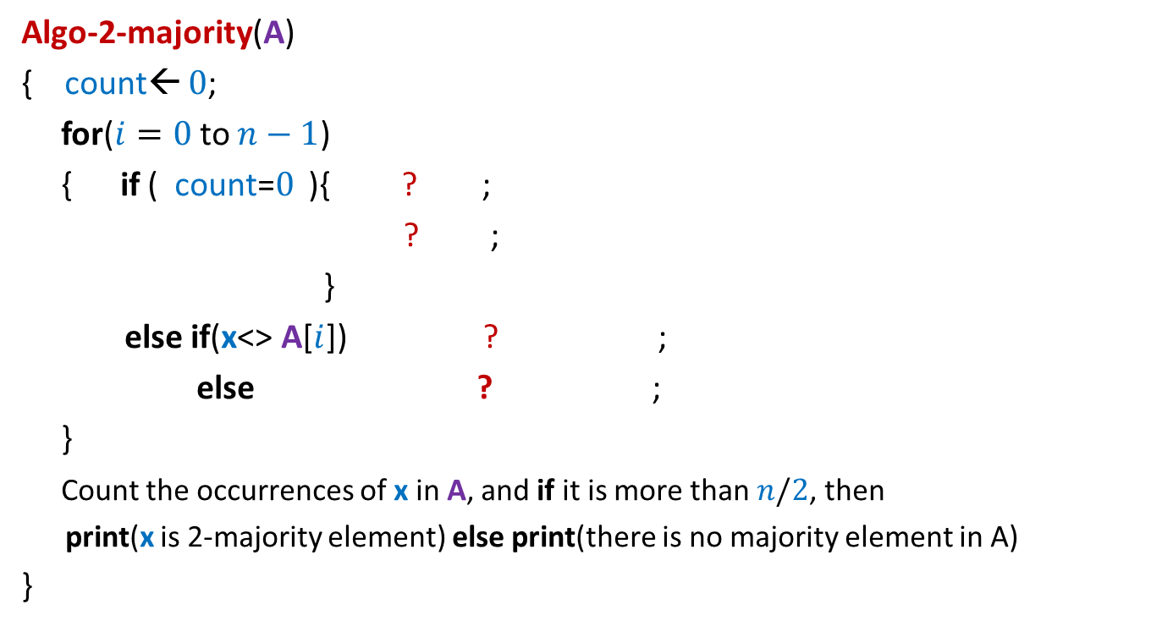
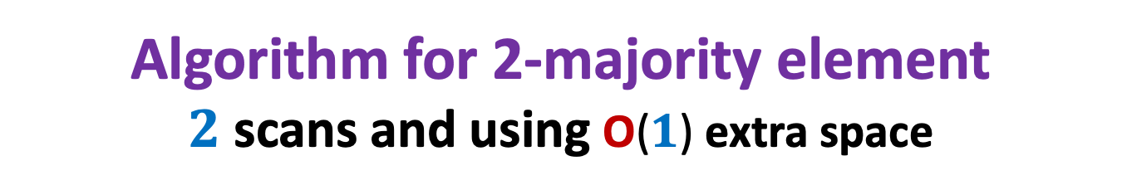

Algorithm for 2-majority element $2$ scans and using O($1$) extra space
Algo-2-majority(A)
{ count← $0$;
for($i=0$to $n−1$)
{ if ( count=$0$ ){ ? ;
? ;
}
else if(x<> A[$i$]) ? ;
else ? ;
}
Count the occurrences of x in A, and if it is more than $n/2$, then
print(x is 2-majority element) else print(there is no majority element in A)
}
x← A[$i$];
count← 1;
count ← count - 1
count← count + 1

Slide 24
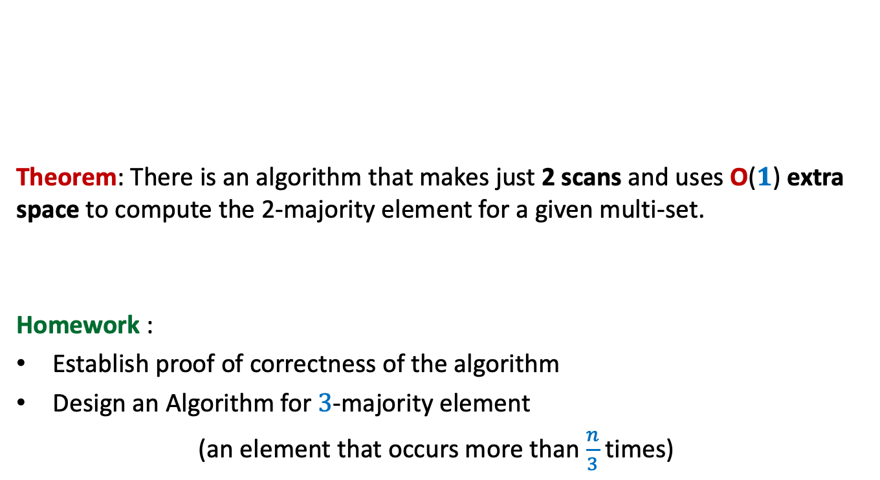
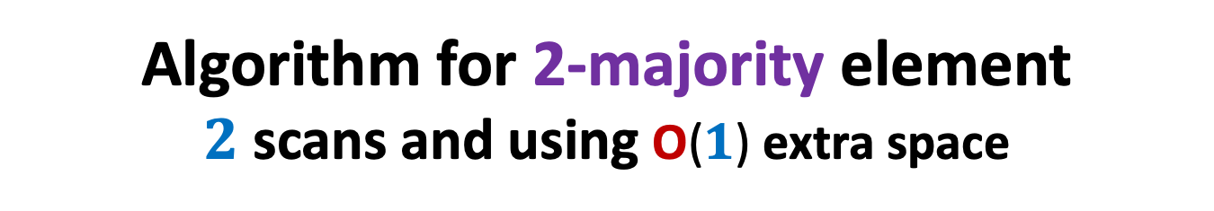
Algorithm for 2-majority element $2$ scans and using O($1$) extra space
Theorem: There is an algorithm that makes just 2 scans and uses O($1$) extra space to compute the 2-majority element for a given multi-set.
Homework :
Establish proof of correctness of the algorithm
Design an Algorithm for $3$-majority element
(an element that occurs more than $\frac{n}{3}$ times)

Slide 25
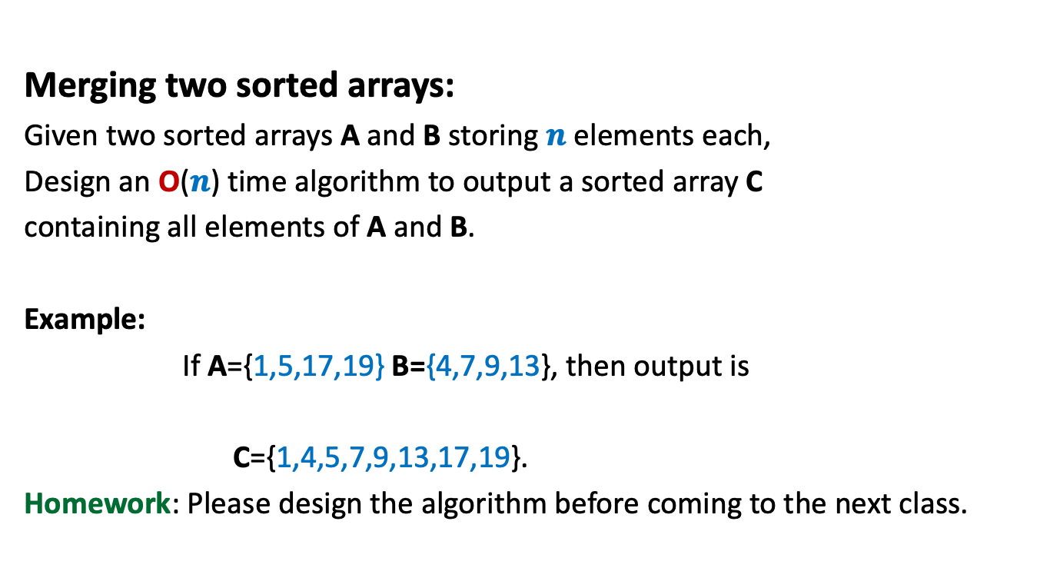
A problem in a Practice sheet
Merging two sorted arrays:
Given two sorted arrays A and B storing $n$ elements each,
Design an O($n$) time algorithm to output a sorted array C
containing all elements of A and B.
Example:
If A={1,5,17,19} B={4,7,9,13}, then output is
C={1,4,5,7,9,13,17,19}.
Homework: Please design the algorithm before coming to the next class.

Slide 26
A nice programming exercise ?
0 1 2 3 4 5 6 7 8
x

Slide 27
A nice programming exercise ?
0 1 2 3 4 5 6 7 8
>x
<x
x

Slide 28
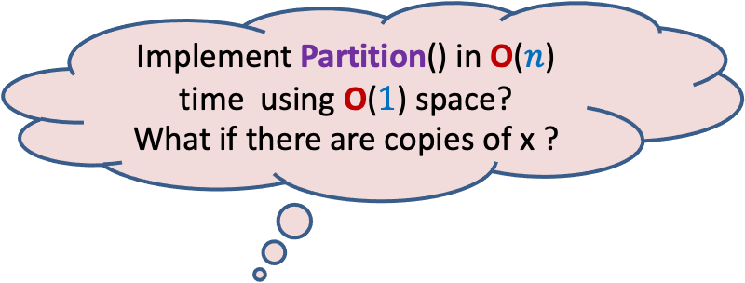
A nice programming exercise ?
This procedure is called Partition.
It rearranges the elements so that all elements less than x appear to the left of x and all elements greater than x appear to the right of x.
0 1 2 3 4 5 6 7 8
Implement Partition() in O($n$) time using O($1$) space?
What if there are copies of x ?
0 1 2 3 4 5 6 7 8
<x
>x

Slide 29
Word RAM model of computation
Further refinements

Slide 30
word RAM : a model of computation
Data
Processor
Program
RAM

Slide 31
Execution of a instruction
Processor
RAM

Slide 32
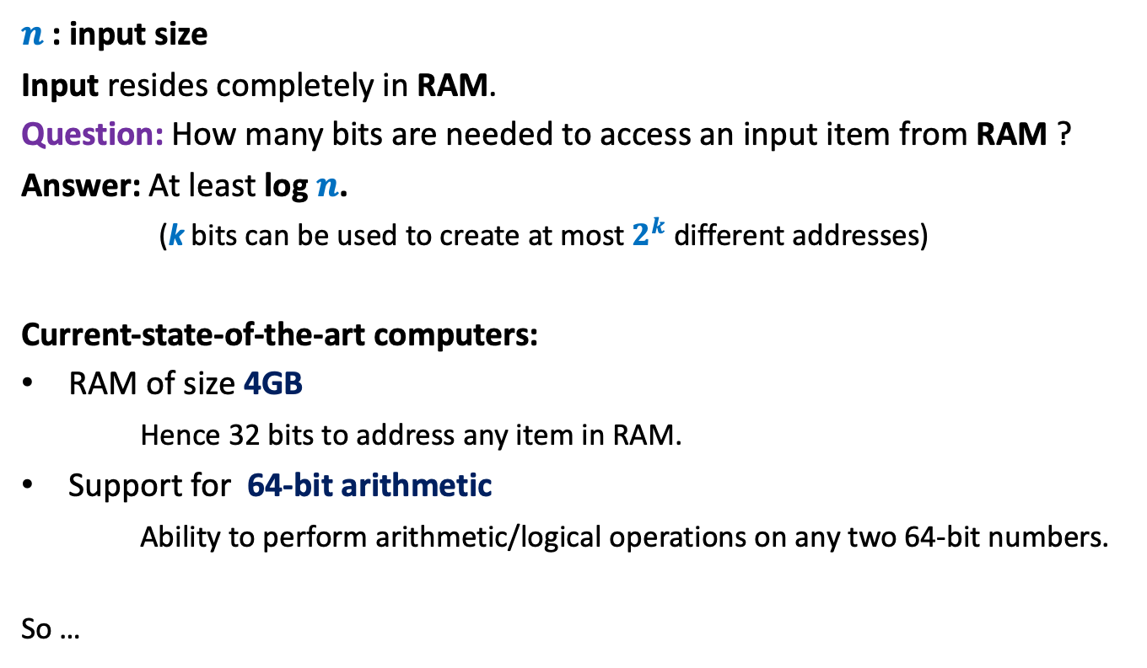
A more realistic RAM
$n$: input size
Input resides completely in RAM.
Question: How many bits are needed to access an input item from RAM ?
Answer: At least log $n$.
(k bits can be used to create at most $2^{k}$ different addresses)
Current-state-of-the-art computers:
RAM of size 4GB
Hence 32 bits to address any item in RAM.
Support for 64-bit arithmetic
Ability to perform arithmetic/logical operations on any two 64-bit numbers.
So …

Slide 33
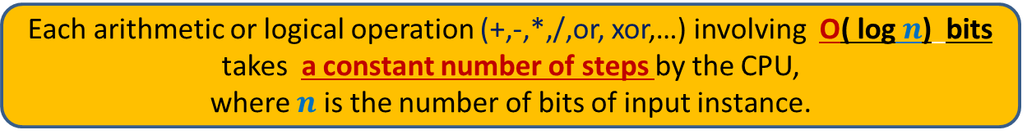
word RAM model of computation: Characteristics
Word is the basic storage unit of RAM. Word is a collection of few bytes.
Data as well as Program reside fully in RAM.
Each input item (number, name) is stored in binary format.
RAM can be viewed as a huge array of words. Any arbitrary location of RAM can be accessed in the same time irrespective of the location.
Each arithmetic or logical operation (+,-,*,/,or, xor,…) involving a constant number of words takes a constant number of steps by the CPU.
Each arithmetic or logical operation (+,-,*,/,or, xor,…) involving O( log $n$) bits
takes a constant number of steps by the CPU,
where $n$ is the number of bits of input instance.

