Slide 1
Data Structures and Algorithms (ESO207A)
Lecture 16
Algorithm paradigms
Algorithm paradigm of Divide and Conquer
Proof of correctness of the algorithm for 2-Majority element (if time permits)

Slide 2
Algorithm Paradigms

Slide 3
Algorithm Paradigms
Motivation:
Many problems whose algorithms are based on a common approach.
A need of a systematic study of such widely used approaches.
Algorithm Paradigms:
Divide and Conquer
Greedy Strategy
Dynamic Programming

Slide 4
Divide and Conquer A paradigm for Algorithm Design

Slide 5
Divide and Conquer paradigm
An Overview
Divide the problem instance
Solve each smaller instances
Combine the solutions of the smaller instances
to get the solution of the original instance.
into two or more instances of the same problem
recursively (base case suitably defined).
This is usually the main nontrivial step in the design of an algorithm using divide and conquer strategy

Slide 6
Example 1
Sorting

Slide 7
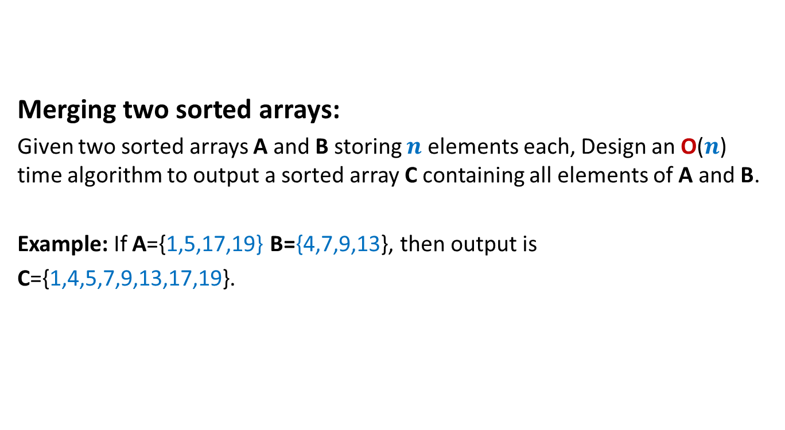
A problem in Practice sheet 1
Merging two sorted arrays:
Given two sorted arrays A and B storing $n$ elements each, Design an O($n$) time algorithm to output a sorted array C containing all elements of A and B.
Example: If A={1,5,17,19} B={4,7,9,13}, then output is
C={1,4,5,7,9,13,17,19}.

Slide 8
Merging two sorted arrays A and B
A
1
5
17 19
B
17 19
4
7
9
13
C
1
4
5
7 9 13

Slide 9
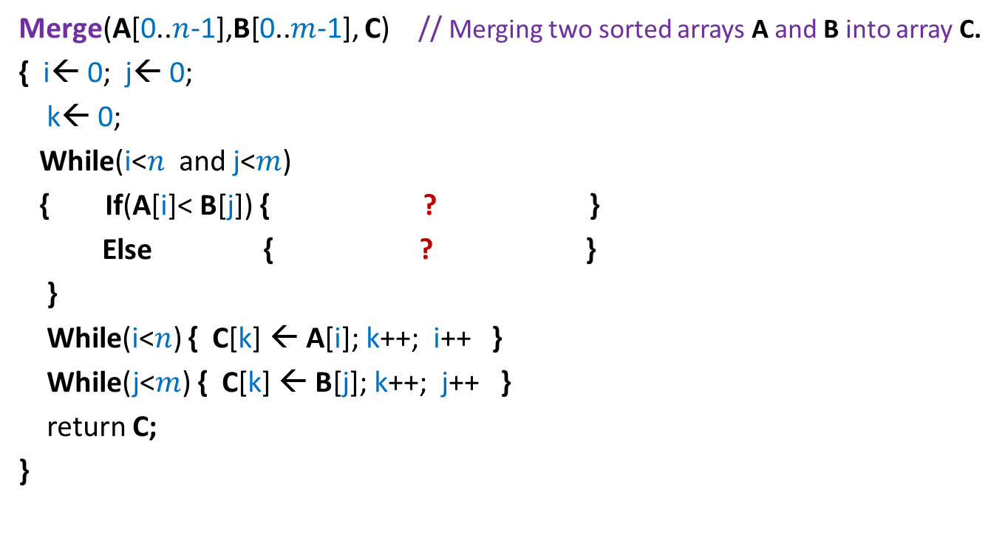

Pesudo-code for Merging two sorted arrays
Merge(A[0..$n$-1],B[0..$m$-1], C) // Merging two sorted arrays A and B into array C.
{ i← 0; j← 0;
k← 0;
While(i<$n$ and j<$m$)
{ If(A[i]< B[j]) { ? }
Else { ? }
}
While(i<$n$) { C[k] ← A[i]; k++; i++ }
While(j<$m$) { C[k] ← B[j]; k++; j++ }
return C;
}
C[k] ← A[i]; k++; i++
Homework: Prove correctness
C[k] ← B[j]; k++; j++
Time Complexity = O($n$+$m$)

Slide 10

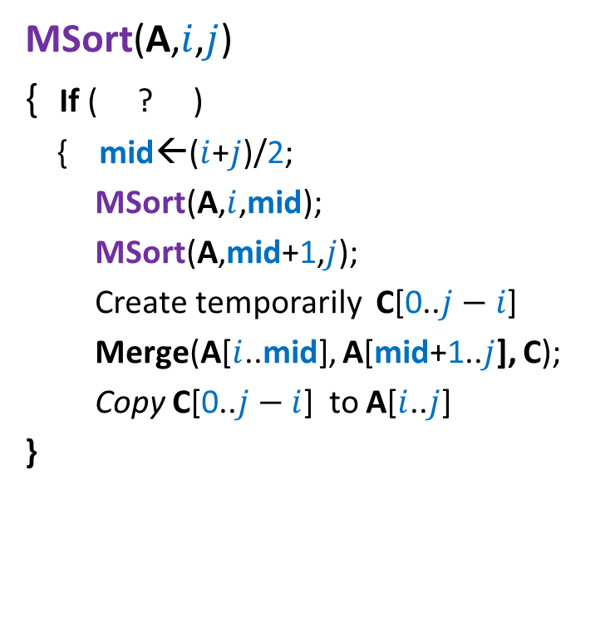
Divide and Conquer based sorting algorithm
MSort(A,$i$,$j$)
{ If ( ? )
{ mid←($i$+$j$)/2;
MSort(A,$i$,mid);
MSort(A,mid+1,$j$);
Create temporarily C[0..$j−i$]
Merge(A[$i$..mid], A[mid+1..$j$], C);
Copy C[0..$j−i$] to A[$i$..$j$]
}
// Sorting the subarray A[$i$..$j$].
i< j
Divide step
Combine/conquer step
This is Merge Sort algorithm

Slide 11
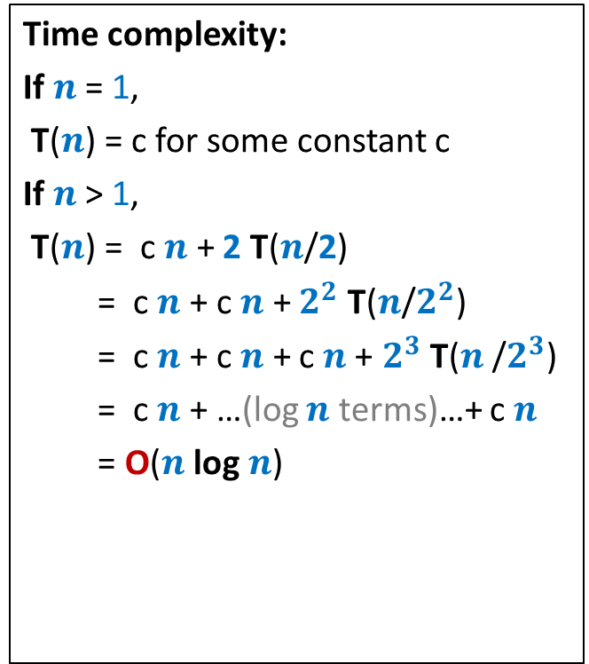




Divide and Conquer based sorting algorithm
MSort(A,$i$,$j$)
{ If ( ? )
{ mid←($i$+$j$)/2;
MSort(A,$i$,mid);
MSort(A,mid+1,$j$);
Create temporarily C[0..$j−i$]
Merge(A[$i$..mid], A[mid+1..$j$], C);
Copy C[0..$j−i$] to A[$i$..$j$]
}
Time complexity:
If $n$ = 1,
T($n$) = c for some constant c
If $n$ > 1,
T($n$) = c $n$ + 2 T($n$/2)
= c $n$ + c $n$ + $2^{2}$ T($n$/$2^{2}$)
= c $n$ + c $n$ + c $n$+ $2^{3}$ T($n$/$2^{3}$)
= c $n$ + …(log $n$ terms)…+ c $n$
= O($n$ log $n$)
// Sorting the subarray A[$i$..$j$].
i< j
T($n$/2)
T($n$/2)
c $n$

Slide 12
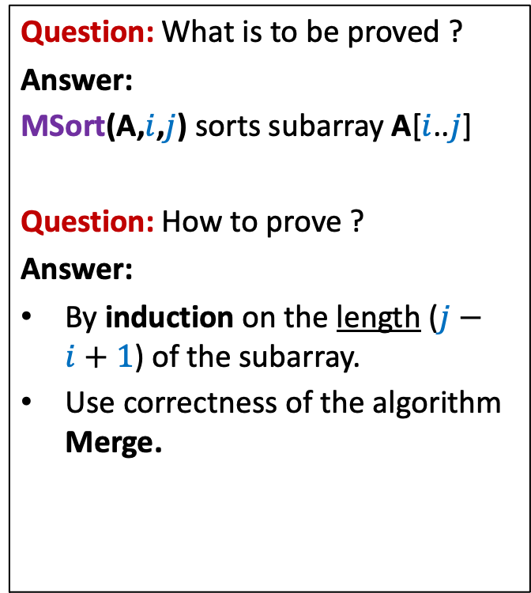
Proof of correctness of Merge-Sort
MSort(A,$i$,$j$)
{ If ( ? )
{ mid←($i$+$j$)/2;
MSort(A,$i$,mid);
MSort(A,mid+1,$j$);
Create temporarily C[0..$j−i$]
Merge(A[$i$..mid], A[mid+1..$j$], C);
Copy C[0..$j−i$] to A[$i$..$j$]
}
Question: What is to be proved ?
Answer:
MSort(A,$i$,$j$) sorts subarray A[$i$..$j$]
Question: How to prove ?
Answer:
By induction on the length ($j−i+1$) of the subarray.
Use correctness of the algorithm Merge.
// Sorting the subarray A[$i$..$j$].
i< j

Slide 13
Example 2
Faster algorithm for
multiplying two integers

Slide 14




Addition of two $n$-bit numbers
$$0$$ | $$0$$ | $$0$$ | $$0$$ | $$0$$ | $$1$$ | $$0$$ | $$0$$ | $$0$$ | $$1$$ | $$1$$ | $$1$$ | $$0$$ | $$1$$ | $$0$$ | $$1$$
$$X$$
$$+$$
$$0$$ | $$0$$ | $$1$$ | $$0$$ | $$1$$ | $$1$$ | $$0$$ | $$0$$ | $$0$$ | $$1$$ | $$0$$ | $$1$$ | $$0$$ | $$0$$ | $$1$$ | $$0$$
$$Y$$

Slide 15


$$1$$
$$0$$ | $$0$$ | $$0$$ | $$0$$ | $$0$$ | $$1$$ | $$0$$ | $$0$$ | $$0$$ | $$1$$ | $$1$$ | $$1$$ | $$0$$ | $$1$$ | $$0$$ | $$1$$
$$X$$
$$+$$
$$0$$ | $$0$$ | $$1$$ | $$0$$ | $$1$$ | $$1$$ | $$0$$ | $$0$$ | $$0$$ | $$1$$ | $$0$$ | $$1$$ | $$0$$ | $$0$$ | $$1$$ | $$0$$
$$Y$$
 |  |  |  |  |  |  |  |  |  |  |  | $$0$$ | $$1$$ | $$1$$ | $$1$$
$$0$$

Slide 16
$$1$$
$$0$$ | $$0$$ | $$0$$ | $$0$$ | $$0$$ | $$1$$ | $$0$$ | $$0$$ | $$0$$ | $$1$$ | $$1$$ | $$1$$ | $$0$$ | $$1$$ | $$0$$ | $$1$$
$$X$$
$$+$$
$$0$$ | $$0$$ | $$1$$ | $$0$$ | $$1$$ | $$1$$ | $$0$$ | $$0$$ | $$0$$ | $$1$$ | $$0$$ | $$1$$ | $$0$$ | $$0$$ | $$1$$ | $$0$$
$$Y$$
 |  |  |  |  |  |  |  |  |  |  |  | $$0$$ | $$1$$ | $$1$$ | $$1$$
$$0$$
$$0$$

Slide 17


$$1$$
$$0$$ | $$0$$ | $$0$$ | $$0$$ | $$0$$ | $$1$$ | $$0$$ | $$0$$ | $$0$$ | $$1$$ | $$1$$ | $$1$$ | $$0$$ | $$1$$ | $$0$$ | $$1$$
$$X$$
$$+$$
$$0$$ | $$0$$ | $$1$$ | $$0$$ | $$1$$ | $$1$$ | $$0$$ | $$0$$ | $$0$$ | $$1$$ | $$0$$ | $$1$$ | $$0$$ | $$0$$ | $$1$$ | $$0$$
$$Y$$
 |  |  |  |  |  |  |  |  |  |  |  | $$0$$ | $$1$$ | $$1$$ | $$1$$
$$1$$
$$0$$
$$0$$

Slide 18

$$0$$ | $$0$$ | $$0$$ | $$0$$ | $$0$$ | $$1$$ | $$0$$ | $$0$$ | $$0$$ | $$1$$ | $$1$$ | $$1$$ | $$0$$ | $$1$$ | $$0$$ | $$1$$
$$X$$
$$+$$
$$0$$ | $$0$$ | $$1$$ | $$0$$ | $$1$$ | $$1$$ | $$0$$ | $$0$$ | $$0$$ | $$1$$ | $$0$$ | $$1$$ | $$0$$ | $$0$$ | $$1$$ | $$0$$
$$Y$$
$$0$$ | $$0$$ | $$1$$ | $$1$$ | $$0$$ | $$0$$ | $$0$$ | $$0$$ | $$1$$ |  |  |  | $$0$$ | $$1$$ | $$1$$ | $$1$$
$$1$$
$$0$$
$$0$$
O($n$) time

Slide 19












Multiplication of of two $n$-bit numbers
$$1$$ | $$0$$ | $$1$$ | $$1$$ | $$1$$ | $$0$$ | $$1$$ | $$1$$
$$X$$
$$×$$
$$0$$ | $$0$$ | $$1$$ | $$0$$ | $$0$$ | $$1$$ | $$0$$ | $$1$$
$$Y$$
$$1$$ | $$0$$ | $$1$$ | $$1$$ | $$1$$ | $$0$$ | $$1$$ | $$1$$
$$0$$ | $$0$$ | $$0$$ | $$0$$ | $$0$$ | $$0$$ | $$0$$ | $$0$$ | 0
$$+$$
$$1$$ | $$0$$ | $$1$$ | $$1$$ | $$1$$ | $$0$$ | $$1$$ | $$1$$ | 0 | 0
$$0$$ | $$0$$ | $$0$$ | $$0$$ | $$0$$ | $$0$$ | $$0$$ | $$0$$ | $$0$$ | $$0$$ | $$0$$
O($n^{2}$) time

Slide 20




Multiplying a number $X$ by $2^{i}$
$$1$$ | $$0$$ | $$1$$ | $$1$$ | $$1$$ | $$0$$ | $$1$$ | $$1$$
$$X$$
$$×$$
$$0$$ | $$0$$ | $$1$$ | $$0$$ | $$0$$ | $$0$$ | $$0$$ | $$0$$
$$2^{i}$$
$$1$$ | $$0$$ | $$1$$ | $$1$$ | $$1$$ | $$0$$ | $$1$$ | $$1$$ | $$0$$ | $$0$$ | $$0$$ | $$0$$ | $$0$$
O($i$) time

Slide 21

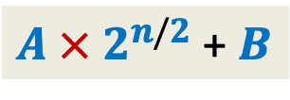



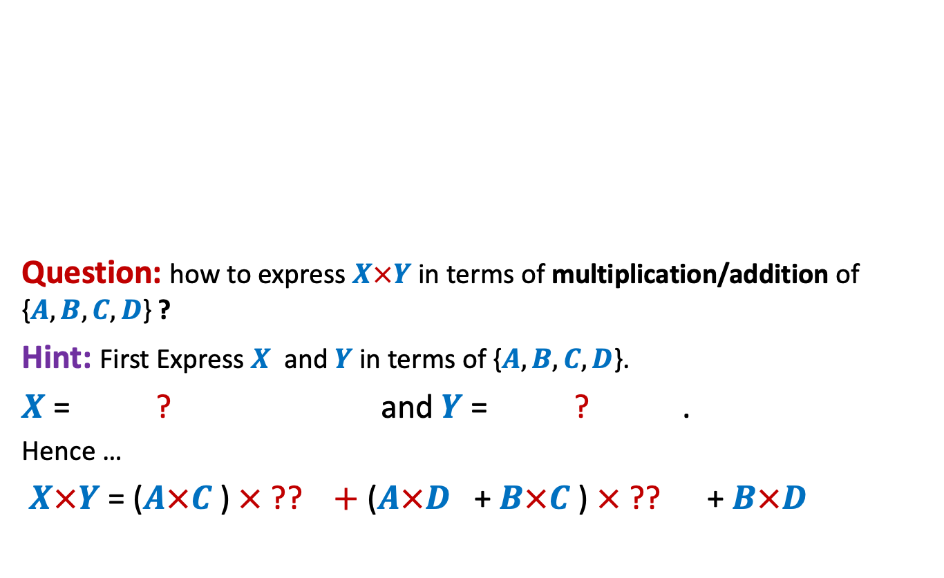






Pursuing Divide and Conquer approach
MSB
LSB
Question: how to express $X×Y$ in terms of multiplication/addition of {$A,B,C,D$} ?
Hint: First Express $X$ and $Y$ in terms of {$A,B,C,D$}.
$X$ = ? and $Y$ = ? .
Hence …
$X×Y$ = ($A×C$ ) $×$ ?? $+$ ($A×D$ + $B×C$ ) $×$ ?? + $B×D$
$$A$$
$$B$$
$$X$$
n-1 n-2…......………………n/2.............................2 1 0
$$×$$
$4$multiplications
$$C$$
$$D$$
$$Y$$
$A$ $×$ $2^{n/2}$ + $B$
$C$ $×$ $2^{n/2}$ $+$ $D$
$$2^{n}$$
$$2^{n/2}$$

Slide 22



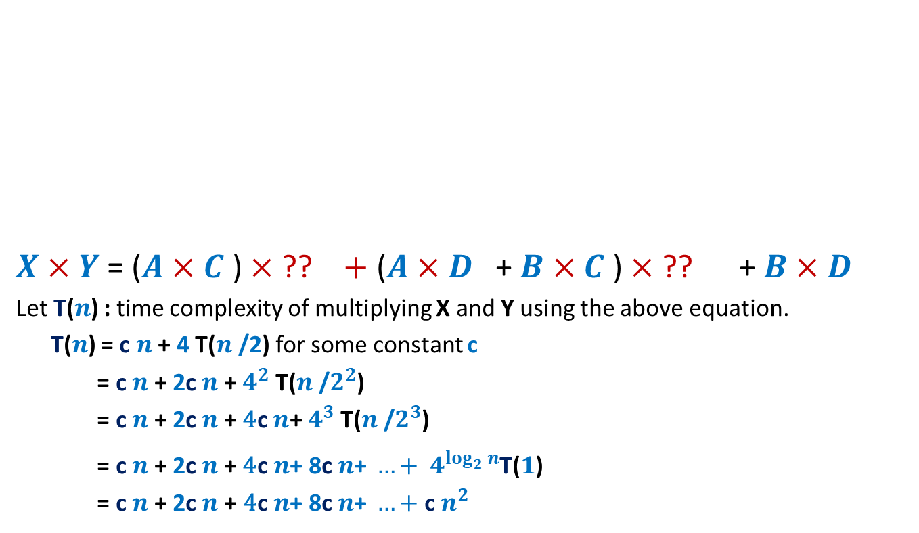




Pursuing Divide and Conquer approach
MSB
LSB
$X×Y$ = ($A×C$ ) $×$ ?? $+$ ($A×D$ + $B×C$ ) $×$ ?? + $B×D$
Let T($n$) : time complexity of multiplying X and Y using the above equation.
T($n$) = c $n$ + 4 T($n$/2) for some constant c
= c $n$ + 2c $n$ + $4^{2}$ T($n$/$2^{2}$)
= c $n$ + 2c $n$ + ${\text{4}\text{c} n\text{+} 4}^{3}$ T($n$/$2^{3}$)
= c $n$ + 2c $n$ + ${\text{4}\text{c} n\text{+ 8}\text{c} n\text{+ }…+ 4}^{\log_{2}^{}n}$T($1$)
= c $n$+ 2c $n$+ ${\text{4}\text{c} n\text{+ 8}\text{c} n\text{+ }…+\text{c} n}^{2 }$
$$A$$
$$B$$
X
n-1 n-2…......………………n/2.............................2 1 0
$$×$$
$$C$$
$$D$$
Y
$$2^{n}$$
$$2^{n/2}$$
O($n^{2}$) time algo

Slide 23



Pursuing Divide and Conquer approach
MSB
LSB
$X×Y$ = ($A×C$ ) $×$ ?? $+$ ($A×D$ + $B×C$ ) $×$ ?? + $B×D$
Can we do it ?
$$A$$
$$B$$
X
n-1 n-2…......………………n/2.............................2 1 0
$$×$$
$$C$$
$$D$$
Y
$$2^{n}$$
$$2^{n/2}$$
Can we compute it using only one multiplication ?
Hint: use the fact that we can add and subtract efficiently. And we have already computed …
$4$ Multiplications
$3$ Multiplications

Slide 24
Homework
Ponder over the hint given in the previous slide to reduce 4 multiplications to 3 multiplications. It is doable…if you spend some time …☺

Slide 25
Example 3
Counting the number of
“inversions” in an array

Slide 26
Counting Inversions in an array
Definition (Inversion): Given an array A of size n,
a pair (i,j), 0≤i<j<n is called an inversion if
Example:
Inversions are :
(1,2), (1,4), (1,6),
(3,4),(3,6),
(5,6), (5,7)
AIM: An efficient algorithm to count the number of inversions in an array A.
A[i]>A[j].
0 1 2 3 4 5 6 7
A
3 15 8 19 9 67 11 27

Slide 27
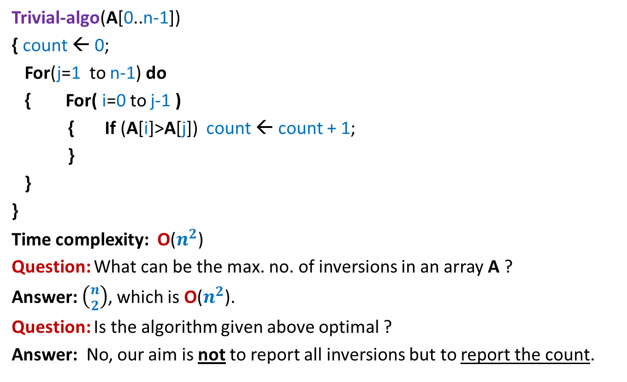
Counting Inversions in an array Problem familiarization
Trivial-algo(A[0..n-1])
{ count ← 0;
For(j=1 to n-1) do
{ For( i=0 to j-1 )
{ If (A[i]>A[j]) count ← count + 1;
}
}
}
Time complexity: O($n^{2}$)
Question: What can be the max. no. of inversions in an array A ?
Answer: $\left({n \atop 2}\right)$, which is O($n^{2}$).
Question: Is the algorithm given above optimal ?
Answer: No, our aim is not to report all inversions but to report the count.

Slide 28
Let us try to design a Divide and Conquer based algorithm

Slide 29



How do we approach using divide & conquer
$${count}_{I}$$
$${count}_{II}$$
0 1 2 3 4 5 6 7
A
3 15 8 19 9 67 11 27
$${count}_{III}$$

Slide 30

Homework
Ponder over ways to compute ${count}_{III}$ efficiently.
Hint:
Make use of $O$($n$ log $n$) sorting algorithm

