Slide 1
Data Structures and Algorithms (ESO207A)
Lecture 17
Divide and Conquer -II
Proof of correctness of the algorithm for 2-Majority element

Slide 2
Recap of the last Lecture

Slide 3
Divide and Conquer paradigm
An Overview
Divide the problem instance
Solve each smaller instances
Combine the solutions of the smaller instances
to get the solution of the original instance.
into two or more instances of the same problem
recursively (base case suitably defined).
This is usually the main nontrivial step in the design of an algorithm using divide and conquer strategy

Slide 4
Example 2
Faster algorithm for
multiplying two integers

Slide 5









Pursuing Divide and Conquer approach
MSB
LSB
$$A$$
$$B$$
$$X$$
n-1 n-2…......………………n/2.............................2 1 0
$$×$$
$4$multiplications
$$C$$
$$D$$
$$Y$$
O($n^{2}$) time algo

Slide 6









Pursuing Divide and Conquer approach
MSB
LSB
$X×Y$ = ($A×C$ ) $×$ ?? $+$ ($A×D$ + $B×C$ ) $×$ ?? + $B×D$
$$A$$
$$B$$
$$X$$
n-1 n-2…......………………n/2.............................2 1 0
$$×$$
$$C$$
$$D$$
$$Y$$
$$2^{n}$$
$$2^{n/2}$$
$4$ Multiplications
$3$ Multiplications

Slide 7




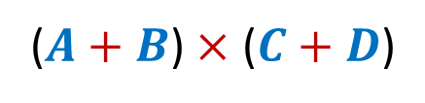


Pursuing Divide and Conquer approach
MSB
LSB
$X×Y$ = ($A×C$ ) $×$ ?? $+$ ($A×D$ + $B×C$ ) $×$ ?? + $B×D$
($A×D$ + $B×C$)
$$A$$
$$B$$
$$X$$
n-1 n-2…......………………n/2.............................2 1 0
$$×$$
$$C$$
$$D$$
$$Y$$
$$2^{n}$$
$$2^{n/2}$$
$$A×C$$
$$+$$
$$+$$
$$B×D$$
$$=$$
($A+B$) $×$ ($C+D$)

Slide 8





Pursuing Divide and Conquer approach
MSB
LSB
$X×Y$ = ($A×C$ ) $×$ ?? $+$ ($A×D$ + $B×C$ ) $×$ ?? + $B×D$
($A×D$ + $B×C$)
$$A$$
$$B$$
$$X$$
n-1 n-2…......………………n/2.............................2 1 0
$$×$$
$$C$$
$$D$$
$$Y$$
$$2^{n}$$
$$2^{n/2}$$
$$=$$
($A+B$) $×$ ($C+D$)
Each of these terms could be $\frac{n}{2}+1$bit long. What to do ?
$$−$$
$$A×C$$
$$−$$
$$B×D$$

Slide 9



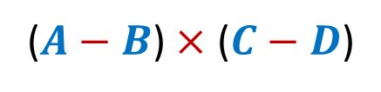

Pursuing Divide and Conquer approach
MSB
LSB
$X×Y$ = ($A×C$ ) $×$ ?? $+$ ($A×D$ + $B×C$ ) $×$ ?? + $B×D$
($A×D$ + $B×C$)
$$A$$
$$B$$
$$X$$
n-1 n-2…......………………n/2.............................2 1 0
$$×$$
$$C$$
$$D$$
$$Y$$
$$2^{n}$$
$$2^{n/2}$$
$$A×C$$
$$−$$
$$+$$
$$B×D$$
$$=$$
($A−B$) $×$ ($C−D$)

Slide 10




Pursuing Divide and Conquer approach
MSB
LSB
$X×Y$ = ($A×C$ ) $×$ ?? $+$ ($A×D$ + $B×C$ ) $×$ ?? + $B×D$
($A×D$ + $B×C$)
$$A$$
$$B$$
$$X$$
n-1 n-2…......………………n/2.............................2 1 0
$$×$$
$$C$$
$$D$$
$$Y$$
$$2^{n}$$
$$2^{n/2}$$
$$−$$
$$=$$
($A−B$) $×$ ($C−D$)
$$−$$
$$A×C$$
$$−$$
$$B×D$$

Slide 11


Pursuing Divide and Conquer approach
MSB
LSB
$X×Y$ = ($A×C$ ) $×$ ?? $+$ ($A×D$ + $B×C$ ) $×$ ?? + $B×D$
($A×D$ + $B×C$)
$$A$$
$$B$$
$$X$$
n-1 n-2…......………………n/2.............................2 1 0
$$×$$
$$C$$
$$D$$
$$Y$$
$$2^{n}$$
$$2^{n/2}$$
$$=$$
$$−$$
($A−B$) $×$ ($C−D$)
$$+$$
$$A×C$$
$$+$$
$$B×D$$

Slide 12
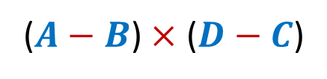

Pursuing Divide and Conquer approach
MSB
LSB
$X×Y$ = ($A×C$ ) $×$ ?? $+$ ($A×D$ + $B×C$ ) $×$ ?? + $B×D$
($A×D$ + $B×C$)
$$A$$
$$B$$
$$X$$
n-1 n-2…......………………n/2.............................2 1 0
$$×$$
$$C$$
$$D$$
$$Y$$
$$2^{n}$$
$$2^{n/2}$$
$$=$$
($A−B$) $×$ ($D−C$)
Each of these terms is surely $\frac{n}{2}$bit long. Good ☺
$$+$$
$$A×C$$
$$+$$
$$B×D$$

Slide 13






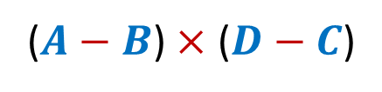


Pursuing Divide and Conquer approach
MSB
LSB
$X×Y$ = ($A×C$ ) $×$ ?? $+$ ($A×D$ + $B×C$ ) $×$ ?? + $B×D$
($A×D$ + $B×C$)
$$A$$
$$B$$
$$X$$
n-1 n-2…......………………n/2.............................2 1 0
$$×$$
$$C$$
$$D$$
$$Y$$
$$2^{n}$$
$$2^{n/2}$$
$$=$$
($A−B$) $×$ ($D−C$)
$$+$$
$$A×C$$
$$+$$
$$B×D$$
$4$ Multiplications
$3$ Multiplications
Using $2$ Subtractions and 2 more additions

Slide 14

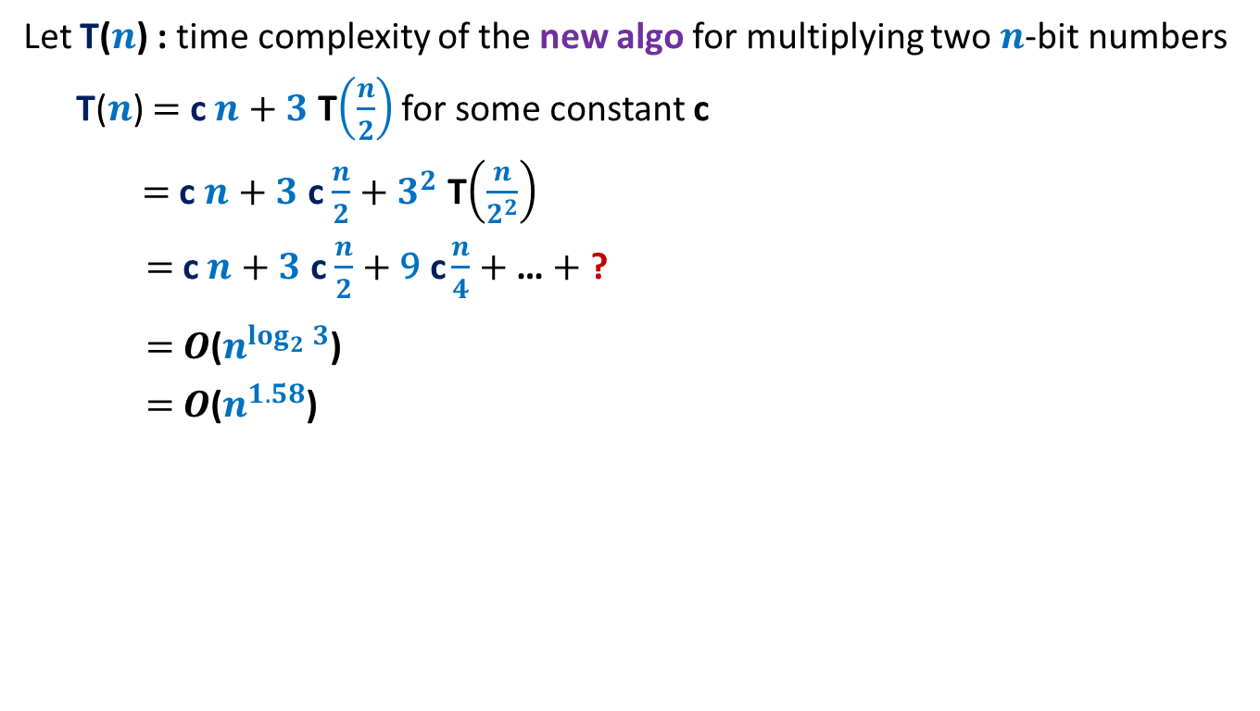
Pursuing Divide and Conquer approach
Let T($n$) : time complexity of the new algo for multiplying two $n$-bit numbers
T($n$) $=$ c $n$ $+$ $3$ T$\left(\frac{n}{2}\right)$ for some constant c
$=$ c $n$ $+$ $3$ c $\frac{n}{2}$ $+$ $3^{2}$ T$\left(\frac{n}{2^{2}}\right)$
$=$ c $n$ $+$ $3$ c $\frac{n}{2}$ $+$ $\text{9} \text{c}\frac{n}{4}$ $+$… $+$ ?
$=$ $O$($n^{\log_{2}^{}3}$)
$=$ $O$($n^{1.58}$)
$3^{\log_{2}^{}n}$ T($1$)

Slide 15
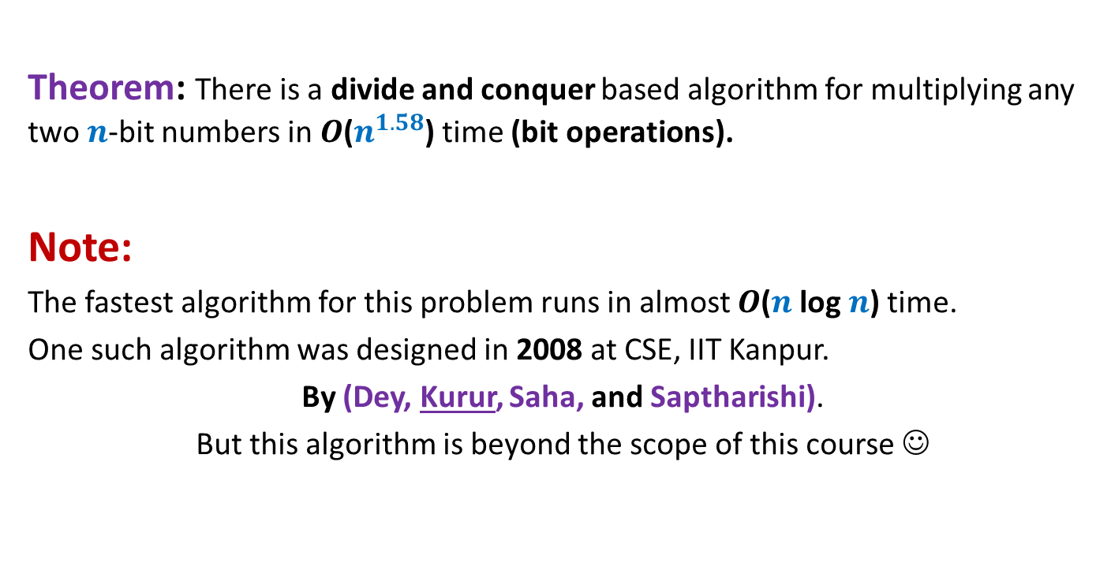
Conclusion
Theorem: There is a divide and conquer based algorithm for multiplying any two $n$-bit numbers in $O$($n^{1.58}$) time (bit operations).
Note:
The fastest algorithm for this problem runs in almost $O$($n$ log $n$) time.
One such algorithm was designed in 2008 at CSE, IIT Kanpur.
By (Dey, Kurur, Saha, and Saptharishi).
But this algorithm is beyond the scope of this course ☺

Slide 16
Example 3
Counting the number of
“inversions” in an array

Slide 17
Counting Inversions in an array
Definition (Inversion): Given an array A of size n,
a pair (i,j), 0≤i<j<n is called an inversion if
Example:
Inversions are :
(1,2), (1,4), (1,6),
(3,4),(3,6),
(5,6), (5,7)
AIM: An efficient algorithm to count the number of inversions in an array A.
A[i]>A[j].
0 1 2 3 4 5 6 7
A
3 15 8 19 9 67 11 27

Slide 18


Counting Inversions in an array Problem familiarization
Trivial-algo(A[$0..n−1$])
{ count ← 0;
For($j$=1 to $n−1$) do
{ For( $i$=0 to $j−1$ )
{ If ( ? ) count ← count + 1;
}
} return count;
}
Time complexity: O($n^{2}$)
A[$i$]>A[$j$]

Slide 19
Let us try to design a Divide and Conquer based algorithm

Slide 20



How do we approach using divide & conquer
$${count}_{I}$$
$${count}_{II}$$
0 1 2 3 4 5 6 7
A
3 15 8 19 9 67 11 27
$${count}_{III}$$

Slide 21

Homework from last class
Ponder over ways to compute ${count}_{III}$ efficiently.
Hint:
Make use of $O$($n$ log $n$) sorting algorithm

Slide 22

$1$ Important Lesson that we will learn today…
Role of Data structures
in algorithms

Slide 23
Role of Data Structures in designing efficient algorithms
Definition: A collection of data elements arranged and connected in a way
which can facilitate efficient executions of a
(possibly long) sequence of operations.
Parameters:
Query/Update time
Space
Preprocessing time

Slide 24

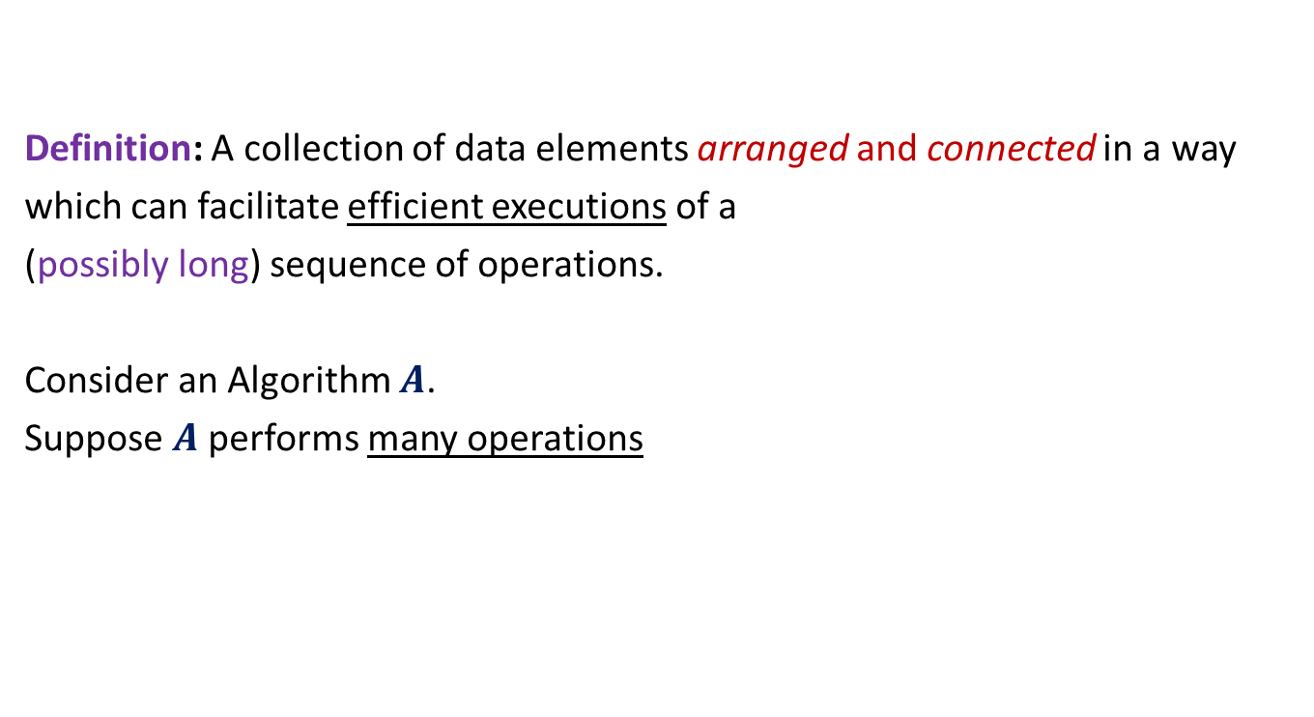
Role of Data Structures in designing efficient algorithms
Definition: A collection of data elements arranged and connected in a way
which can facilitate efficient executions of a
(possibly long) sequence of operations.
Consider an Algorithm $A$.
Suppose $A$performs many operations
of same type on some data.
Improving time complexity of these operations
Improving the time complexity of $A$.
So, it is worth designing
a suitable data structure.

Slide 25

Role of Data Structures in designing efficient algorithms
Consider an Algorithm $A$.
Suppose $A$performs many operations
of same type on some data.
Think of a suitable
data structure.

Slide 26
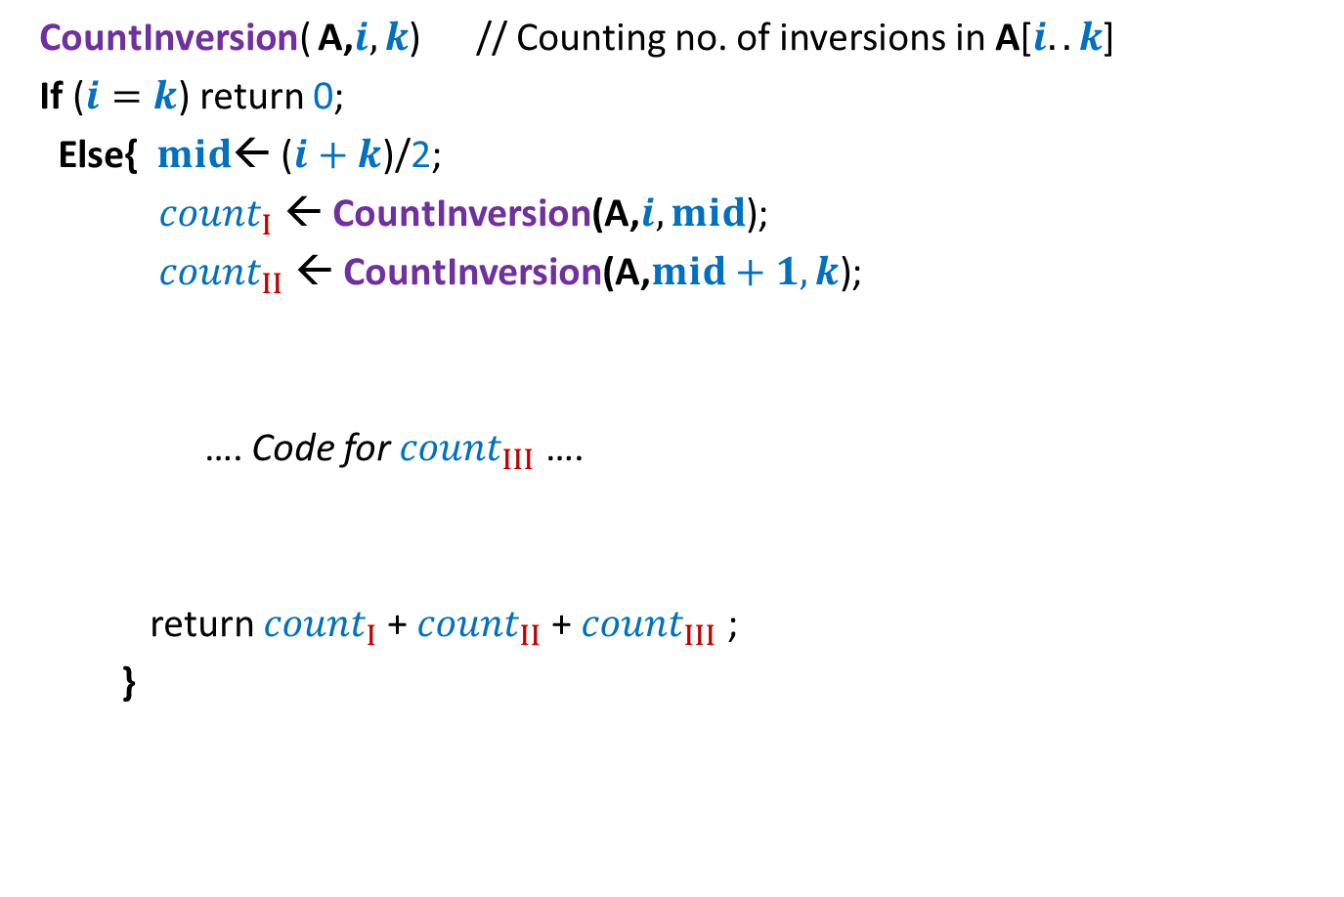
Counting Inversions Divide and Conquer based algorithm
CountInversion( A,$i,k$) // Counting no. of inversions in A[$i..k$]
If ($i=k$) return 0;
Else{ $mid$← ($i+k$)/2;
${count}_{I}$ ← CountInversion(A,$i,mid$);
${count}_{II}$ ← CountInversion(A,$mid+1,k$);
…. Code for ${count}_{III}$ ….
return ${count}_{I}$+ ${count}_{II}$+ ${count}_{III}$ ;
}

Slide 27

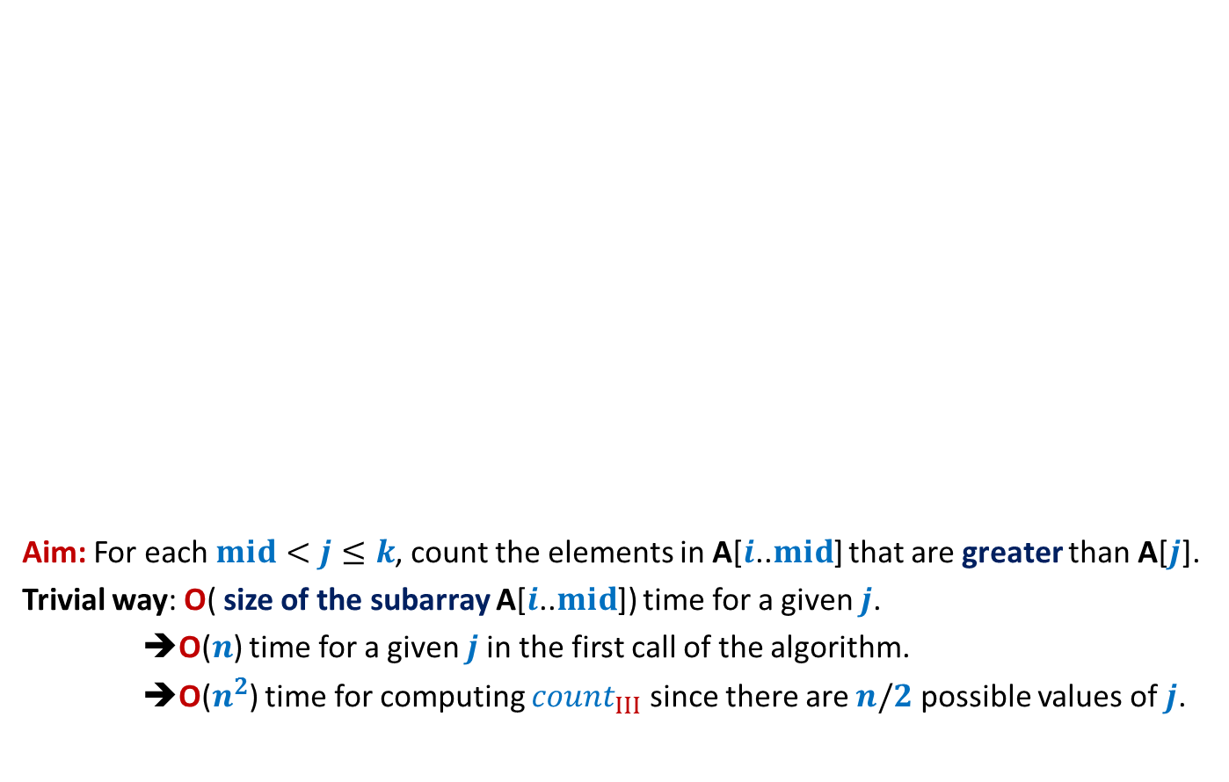

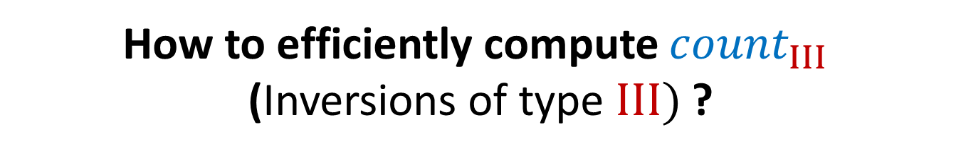


How to efficiently compute ${count}_{III}$ (Inversions of type $III)$ ?
Aim: For each $mid<j≤k$, count the elements in A[$i$..$mid$] that are greater than A[$j$].
Trivial way: O( size of the subarray A[$i$..$mid$]) time for a given $j$.
➔O($n$) time for a given $j$in the first call of the algorithm.
➔O($n^{2}$) time for computing ${count}_{III}$ since there are $n/2$ possible values of $j$.
$$i$$
$$mid$$
$$j$$
$$k$$
A
3 15 8 19 9 67 11 27
O($n^{2}$) time algo
$${count}_{III}$$

Slide 28


How to efficiently compute ${count}_{III}$ (Inversions of type $III)$ ?
Let us state clearly what we want to achieve …
$$i$$
$$j$$
$$k$$
A
3 15 8 19 9 67 11 27
For each $j∈[mid+1,k]$
$${count}_{III}$$
count the elements in A[$i$..$mid$] that are greater than A[$j$].
What should be
the data structure ?
Time to apply the Lesson
Sorted subarray A[$i$..$mid$].

Slide 29
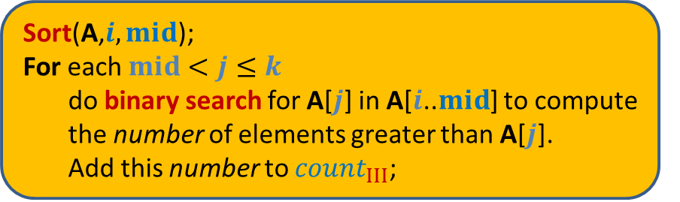
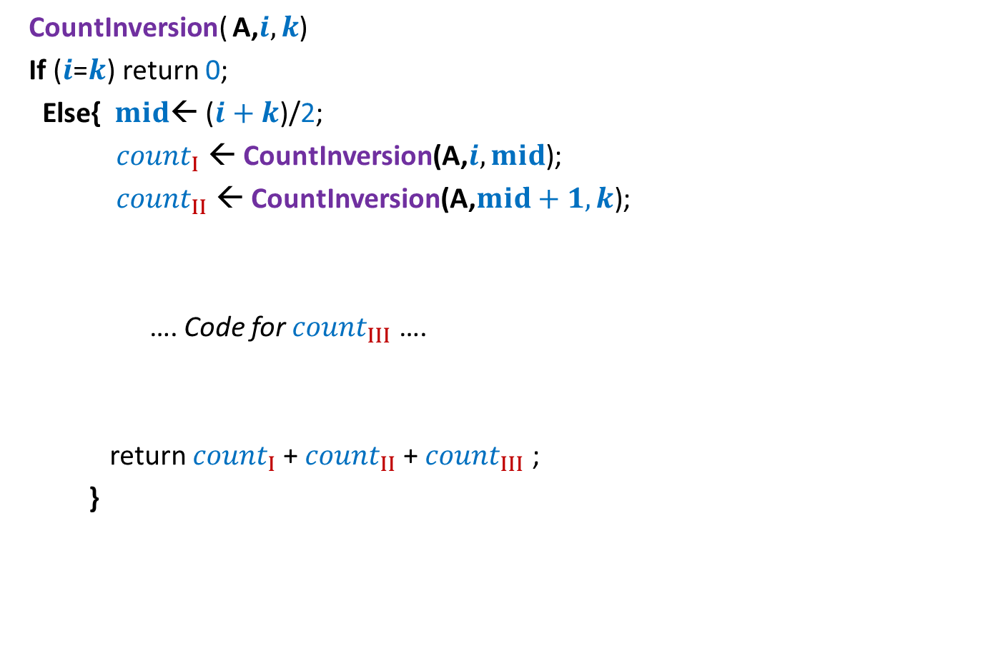


Counting Inversions First algorithm based on divide & conquer
CountInversion( A,$i,k$)
If ($i$=$k$) return 0;
Else{ $mid$← ($i+k$)/2;
${count}_{I}$ ← CountInversion(A,$i,mid$);
${count}_{II}$ ← CountInversion(A,$mid+1,k$);
…. Code for ${count}_{III}$ ….
return ${count}_{I}$+ ${count}_{II}$+ ${count}_{III}$ ;
}
2 T($n/2$)
Sort(A,$i,mid$);
For each $mid<j≤k$
do binary search for A[$j$] in A[$i$..$mid$] to compute
the number of elements greater than A[$j$].
Add this number to ${count}_{III}$;
c $n$ log $n$

Slide 30
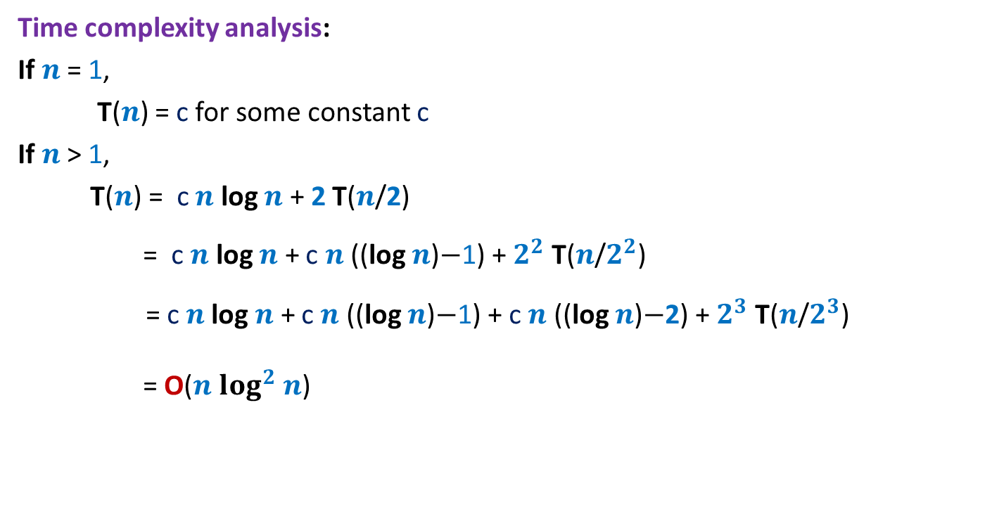
Counting Inversions First algorithm based on divide & conquer
Time complexity analysis:
If $n$ = 1,
T($n$) = c for some constant c
If $n$ > 1,
T($n$) = c $n$ log $n$ + 2 T($n$/2)
= c $n$ log $n$ + c $n$ ((log $n$)$−$1) + $2^{2}$ T($n$/$2^{2}$)
= c $n$log $n$ + c $n$ ((log $n$)$−$1) + c $n$ ((log $n$)$−$2) + $2^{3}$ T($n$/$2^{3}$)
= O($n$ $\log^{2}$ $n$)
Can we improve it further ?

Slide 31
Counting Inversions First algorithm based on divide & conquer
CountInversion( A,$i,k$)
If ($i$=$k$) return 0;
Else{ $mid$← ($i+k$)/2;
${count}_{I}$ ← CountInversion(A,$i,mid$);
${count}_{II}$ ← CountInversion(A,$mid+1,k$);
…. Code for ${count}_{III}$ ….
return ${count}_{I}$+ ${count}_{II}$+ ${count}_{III}$ ;
}
2 T($n/2$)
Sort(A,$i,mid$);
For each $mid<j≤k$
do binary search for A[$j$] in A[$i$..$mid$] to compute
the number of elements greater than A[$j$].
Add this number to ${count}_{III}$;
c $n$ log $n$

Slide 32
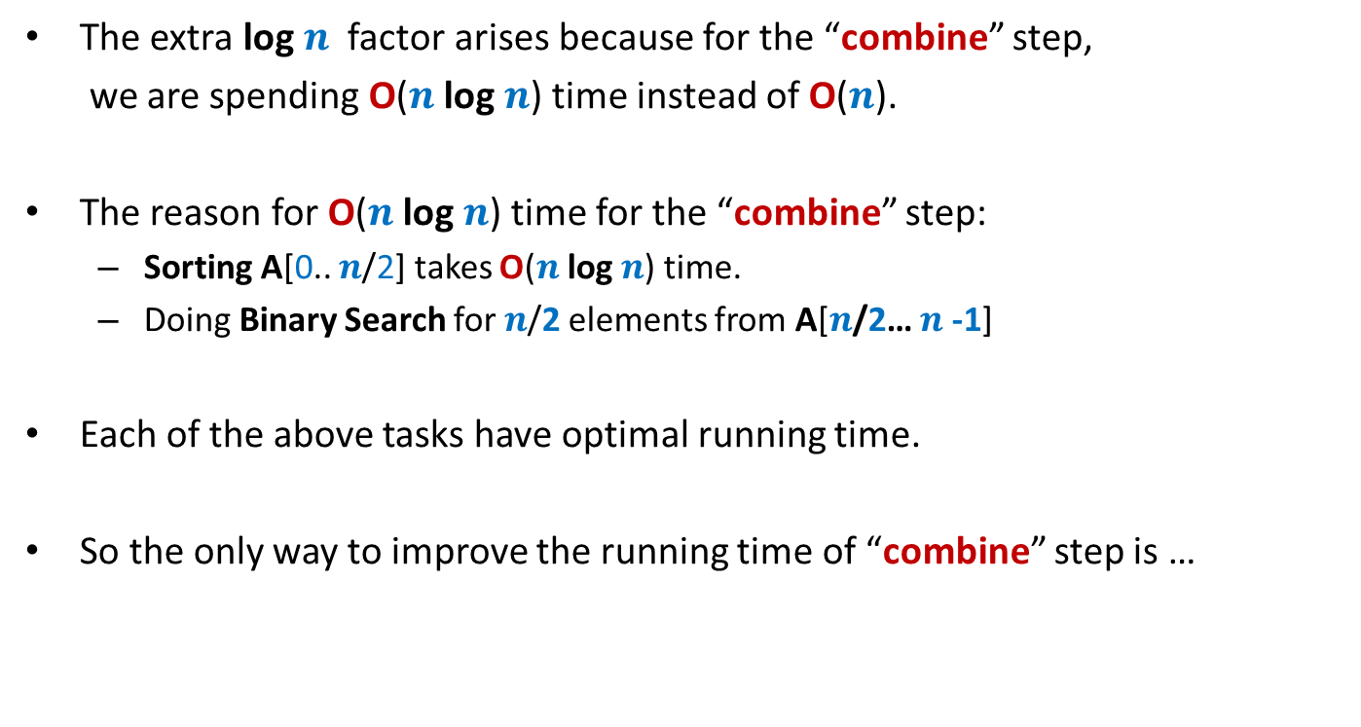
Sequence of observations To achieve better running time
The extra log $n$ factor arises because for the “combine” step,
we are spending O($n$ log $n$) time instead of O($n$).
The reason for O($n$ log $n$) time for the “combine” step:
Sorting A[0.. $n$/2] takes O($n$ log $n$) time.
Doing Binary Search for $n$/2 elements from A[$n$/2… $n$-1]
Each of the above tasks have optimal running time.
So the only way to improve the running time of “combine” step is …
some new idea

Slide 33
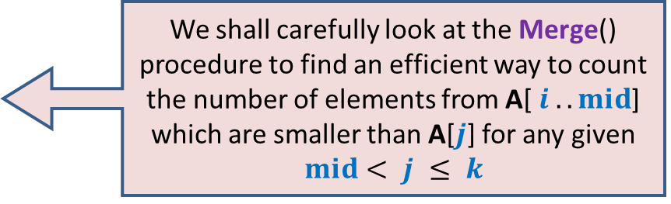
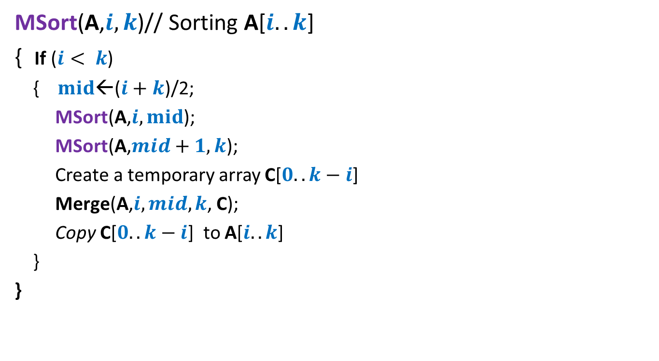
Revisiting MergeSort algorithm
MSort(A,$i,k$)// Sorting A[$i..k$]
{ If ($i< k$)
{ $mid$←($i+k$)/2;
MSort(A,$i,mid$);
MSort(A,$mid+1,k$);
Create a temporary array C[$0..k−i$]
Merge(A,$i,mid,k$, C);
Copy C[$0..k−i$] to A[$i..k$]
}
}
We shall carefully look at the Merge() procedure to find an efficient way to count the number of elements from A[ $i ..mid$] which are smaller than A[$j$] for any given $mid< j ≤ k$

Slide 34




Relook Merging A[$i..mid$] and A[$mid+1..k$]
Sorted
Sorted
A
x
x
$$i$$
$$j$$
$$k$$
>x
C

Slide 35
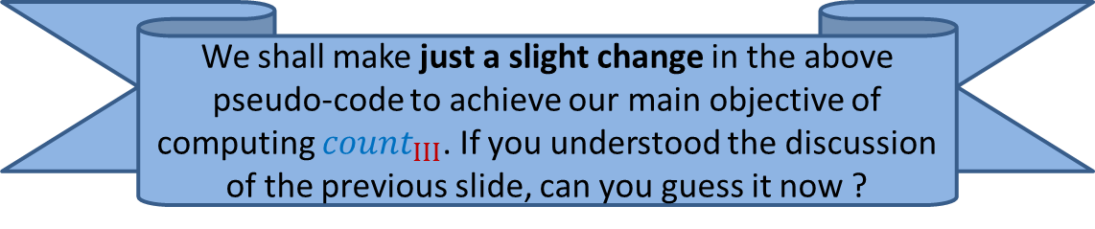
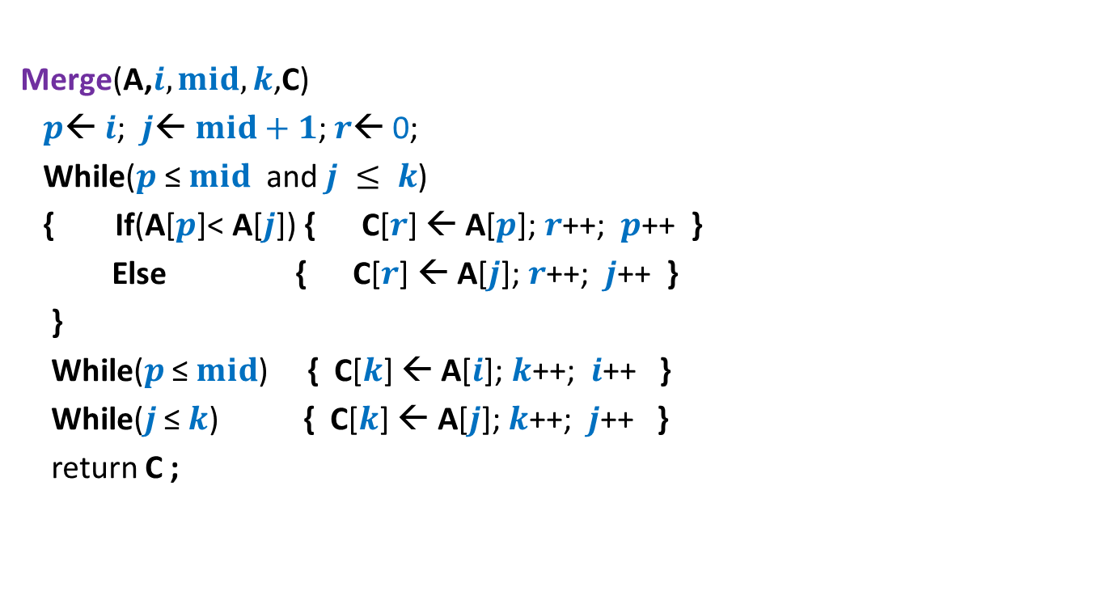
Pesudo-code for Merging two sorted arrays
Merge(A,$i,mid,k$,C)
$p$← $i$; $j$← $mid+1$; $r$← 0;
While($p$ ≤ $mid$ and $j ≤ k$)
{ If(A[$p$]< A[$j$]) { C[$r$] ← A[$p$]; $r$++; $p$++ }
Else { C[$r$] ← A[$j$];$r$++; $j$++ }
}
While($p$ ≤ $mid$) { C[$k$] ← A[$i$]; $k$++; $i$++ }
While($j$ ≤ $k$) { C[$k$] ← A[$j$]; $k$++; $j$++ }
return C ;
We shall make just a slight change in the above pseudo-code to achieve our main objective of computing ${count}_{III}$. If you understood the discussion of the previous slide, can you guess it now ?

Slide 36

Homework
Suitably modify the Merge procedure to compute ${count}_{III}$ .

Slide 37
Proof of correctness
Algorithm for majority element

Slide 38
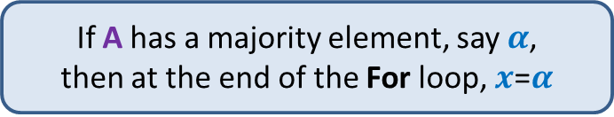
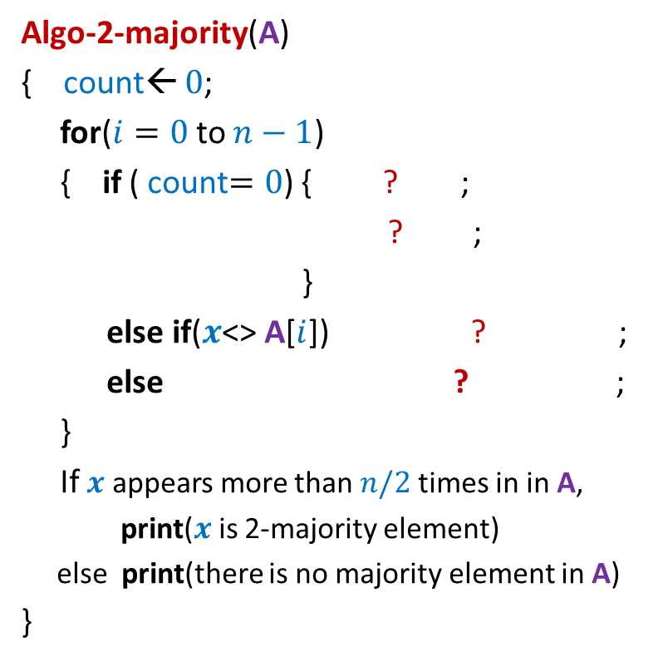

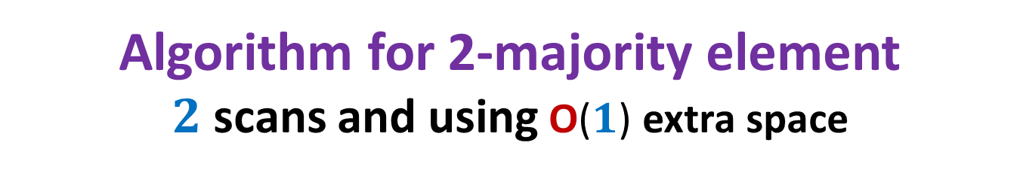


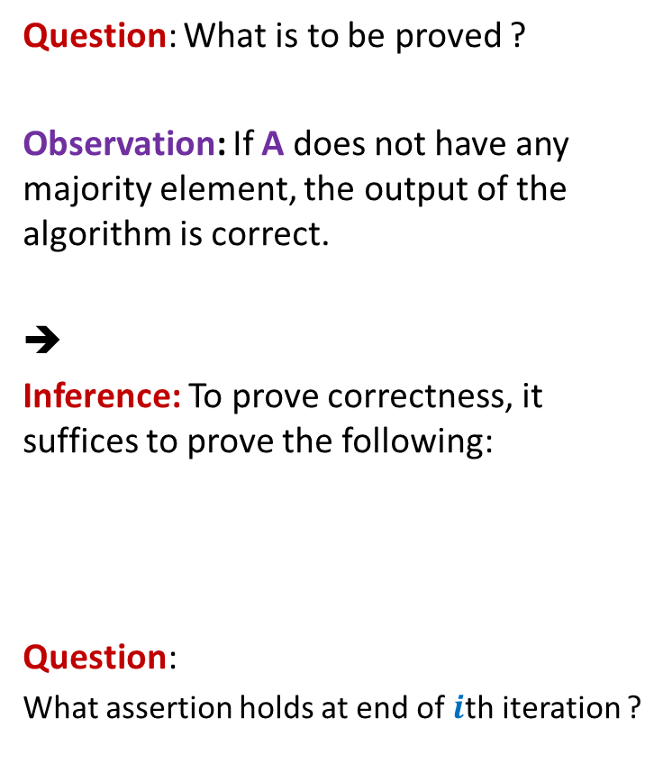
Algorithm for 2-majority element $2$ scans and using O($1$) extra space
Algo-2-majority(A)
{ count← $0$;
for($i=0$to $n−1$)
{ if ( count$=0$) { ? ;
? ;
}
else if($x$<> A[$i$]) ? ;
else ? ;
}
If $x$ appears more than $n/2$times in in A,
print($x$ is 2-majority element)
else print(there is no majority element in A)
}
Question: What is to be proved ?
Observation: If A does not have any majority element, the output of the algorithm is correct.
➔
Inference: To prove correctness, it suffices to prove the following:
Question:
What assertion holds at end of $i$th iteration ?
$x$← A[$i$] ;
count← 1 ;
Proof of correctness ?
count ← count $−$ 1
count← count $+$ 1
If A has a majority element, say $α$,
then at the end of the For loop, $x$=$α$

Slide 39

The Algorithm at the end of $i$th iteration
First scan
$a b c c c z c a b b c c c c d c$

Slide 40




The Algorithm at the end of $i$th iteration
$$i−1$$
Question: What assertion holds at the end of $i$th iteration ?
Answer:
P($i$) :
$a b c c c z c a b b c c c c d c$
$$x$$
count
$α$ is a majority element of {A[$0$],A[$1$],…,A[$i−1$]}
$x$ is a majority element of {A[$0$],A[$1$],…,A[$i−1$]}
To be continued and concluded tomorrow ☺

